Slide 1
Live Streaming
Daniel Sprick

Slide 2
Origins
Justin.tv
  Justin Kan – lifestreaming in 2007
  24/7 video and audio feed from his hat

Slide 3
Live Streaming Software
Open Broadcaster Software
XSplit
FFSplit
QuickTime Broadcaster
Wirecast
VLC

Slide 4
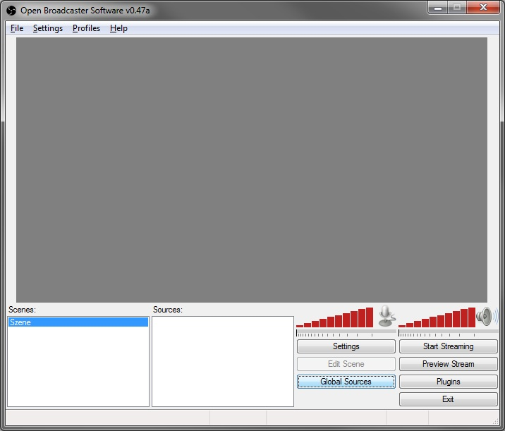
Ease of Use
Select inputs – microphone, camera
Select outputs – monitor capture

Slide 5
The Online Couch
All viewers are sitting on the “online couch”
Live chat

Slide 6
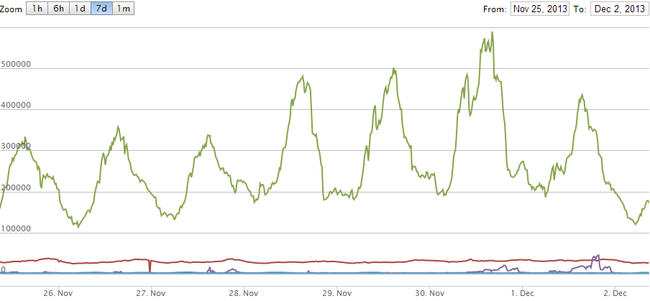
Popularity

Slide 7
Twitch.tv
Gaming category from Justin.tv became big enough for own site
June 2011
Expansion of eSports

Slide 8
Electronic Sports
Live streaming acts as the media coverage
Recent League of Legends competition had a reported 32 million unique viewers total, and 8.5 million unique viewers peak
The same competition last year was watched by 8.1 total unique viewers, with a peak of 1.1 million

