Slide 1
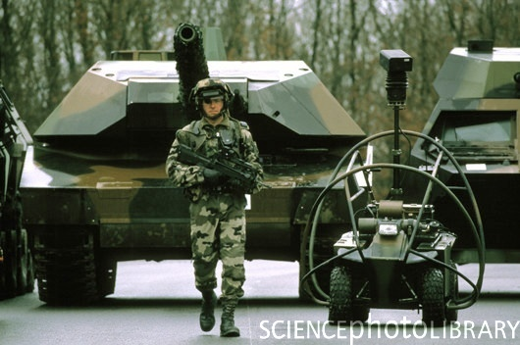
Roles of Military Technology
The Proposal
Austin Barber & Kevin Leary
COMP 089

Slide 2
Why Military Technology?
Military technology is so significant because it directly affects the development of all other sectors of technology we have discussed in class so far, and more.
With the backing of the United States government, our military has the highest budget available to spend on the research and production of the most state-of-the-art technology.
Because of this, there is fierce competition among defense contractors to fight for who’s products and services will be purchased.
One of the main reasons we chose this topic is because this technology is often released at a later time for commercial use, so some of what is in production and being developed now could be seen by us later. It is said that the government is more or less ten years ahead of civilian technology, but surely some of that technology will never be released to the public.
Because we have one of the most advanced militaries in the world, the American public often receives word of new technologies before anyone else in world.

Slide 3
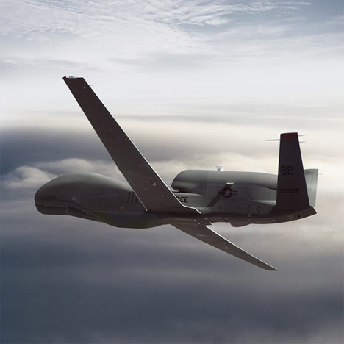
Really…Why (cont’d.)
Since some of this technology will be readily available to us at a later date, observing military technology is an effective way of making predictions for commercial markets in the future.
Researching this topic is also relevant because of the level of activity that has been seen recently; there has been a lot of international military turbulence, and we can apply some of the technologies we learn about to military actions that are taking place all over the world.
U.S. military drone, often used for surveillance and information gathering.

Slide 4
Issues and Challenges
Because our military is state-of-the-art, it may pose a challenge researching specific technologies because they are so advanced and must be kept in a degree of secrecy for national security.
As far as the development of new military technologies, issues may arise because these technologies are so advanced, therefore, extremely high prices lead to low demand. This could hinder progressions in the technology if the budget is not sufficient for R&D.
The advancement of technology for commercial use can also be put to the side if a need for the development of military technology emerges. This means that military technology takes a permanent precedence over commercial technology.

Slide 5
Structure
We plan on structuring this project around the investigation of a variety of technologies being researched and applied to different sectors of the technological market.
This includes not only technologies implemented by the U.S. military on the military, but also technologies implemented by the U.S. military on commercial, and possibly, other sectors.
This means that we will be researching technologies that are widely distributed for commercial use and were originally developed for strictly military purposes.
For example, RADAR and GPS systems have since been brought to the commercial realm through automobiles and individual use. Tempur-Pedic equipment was originally designed for use in space and has since been brought to the American citizen.

Slide 6
Structure
In addition to commercially released technologies, we will explore technologies focused on the development of soldiers and the military.
For example, flight simulators and other simulators, unmanned robotics, the individual gunshot detector, and so on. Simulators have influenced the video game market significantly.
Often times, portions of these technologies will get passed on for commercial use, but other parts will never see such a market.
The purpose of our research is to gain valuable information on the impact of military technology on today’s technology.

