Slide 1
Project Proposal
Claire Powers
Notes:
http://tarheelreader.org/accessing-tar-heel-reader/

Slide 2
Project:
I will be creating and editing a series of books for Tarheel Reader

Slide 3
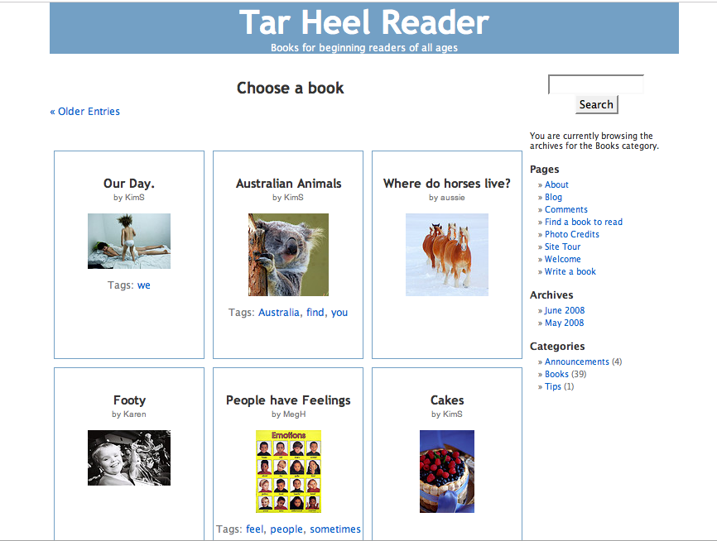
Background: Tarheel Reader
Tarheel Reader is an online collection of short stories with pictures
The stories are free and can be downloaded into different formats
Each story is accessible to readers with disabilities

Slide 4
Tarheel Reader: Accessibility
Readers may use a mouse, an alternative pointing device, or a touch screen
Alternative pointing devices include:
Assistive Mouse Adaptor: for users with hand tremors
Ballpoint Mouse: for users with dexterity difficulties or users with physical impairments
Haptic Devices: for blind/visually impared users or users with learning disabilities
Head Mounted Pointers: users with severe physical impairments
Joysticks: for users with dexterity impairments
Mouse Keys (keyboard arrows used as mouse): users with dexterity difficulties
Mouse Mats/Tables (to be placed on upper leg for users in wheelchairs): users with dexterity difficulties
Touchpads: users with severe physical impairments
Touchscreens: users with dexterity difficulties
Trackballs: users with dexterity difficulties
Notes:
http://www.gawds.org/show.php?contentid=98

Slide 5
Tarheel Reader: Accessibility
There are custom built overlays for students to use IntelliKeys with Tarheel Reader
IntelliKey is a large keyboard that is usually used for writing on the computer but can be programmed with different overlays
IntelliKeys are helpful for a wide range of students: those with dyslexia, autism, ADHD, ADD, elementary school students who are behind in reading, and students with limited English proficiency.
Notes:
http://www.intellitools.com/default.html

Slide 6
Motivation:
I want to create a series of books on Tarheel Reader to contribute to the limited amount of accessible books that are available to disabled students learning how to read.

Slide 7
Challenge:
It will be a challenge to create a series of books that will appeal to many students while still being appropriate for lower-level readers

Slide 8
Possible ideas:
I will potentially create an animation to go with the book series that will lend itself to the comprehension of one the books.

