Slide 1






3D Animation
show, don’t tell
Megan Cruz

Slide 2
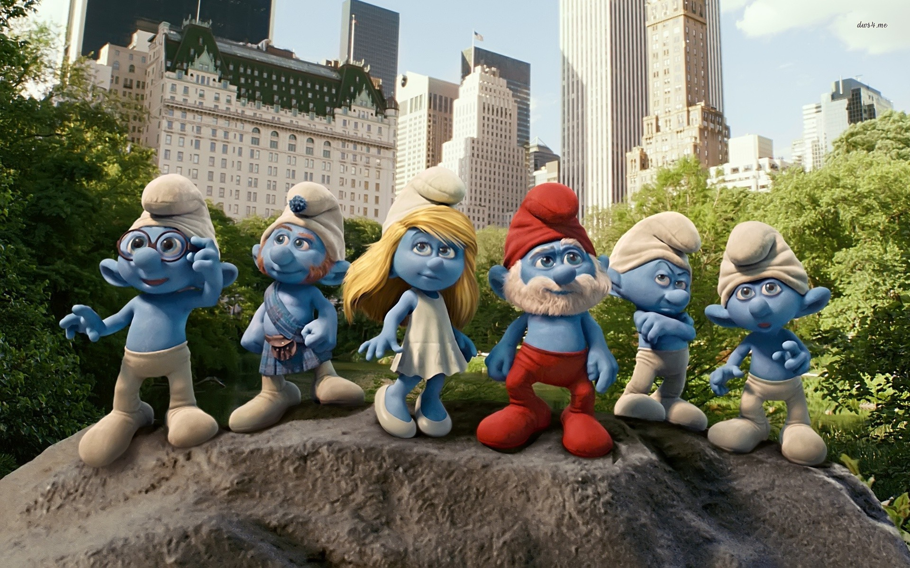
The Short Story….
story idea
script
pictures
acting
bit of editing

Slide 3
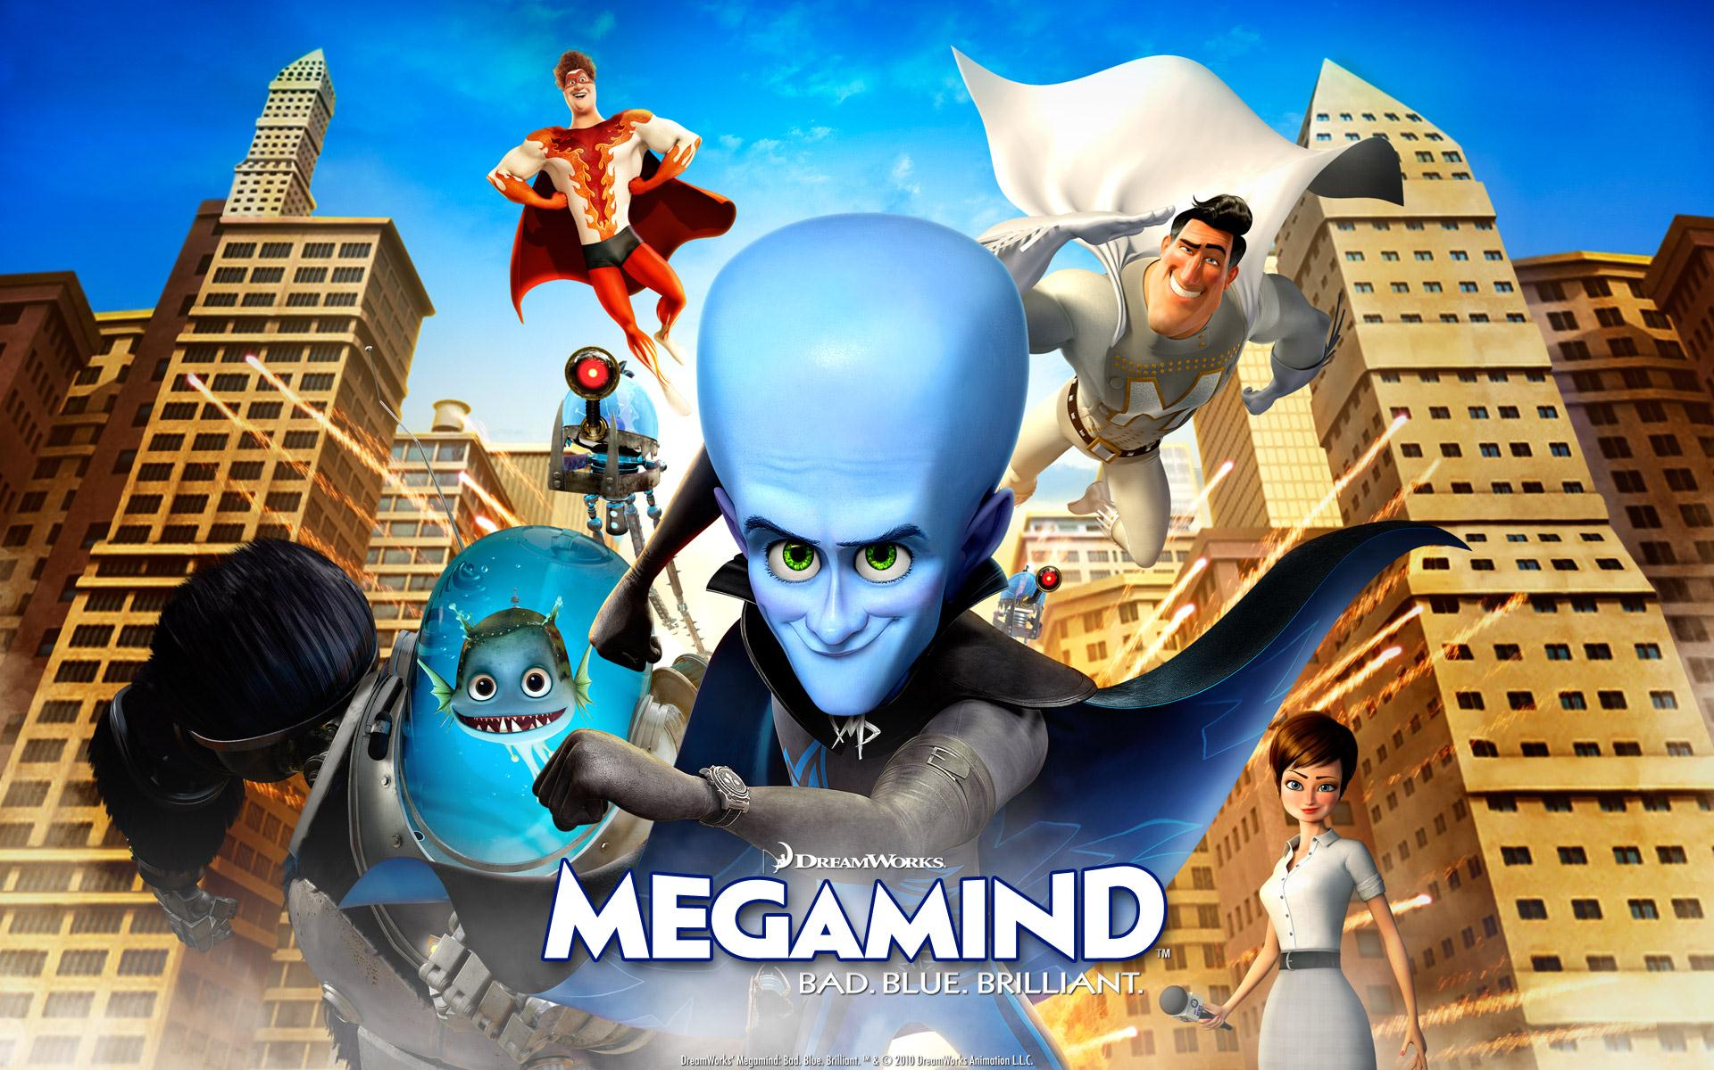
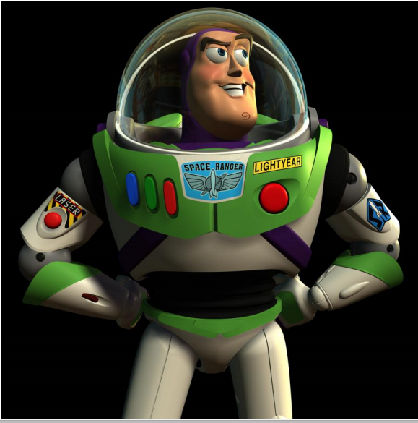
The Real Story...
BRINGING THE IDEA TO LIFE!
text treatment
script
storyboard
voice talent
reels
look and feel (color scripts)
models
sets
shots
animation
shade
lighting
rendering
final touches, musical score

Slide 4



F
O
C
U
S
3D Children’s Animated Films:
Pixar
Disney
Dreamworks

Slide 5

Emo to Premo (Dreamworks)
Emo:
previous animation software (developed in 1980s)
animate primitive graphics and texts
evolved to bring Princess Fiona & Puss in Boots to life
Disadvantages:
animators work with rough geometric approximations of creatures
efficient use of power;;
Notes:
Disadvanatages:
relied on animation software EMO: developed in the 1980s
designed to animate primitive graphic and texts
evolved to produce Princess Fiona and Puss in Boots
however, animators would have to work with rough geometric approximations of creatures rather than fully-realized models or turn off different body parts altogether to get the software to run at an acceptable speed
rendering would tie up the workstation completely

Slide 6
Emo to Premo (Dreamworks)
Premo:
fully realized and skinned characters
interact with and modify characters in real time
camera positions moved easily
latest multi-core processor
rendering done in the background

Slide 7
Emo to Premo (Dreamworks)
Easy, creative to use
software platform: Apollo
developed How to Train Your Dragon 2 and Puss in Boots

Slide 8
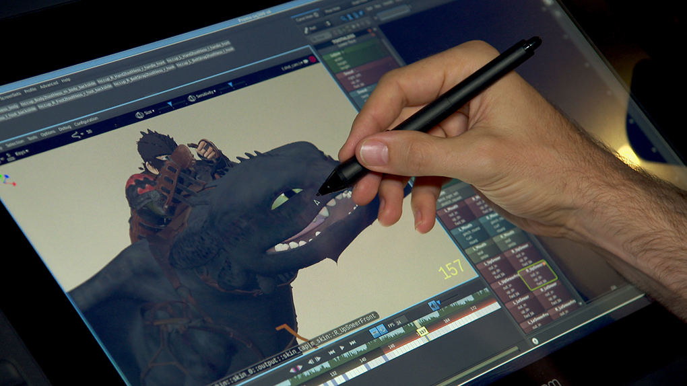
Emo to Premo (Dreamworks)
How to Train Your Dragon 2

Slide 9
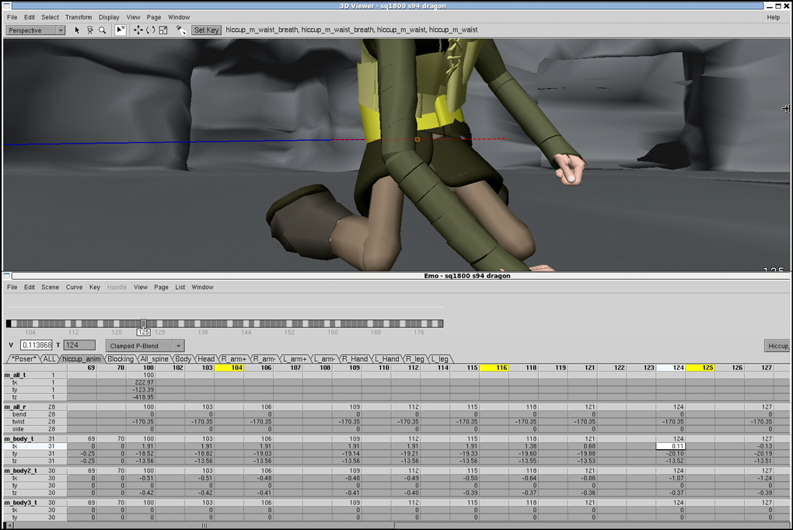
Emo to Premo (Dreamworks)
interface

Slide 10
Emo to Premo (Dreamworks)
Premo
large, pressure sensitive screens from Wacom
use a pen to interact directly with computer generated character
skin, muscle, etc respond in real time
immediate, naturalistic way of working that allows for more experimentation
can work on many characters at once without tying up the workstation completely

Slide 11
Renderman (Pixar)
core rendering technology
3D rendering program
Renderman Interface Specification (RIS) - application programming interface
Renderman Shading Language - scripting language for 3D rendering jobs

Slide 12
Renderman (Pixar)
fast global illumination
  realistic lighting with minimal setup
interactive shading, lighting
ray tracing RIS framework
camera effects:
  motion blur
  depth of field
  mimic behavior of real-world cameras
fur, hair
  riCurve

Slide 13
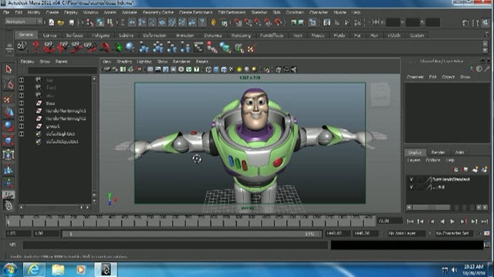
Renderman (Pixar)
RIS (Renderman Integrator System):
rendering global illumination
ray tracing scenes with heavy geometry, hair, volumes
  framework for advanced light transport through:
    unidirectional path tracer
    innovative VCM unified rendering algorithm
Notes:
ray tracing: technique for generating an image by tracing the path of light through pixels in an image plane and simulating the effects of its encounters with virtual objects.

Slide 14
Renderman (Pixar)
Unidirectional Path Tracing:
create global illumination
  ray follows a path from camera to objects in the shot
VCM:
bidirectional path tracing and photo techniques
rays follow 2 paths: 1 from camera, 1 from light source
understand where light is relative to everything else in the shot

Slide 15
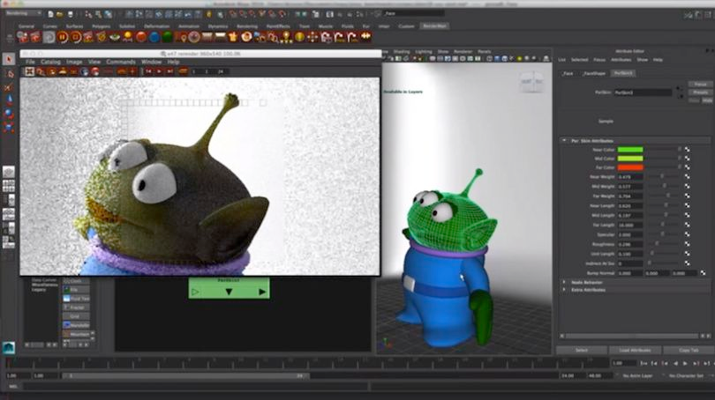
Renderman (Pixar)

Slide 16
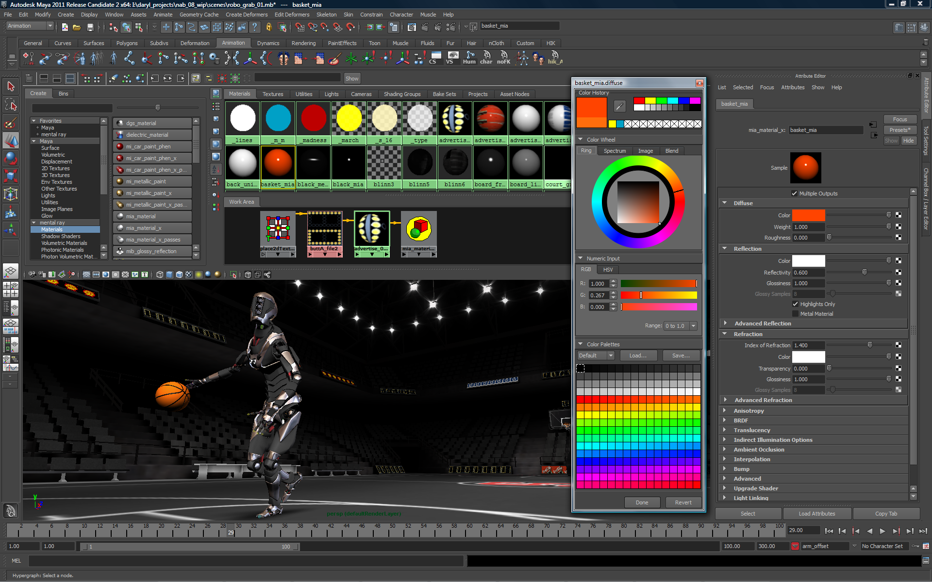
Autodesk Maya
3D computer graphics software - animation, modeling, simulation, rendering
get free 3 year license!! (http://www.autodesk.com/education/free-software/all)

Slide 17
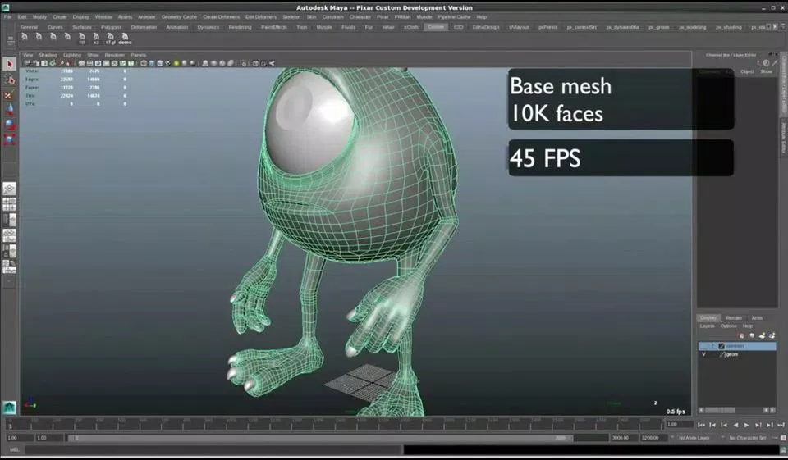
Maya

Slide 18
Maya
Components:
fluid simulator: Navier-Stokes equations; smoke, fire, clouds, explosions, water, magma, mud
Bifröst: computational fluid dynamics framework; depict foam, droplets, waves realistically
Classic Cloth:
Fur
nHair

Slide 19
Maya
Advantages:
maximize productivity
example tools included: focus on workflow; creative expressions
  grease pencil
  automatic joint centering
  camera sequence
  weight distribution
3D models & visual effects are rendered in real time
scripting language: Maya Embedded Language:
  create own set of tools to achieve their goal easier
  customizable

Slide 20
a closer look at 2 animated films and complexities that animators faced
Brave, Frozen

Slide 21

Brave
Software
Taz: hair simulation software
  formed individual coils around computer-generated cylinders of varying lengths, diameters
  resulting locks stretch out when Merida runs, but snap back into place when she stops

Slide 22
Brave - Merida’s Hair
Problem: wild, unruly, curly hair
modeled using mass & springs (springs connecting point masses)
stiff curls lead to rigid springs; however, a soft, flowing movement of hair is required
very soft springs lead to hair unwinding
very stiff springs lead to unrealistic movement of hair
thus, a problem of collision and intersection

Slide 23
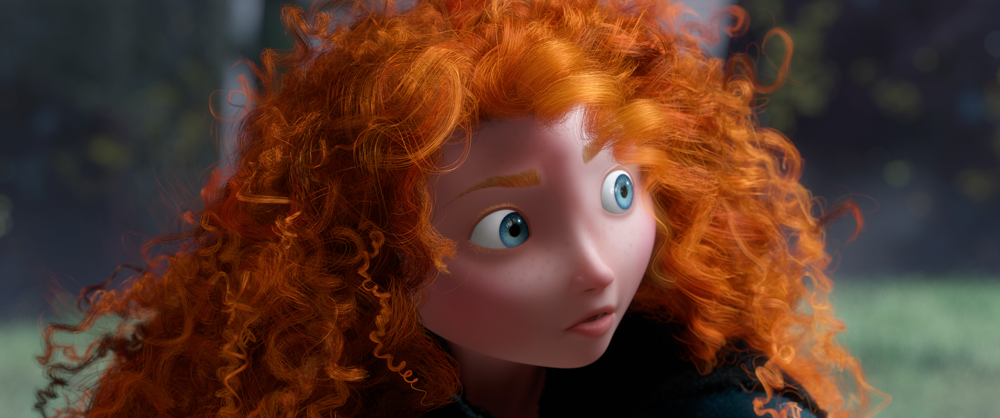
Brave - Merida’s Hair
Goals:
preserve helical shape regardless of intense forces caused by extreme motion
thin, elastic rods that would retain shape
Notes:
Goals:
- preserve helical shape regardless of intense forces caused by extreme motion
- wanted hair to have small helical shapes like thin, elastic rodes p
- reserve helical shape regardless of intense forces caused by extreme motion

Slide 24
Brave - Merida’s Hair
Remedy: new software, Taz
new, multi-threaded simulator
addressing the curls themselves: core thread/curve that runs through middle of a primary curl.
each strand has a flexible core curve (string of beaded necklace) which allows coils to bounce and brush against each other without unwinding.
Merida had 1500 hand placed curves which interpolate to 111,000 curves at a final render
Notes:
new, multi-threaded simulator
cluster of hairs can be dealt with as one group
code does computation before sending hair off to simulator to determine how other hairs would relate
addressing the curls themselves: core thread/curve that runs through middle of a primary curl. Key hairs known as B-splines which are used to interpolate the motion of the rest of the hairs
Merida had 1500 hand placed curves which interpolate to 111,000 curves at a final render
each strand has a flexible core curve (string of beaded necklace) which allows coils to bounce and brush against each other without unwinding.

Slide 25
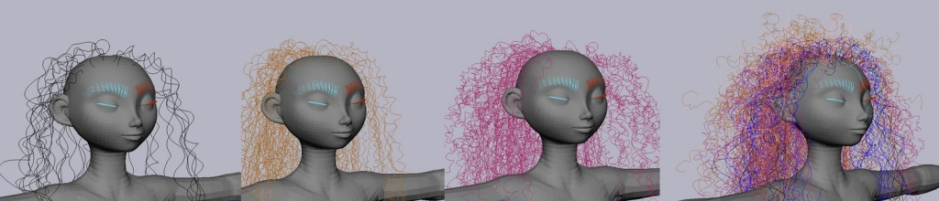
Brave - Merida’s Hair
mass of curly hair v. mass of straight hair; each reacts differently to gravity
Merida’s hair wanted to unwind due to its heavy weight, but when the mass was decreased, the movement of the hair was that it was floating like it was underwater, which was unrealistic.
mass of Merida’s hair was kept the same, but the coefficient of gravity changed from the earth to the moon to achieve a realistic hair movement.

Slide 26
Brave - Merida’s Hair
Solution:
represent hair as mass-spring system
piecewise linear curve which captures deformation of hair over time
Advantages:
intuitive interface to define and modify detailed, complex geometry
easy integration of external forces
Limitations:
stability when faced with stiff systems

Slide 27
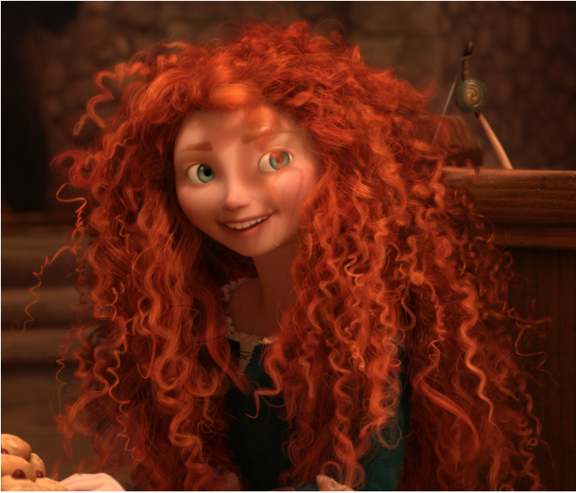
Brave - Merida’s Hair
What constitutes the mass-spring system?
3 springs:
  one main spring; connect each hair particle with linear spring
  spring controlling the bending along the curl
  spring controlling longitudinal stretch of the curls (bouncy and soft looking without coming undone)
hair model uses large number of “guide hairs” that are rendered

Slide 28
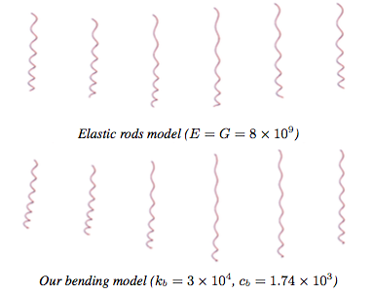
Brave - Merida’s Hair
The stretch spring: for longitudinal movement
springs are connecting 2 particles; therefore, each spring force is applied equally to both particles in opposite directions
wanted to enable bounce during walk cycle by allowing hair to stretch

Slide 29

Brave - Merida’s Hair
The bend spring:
use elastic rodes
transport root frame of hair along a smoothed piecewise linear curve
preserves linear momentum but not angular momentum

Slide 30

Brave - Merida’s Hair
The core spring:
mass spring model with stiff stretch & bending springs can hold the curly shape during fast motion, but reduces ability for hair to bend
  problem: reduce stiffness of bending springs to allow flexibility, curls lose shape and unwind at high acceleration
  resulting curls looks straight and appears much longer than desired
thus, a core spring which controls longitudinal stretch of curls without stiffening bending springs was created
  piecewise linear curve to represent direction to the center of the curl

Slide 31
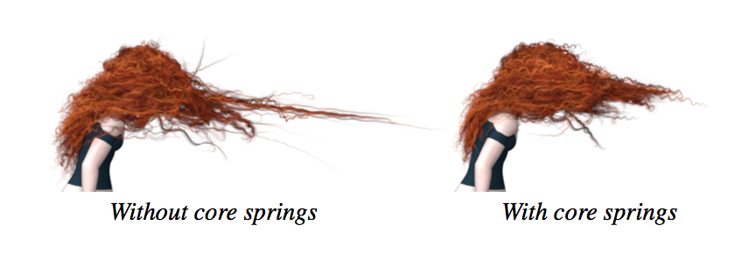
Brave - Merida’s Hair

Slide 32
Frozen - Snow
Snow is difficult to simulate:
snow material behavior is a combination of water and ice
snow is typically compressible
behavior changes dramatically with environmental factors (temperature, humidity, density, snow age)

Slide 33
Frozen - Snow
Snow Batcher, Matterhorn
Material Point Method for snow simulation
  developed a semi-implicit Material point method (MPM) designed to efficiently treat wide range of material stiffnesses, collisions and topological changes
    combined lagrangian material particles (points) with Eulerian Cartesian grids
    handle self-collision
Notes:
Use of Snow Batcher - software
paper: user controllable elasto-plastic constitutive model integrated with hybrid Eulerian/Lagrangian Material Point Method to portray wet or dense snow that has both solid and fluid-like properties (difficult to portray realistically)
method is continuum based; hybrid nature allows use of regular Cartesian grid to automate treatment of self-collision and fracture
derive grid-based semi-implicit integration scheme with conditioning independent of the number of Lagrangian particles.

Slide 34
Frozen - Snow
Material Point Method:
relies on continuum approximation ( don’t need to model every snow grain)
use Cartesian grid to make topology changes and self collisions automatic
constitutive properties central to snow: volume preservation, stiffness, plasticity, fracture

Slide 35
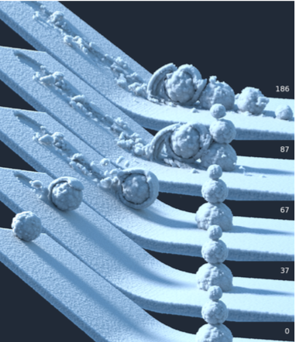
Frozen - making of snow
Notes:
shows packaging snow effect:
snowball moves downhill, compressed snow sticks

Slide 36
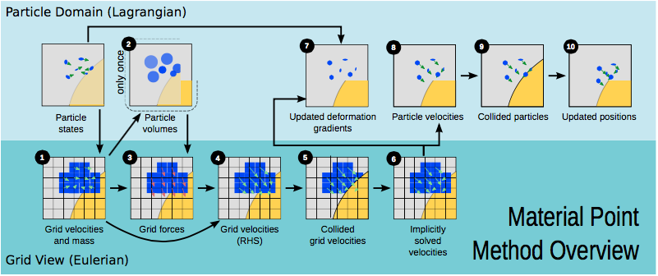
Frozen - Snow
Material Point Method: basic idea
use material points (particles) to track mass, momentum, deformation gradient

Slide 37
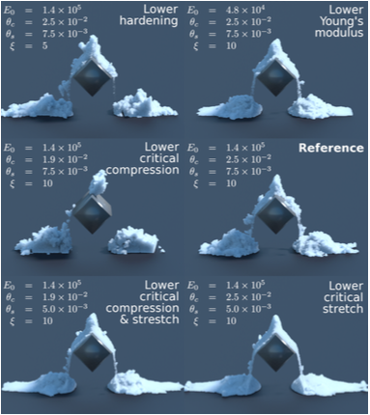
Frozen - Snow
Notes:
changing parameters affects look and dynamics of snow
Young’s Modulus: a measure of elasticity, equal to the ratio of the stress acting on a substance to the strain produced.
force per unit area needed to stretch or compress a material sample

Slide 38
Frozen - Snow
MPM Steps:
rasterize particle data to the grid; transfer mass from snow particles to the grid
compute volumes and densities of particles
compute grid forces
grid-based body collisions
solve linear system
update deformation gradient
update particle velocities
particle-based body collisions
update particle positions

Slide 39
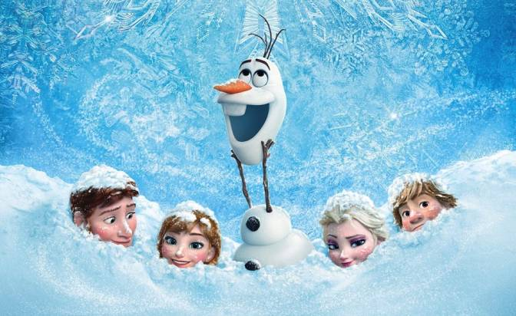
Frozen - Snow

Slide 40
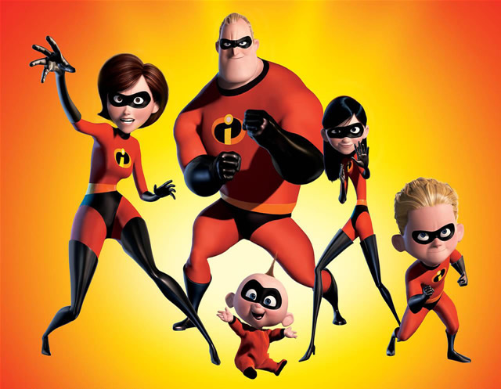
Getting started...
If you’re interested….
students get 3 year free trial for Maya
  free downloads: Autodesk software for students
non-commercial RenderMan
open source software from Disney!

