Slide 1
Assistive Technology
Tia Holmes

Slide 2
What is AT?
Any item, piece of equipment or product system, whether acquired commercially off the shelf, modified, or customized, that is used to increase, maintain, or improve the functional capabilities of children with disabilities.

Slide 3
Examples of AT
There are many different forms of assistive technology to aid people with disabilities

Slide 4
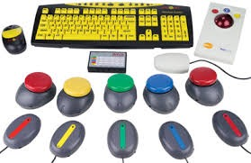
Access and Environmental Control
Helps provide easier access to places
Buttons to open doors, ramps, handle bars, remote controls
Helps increase control in an environment
Adapted keyboards, mice, touchpads, electronic switches

Slide 5
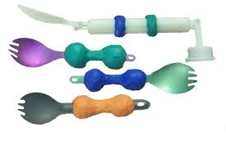
Daily Living AT
Devices to aid in doing “daily activities”
Motorized tooth brushes, adapted silverware (i.e with grips), electronic can openers
Helps people with disabilities be more independent and able to live without constant assistance

Slide 6
Augmentative Alternative Communication
Helps people with disabilities communicate in a less conventional way that individuals without disabilities
Voice-output devices, computers, picture boards

Slide 7
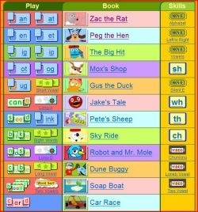
Computer-Based Educational Tools
Programs, software, and online tools that help students understand a specific subject area
word-prediction programs
Screen reading programs
Online tutorials/learning games

Slide 8
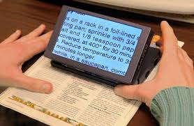
Visual/Hearing Aids
Devices that allow people with visual impairments to access information
Magnified e-texts
Voice-over capabilities
Text-to-speech programs

Slide 9
Apple: A leading company in AT

Slide 10
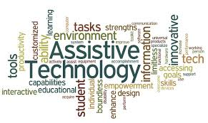
Making a Difference
Assistive technology has so many positive impacts and can truly change a person’s life
Allows people with disabilities to live and learn with their peers and to keep up with people who don’t have disabilities
AT can be costly, but giving someone the power to learn, speak, write, or live independently is truly priceless

Slide 11
Questions?

Slide 12
Citations
http://www.pbs.org/parents/education/learning-disabilities/strategies-for-learning-disabilities/assistive-technology/
http://www.pbs.org/parents/education/learning-disabilities/strategies-for-learning-disabilities/assistive-technology-devices/
http://www.pacer.org/stc/pubs/reallyusefultech.pdf

