Slide 1
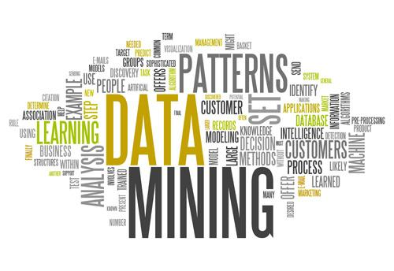
Data Mining and its Application in Marketing and Business
Credit: Gaby Matalon

Slide 2
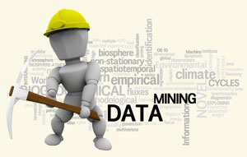
What is Data Mining?
The process of analyzing data from different perspectives and summarizing it into useful information
It uncovers patterns in a large set of data
Growing industry to target their products and advertisements towards consumers based on data mining

Slide 3
Why Data Mining?
Almost everything we do leaves electronic data behind
Needs to extract useful information from data in order to interpret the data
Data mining helps speed up the process of finding relationships and patterns in raw data

Slide 4
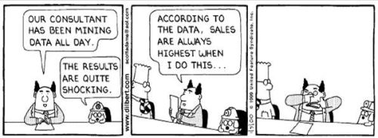
Uses of Data Mining
Healthcare
Finance
Retail & E-Commerce
Learn about consumer preferences
Countless others!
Notes:
Tailor products to consumers
Predict what consumers will buy in the future
Predict which consumers are likely to leave you for a competitor
Market basket analysis- predict which products are commonly purchased together

Slide 5
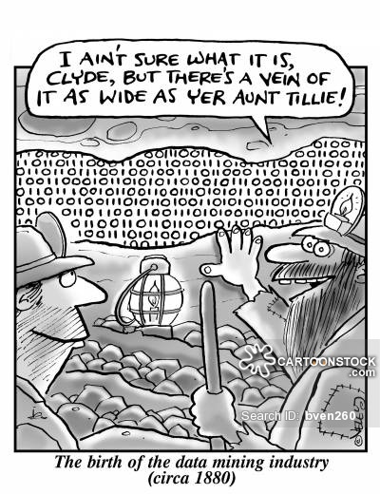
History of Data Mining
The term “data mining” is relatively new but the concepts have been around for many years
Classical statistics, artificial intelligence and machine learning culminated over the years and evolved into data mining

Slide 6
History of Data Mining (Cont.)
Data Collection (1960s)- process of storing information on computers
Technology- computers, tapes and disks
Data Access (1980s)-the introduction of structured query languages and relational databases helped us learn more about data
Data available at record level dynamically

Slide 7
History of Data Mining (Cont.)
Data Warehousing and Decision Report (1990s)-the process of centralized data management and retrieval
Maintaining a central location for all organizational data
Helps you analyze data and concentrate on very specific characteristics
Dynamic data delivery at multiple levels
Data Mining (present)- generalizing patterns, predictive

Slide 8
Influential People/Events
In 1975, John Henry Holland wrote Adaptation in Natural and Artificial Systems, a book on genetic algorithms – start in data mining
1990s, the term “data mining” appeared in the database community for the first time
In 2001, William S. Cleveland introduced data mining as an independent discipline
DJ Patil became the first Chief Data Scientist
in the White House in February 2015

Slide 9
Terminology
Data: facts, numbers or text that can be processed by a computer
Information: the patterns, associations and relationships of data
Knowledge: understanding of a subject, synthesise information to gain knowledge about historical patterns and future trends

Slide 10
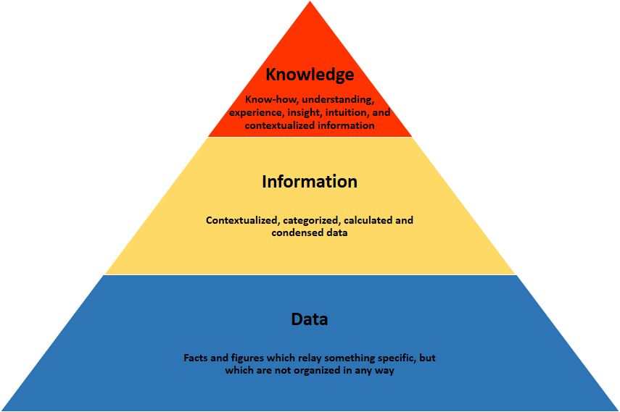
Data, Information, vs. Knowledge

Slide 11
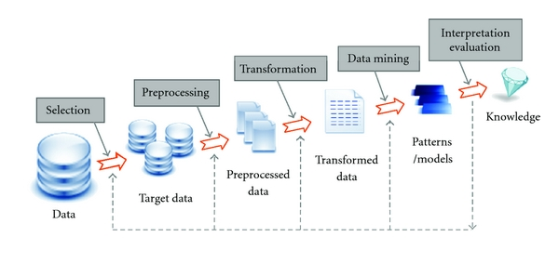
Data Mining in the Knowledge Discovery Process
Notes:
Selection: Obtain data from various sources.
Preprocessing: Cleanse data.
Transformation: Convert to common format. Transform to new format.
Data Mining: Obtain desired results.
Interpretation/Evaluation: Present results to user in meaningful manner.

Slide 12
How Data Mining Works
Need a clear understanding of data in order to be able to use the information effectively
To do this, classify data into these groups:
Classes
Clusters
Associations
Sequential Patterns

Slide 13
Classes
Classes are groups where the data shares characteristics
Example- A class for a company like Netflix would be the customers who all watched a certain movie

Slide 14
Clusters
Very similar to classes but with additional attributes (ie. logical relationships & consumer preferences)
Example- product recommendations, people who bought this product also bought...
In terms of business this can be the most helpful/effective way to classify data

Slide 15
Associations
Takes clustering even further
Use data to find relationships/patterns that would often go unnoticed
Example: finding a connection between buying two unrelated products
Associations can help businesses identify these patterns and they can tailor deals or promotions to take advantage of their consumers’ buying habits
Notes:
beer & diaper example

Slide 16
Sequential Patterns
Sequential patterns uses past data to form a predictive model
Produces projected trends of what the data shows a consumer will buy
Example: Target could predict a consumer will buy diapers if they are/have purchased baby clothes and pacifiers in the past

Slide 17
Data Mining’s Major Elements
Extract, transform, and load transaction data onto the data warehouse system.
Store and manage the data in a multidimensional database system.
Analyze the data by application software.
Present the data in a useful format, such as a graph or table, for display and visualization

Slide 18
Methods of Analysis
Artificial neural networks: Non-linear predictive models that resemble biological neural networks in structure
Genetic algorithms: Optimization techniques that use genetic combination, mutation, and natural selection based on the concepts of natural evolution
Rule induction: The extraction of useful if-then rules from data based on statistical significance

Slide 19
Methods of Analysis (Cont.)
Decision trees: Tree-shaped structures that represent sets of decisions. These decisions generate rules for the classification of a dataset.
Classification and Regression Trees (CART), Chi-Square Automatic Interaction Detection (CHAID)
CART segments a dataset by creating 2-way splits while CHAID segments using chi square tests to create multi-way splits.

Slide 20
Methods of Analysis (Cont.)
Nearest neighbor method: A technique that classifies each record in a dataset based on a combination of the classes of the k-record(s) most similar to it in a historical dataset (where k=1)
Data visualization: The visual interpretation of complex relationships in multidimensional data.
Use graphics tools to illustrate data relationships

Slide 21
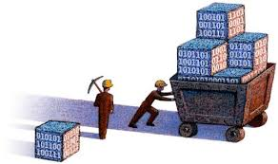
How Data Mining Applied
Data mining is accomplished through modeling
Modeling is the act of building a model that applies to one situation and then applying it to another situation where you don’t have a model
Use these new models to predict patterns

Slide 22
Data Mining and Marketing
Advances in the data mining field have had profound effects on the marketing of companies
Companies use this data to tailor their coupons, advertisements and sales to consumers
This marketing tactic is more effective, efficient and can save the company money

Slide 23
Target Case Study
Target uses data mining to tailor the coupons they send in hopes to attract consumers at times in their lives where they are vulnerable to changing their store loyalties
The period where consumers are most vulnerable is when parents are expecting a child
Research has found that when a couple is expecting, they often break their habits and form new ones
This gives stores like Target the opportunity to lure consumers into their stores and get them hooked for life
Notes:
talk about habits
“For companies like Target, the exhaustive rendering of our conscious and unconscious patterns into data sets and algorithms has revolutionized what they know about us and, therefore, how precisely they can sell”
Target collects data by assigning you a guest id
every purchase you make/ survey taken/ anything is recorded and linked to your ID, target collects everything, every piece of data is important

Slide 24
Target (Cont.)
Target uses data that it collects while you are in the store/on their website along with personal information that they buy from other companies
“For decades, Target has collected vast amounts of data on every person who regularly walks into one of its stores. Whenever possible, Target assigns each shopper a unique code — known internally as the Guest ID number — that keeps tabs on everything they buy” (Duhigg)
This data is then analyzed to better understand consumers’ shopping and personal habits

Slide 25
Target (Cont.)
Analyst, Andrew Pole, started work on a “pregnancy prediction model” by combing through Target’s baby shower registry and taking note of how shopping habits of pregnant women changed throughout their pregnancy
Using this info, he created a list of about 25 items that signal that a woman is pregnant
This model was able to predict not only if someone is pregnant but also estimate due date

Slide 26
Amazon Case Study
Amazon is using the data they have collected to improve the customer-service
This includes, name, address & basic personal info as well as consumer preferences and the specific issue the consumer is trying to fix
Use synchronized data to transfer all the data about an individual collected from various departments to provide the customer service representative with the information they need to have an effective human conversation

Slide 27
Amazon (Cont.)
It makes interactions with consumers more efficient
Customer service employees have access to the info needed when interacting with customers
The employees know enough about you to make your interaction seem personal but not too much that it seems creepy
Good to know name, address and the topic of the call but don’t need to suggest an item that your data has shown they may like

Slide 28
Starbucks Case Study
Starbucks uses data to determine the best locations for their stores
Multiple Starbucks locations are able to do so well in such close proximity due to data mining and modeling
Use location-based data, street traffic analysis and demographic information to determine where their locations will have the most success

Slide 29
Starbucks (Cont.)
Starbucks uses a company called Esri and their data platform, ArcGIS online, to monitor sales, demographics and proximity to potential consumers’ homes, work and other excursions
This company takes Starbucks’ massive amount of data, analyzes it and places it in easy-to understand platform for Starbucks employees

Slide 30
The Future of Data Mining
Predictive analytics: “one-click data mining”, achieved by a easier and more efficient data-mining process
Allow advanced analytics to be applied across subjects
The most revolutionary will be in medicine
Researchers can use predictive analytics to find factors associated with a disease or predict what patient might respond best to an experimental treatment.

Slide 31
Future Trends
Distributed Data Mining: mining data that is located in various different locations
Uses a combination of localized data analysis with a global data model
Hypertext/Hypermedia Data Mining: mining data which includes text, hyperlinks, text mark-ups, and other forms of hypermedia info
Techniques: classification, clustering, semi-structured learning & social network analysis
Notes:
DDM: currently most data mining occurs where all the data is in one spot/warehouse

Slide 32
Future Trends
Multimedia Data Mining: multimedia data (including images, video, audio and animation) need to be represented differently than traditional data
Audio data mining (mining music)
Spatial/Geographical Data Mining: analyzing info about natural resources, images from satellittes, or topographical data
Most of data is image oriented, a lot of it is from different locations
Notes:
audio data mining: tedious and straining to concentrate on looking for patterns in a set of data: the idea is basically to use audio signals to indicate the patterns of data or to represent the features of data mining results.

Slide 33
Concerns about Data Mining
Privacy:
As data mining becomes more widely used, more info is collected about every individual
Useful applications of this knowledge vs. potentially dangerous misuse
Possible easy access of data and ill intentions
Potential for identify theft and more!

Slide 34
Other Concerns
User Interface Issues: do visualization tools make the uncovered knowledge interesting & understandable?
Performance Issues: many analysis tools and statistical methods were designed for smaller sets of data. As the data size increases, how do they scale?
Trade-off: Do benefits of data collection and data mining outweigh the potential risk?

