Slide 1
Technology as a Learning Tool
By: Kishin Aruwani

Slide 2
Impact on Students’ Learning
Allows students to work at their own pace
Computer software can utilize different media to provide a variety of options for learners.
Students can build on their own understanding by using computers as resource tools

Slide 3
Impact Outside of the Classroom
Computer networking allows students to communicate with teachers outside of the classroom.
Some examples of these communication tools include listservs, e-mail, and chat groups.

Slide 4
Categories of Learning Tools
Q&A Platforms – Piazza and Prulu
Online Education Platforms – Khan Academy, Coursera, and Udacity
Study Tools – Quizlet, Cram.com, and StudyBlue
Instructional Assignment Providers– WebAssign, WeBWorK, and MyMathLab,

Slide 5
Examples of these Learning Tools
Piazza - Connect students, TAs, and professors so every student can get help when needed
Khan Academy - Provide a free, world‑class education for anyone, anywhere.
Quizlet - Provide everybody with access to free and powerful learning tools.
WebAssign - Promote, support, and improve educational instruction and student learning

Slide 6
Differences Among These Systems
Piazza – Optional tool designed to allow students to ask questions regarding class material.
Khan Academy – Provides online tutorials and lectures for multiple subjects. May or may not be required by teachers who wish to monitor their students activity on the site.
Quizlet – Supplemental tool used to aid students in memorizing certain concepts via repetition.
WebAssign – Homework system provider mainly focused on STEM courses. Classes may require students to purchase access to WebAssign in order to do homework assignments.

Slide 7

Piazza
Q&A platform
Wiki style format
Instructors given ability to endorse answers
Allows students to ask questions anonymously
Format code snippets and mathematical equations

Slide 8

Purpose

Slide 9
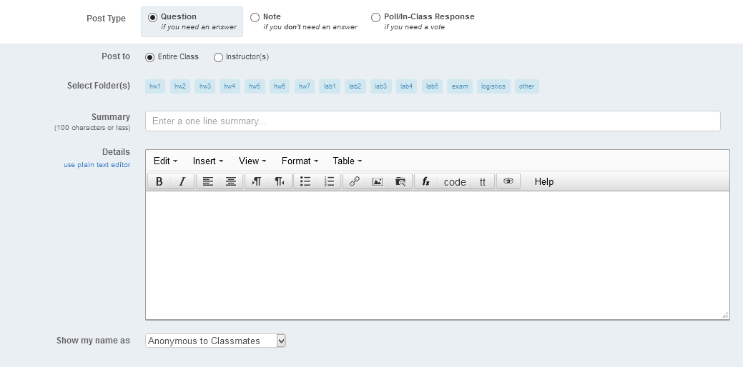
Creating a Post

Slide 10
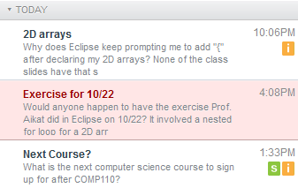
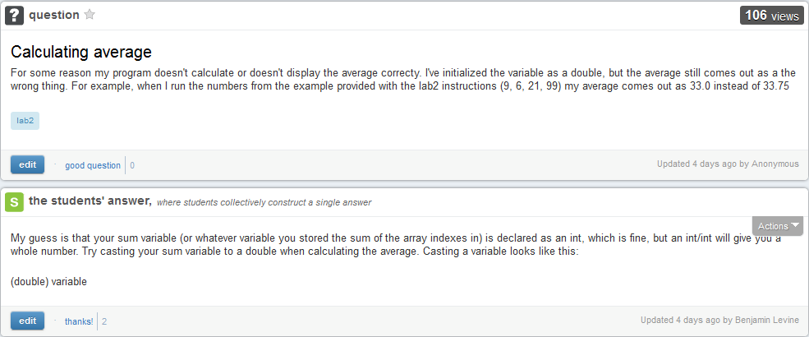
Sample Student Question

Slide 11
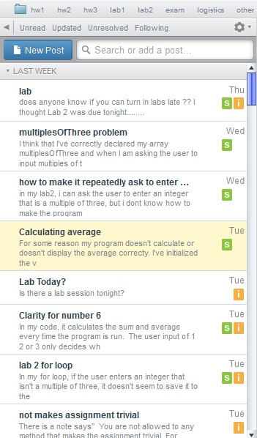
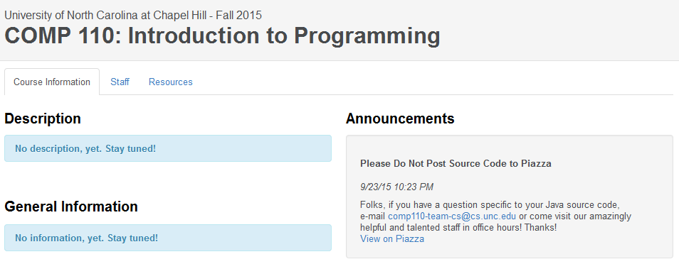
Q&A and Announcements

Slide 12
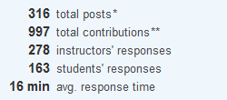
Piazza Statistics
More than 100,000 students at hundreds of schools worldwide (including 109 of the top 250 colleges in the US) have used this website

Slide 13
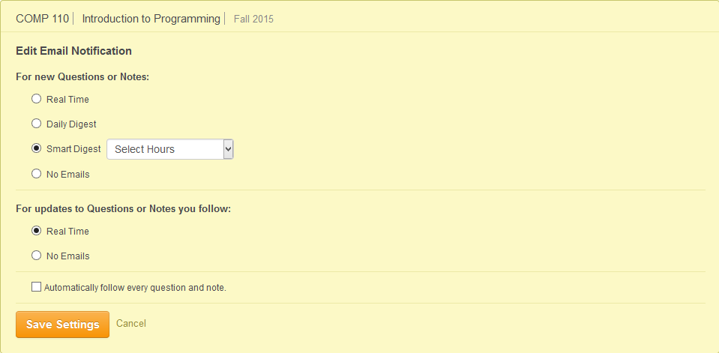
Email Notifications

Slide 14
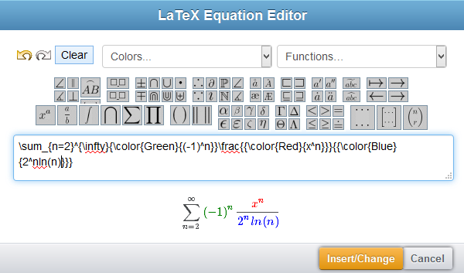
LaTeX Equation Editor

Slide 15

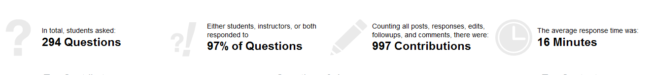

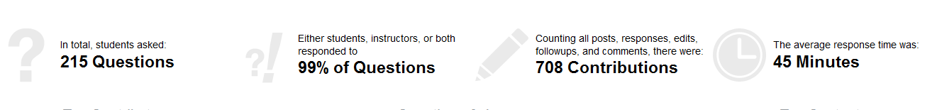
Drawbacks
The ability to ask questions anonymously is dependent upon the instructor’s settings.
The average response time can vary depending on the type of class.

Slide 16
Technology as a Resource
Technology provides better resources that teachers can offer to their students
Computers can provide online access to content and up-to-date information from original sources.
Technology also allows students to watch videos of concepts they are learning in class to better their understanding

Slide 17

Khan Academy
Offers practice exercises, instructional videos, and a personalized learning dashboard on their website.
5000+ videos uploaded to YouTube
Over 2.3 million subscribers

Slide 18
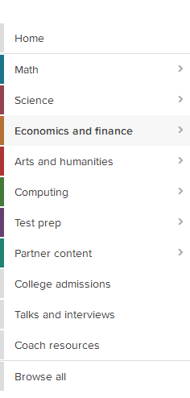
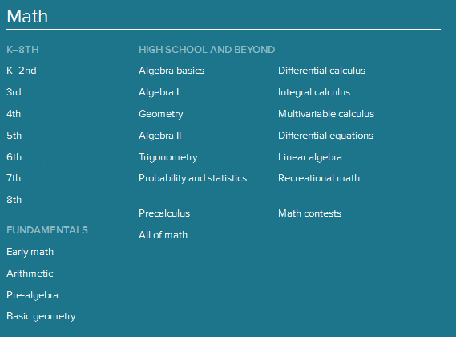
Courses

Slide 19
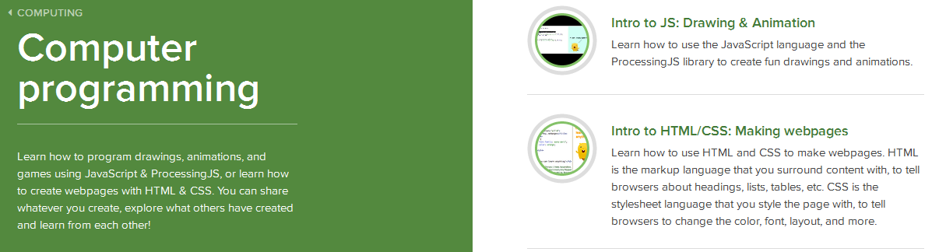
Tutorials

Slide 20
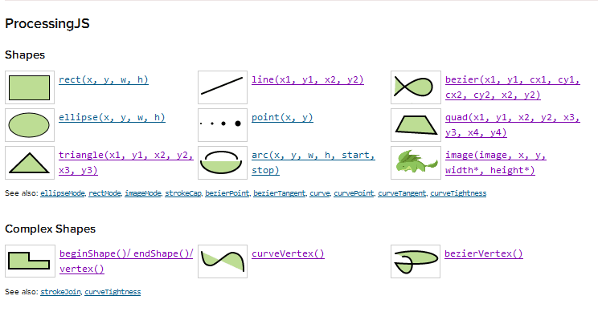
Coding Documentation

Slide 21
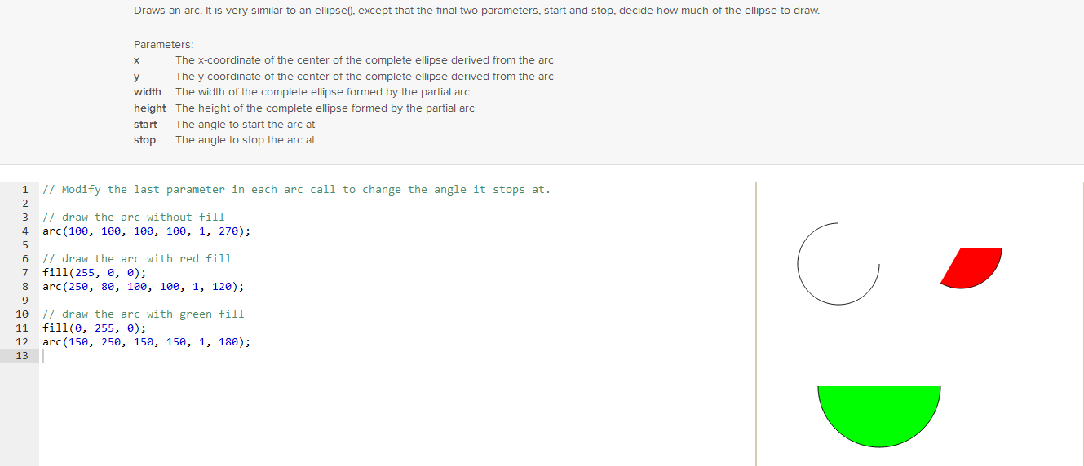
Documentation Tutorial

Slide 22
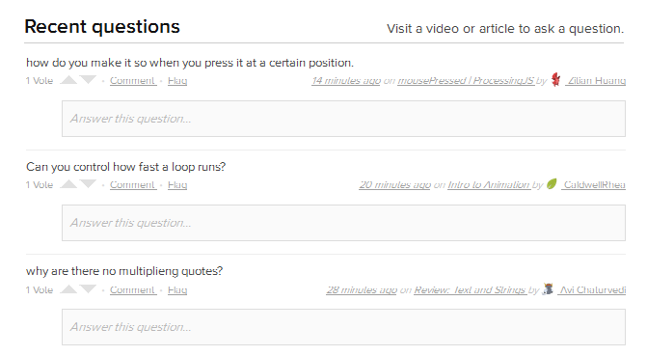
Community Questions

Slide 23
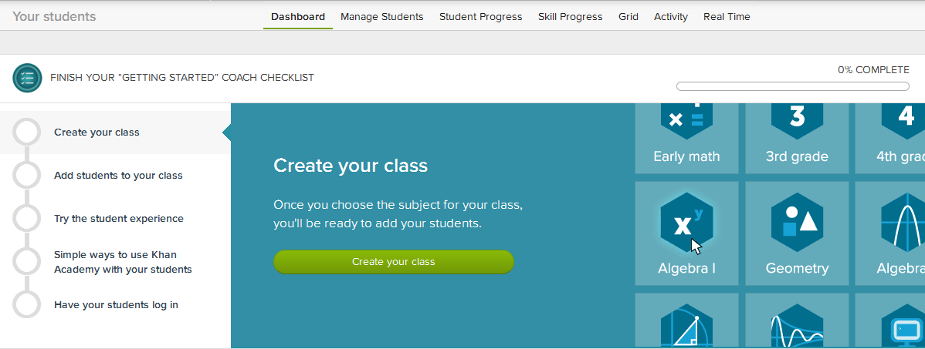
Teacher Resources

Slide 24
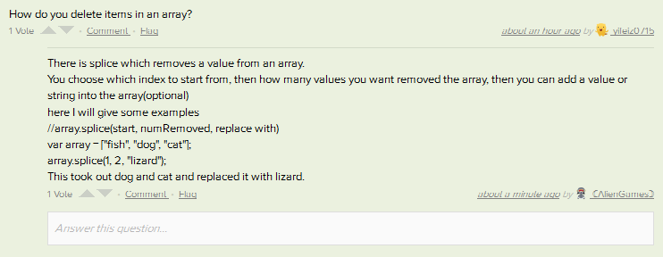
Flaws with Khan Academy
Currently does not provide tutorials on calculus-based physics and programming languages other than JavaScript and ProcessingJS.
A user may have to wait an hour or more for a question to be answered.

Slide 25
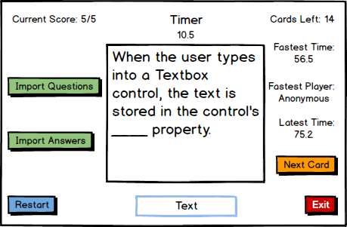
Flashcard Quiz Program
My flashcard quiz program is intended to be another learning tool that students can use.
It will keep track of the player’s fastest times to motivate the student to keep practicing the flashcards.

Slide 26

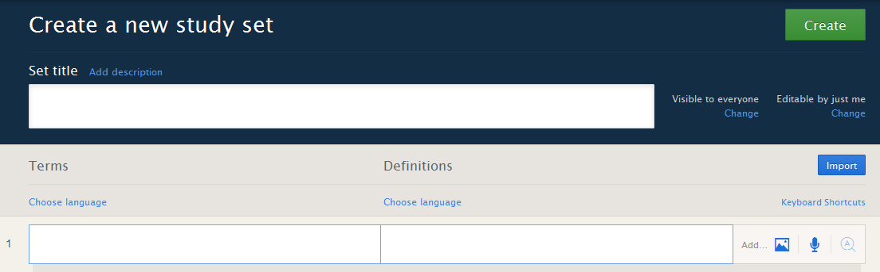

Advantages of Digital Flashcards
Easily create, edit and share flashcards.
Use on a mobile device
Provides multiple methods of studying flashcards
Add audio and images to flashcards*

Slide 27
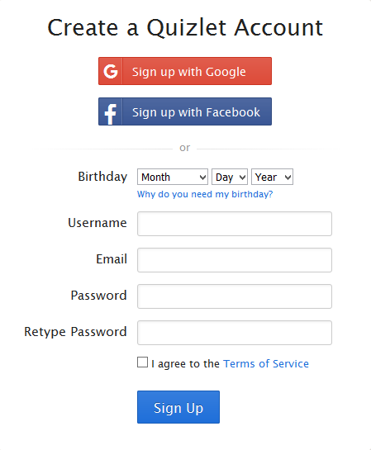
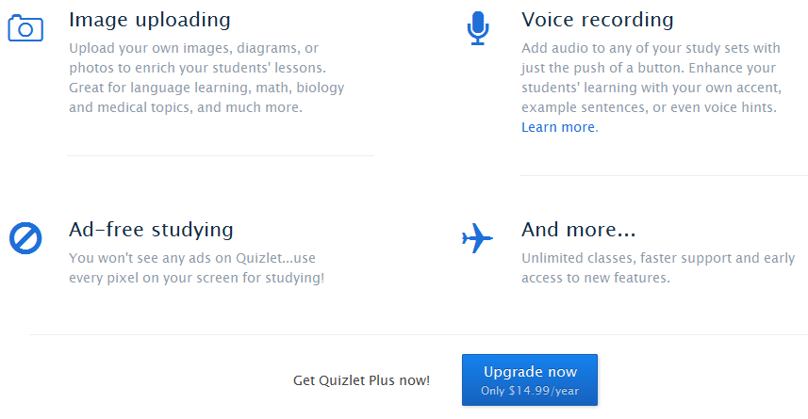
Disadvantages of Digital Flashcards
Certain features may require the user to pay money
The user may have to sign up for an account to create a set of flashcards

Slide 28

WebAssign
Provides extensive content and instant assessment
Integrated with more than 900 textbooks
Used by more than one million students from over 2,300 educational institutions each year
Delivered more than one billion questions to students since its launch in 1997

Slide 29
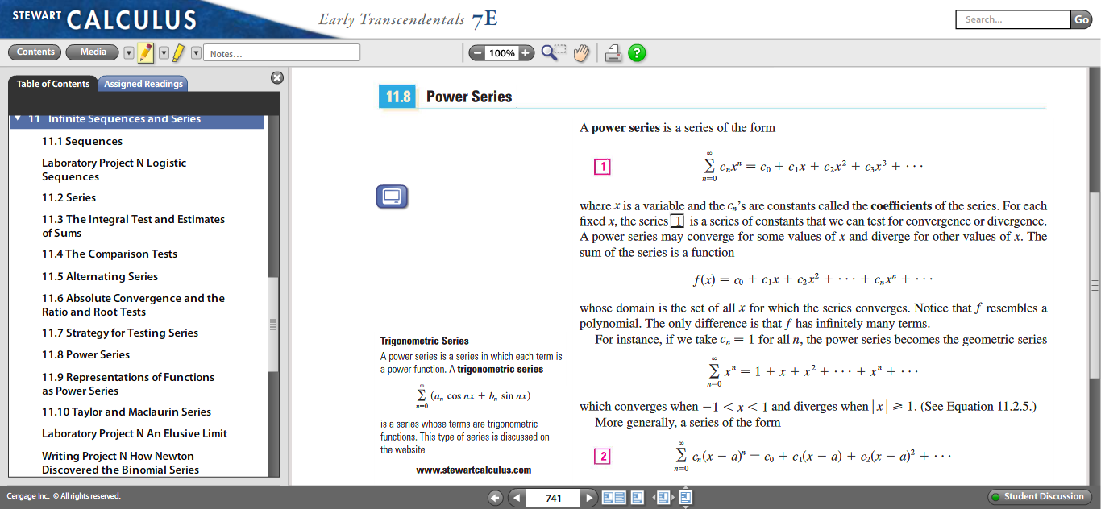
eBook

Slide 30
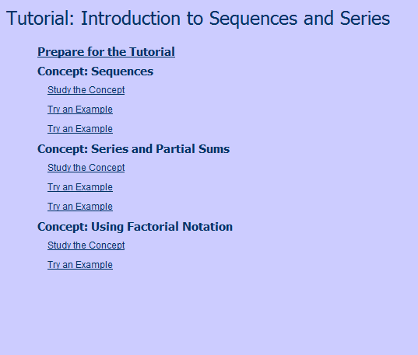
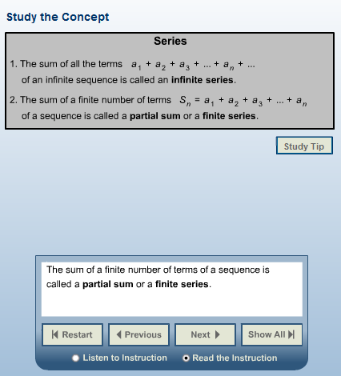
Studying Concepts

Slide 31

Lecture Videos
The lecture videos discuss different concepts of a particular chapter.

Slide 32
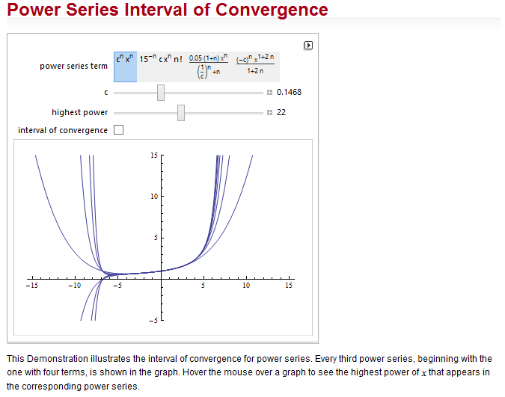
Wolfram Demonstrations
Provides interactive tools to help students understand certain concepts

Slide 33
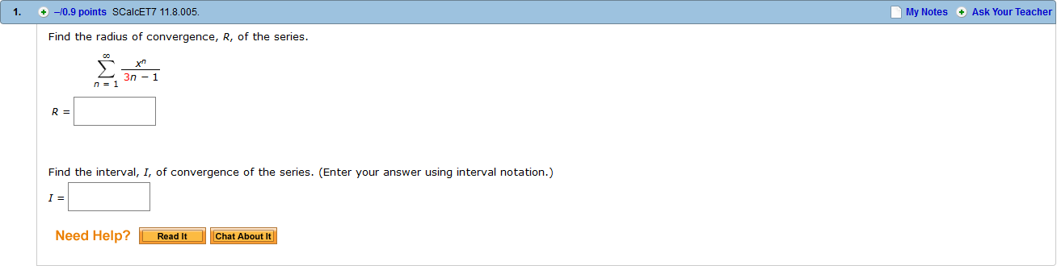
Question Format
Questions on WebAssign are modifications of problems in the textbook

Slide 34
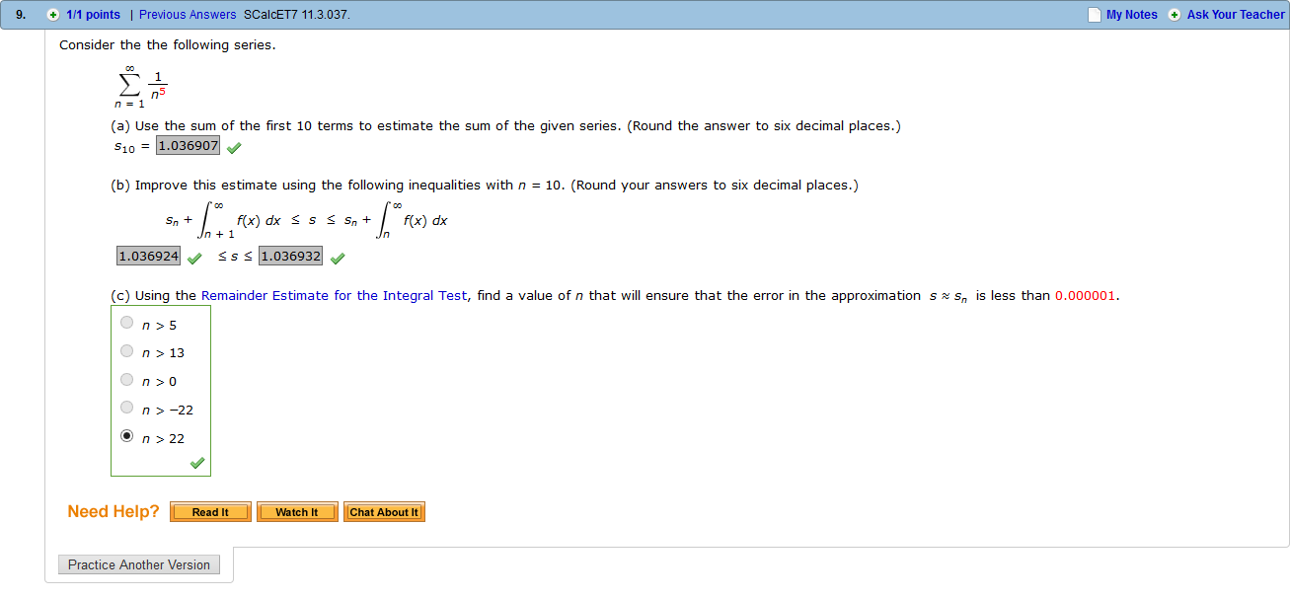
Completed Question Format

Slide 35
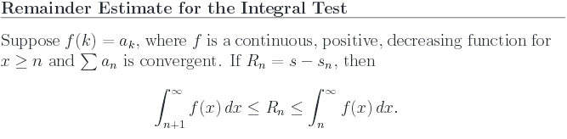

Question Features
Explanation of the concept needed to solve the problem
Number of submissions used
Ability to send the teacher a question regarding the problem

Slide 36
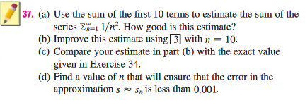

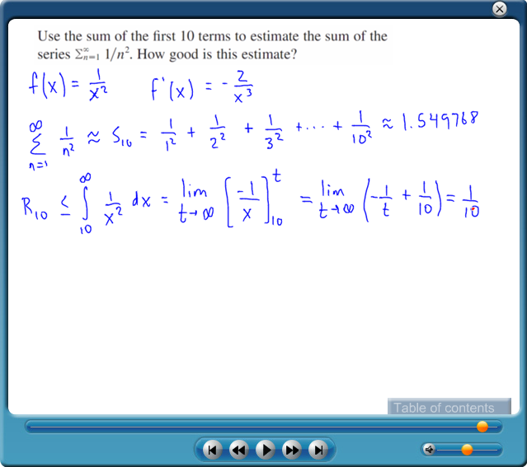
Homework Hints and Video Tutorials

Slide 37
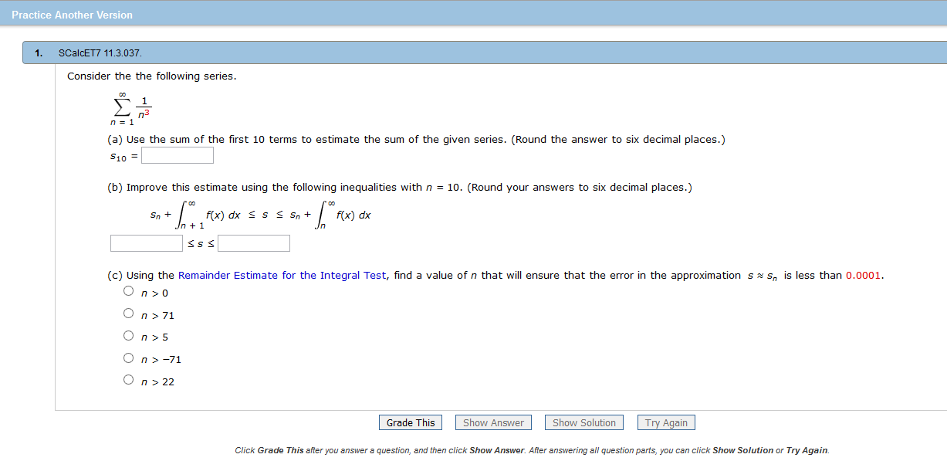
Practice Another Version

Slide 38
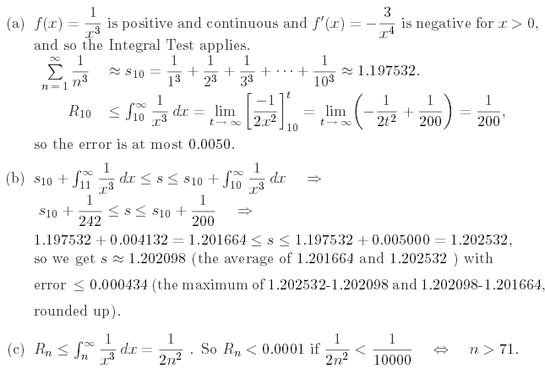
Practice Another Version Solutions
PDF of solution with steps needed to find the answer

Slide 39
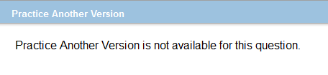
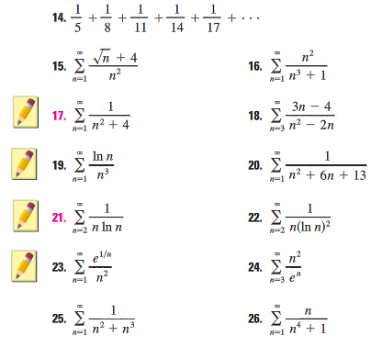
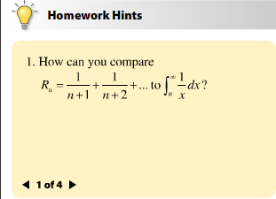
Flaws with WebAssign
Not all questions have another version available to practice.
Only certain problems in the textbook have Homework Hints available.
Some Homework Hints do not provide video solutions.

Slide 40
Connections with Learning Tools
The learning tools discussed can be used in conjunction with each other to help students gain a better understanding of the material in a timely manner.

Slide 41


Future of Online Learning Tools
As the learning tools of technology improve, more teachers will integrate them into their classrooms and provide multiple ways for students to learn the material and collaborate with one another.

Slide 42
Bibliography
http://www.sedl.org/pubs/tec26/cnc.html
https://quizlet.com/
https://piazza.com/
https://webassign.com/
https://khanacademy.org/

