Slide 1
Creating visual interfaces in python
By, Chase Fortier

Slide 2
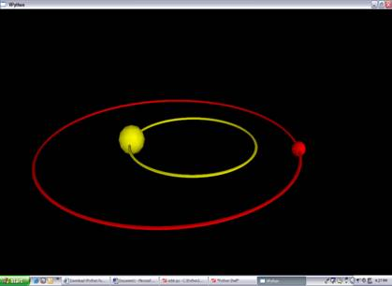
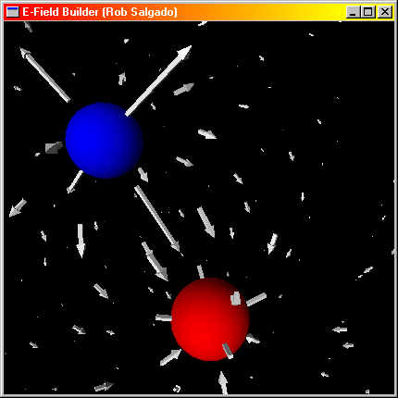
What is visual python?
-Visual Python is a 3D graphics module that acts in unison with the normal python programming language.
-Visual python has features that can create a variety of graphs and shapes which can be manipulated and moved.
-Visual Python is helpful in creating real life animations, both for playful and educational uses.
-It is especially helpful in creating examples of simple laws of physics.

Slide 3
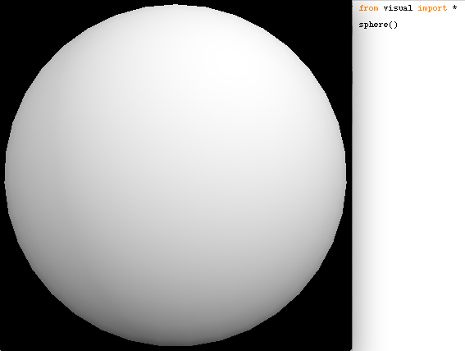
Creating shapes
Creating a shape in visual python is quite simple. The formatting looks like:
From visual import *
Shape()
The shape can either be 2-D or 3-D, depending on the variable called.
The shape must be stored in the visual python library!
The picture on the right is an example of a sphere created using visual python.

Slide 4
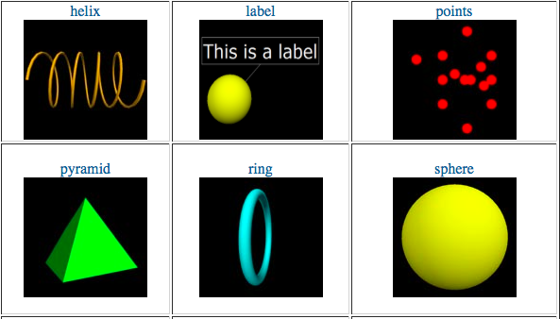
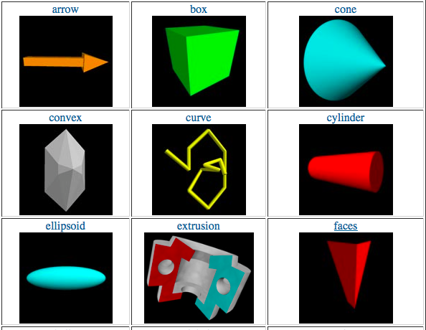
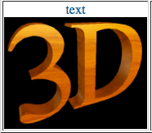
Other 3-D objects in python
The above images were taken from http://vpython.org/contents/docs/primitives.html

Slide 5
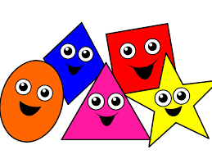
2-d shaped in the vpython library
Rectangle
Circle
Ellipse
Line
Arc
Triangle
Pentagon
Hexagon
Ngon
Star
Trapezoid
Cross
Pointlist
Text
Gear

Slide 6
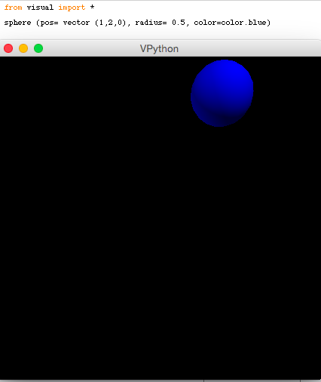
Changing object attributes
The object’s attributes can also be changed. Notice the differences between this sphere and the one on the first slide.
In this example, the position of the center of the circle is moved to (1, 2, 0), the radius of the circle is changed to 0.5 and the color is changed to blue.

Slide 7
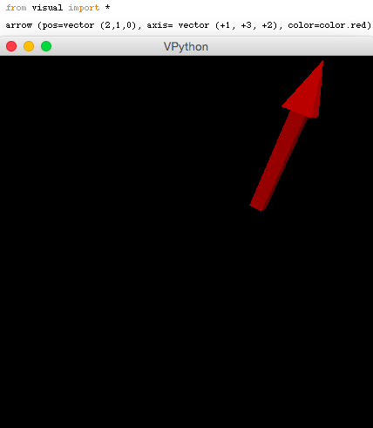
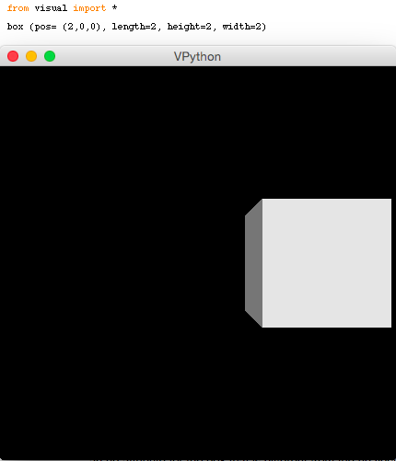
Different objects have different attributes
The position of an arrow specifies its starting point rather than its center. It also has an axis attribute that determines the direction in which it points.
Like the circle, the position refers to the center of the shape. The box also allows one to specify its length, width and height.

Slide 8
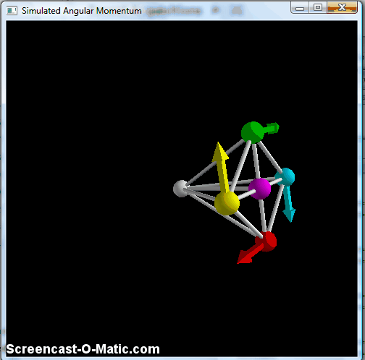

Moving the objects
Without motion, the shapes and 3D objects created don’t serve too much of a purpose.
BUT DON’T WORRY… visual python also allows one to set these objects into motion and create animation!

Slide 9
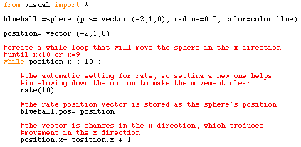
Creating moving objects
One can use a loop to continuously change the motion of an object, which therefore creates movement.

Slide 10
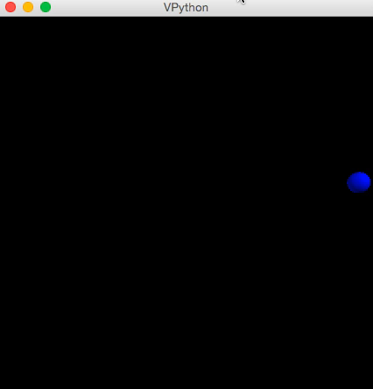
Creating moving objects: running the program

Slide 11
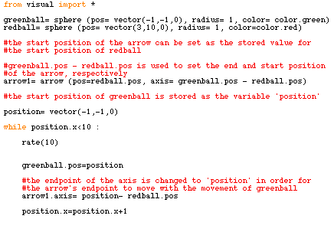
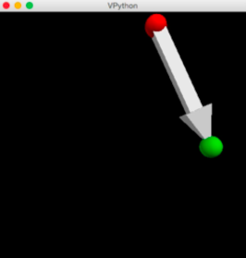
Relative object motion
A function can also be edited as to move two objects in relation to one another. In this example, the arrow is programmed to continue pointing at the green ball as it moves.

Slide 12

Relative object motion: running the program

Slide 13
What isn’t in visual python?
Visual python allows the user to create and manipulate many interesting objects and animations, but it does not provide interactive visual interfaces for the user to enter input or control a function.
This is where Tk Interface comes in!

Slide 14

What is tk interface?
-Tk interface is Python’s Graphic User Interface (GUI) toolkit
-Tk creates GUI applications with user-friendly window interfaces to help the user navigate and control a program.
-The specific methods that I will be teaching are the Entry Box and Button widgets, which work to create an easier way for the user to input data into a function.

Slide 15
Tk widgets
Button
Canvas
Checkbutton
Entry
Frame
Lable
Listbox
Menu
Menubutton
Message
Radiobutton
Scale
Scrollbar
Text
Toplevel

Slide 16
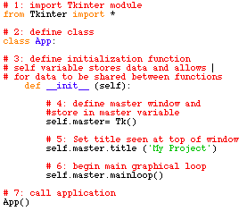
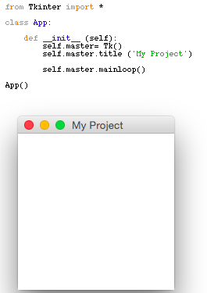
Creating a plain window
Function explained
Outcome of function

Slide 17
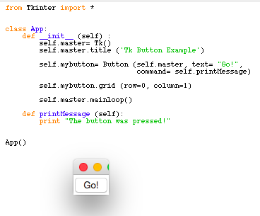
ADDING A BUTTON TO THE WINDOW
Once the initialization function for the window has been defined, it is fairly easy to add to it to create a button widget.
Store button object as a variable. Set parent window, button display text and command.
In order for the button command to work, the command (printMessage) must be defined. When the button is pressed the command will print the message ‘The button was pressed!”.
This function is necessary to make the button appear. The row and column define where it will be displayed within the window.

Slide 18
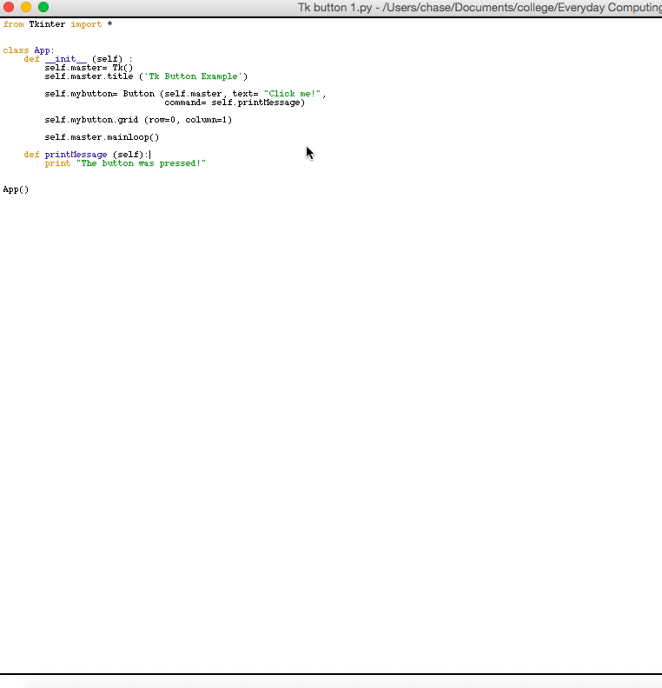
Pressing the button
When the button is pressed, the command printMessage is run, which has been defined to print “The button was pressed!”

Slide 19
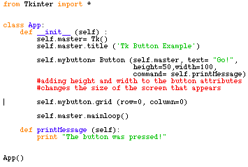
Enlarging button window
The size of the window that the button is displayed on can be changed by adding height and width to the button attributes.
50 and 100 were chosen arbitrarily- these can be set to any number to change the size.

Slide 20
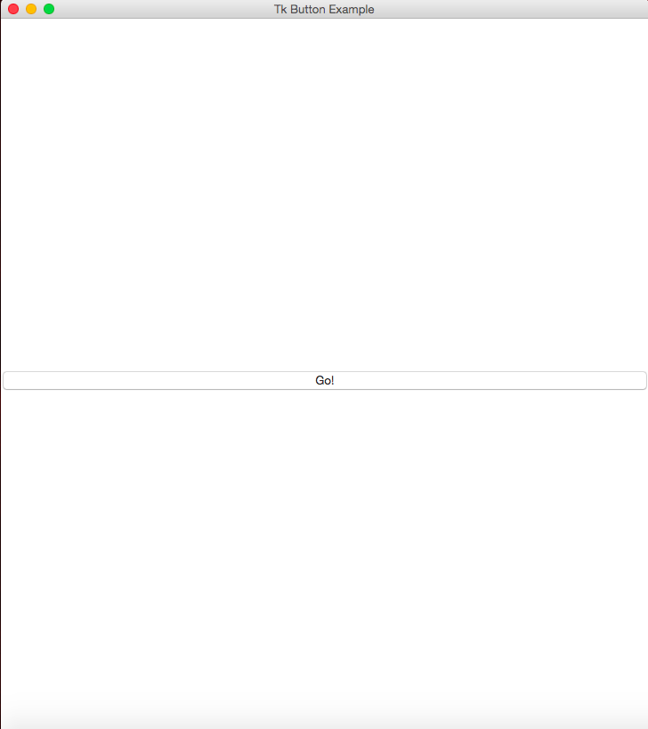

Enlarged window
Notice the difference in size between the original button window and edited button window!

Slide 21
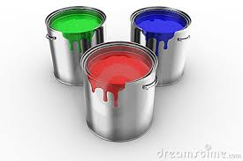
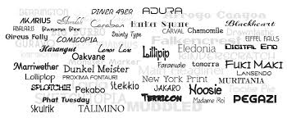
Object attributes
In addition to size, there are many other object attributes that can be edited in Tkinter.
Each object has attributes that are specific to that object. For example, one would not be able to change the font on a scrollbar, which does not have any text.
Attributes in Tkinter include background color, font, border width, text color and more!
Each object has default attributes that will be displayed if a change is not specified.

Slide 22
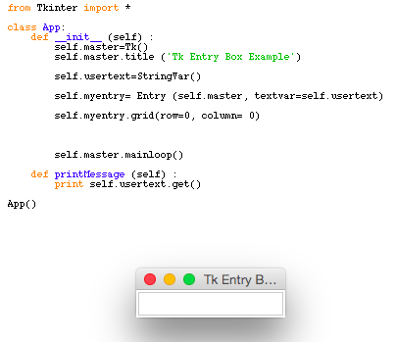
Adding an entry box to the window
Another useful widget is the entry method. This allows the user to enter text into a text box.
This sets a variable to hold the text that the user inputs. StringVar() stores a string of what the user types.
Store the entry object as a variable.
self.master: defines parent window
Textvar=self.usertext : defines where to store user text
This function makes the entry box appear and specifies where on the window it is located.

Slide 23
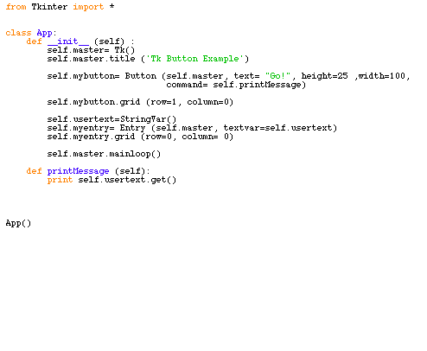
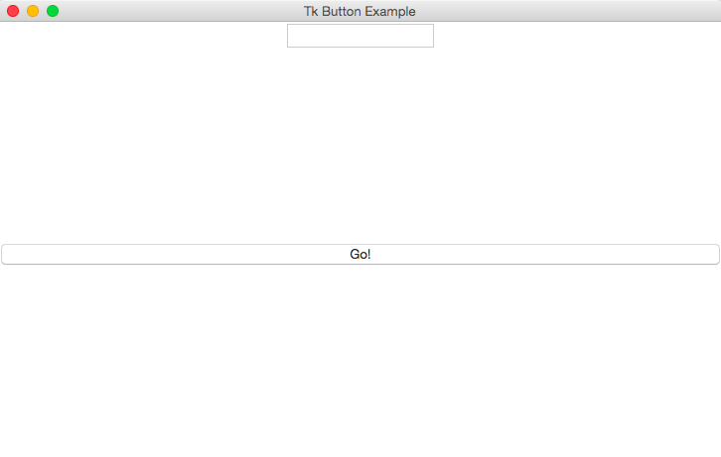
using the two together
Without a button, the entry has no way of being input into the program.
Combining the two widgets allows one to enter text and then push the button to signal the program that the entry is complete and should be printed.
Notice that the variables entered from the text box and button have simply been entered together, but the definition of the printMessage function has changed to call the user text.

Slide 24
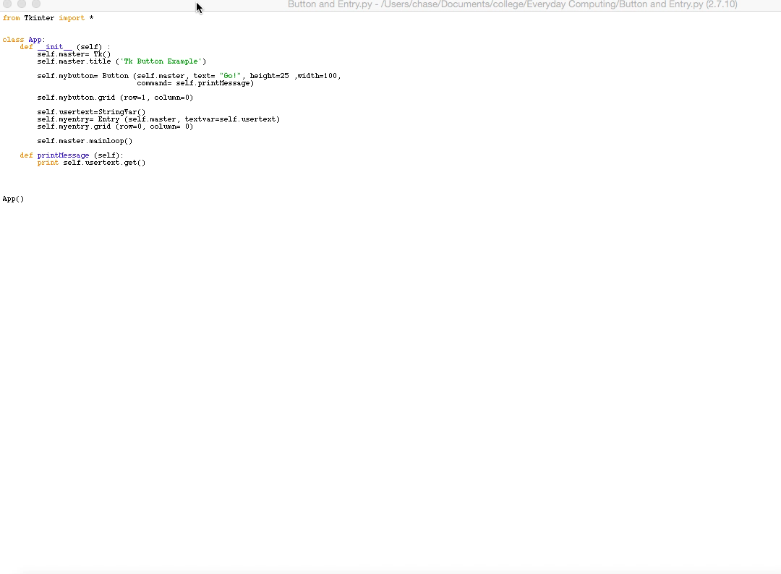
outcome
After pressing the go button, the user text is printed as was called to do in the program.

Slide 25
conclusion
Adding visual elements creates another whole set of functions and that can be created and tasks that can be performed. Visual Python allows one to use python to create animations that emulate real life situations and movement. The visual elements created in Tk interface are slightly different in that they are more for the improvement of the user experience. The various widgets allow for an interactive visual interface in which one can input text and data. Both supplement the python programming language and help to strengthen and broaden its capabilities.

