Slide 1

Bitcoins & Cryptocurrency
By: Alec Vtorov
COMP 89H

Slide 2

What is Cryptocurrency?
A medium of exchange that uses cryptography to secure transactions and control the creation of new units.
Well, what is cryptography?
Cryptography is the practice of transforming data or information into an unreadable format in order to increase security so that only those with a proper secret key can read the unencrypted information.

Slide 3

Why Cryptocurrency?
Decentralized vs. Centralized
The Federal Reserve is a centralized banking and economic system.
  The government controls the supply of currency by printing more units of fiat money or requiring deposits to digital banking ledgers.
  This can lead to hyperinflation.
Decentralized currency is produced collectively by the entire cryptocurrency system.
  The rate of currency production is defined when the cryptocurrency is created and is publicly known.
  Cryptocurrency is designed so that the rate of production will gradually slow down so that there is a cap on the total amount of cryptocurrency in circulation.

Slide 4
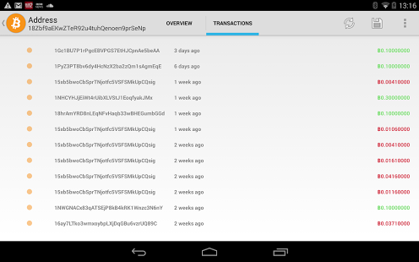
Advantages of Decentralization
Transparency
  All finalized transactions are listed to a public ledger known as the block chain.
  However personal information is excluded from the block chain.
  Anyone at anytime can verify transactions by examining the public block chain.
  No changes to cryptocurrency protocol can be made since it is cryptographically secure

Slide 5

Advantages of Decentralization
Privacy & Security
  Anonymous payments can be made and finalized without giving up an personal information.
  Very personal little information is attached to the transaction, itself.
  Extra fees cannot be added on to a transaction without the consent of the consumer.
  Due to the lack of a central controlling body, funds cannot be seized or garnished from a user.
  No third parties have access to personal financial data.

Slide 6

Advantages of Centralization
A central body backs the value of the currency to ensure it will continue to exist and be traded.
  Results in a much less volatile currency.
Government regulations exist to maintain the security of the currency.
  Regulations against forgeries
  Banking regulations guarantee deposits
  The Federal Deposit Insurance Corporation (FDIC) insures deposits up to $250,000 per account.
Double Spending of currency never occurs.

Slide 7
History of Cryptocurrency
The creation of cryptocurrency began in 1992 by Timothy May, a retired Intel physicist.
  He became worried about the lack of privacy in the financial world and searched for a way to obscure personal information from transaction.
It took until 1998, when Wei Dai created the technology necessary for cryptocurrency and released “b-money”.
  B-money was an anonymous, distributed electronic cash system.
  It was created so that users couldn’t be “taxed or regulated through the threat of force”.
Notes:
B-money was only a small step in the right direction. It was just a personal project.

Slide 8
History of Cryptocurrency
Later in 1998, Nick Szabo created his own cryptocurrency known as “Bit Gold”.
  It was very similar to and considered the precursor to Bitcoin.
  His primary focus was to be able to program a virtual currency that would be able to acquire value.
  Szabo’s implementation didn’t value privacy and lacked many of the security aspects that Bitcoin has adopted.
  A proof of work function was created to cryptographically verify transactions and to create new currency.
    A proof of work function uses a participants’ computer power to solve cryptographic equations assigned by the system.
    The solved equations would then be sent to the block chain and if verified the work would be credited in the form of more currency.
    The solution must be verified by a majority of the block chain before the system can move on to the next equation.

Slide 9
History of Cryptocurrency
Bit Gold proved that it was possible to transform solutions to complicated cryptographical problems into currency of value.
It also raised a series of questions about the feasibility of cryptocurrency:
  How do you assign proper value to different strings of data if they are not equally difficult to make?
  How do you encourage people to recognize this value and adopt the currency?
  What system controls the transfer of currency between people?
These issues prevented b-money and Bit Gold from garnering widespread support and led to them eventually dying out.

Slide 10

History of Cryptocurrency
It took until 2008 for there to be another attempt at creating virtual money and cryptocurrencies.
A man from Japan who wrote under the name of “Satoshi Nakamoto” announced his proposal for a new cryptocurrency known as Bitcoin.
Nakamoto’s proposal stressed the importance of a chain of data that tracked all the transactions in this virtual economy.
This virtual ledger became known as the blockchain.
His proposal was implemented in 2009 and the open source was
  released.

Slide 11
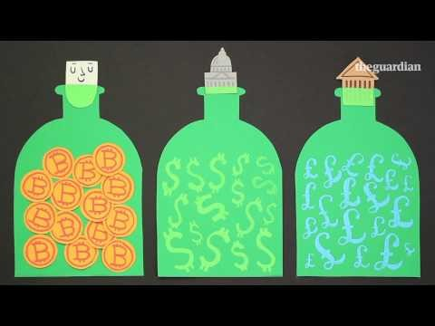
Bitcoin Overview

Slide 12
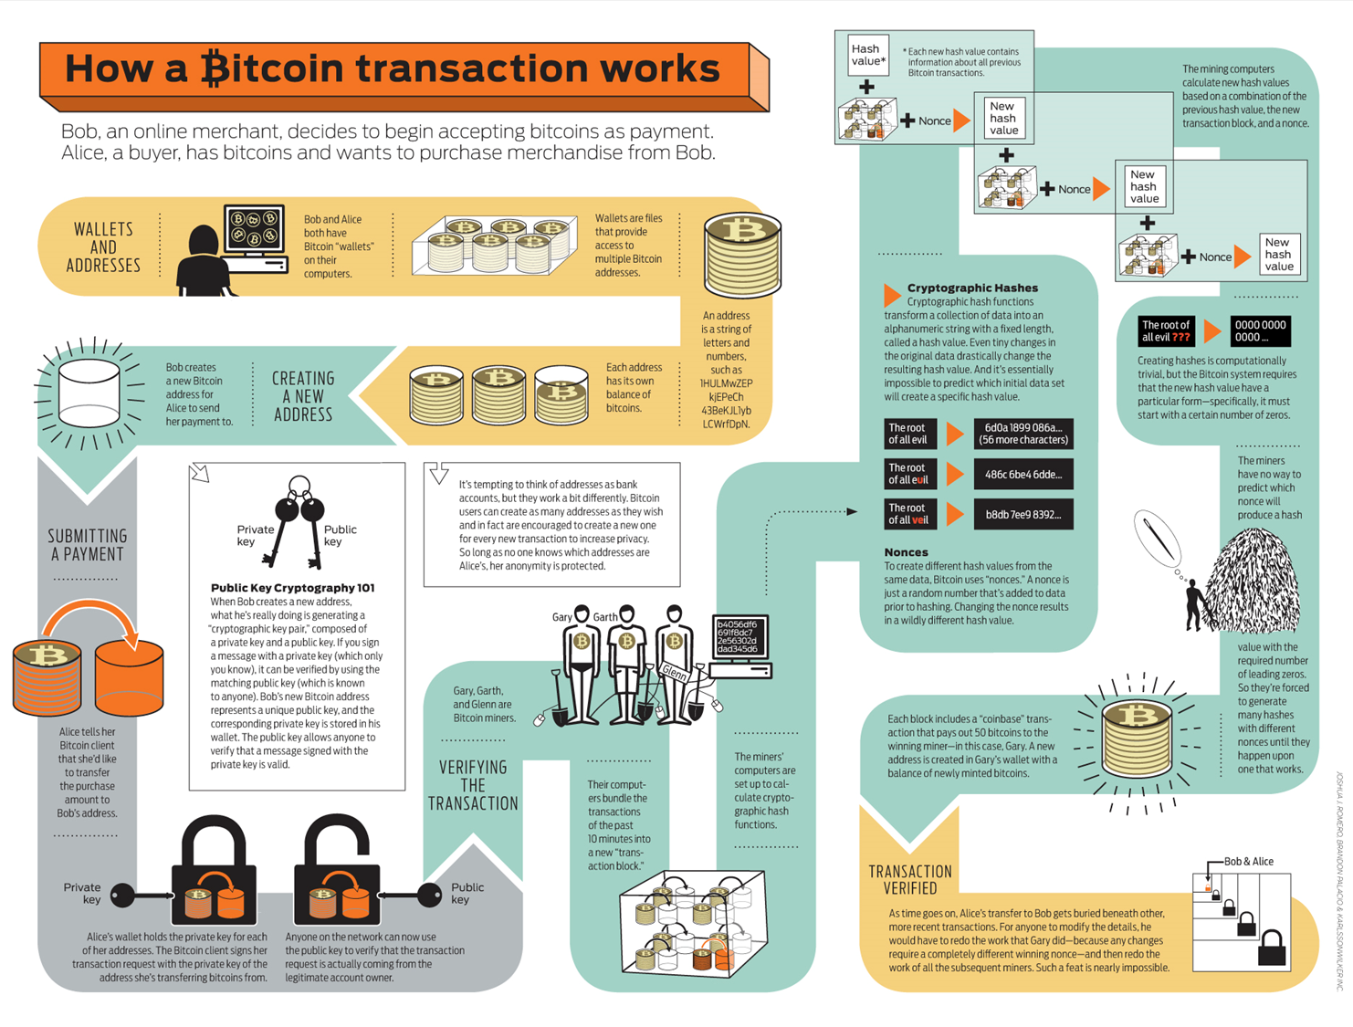

Slide 13
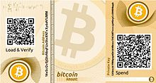
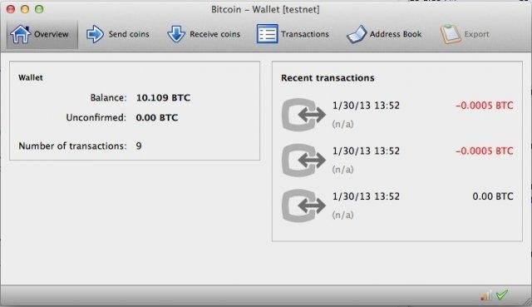
Starting a Bitcoin Transaction
All Bitcoin transactions start from a user’s “wallet”.
A wallet is a software or web application that manages a user’s Bitcoin balance and allows them to send and receive bitcoin from other users.
  First wallet program released in 2009 by Nakamoto was open source and called bitcoind.
Every time a user attempts to view their balance or complete a transaction, the client must send out a transaction request to download an updated version of the block chain.

Slide 14


Starting a Bitcoin Transaction
A Bitcoin wallet doesn’t directly hold or store a user’s bitcoins but in reality stores the digital credentials that allow you to access and spend your bitcoin holdings from the block chain.
Wallets are comprised of addresses that each hold a balance of Bitcoins.
Addresses are strings of letters and numbers that are shared between users to complete transactions.
  3J98t1WpEZ73CNmQviecrnyiWrnqRhWNLy
Addresses can also be in the form of QR codes for more convenient
and faster transactions.

Slide 15
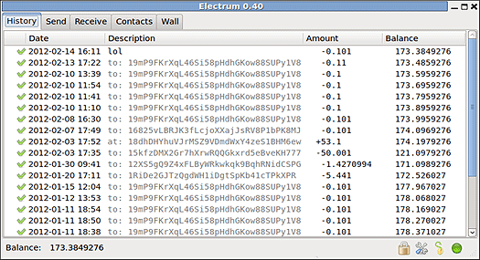
Starting a Bitcoin Transaction

Slide 16
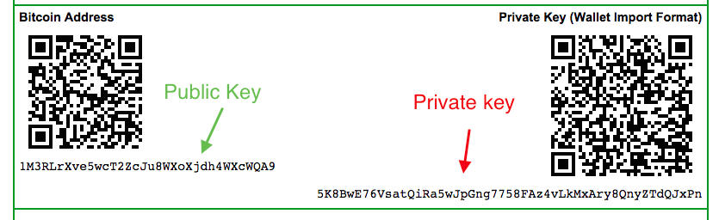
Starting a Bitcoin Transaction
Bitcoin uses public-key cryptography to build and maintain the security of wallets and transactions.
  Public-key cryptography uses the combination of a private and public key to encrypt data
Each Bitcoin address has its own pair of private and public keys.
For a user to send Bitcoins from their wallet, the user’s wallet must digitally sign the transaction using the corresponding private key. The network then verifies the transaction by examining the private key with the public key before approving the transaction.
This results in bitcoin transactions being irreversible.

Slide 17
Public-Key Cryptography
So say Mark creates a new address in his bitcoin wallet:
  A private signing key and a public verification key is automatically created.
When Mark decides to pay Jane for coffee with bitcoin in his wallet four things happen:
  A message with the transaction details is created.
  Jane’s public key is attached to the transaction.
  The transaction is signed by Marks private key using SHA-256 which is the hash function.
  The transaction is then sent to the network which publicly transfers the ownership of the coins.
Mark’s private key signature verifies that the transaction is authentic since any user can verify the legitimacy of the transaction.
Notes:
It’s almost impossible to create a signing key from just a public key.
This is the anologue of signing something with a handwritten signature.

Slide 18
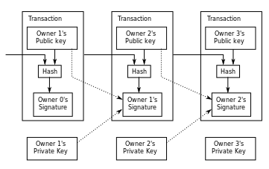
Simplified Chain of Ownership

Slide 19
Verifying a Bitcoin Transaction
All bitcoin transactions are independently verified by other computers in the network known as “miners”.
Miners are computers that run dedicated software to keep the block chain consistent, complete, and unalterable by repeatedly verifying and collecting newly broadcast transactions into a new group of transactions called a block.
A block is a bundle of all the transactions that occurred in the last 10 minutes.
Mining creates trust by ensuring that transactions are only confirmed if enough computational power was devoted to the block that contains them. More blocks mean more computation, which means more trust.
Before each block becomes accepted to be apart of the block chain, it must successfully complete a specific proof of work.

Slide 20
Bitcoin Proof of Work: Hashcash
Bitcoin’s proof of work uses a method called Hashcash that requires miners to cover all the data of the block before the block can be accepted.
Hashcash uses cryptographic hash equations to transform the blocks before they can be added to the block chain.
  A computational efficient mathematical transition that aims to hide the information of the input.
  SHA-256 hash function is used so that regardless of the length of the input, the output will always be 256 bits.
The beauty of hashcash is that it requires no user interaction and has no secret keys that have to be managed by a central server or relying party.
  Decentralization

Slide 21
SHA-256
A cryptographic hash function designed by the NSA in 2001.
SHA stands for Secure Hash Algorithim.
A SHA-256 hash function takes an arbitrary-length data input and produces a fixed-length deterministic result, a digital fingerprint of the input.
The goal of hash functions is to make it impossible to find any two inputs that result in the same output.
  Collision Resistance

Slide 22
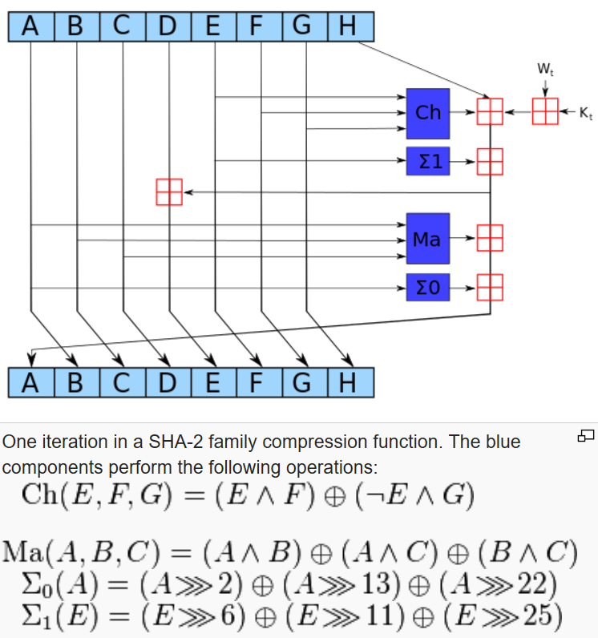
SHA-256

Slide 23
Bitcoin Proof of Work: Hashcash
Bitcoin uses “nonces” to create hash values from the same data.
  Nonces are simply random numbers that are added to data before hashing.
Every new hash value is created from a combination of the previous hash value, the new transaction block, and a nonce.
In order to be added to the block chain, an output hash must start with a certain number of zeroes.
Since miners can’t predict which nonce will create an output hash with the required amount of leading zeroes, they must constantly generate hashes until the correct hash is produced.
This makes it easy for any node in the network to verify the proof of work, but extremely time-consuming to generate one.
Blocks then can be verified and identified by only their hash.

Slide 24
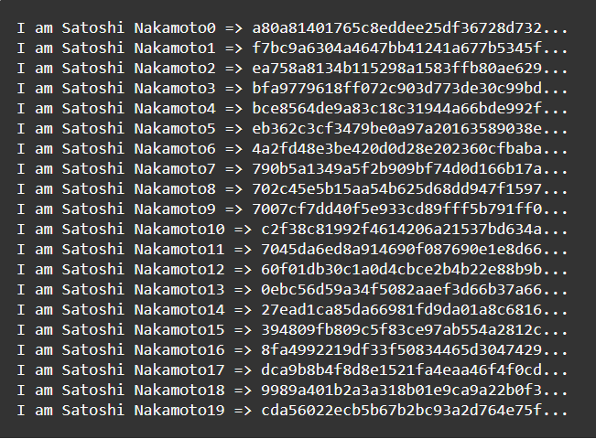
Bitcoin Proof of Work: Hashcash

Slide 25
Bitcoin Proof of Work: Hashcash
The Hashcash difficulty factor is determined by number of leading zeroes the hash output must have.
The difficulty is designed to adjust so that block production stays at approximately 1 block per 10 minutes.
The difficulty automatically adjusts internally through the entire Bitcoin network.
The harder the difficulty factor, the harder it is for someone to overwrite the block chain and double spend coins.

Slide 26
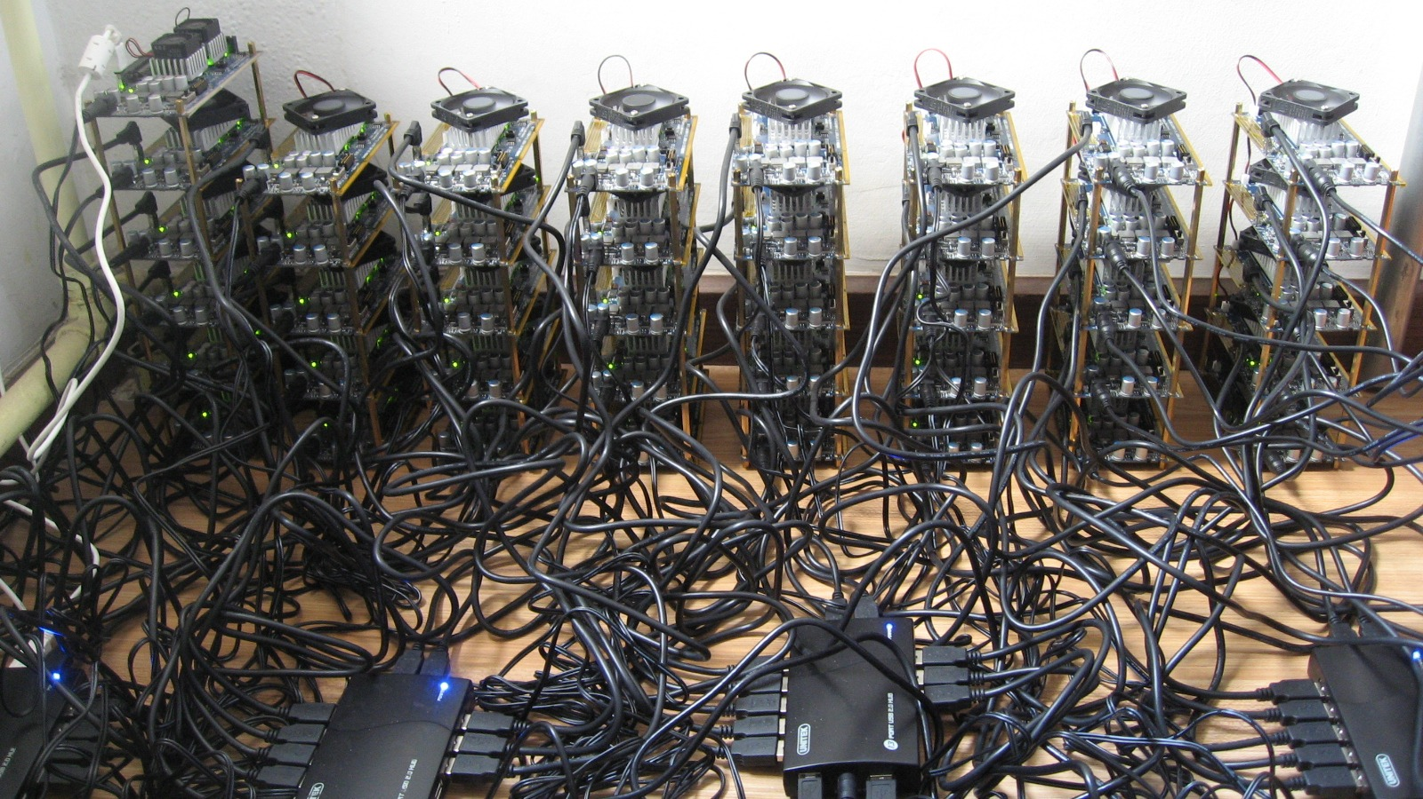
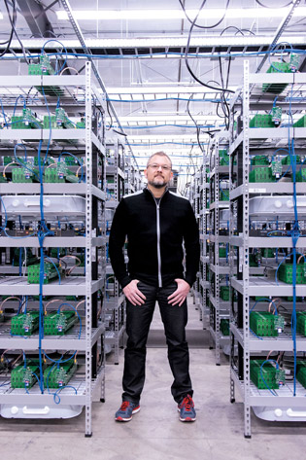
Bitcoin Proof of Work: Hashcash

Slide 27
Verifying a Bitcoin Transaction
Each block contains a “coinbase transaction” that awards bitcoin to the miner that is able to generate the correct hash for the block.
Miners also receive all the transaction fees from the block that they solve.
The innovation of bitcoin is how the processing and verification of transaction requests works as the mechanism for systematically creating new Bitcoin.
As more and more transactions occur and those are added to the block chain, previous transactions and blocks become buried in the block chain making it nearly impossible to modify or remove any of these transactions.
  Prevents Double spending
Each transaction receives a “confirmation” for ever new block it is added to. A transaction is considered confirmed after 6 confirmations.

Slide 28

Future of Mining Bitcoin

Slide 29

Security Concerns
Bitcoin relies on the fact that no single entity can control most of the processing power on the Bitcoin network for any significant length of time.
  They would be able to extend branches of blocks faster than the rest of the network which would allow to choose which transactions to appear in the block chain.
Though Bitcoin itself is very secure, many of the early exchanges that allowed users to buy and sell bitcoins have been targets of attacks.
In Febuary 2014, Mt. Gox, one of the largest exchanges at time, was hacked and over 744,000 Bitcoins were stolen and the company was forced to file for bankruptcy.
In January 2015, Bitstamp was forced to suspend its service after having 19,000 Bitcoins valued at about $5 million stolen because of a hack.

Slide 30
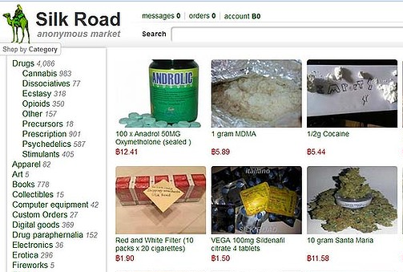
Social Challenges
Due to the anonymous nature of cryptocurrency, Bitcoin is often used for unethical and illegal activities online.
The online dark net market Silk Road was taken down by the FBI for selling drugs and weapons for bitcoins in 2013.
Dark net markets continue to expand as dealers and suppliers are able to remain anonymous despite increased government surveillance.
  Silk Road 3

Slide 31

Uses of Bitcoin
By 2015, the number of merchants that accept Bitcoin has reached well over 100,000.
Major retailers include: Dell, Dish Network, Microsoft, Overstock.com, and Tiger Direct
Recently major payment processor PayPal has begun accepting Bitcoins.
Nonprofits such as Greenpeace, The Mozilla Foundation, and The Wikimedia Foundation have begun to accept donations in the form of Bitcoins.

Slide 32
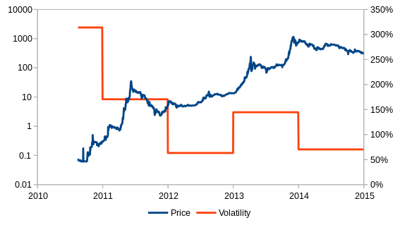
Price and Volatility

Slide 33
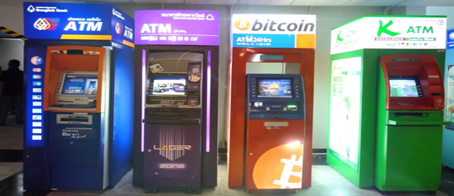
Uses of Bitcoin
Over 285 Bitcoin ATMs exist all around the world since 2013.
These ATMs allow you to easily convert between cash and bitcoin.
  At the time many of these have large transaction fees.
Chapel Hill, NC actually has the state’s first bitcoin ATM located in Med Deli.

Slide 34
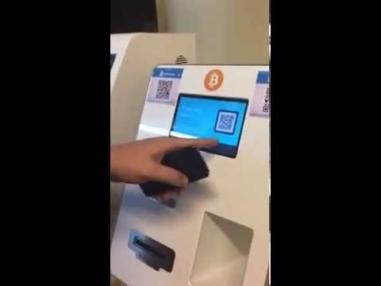
Uses of Bitcoin

Slide 35

Other Modern Cryptocurrencies
There have been numerous spinoffs of Bitcoin that incorporate minor changes known as Altcoins.
  Use different algorithms for the proof of work scheme.
  Blackcoin, Dogecoin, Litecoin, Peercoin, and over 200 others
These alternatives aim to increase the cryptographic security of
Bitcoin by adopting new mining algorithms.
  Litecoin uses a scrypt proof of work that encourages CPU mining
  that is available to the average user.
It appears that Bitcoin will continue to be the dominant
cryptocurrency in the future due to its widespread adoption and
a market cap of over $5 billion.

Slide 36
Questions?

