Slide 1
Cryptography and Its Algorithms
Scott Chappell

Slide 2

What is Cryptography?
Definition: the art of writing or solving codes

Slide 3
Basic Encryption Methods
Caesar Shift
Simple Substitution Cipher
Fun to use, but are easily cracked by computers and even by humans

Slide 4
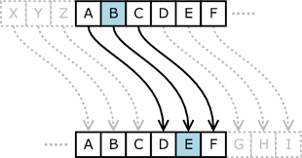
Caesar Shift
Replaces each letter of a message with a different one a fixed number of places down the alphabet
Can be shifted either to the right or to the left
The most basic encryption method
This method would shift 3 to the right
To decode, shift 3 to the left

Slide 5
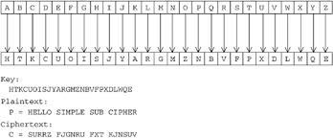
Simple Substitution Cipher
Each letter of the alphabet is replaced with a random letter
To decode, simply reverse the process
Like Caesar, these methods are easy to crack even without a computer because certain letters are used more often than others

Slide 6
Key Cryptography
Cryptographic Algorithms
Encrypt/Decrypt
Transferring the Key

Slide 7
What Can You Encrypt?
Basically anything that you want to keep secure
Emails, texts, messages, files, documents, letters
There are easy ways online to encrypt any sensitive files that you may have
For average users, an encryption of every file on your computer is not recommended

Slide 8
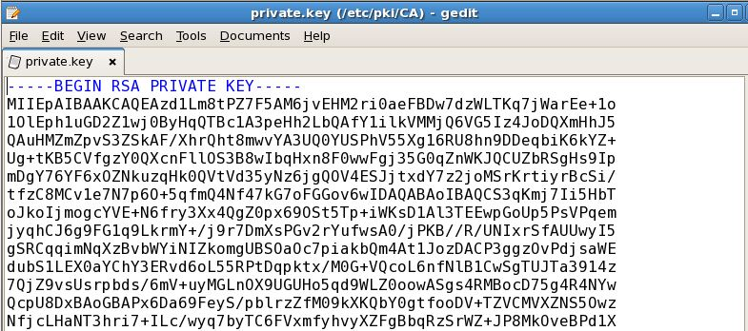
The Key: What is it?
A long series of letters or numbers with no ordering or grouping
Used to encrypt/decrypt messages
The longer the key is, the harder it is to
crack the encrypted message without
knowing the key.
However, also takes more computing power with longer keys

Slide 9
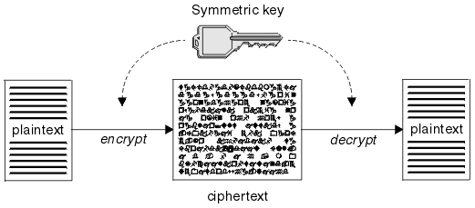
Private-Key Cryptography

Slide 10
How Does Private-Key Encryption Work?
Computers each have their own private key which is unique to their computer
The first computer encrypts the message or document with its own key
Therefore, as the message is being sent through cyberspace, it is unreadable to any third parties
The second computer must know the first computer’s private key to decode the message
Risks: Key can be compromised, transfer of key is hard
Two Major types of algorithms: Block Cipher or Stream Cipher

Slide 11
Block Ciphers
For these algorithms, encrypting of the plaintext is done by a single key for a block of fixed length. Generally these blocks can be 64 or 128 bits in size
Usually more secure than stream ciphers
However, the encrypting/decrypting algorithm takes longer
Examples: DES, Blowfish, RC5

Slide 12
DES: Data Encryption Standard Algorithm
One of the first encryption algorithms
A block cipher: meaning it operates with plaintext blocks of a certain size and returns a block of the same size. DES operates on 64-bit blocks
Each 64-bit block is made up of 16 hexadecimal characters, as each hexadecimal equates to a binary of 4 characters long and each character of binary equates to a bit of data
E.g. a → 61 → 0110 0001

Slide 13
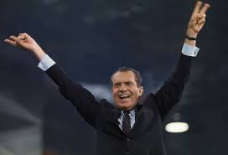
DES Algorithm History
Data Encryption Standard algorithm is today, the most widely used encryption algorithm in the world.
Developed under Richard Nixon’s campaign in the 1970s by National Bureau of Standards because government, industry, and the private sector were storing more and more sensitive data on the web

Slide 14
DES Algorithm History Continued
Data Encryption Standard (DES) 1970s uses a 56-bit key
56-bit key results in over 70 quadrillion possible key combinations
Today, that number is too small to be considered entirely secure
Advanced Encryption Standard (AES)
Implements 128, 192, or 256-bit keys
Considered secure: 256-bit key has 2^256 combinations. Has superseded DES as the cryptographic algorithm used by US government in 2002

Slide 15
Stream Ciphers
As opposed to block ciphers, stream ciphers encrypt the plaintext bit by bit
The bits of the plaintext are encrypted by different parts of the keystream
Process much faster than block ciphers
However, generally not as secure
Examples: FISH, RC4, SEAL

Slide 16
RC4 Algorithm
A stream cipher
Unique from other ciphers because it allows the user to pick the key size from 1-2048 bits (although generally it is 40)
Created by Ronald Rivest of RSA security
Used in Microsoft Excel, Adobe’s Acrobat 2.0, and BitTorrent clients

Slide 17
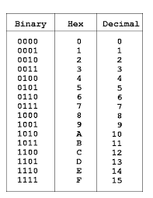
Cracking the Key
Example: hexadecimal key of 5B9E
Converts to 0101 1011 1001 1110
This is a 16-bit key because 16 binary numbers
To crack key through “Brute Force Method,” hackers would have to check 2^16 types of keys
Shows how adding even a few more bits to a key makes it exponentially harder to crack

Slide 18
Hacker Capabilities
Today, some of the top computers on the market today such as the dual Pentium 4D with two processors each running at 3.2 Ghz have the capability to guess 4,000,000 keys per second
What if a hacker was using this computer to hack the DES algorithm through brute-force?
56-bit key has 2^56 possible keys so 2^56 / 4,000,000 = 1.80 * 10^11 seconds to check every key
Assuming you only need to check half of the keys to find the right one, it would take over 34,000 years with this computer to find the right key
Computers can be used in parallel
DES key broken in 22 hours and 15 minutes in 1999 by Electronic Frontier Foundation’s machine “Deep Crack.”

Slide 19
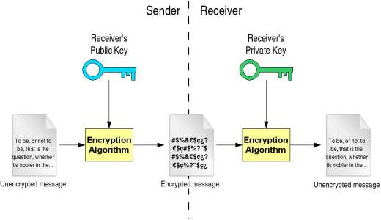
Public-Key Cryptography

Slide 20
Public-Key Cryptography
Someone or some company sends out a public key for anyone to see
Anyone can encrypt a message and send it back to the original user
However, this message can now only be decrypted by the sender of the public key with their own, personal private key
Even the person that encrypted the message with the public key can no longer decrypt the message
Much much slower than private-key cryptography (about 1,000 times lower). Cannot be used for large amounts of data
Examples: RSA, ElGamal, DSA

Slide 21
RSA Algorithm Example
To begin: Zach sends out his public key for all to see
For RSA, public key is the product of two large prime numbers p and q
While in reality these numbers would be huge, we will use 43 and 37
Therefore our public key is 43*37 = 1591
Zach picks a number k that is relatively prime to (p-1) * (q-1) meaning k does not go evenly into 42*36 = 1512
Zach can pick 23 for k as it does not go into 1512 evenly
Zach sends out k as part of his public key as well

Slide 22
RSA Algorithm Example Continued
Sara wants to send Zach a message: “UNC is best”
First, she must convert this to Decimal from Char with an ASCII table
“UNC is best” converts to 85 78 67 32 105 115 32 98 101 115 116
To encrypt it using the public key, Sara will use the % function of programming known as the mod function
The encrypted cipher would have each letter of the plaintext now equal w^23 mod 1591 where w is each number above
Using wolfram alpha, the encrypted message is now 730 580 361 868 413 62 868 1404 1343 62 390

Slide 23
RSA Algorithm Explained Continued
Zach will now find his private key d using The Euclidean Algorithm
K = 23 and (p-1) * (q-1) = 1512 6 – 1 * 5 = 1
23x + 1512y = 1 6 – 1 * (17 – 2 * 6) = 1
1512 = 65 * 23 + 17 (23 – 1 * 17) – 1 *(17 – 2 * 6) = 1
23 = 1 * 17 + 6 23 – 1512 + 65 * 23 – 1512 + 65 * 23 + (23 – 17)*2 = 1
17 = 2 * 6 + 5 133 * 23 – 2 * 1512 – 2 * 1512 + 130 * 23 = 1
6 = 1 * 5 + 1 263 * 23 – 4 * 1512 = 1
Therefore d = 263 mod 1512

Slide 24
RSA Algorithm Explained Decryption
Finally, Zach has the encrypted message of 730 580 361 868 413 62 868 1404 1343 62 390 and the private key of 263
To decrypt, he does each set of numbers^263 mod 1591
Using Wolfram Alpha we find that the cipher text goes back to 85 78 67 32 105 115 32 98 101 115 116 which Zach can use the ASCII table to convert to “UNC is best”
Can see how these large numbers make computing these functions take a long time

Slide 25
Large Prime Numbers
Essential to Public-Key Cryptography
Advances in Computing
Hackers Gaining Access to Supercomputers

Slide 26
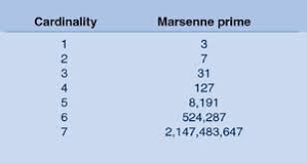
Mersenne Primes
What are they?
Mersenne Primes are prime numbers of the form 2^p – 1
Great Internet Mersenne Prime Search
Largest Known Mersenne Prime is 2^57885161-1

Slide 27
Digital Signatures
Basically a reverse of the RSA algorithm
If Zach uses his private key to encrypt a message, people who decrypt it with Zach’s public key know that the encryption was done by Zach or someone with Zach’s private key
This places authenticity on the message from Zach, proving that he or someone he has given his private key to sent the message

Slide 28
Practical Use of Public-Key Cryptography
Public-Key Cryptography is much slower than Private-Key Cryptography
One of the major problems with Private-Key Cryptography is actually getting the private key to both parties without it being tampered with
Public-Key Cryptography with a digital signature can allow one party to create a session key and transfer it securely and with authenticity to the second party
After both parties have received this session key, they can transfer large amounts of data by using Private-Key Cryptography

Slide 29
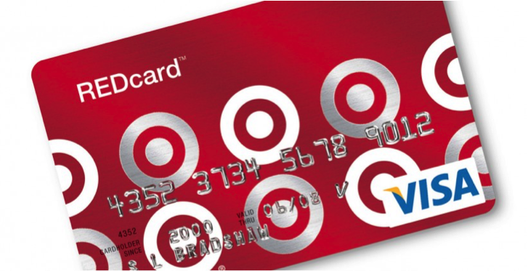



Why is Cryptography Important?
Preventing Hacks
Lost Privacy
Lost Revenue
Lost Trust

Slide 30
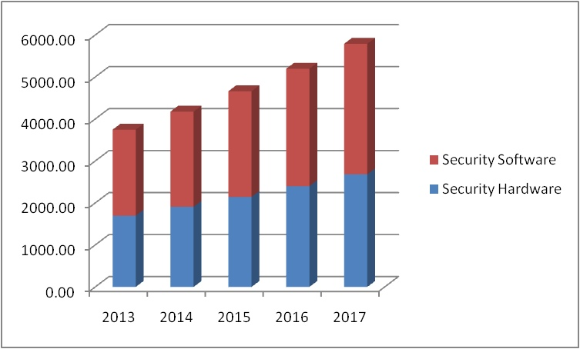
Finances of Cryptography
This is a graph of the Asian Pacific Region’s annual spending on security software and hardware
As we can see, these numbers have been rising continuously and are expected to rise more, showing how important security is to companies

Slide 31

Looking to the Future: Honey Encryption
Honey Encryption: When decrypted with an incorrect key from the attacker, the encryption produces a ciphertext that appears to be a plausible message or phrase but is actually incorrect
Helps fight against “Brute Force” methods of hacking by leading them to believe they have the right key

Slide 32
Looking to the Future: Quantum Key
Quantum Key Distribution: Relies on quantum mechanics: It is used when two parties are making a key to use together.
If the key is eavesdropped on by a third party, the quantum balance will be disturbed and the two parties will know that the key is compromised and communication is not suitable

