Slide 1
Special Effects in Film Production
Jin Lin

Slide 2
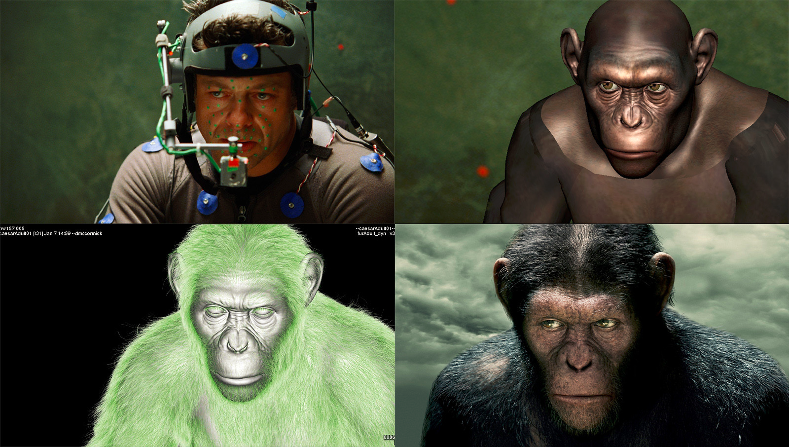
What is special effects (sFX)?
an illusion created for movies and television by props, camerawork, computer graphics, etc
used in the film, television, theatre, video game, and simulator industries
Freedom for filmmakers

Slide 3
Special effects vs. visual effects
Special effects
Applied physically on set during a shoot
prosthetic makeup
scale models
Visual effects
Applied virtually in post-production
Computer generated imagery(CGI)
Matte painting

Slide 4
The Evolution of special Effects
Gertie the Dinosaur – Animation
Created in early 1900s
Pioneered by comic illustrators
Made using the single-frame method

Slide 5
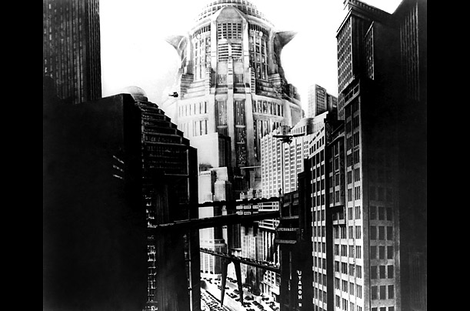
The Evolution of special Effects
Metropolis – Miniatures
Directed by Fritz Lang in 1927
Used detailed miniature models and filmed with schufftan process
the technique has been replaced by travelling matte and bluescreen effects

Slide 6
Schufftan process

Slide 7
miniature

Slide 8
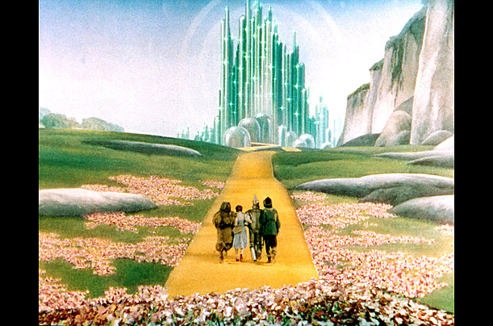
The Evolution of special Effects
The Wizard of Oz – Matte Paintings
Produced by Mervyn LeRoy in 1939
Actual projections or paintings placed behind the foreground objects

Slide 9
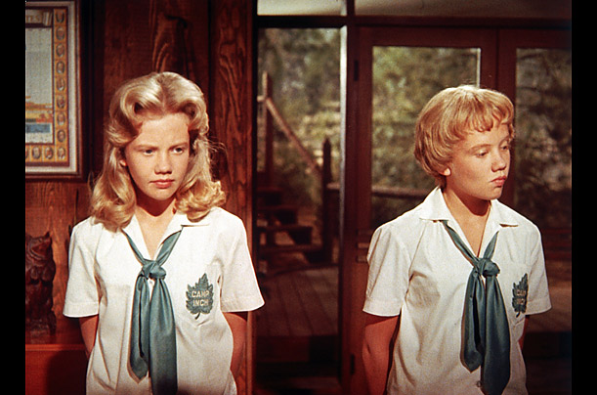
The Evolution of special Effects
The Parent Trap – Doubling
1961 Disney movie
Used split-screen technique
Compositing

Slide 10
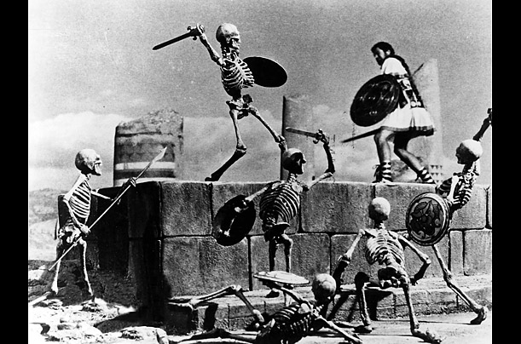
The Evolution of special Effects
Jason and the Argonauts – Stop Motion
Made in 1963
Uses realistic puppets or models
Photographed one frame at a time

Slide 11
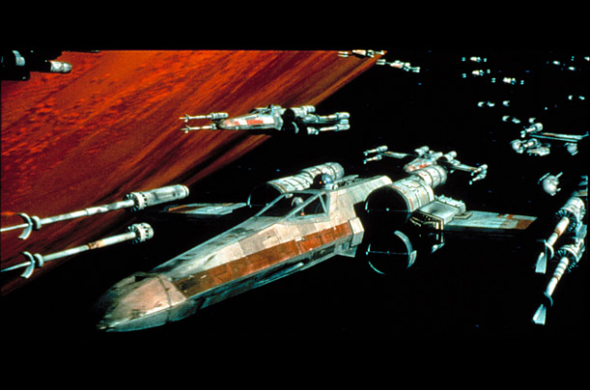
The Evolution of special Effects
Star War – Motion Control
Directed by George Lucas in 1977
Won the Academy Award for Best Achievement in Visual Effects
First film to use a motion-controlled camera

Slide 12
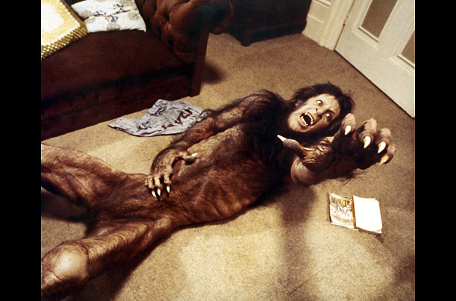
The Evolution of special Effects
An American Werewolf in London – Makeup
Created in 1981
First film to win the Academy Award for Best Makeup
Used prosthetics and robotic limbs

Slide 13
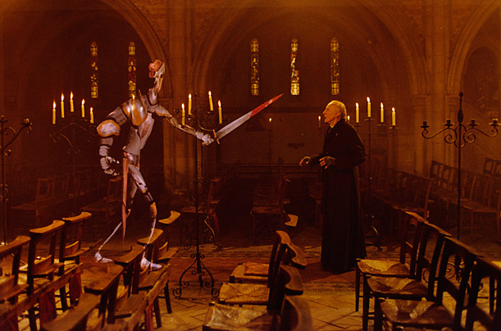
The Evolution of special Effects
Young Sherlock Holmes – Computer Generated Imagery
Produced by Steven Spielberg and Pixar in 1985
First realistic yet fully CGI-animated character
CGI adopted in many sci-fi films

Slide 14
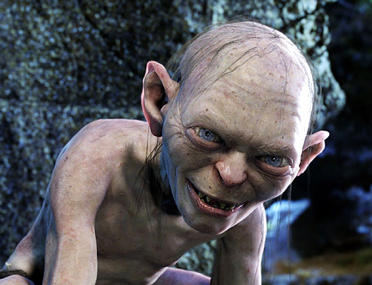
The Evolution of special Effects
The Lord of the Rings – Motion Capture
Digitally created by director Peter Jackson in early 2000s
Using 13 cameras pointed at different sensors attached to the actor’s costume
Generate a 3D image of the actor’s movements.

Slide 15
Motion Capture

Slide 16
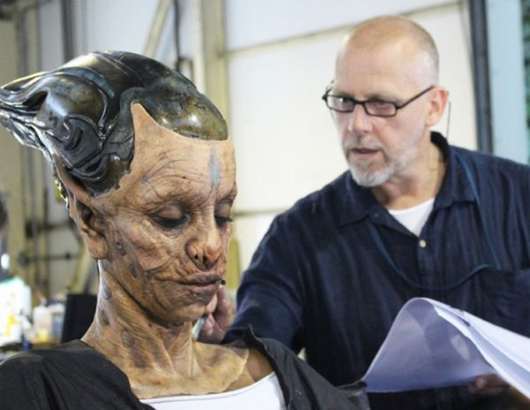
Visual Effects vs. Special Effects

Slide 17
Any Questions?

