Slide 1
Smart-shirts
The new direction of “wearables”

Slide 2
What do WE define as a “wearable”?
Obviously, we can wear it
Has computing ability
Relatively seamless integration between wearing and computing(Ie not just taping a computer to our body)
Notes:
Emphasize and elaborate on the idea of integration

Slide 3
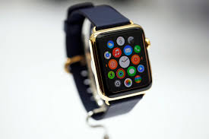
Pros of Smartwatches
Varies from being an actual watch and carrying out lower end functions to being a basic fitness tracker
Developers have reached a sense of aesthetics with these devices
Relatively affordable(quality ones are usually at least $100)

Slide 4
Cons of Smartwatches
Way too much variation(Fitbit, Moto, Samsung, Apple, Jawbone, insertsketchy3rdpartybrandhere.jpeg
Battery Drainer
Is the function worth the cost?

Slide 5

Pros of Smartglasses
Still in production-Multiple functions still being developed
Has greater capacity than the smart watch(Example video and audio capacity, HUD, RAM, OS)
What can be achieved is pretty cool

Slide 6
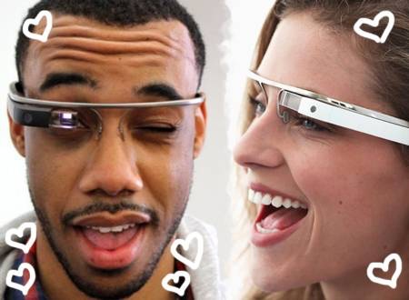
Cons
Still in Development
This leads to an unrealistic price(Developer Kit is 1K)
Looks pretty tacky

Slide 7
The new direction…
More comprehensive features or useful features
Will incorporate aesthetics/or can be blended in
Will move to a consumer friendly price
*drum roll*

Slide 8
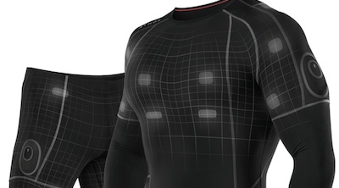
The “Smart” Shirt

Slide 9
History
Materials to create such a thing has been around for centuries.(For example: Queen Elizabeth had gowns made of gold fibers)
Harry Wainwright was the first to create an “animated shirt” where a microprocessor controlled the individual frames creating a cartoon on the surface of the textile

Slide 10
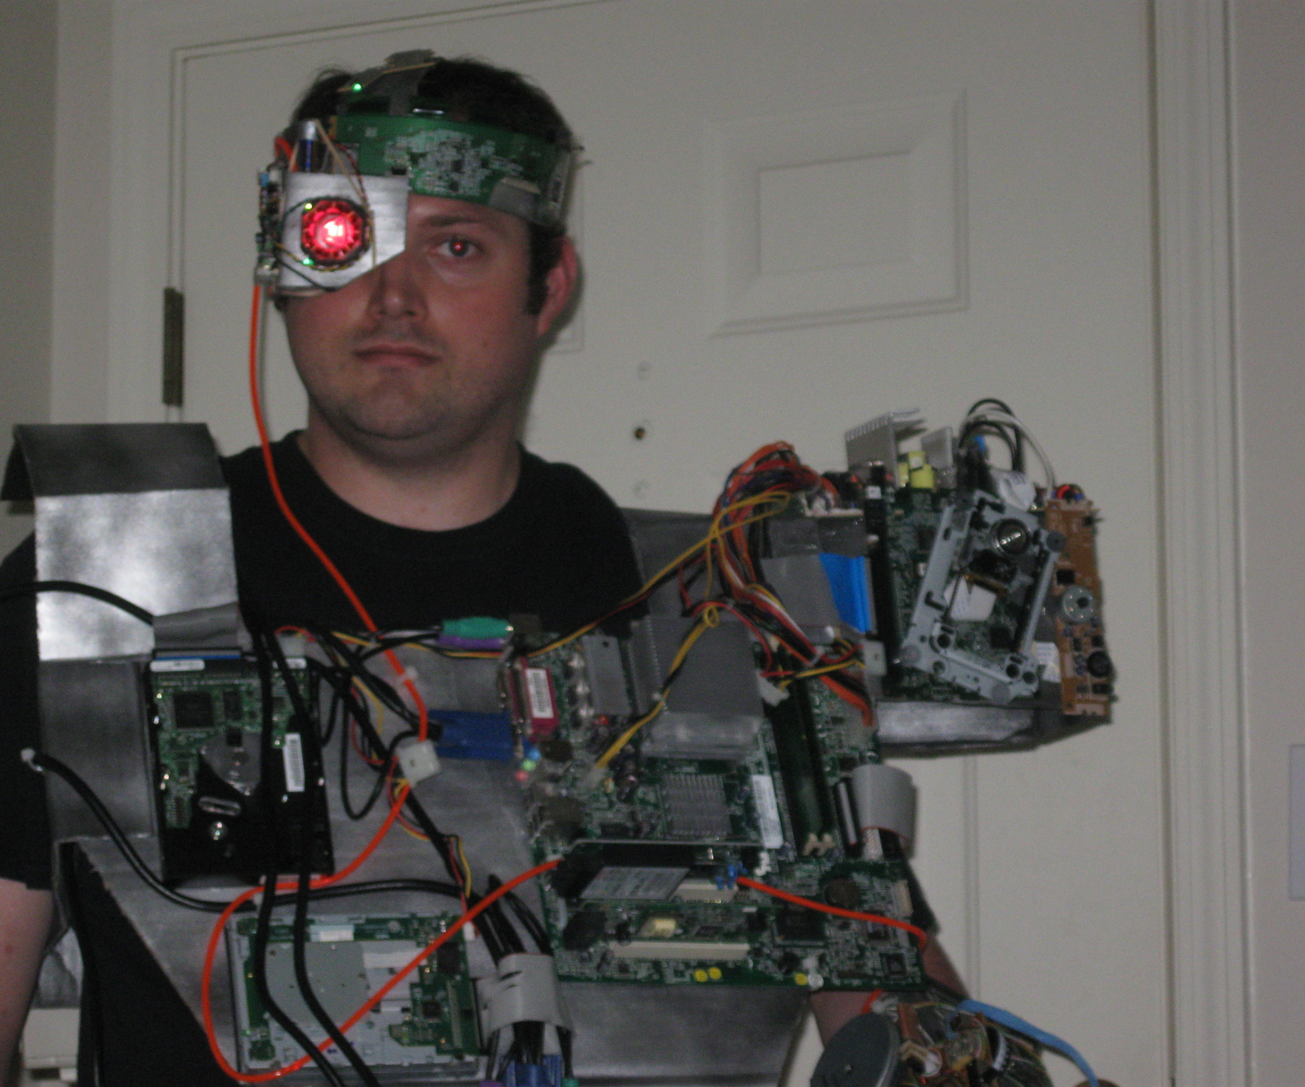
History cont.
MIT took the next step towards the “wearable motherboard” in the mid 90s
However this didn’t amount to more than simply attaching traditional hardware to the body(failed our goal of seamless integration and aesthetics)

Slide 11
The present
Further steps have been achieved to “seamless integration” thanks to Sundaresan Jayaraman and Georgia Tech. His findings have the most application and depth.
Other companies such as OMsignal and Hexoskin have created their own e-textiles focusing more on aesthetics and fitness applications
For the sake of broader understanding, I’ll be using Dr.Jayaraman’s “Wearable Motherboard”

Slide 12
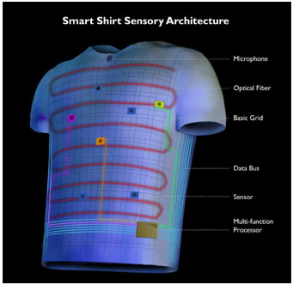
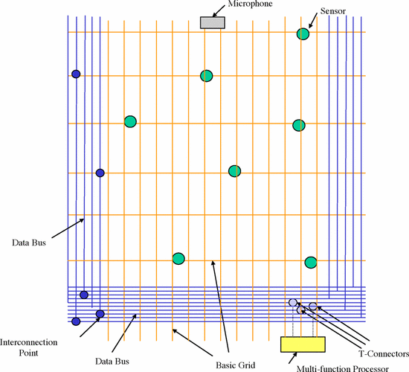
The components

Slide 13
Two major components
Sensors-Acquires the raw data from the user and it’s environment. Provides a context.
Signal Processors-Takes data from sensors and computes them into something appropriate to the context. For example biometric data from the sensors is computed into heart rate or body temperature.
This data is then usually transmitted to somewhere else.
Notes:
Explain/simplify the Sensor and Signal processing

Slide 14
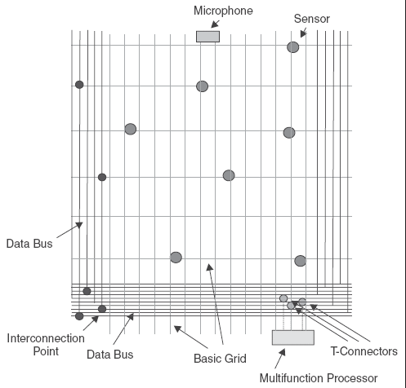
Architecture of the shirt

Slide 15
Sensors
Core piece: Carbon fiber
Tears in this fiber will be recorded, as we’ll see later has variety of applications for people in dangerous environments
Rest is up to the user’s required function, “plug and play model”
Includes slot for microphone
For example, hospitals attach the very same sensors they use on patients to measure heart-rate, respiration, EKG, body temperature, and pulse oximetry.(SpO2)
Allows to retrieve the same accuracy of data from afar

Slide 16
Signal Processing
This is how the data is sent from the shirt to afar
The data is integrated into the data bus and transmitted to the multifunction processor known as the Smart Shirt Controller
The controller then takes this data and transmits it wirelessly via Bluetooth, Wi-Fi, or cell data.
Data can also simultaneously be transmitted to the sensors

Slide 17
Plug and play cont.
The sensors that can be integrated are completely open ended
For example, a sensor that can detect outside O2 levels or hazardous gas could be utilized in a smart shirt for Firefighters
This opens up a whole market for development

Slide 18
Material of the shirt
The base fiber is that of standard textiles(eg Cotton) and depends on the shirt’s application
However a “Weighted Prioritization Matrix” is used often to select the materials to be used.
For example, if we wanted to have a smart shirt that could detect bullet penetration, there’d be a certain prioritization of some materials over others
Can be worn as an undershirt or as a simple garment

Slide 19
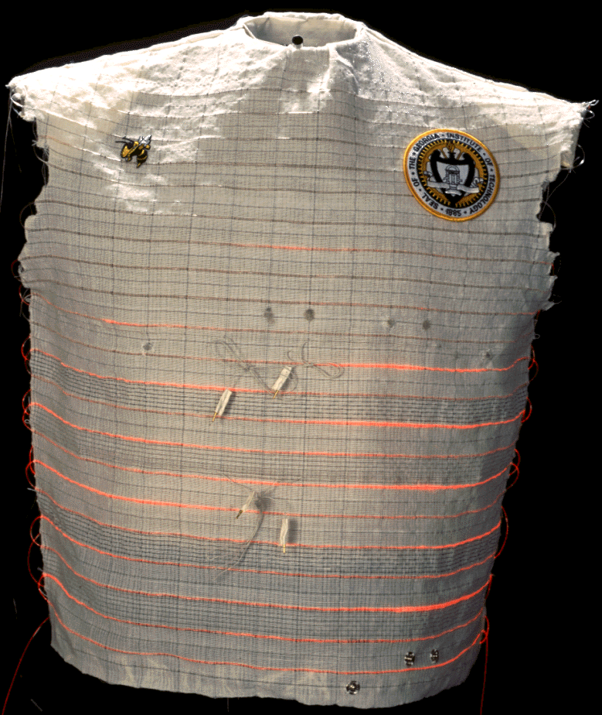

Slide 20
Military Applications
Combat deaths usually occur due to the time it takes for an injured soldier to be extracted, assessed, and then treated.
The Smartshirt speeds up the assessment process with it’s sensor technology.
The precise penetration is detected and the data is sent off to medical personnel
When the soldier finally reaches Medical Care, surgeons can get right to work and the chances of saving his life are increased.

Slide 21
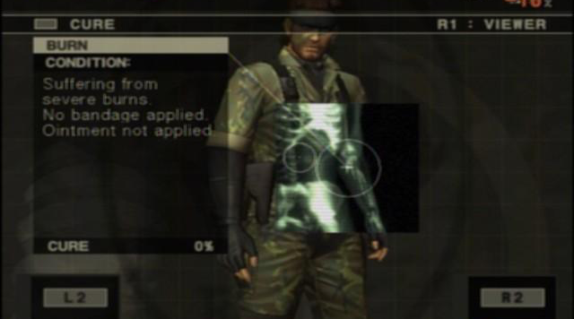
Military Applications Cont.
As mentioned before, because the Smartshirt can have a heart rate monitor as well as vitals signs, we can know the impact of their injuries in addition to the extent
If you’ve played any big name shooters, it’s like we’re moving towards having actual real-time health bars/damage statuses, which can be crucial.

Slide 22
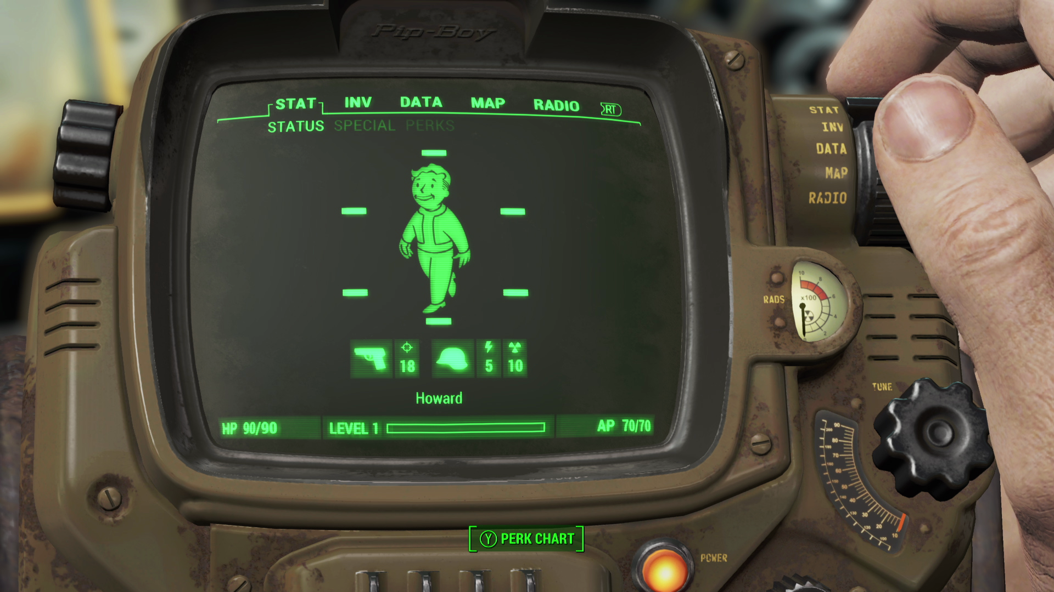

Slide 23
Georgia Tech Demos
https://www.youtube.com/watch?v=4otdLlzFioQ

Slide 24
Second Major Application:Medicine
Given the real-time sensor capability and the focus on saving soldiers, not much surprise there is carryover in Medical practices
Primary application is monitoring of patients after high intensive surgery
Allows the patient more mobility and alleviates nurses taking care of them. If the vitals appear off, the system gets alerted and everyone gets brought in.

Slide 25
Medical Application Cont.
Senior citizens/patients who require constant medical care- Once again, with constant vital sign monitoring, these patients gain far more mobility in their lives than they did locked down in a hospital bed. This also opens up the nurses taking care of them
Example: Diabetic patients, recovering Cancer patients, patients with heart disease

Slide 26
Other applications
Public Safety-Analyzing the vitals of Police Officers/Firefighters in dangerous scenarios or serving as a Body Cam
Athletics-Can be used to gauge performance for high end athletes or for extreme sports such as cliff diving
Space-Monitor vitals of Astronauts
Teaching Hospitals/Research Hospitals
Notes:
Mention for Athletics a possible tie in to your own project

Slide 27
Discussion
If you had access to this kind of technology what could you do with it?
What sensors would you want to try and see?

Slide 28
Growing Market
Consider the smartphone or your personal computer. Was very limited until it was put in the hands of many people
The Smartshirt has the potential to be the same
Notes:
Give on the fly examples

Slide 29
Obstacles for growth
Cost and availability: This project has only been created once for DARPA and now lies in the Smithsonian Institution
If it’s not being mass produced and constantly refined, it cannot succeed as a true wearable
Furthermore, the current design is rudimentary and crude. Although it is an improvement over the MIT project, it is not integrate aesthetics enough to be seamless enough as a wearable
The only sensors available are the ones military/hospitals use in their day to day necessities; more most be developed for civilian or other usage.

Slide 30
Prediction
Eventually companies like Apple or Google will put enough funding into it(like the smart glasses or smart watches) and it will become big enough that everyone can start developing for it or will wish to purchase it.
When that occurs, the vast superiority and capacity of the smartshirt will make it more versatile product than the smartwatch or smartglass

Slide 31
Questions?

Slide 32
Relevent Sources
http://www.sciencedirect.com/science/article/pii/S0925400509003724
http://journals.cambridge.org/action/displayAbstract?fromPage=online&aid=7965189&fileId=S0883769400018881
http://ieeexplore.ieee.org/xpls/icp.jsp?arnumber=5089443

