Slide 1
Computers and Technology in the Sports World
Hardin Lucas

Slide 2
History of Computers in Sports
As early as the 1960’s computers were used for statistical analysis
Broadcasting expanded the use of computers in the 1990’s and early 2000’s
Use has only expanded and will continue to increase for the foreseeable future

Slide 3
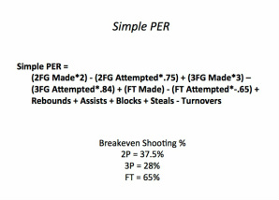
Projection Systems
Earliest use of computers in sports in the 1960’s
Use has only increased, with more and more statistics that have become available
Many different systems available now in almost every sport

Slide 4
Analytics Movement
Sloan Conference at MIT
More and more advanced stats

Slide 5
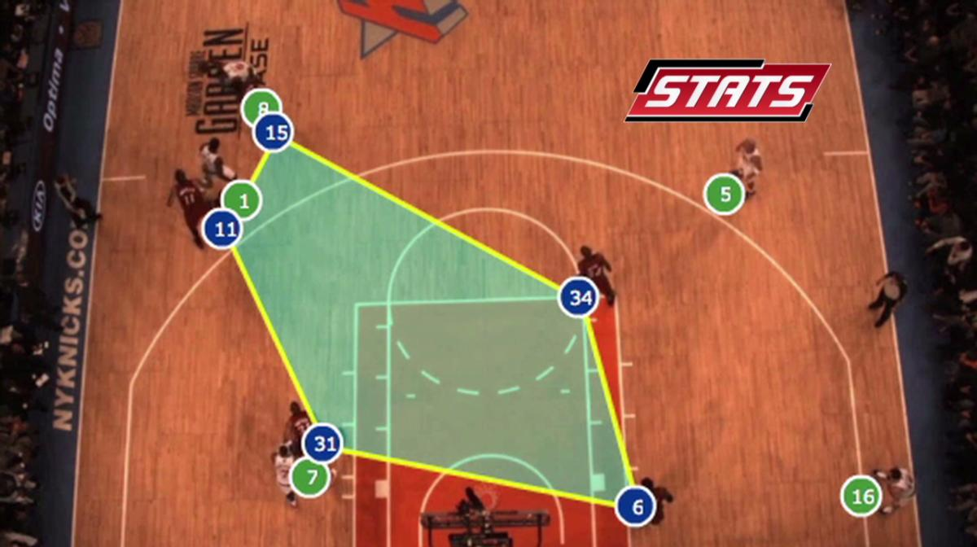
Analytics: SportVU
Camera system that tracks every move of the player and ball on an NBA court
Installed in all NBA arenas
Allows teams to get even more data on player and ball movement during games

Slide 6
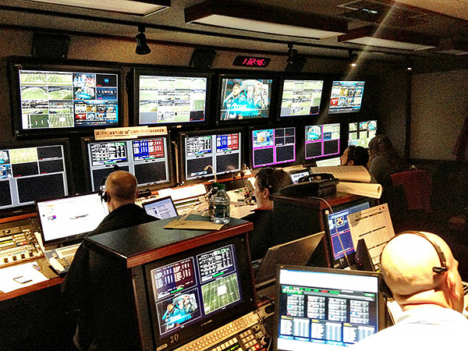
Computers in Sports Broadcasting
Computers to build graphics
Automatically switch angles
Provide broadcasters with information in real time

Slide 7
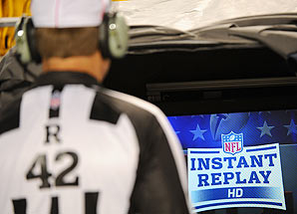
Broadcasting: Instant Replay
Instant replay has been a key part of many different sports at the highest level for years
It was implemented in the NFL in 1999, the NBA in 2002, and the MLB in 2008, and has only expanded since then

Slide 8
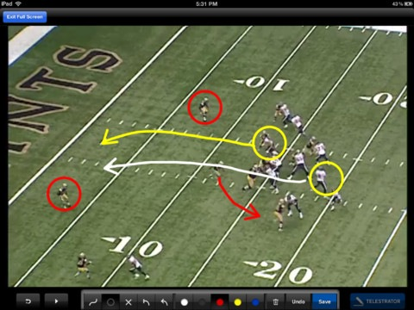
Broadcasting: Telestrators
One of the most visible uses of computers in sports broadcasting is the telestrator
Touchscreen projects an illustration made by an analyst for the audience to see on their screen

Slide 9
Sports Video Games
EA Sports’ Madden NFL and FIFA Soccer video game franchises are among the best selling video games every year
As the technology used to make these games gets more and more advanced, the games become more realistic

Slide 10
Trending Now: Player Health
Teams are using computers to better monitor injuries such as concussions
Sensors such as the one in this video are available to the public and can make sports safer for everyone, especially youth sports
The sensors are accelerometers which measure the speed of a collision that connect to a device such as an iPad or iPhone through bluetooth which displays the data and sends alerts in the event of a high trauma collison
Video: https://youtu.be/aItTBBc0a4o

Slide 11
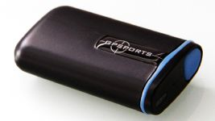
Health: Player Trackers
Teams are using mini GPS monitors to track player movement during practices
These devices can also track heart rate, pace, and force of collision
Across the sports world, these devices are being used to monitor athlete performance

Slide 12
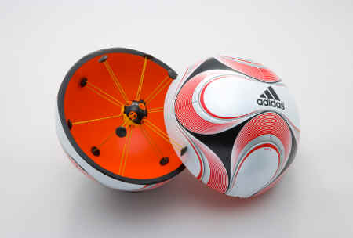
Computers on the Field
Goal line technology in soccer: Sensors inside the ball communicate with a system that tracks the ball, and alerts the referee if and when the ball crosses the goal line, eliminating the possibility of human error

Slide 13
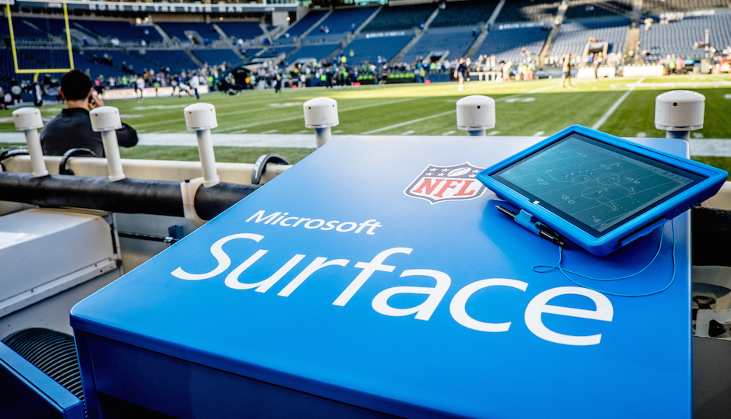
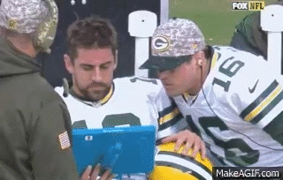
On the Field: Tablets
Teams are using tablets on the sidelines to review plays instantaneously and help with sideline communication

Slide 14
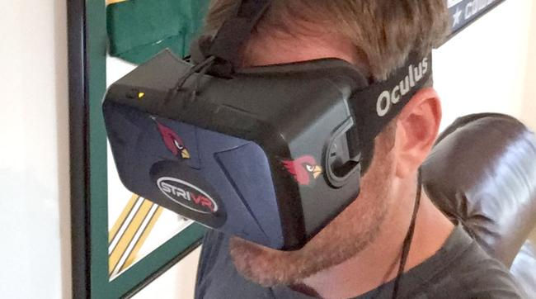
Future: Virtual Reality
Help with game preparation
Players get personalized headsets
Safer practices
NFL teams such as the Tampa Bay Buccaneers and Dallas Cowboys have adopted this technology
Video: http://bleacherreport.com/articles/2563010-stanfords-new-virtual-reality-system-is-changing-sports-forever

Slide 15
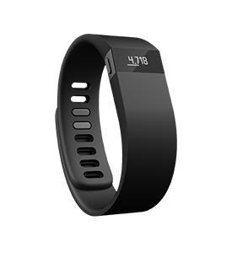
Future: Wearables
Right now wearables are just starting to become popular in the sports world
Smart watches and headphones
Soon, smart shirts and other types of smart fabrics will be widely used

Slide 16
References
http://quality.fifa.com/en/Goal-Line-Technology/Get-to-know-goal-line-technology/What-is-goal-line-technology/
http://espn.go.com/blog/carolina-panthers/post/_/id/12339/carolina-panthers-gm-sold-on-using-gps-technology
http://www.sloansportsconference.com/
http://www.theshockbox.com/helmet-sensors/
http://www.momsteaminstitute.org/article/impact-sensors-frequently-asked-questions-about-use-contact-and-collision-sports
http://grantland.com/features/the-toronto-raptors-sportvu-cameras-nba-analytical-revolution/
http://www.usatoday.com/story/tech/2015/03/20/how-wearable-technology-will-shape-the-future-of-sports-mike-bell-intel/25079157/

