Slide 1
Text Mining & Applications In Social Media
By Anthony Yang

Slide 2
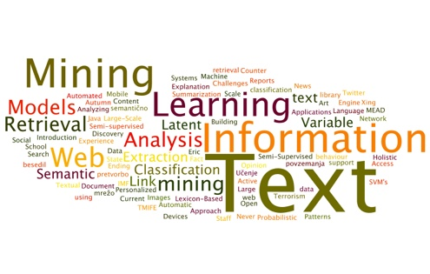
What Is Text Mining?
Also known as Text Data Mining
Process of examining large collections of unstructured textual resources in order to generate new information, typically using specialized computer software

Slide 3
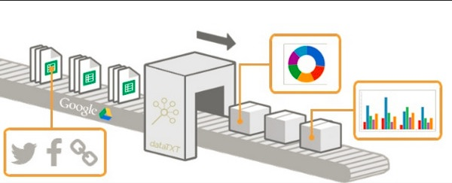
Why Do We Use Text Mining?
Turn text into data for analysis
Generate new information
Populate a database with the information extracted

Slide 4
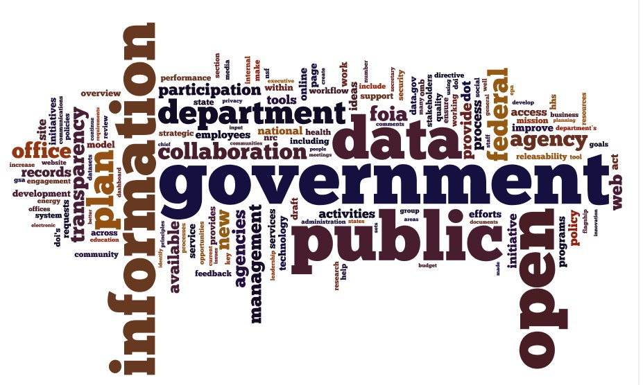
Where Do We See It Being Used?

Slide 5
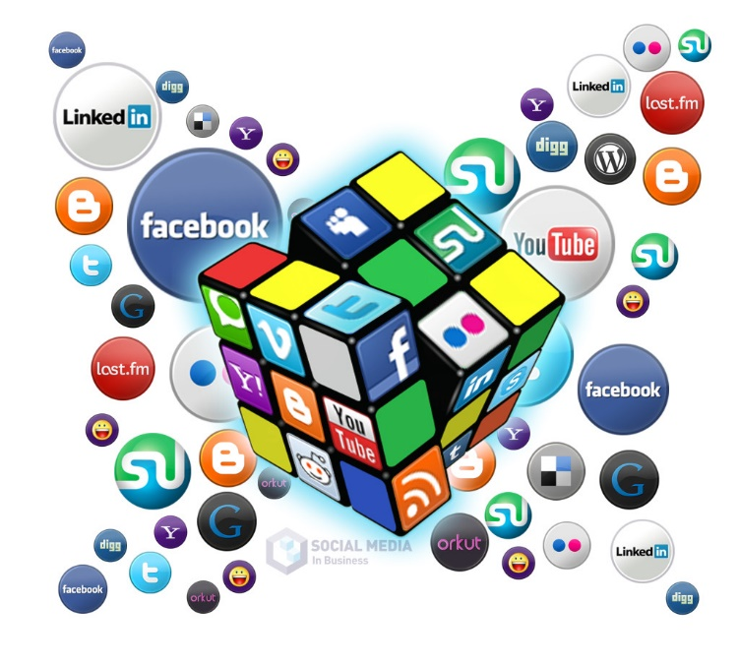
Applications
Enterprise Business Intelligence
Healthcare/Medical Records
National Security
Scientific Discovery
Sentiment Analysis Tools
Natural Language Service
Publishing
Automated Ad Placement
Information Access
Social Media Monitoring

Slide 6
Text Mining Process

Slide 7
Text
Collect large volume of textual data
Text Characteristics:
High dimensionality w/ tens of thousands of words
Noisy data
Erroneous data or misleading data
Unstructured text
Written resources, chat room conversations, or normal speech
Ambiguity
Word ambiguity or sentence ambiguity

Slide 8
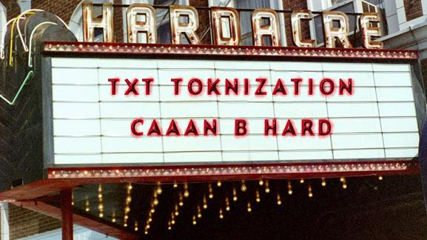
Text Preprocessing
Text Cleanup
Normalize texts converted from binary formats (programs, media, images, and most compressed files)
Deal with tables, figures, and formulas
Tokenization
Process of breaking a stream of text up into words, phrases, symbols, or other meaningful elements called tokens

Slide 9
Attribute Generation
Text document is represented by the words (features) it contains and their occurrences
Two approaches to generate attributes/document representation:
Bag of Words Model, used in methods of document classification, where the (frequency of) occurrence of each word is used as a feature
Vector Space Model, used cosine similarity to calculate a number that describes the similarity among documents

Slide 10
Attribute Selection
Further reduction of high dimensionality
Analysts have difficulty addressing tasks with high dimensionality
Features Selection
Select just a subset of the features to represent a document
Not all features help
Remove stop words
Can be viewed as creating an improved document
representation

Slide 11
Data Mining
Traditional Data Mining Techniques
Classification
Clustering
Associations
Sequential Patterns
Extract information from the processed text data via data modeling and data visualization (visual maps)
Data Visualization
Purpose is to communicate information clearly and efficiently to users via the statistical graphics, plots, information graphics, tables, and charts selected
makes complex data more accessible, understandable and usable

Slide 12
Interpretation/Evaluation
Terminate
Results satisfied
Iterate
Results not satisfactory but significant
the results generated are used as part of the input for one or more earlier stages
Vs.

Slide 13
Text Mining vs.

Slide 14
Text Mining vs.
Data Mining:
In Text Mining, patterns are extracted from natural language text rather than databases
Web Mining:
In Text Mining, the inputs are unstructured texts, while web sources’ inputs are structured

Slide 15
Text Mining vs. Information Retrieval
New information vs. Web Search
No genuinely new information is found
The desired information merely coexists with other valid pieces of information
Hearst’s Analogy: “Discovering new knowledge vs. merely finding patterns is like the difference between a detective following clues to find the criminal vs. analysts looking at crime statistics to assess overall trends in car theft”

Slide 16
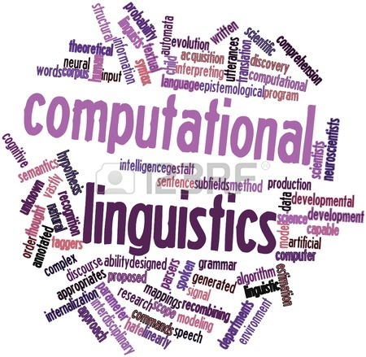
Text Mining vs.
Computational Linguistics (CPL) & Natural Language Processing (NLP):
CPL computes statistics over large text collections in order to discover useful patterns which are used to inform algorithms for various sub-problems within natural language processing

Slide 17
Text Mining In Social Media
People use social media to communicate
Social media provides rich information of human interaction and collective behavior
Traditional Media vs. Modern Social Media
Information in most social media sites are stored in text format
Text Mining can help deal with textual data in social media for research

Slide 18
Distinct Aspects of Text in Social Media
Textual data provides insights into social networks
Textual data also presents new challenges:
Time Sensitivity
Short Length
Unstructured Phrases

Slide 19
Aspect #1: Time Sensitivity
Social media’s real-time nature
Example: some bloggers may update their blog once a week, while others may update several times a day
Large number of real-time updates from Facebook and Twitter contain abundant information
Information → detection and monitoring of an event
Use data to track a user’s interest in an event
A user is connected and influenced by his/her friends
Example: People will not be interested in a movie
after several months, while they may be interested
in another movie released several years ago because
of the recommendation from his friends

Slide 20
Aspect #2: Short Length
Certain social media websites have restrictions on the length of user’s content
Twitter’s 140 characters rule
Windows Live Messenger’s 128 character personal status
Short Messages → people become more efficient with their participation in social media applications
Short Messages also bring new challenges to text mining

Slide 21
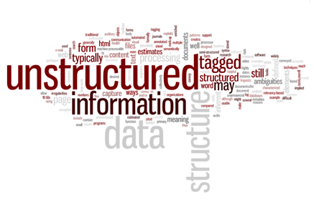
Aspect #3: Unstructured Phrases
Variance in quality of content makes the tasks of filtering and ranking more complex
Computer software have difficulties to accurately identify semantic meaning of new abbreviations or acronyms

Slide 22
Applying Text Mining in Social Media
Certain aspects of textual data in social media presents great challenges to apply text mining techniques

Slide 23
Event Detection
Event Detection aims to monitor a data source and detect the occurrence of an event that is captured within that source
Monitor Real-Time Events via Social Media
Example: Detecting earthquake when people are posting live-situation through microblogging like Twitter & Facebook
Improve traditional news detection
Large number of news are generated from various new channels, but only few receive attention from users
Researchers proposed to utilize blogosphere to facilitate news detection

Slide 24
Collaborative Question Answering
Collaborative question answering services bring together a network of self-declared “experts” to answer questions posted by other people
Through text mining, a tremendous amount of historical QA pairs have built up their databases, and this transformation gives users an alternative place to look for information, as opposed to a web search
The corresponding best solutions could be explicitly extracted and returned

Slide 25
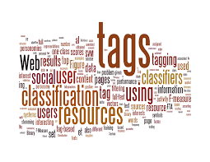
Social Tagging
A method for Internet users to organize, store, manage and search for tags / bookmarks (also as known as social bookmarking) of resources online
Social Tagging vs. File Sharing
Through text mining, it helps to improve the quality of tag recommendation
Facebook’s tag recommendation of a photo
Utilize social tagging resources to facilitate other applications
Web object classification, document recommendation, web search quality

Slide 26
Concerns For Text Mining
Text in unstructured documents is hard to process
The information one needs is often not recorded in textual form
We do not have programs that can fully interpret text. Many researchers think it will require a full simulation of how the mind works before we can write programs that read the way people do

Slide 27
Future Of Text Mining
As most information (common estimates say over 80%) is currently stored as text
This includes emails, newspaper or web articles, internal reports, transcripts of phone calls, research papers, blog entries, and patent applications
Thanks to the web and social media, More than 7 million web pages of text are being added to our collective repository, daily
We can now begin to see the usefulness of software that can process between 15,000- 250,000 pages an hour, compared to a mere 60 pages for humans
Text mining is believed to have a high commercial potential value
Notes:
Possible Research in the future:
How to better make use of the real-time nature in social media? A real-time search system which can find, summarize and track updated breaking news or events in social communities will be very challenging but useful.
How to handle textual data with short length in social media? As we discussed, short text plays a very important role in social media. On one hand, these textual data contains less information than standard documents; on the other hand, it provides possibility for us to use traditional syntax-based NLP models to perform fine- level textual analysis, which were very time consuming for standard text
How to process web scale data available in social media? The large volume and the compact but noisy presentation of textual data in social media hinders the accessibility of information for users to conveniently search, navigate and locate the specific messages one might be interested in. Finding an efficient way to handle these large scale data types is very challenging

Slide 28
Thanks!

Slide 29
Question??

Slide 30
Sources
http://infospace.ischool.syr.edu/2013/04/23/what-is-text-mining/
http://www.public.asu.edu/~xiahu/papers/bookchap12Hu.pdf
http://www3.cs.stonybrook.edu/~cse634/presentations/TextMining.pdf
http://people.ischool.berkeley.edu/~hearst/text-mining.html
http://people.ischool.berkeley.edu/~hearst/papers/acl99/acl99-tdm.html
https://en.wikipedia.org/wiki/Text_mining
http://documents.software.dell.com/Statistics/Textbook/Text-Mining
http://www.cos.ufrj.br/~jano/LinkedDocuments/_papers/aula13/04-IHW-Textmining.pdf
All Images Came from Google Images

