Slide 1
HBM vs. GDDR5
A comparison of the current types of Video Ram
By: Zachary Kessler

Slide 2
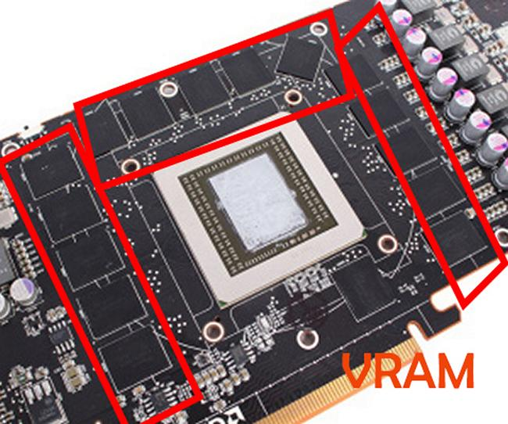
What is VRAM?
Video Ram is a variant Dynamic RAM that is used to boost framerates of video on monitors.
It is used in GPUs to boost graphical performance for gaming and video editing.
HBM and GDDR5 are recent types of VRAM used in high/medium end GPUs.

Slide 3
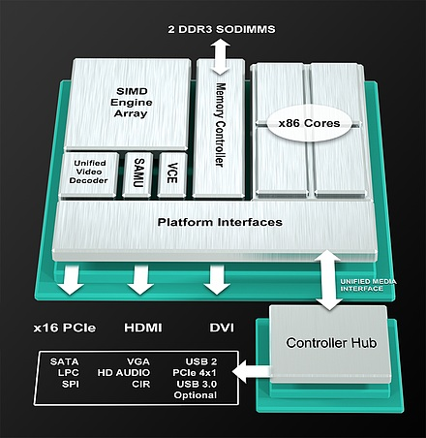
What is VRAM? Cont.
It is often called a frame buffer due to the fact that it boosts framerates.
VRAM works by buffering the image to be displayed on the screen by converting the code of the image from another form of RAM to VRAM which then sends the code to an analog converter to display on the screen.

Slide 4
The Problems with VRAM
Large power consumption due to the amount of processes they must perform
Can cause overheating if not maintained or is overclocked
Non-essential part of a basic GPU

Slide 5
So, What is GDDR5?
GDDR5 is a modern version of VRAM that was developed by AMD in 2008 for then high end graphic cards.
It is a single-ended VRAM chip that has higher bandwidth with lower voltage output than its predecessor which allows for better clocking and overclocking of the GPU.
It has a lower pin count which allows the VRAM to be much smaller but maintains a good performance level.
In order to keep voltage levels at lower, more stable levels AMD developed a feature called Clock Data Recovery where the clock speed is generated out of the data stream to allow the GDDR5 to process more data for less power.

Slide 6
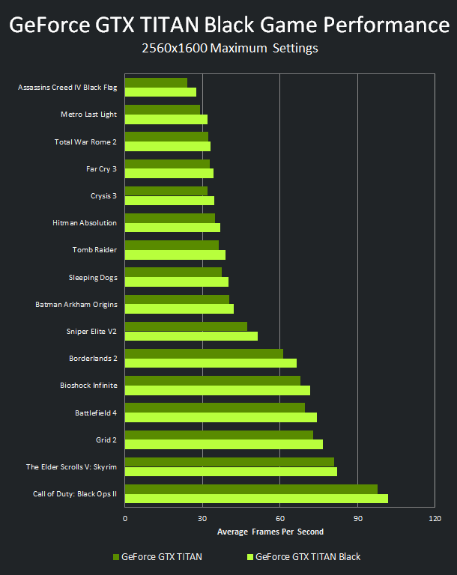
What is GDDR5? Cont.
With the highest end GPU on the market today being the NVIDIA GeForce GTX Titan Black. GDRR5 is still used in modern GPU nowadays.
In this GPU the data rate is 336Gb/s this allows for high-powered gaming performance at maximum graphics levels .

Slide 7

HBM Explained by the guy that developed it.

Slide 8
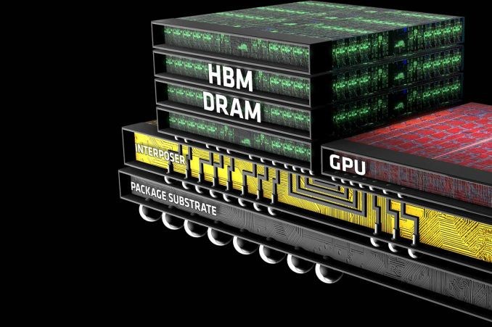
So what is HBM?
HBM stands for high bandwidth memory and is the newest form of VRAM available.
The crucial difference between HBM and other types of RAM is the fact that instead of just staying flat and getting longer, HBM will decrease surface area by moving to a more compact 3-d design and build in a cube form.
It consists of not one large chip spread out but multiple chips smaller chips stacked on top of each other.
This new concept is considered by many to be the future of VRAM and other types of DRAM.

Slide 9
What is HBM? Cont.
The change in surface area allows for faster processing along the chip (but as of now GDDR5 is still faster).
Each stack of the HBM is independent of the other stacks but all of the stacks work together.
HBM also uses less energy than GDDR5 due to the stacks being independent they regulate their own voltage
HBM is said to have 1Tb/s processing power in just a few years.
That more than 3x the power of current GDDR5 chips

Slide 10
So What is HBM? Cont.
The first and only GPU on the market to incorporate HBM is the AMD R9 Fury X as of today.
NVIDIA is set to release an HBM centered GPU next year.

Slide 11
Why HBM and GDDR5
Both types have different concepts of how to approach VRAM design.
Both have pros and cons of each design.
Both are on the market today and are the some of the most recent advances in VRAM technology.

Slide 12
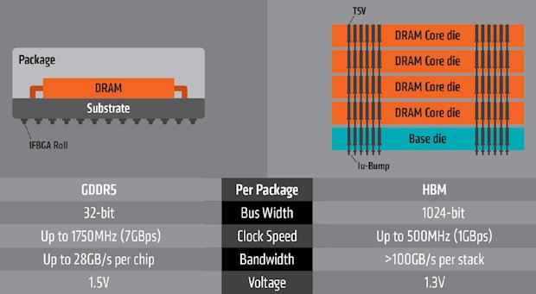
In Conclusion
GDDR5 had a good run but is no match for HBM in terms of efficiency, power, and size*.
HBM is the future of VRAM and the concept can be incorporated into other types of DRAM.
As of now however GDDR5 is still the better technology due to it being well understood and HBM is new and not fully developed.

Slide 13
Conclusion cont.
In near future, GDDR5 will still be widely used but will be replaced by HBM as HBM technology advances past the GDDR5’s rate of advancement.
Smaller more compact GPUs will be more powerful due to the fact that HBM has less surface area and can take less space inside of cases and especially laptops.

Slide 14
QUESTIONS????

