Slide 1
Slow in and Slow out and Arcs -The ball bounces slowly at first and then increases its speed. It travels up and down, with each peak and valley of the bounces forming an arc. I used the bounce path animation to create this.

Slide 2
Timing and Motion -As the car moves forward, it appears to get bigger. The road allows the viewer to get a feel for the size of the car. I used the path animation and grow/shrink animation to create this.

Slide 3
Exaggeration -The butterfly’s facial features are exaggerated; this principle of animation is commonly used in animated movies and cartoons. I used the path animation to move the butterfly across the slide.

Slide 4
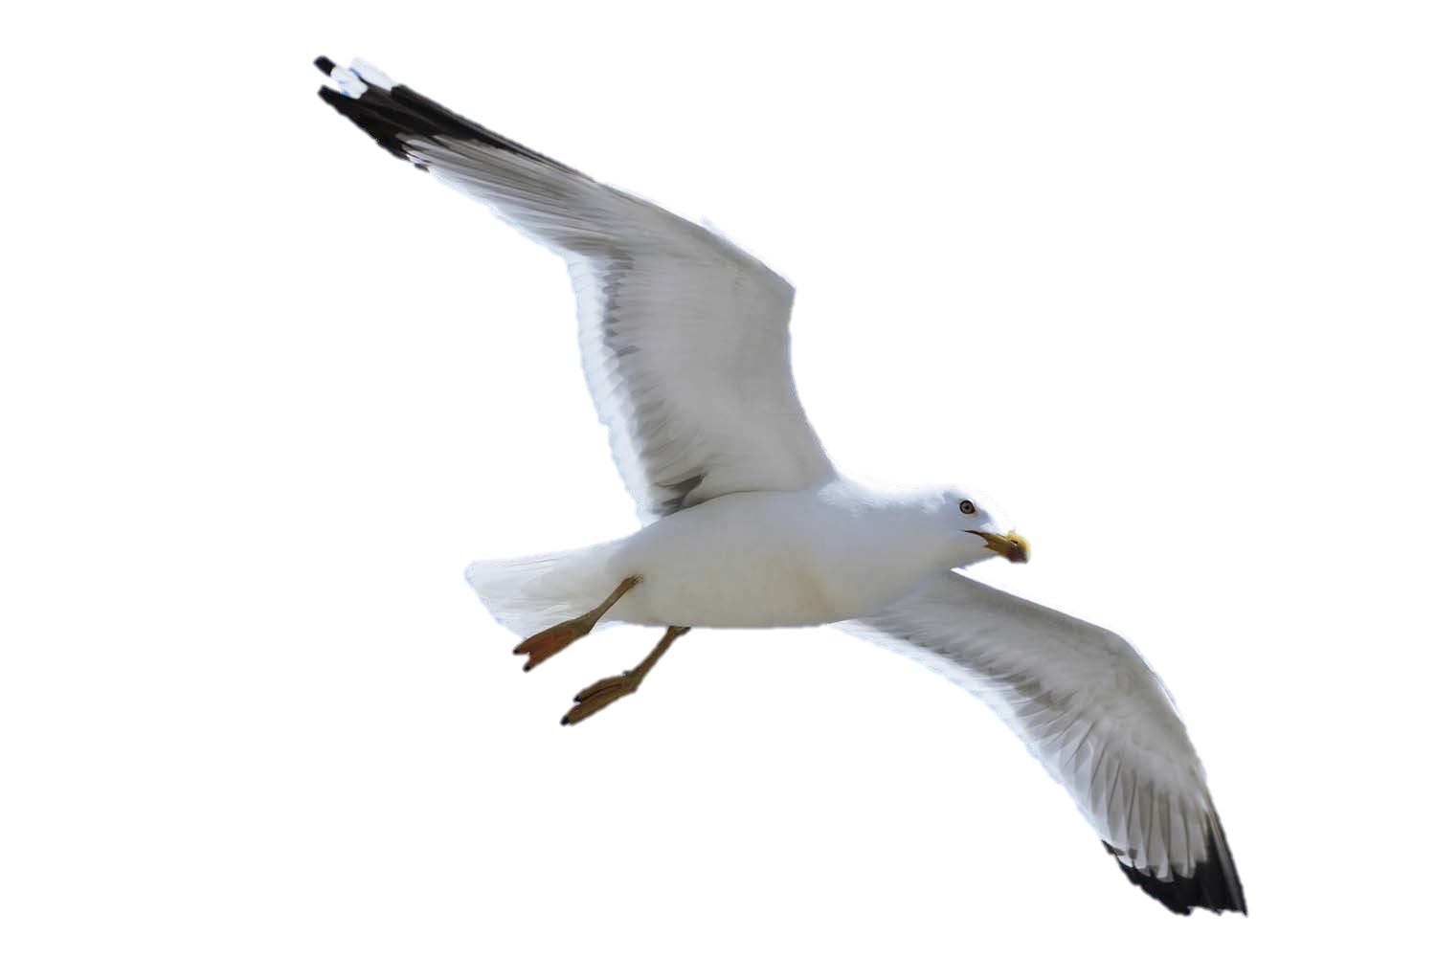
Staging -As the seagull moves across the slide, the viewer’s attention is drawn to the seagull as opposed to the background. I used the path animation tool to move the seagull across the slide.

