Slide 1
AI: Now and the Future
By Chengtao Wang
Notes:
Give the purpose of this lecture:
Give a general overview of artificial intelligence.
Some application of artificial intelligence
Give some possible future with AI.

Slide 2
What is Artificial Intelligence
An “AI”, or Artificial Intelligence is considered as an intelligent machine made by human.
Most of time people think of it as a intelligent computer program.
Ability to achieve goals by solving problems
Ability to correspond to the intellectual mechanism to the task.
Minics cognitive functions such as learning, problem solving, Planning.
Notes:
So what is artificial intellience
Define its a concept or a defination
No define reason but there is some key feature ai should have
Though process and reasoning
It’s a field of Computer science that is consisted of many sub fields

Slide 3
Branches of AI
Artificial Narrow Intelligence(ANI):
Artificial General Intelligence(AGI):
Artificial Superintelligence(ASI):
“weak AI”, specialized in one area. AI for chess game or go game
“strong Ai”, Human level AI where it is smart as human in many different fields. Able to perform task like human. Currently no mature AGI, but many companies and Orgs are working on this.
“The top”, far smarter than human in performing every task, trillions of times smarter. Currently know only in Sci-Fi, and are mostly target by people and media as a treat.
Notes:
Take about the examples
Alpha go,
Tesla.
2
Watson,
3.
Skynet.
Matrix.

Slide 4
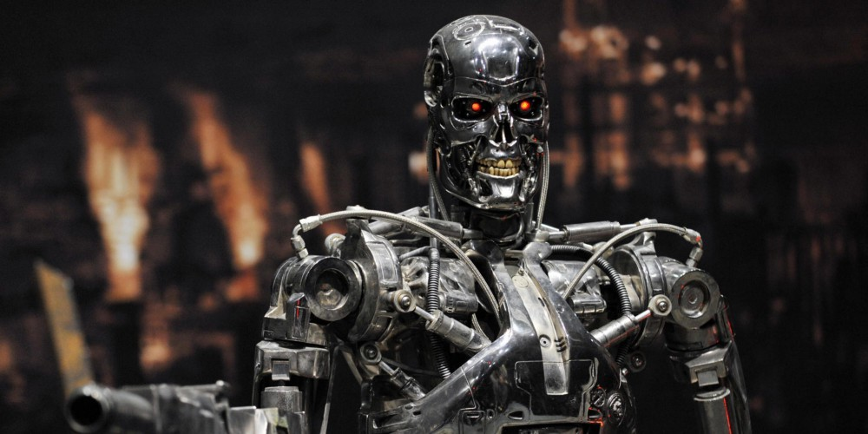

Slide 5
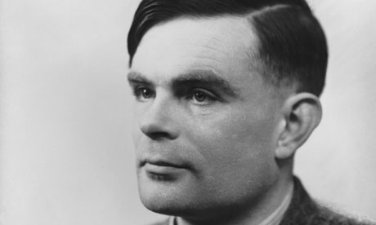
History of AI
First Computer invented: ENIAC- completed in 1946
Alan Turing’s Paper “Computing Machinery and Intelligence”, 1950
Later The Turing test, Feigenbaum test
The term “artificial Intelligence” , by John McCarthy in 1956
Loebner Prize-1990, 100,000 cash reward for a system that can pass the Turing test, most human like
Notes:
Allen -turning, father of theoretical computer science
The Turing test: If the machine si indistinguishable from an intelligent human, then the machine can think.
Edwards Feigenbaum machine to be able to pass as an expert on particular subject
McCarthy first proposed the term in his conference. developed the Lisp programming language family

Slide 6
More history
There has been several AI winters in the course of History
Collapse of Lisp machine market in 1987, the fall of expert system
In the late 90s and the early 2000s, AI was used in more areas such as logistics, data mining and medical diagnosis.
1997 Deep Blue from IBM defeated world chess champion Gary Kasparov.
In 2015 AlphaGo beat the world class Go player Lee Sedol with 4 out of 5 wins. Proving proves on what AI can do in one of human’s most complex game.
Notes:
an expert system is a computer system that emulates the decision-making ability of a human expert.^{[1]} Expert systems are designed to solve complex problems by reasoning about knowledge, represented mainly as if–then rule

Slide 7
AlphaGO vs Lee Sedol

Slide 8
Current use of AI
Game Playing: Game AI plays an important role in the video games you played. If you ever play single player mode in games the NPCs are all game AI.
Speech Recognition: Instruct machine to perform a certain task by speaking. Needs a good understanding of the language, and the mechanism on how to perform task.
Natural Language Processing: Machine needs to understand the meaning behind the text, with word prashing, grammar, context etc. And output text that a human can understanding.
Notes:
Take about current famous AI projects
Heavily in game industry
Speech recognition- related to NLP

Slide 9
More Application
Computer Vision: machine takes input from camera, process the data from the 3D world and then perform a certain task with that data.
Automation: Combine with other applications, automation with AI can free up labor and have enormous impact on the society today.
Customer Service: Being about to serve human on telephone and online, and solve the problem them have.
Notes:
There are more applicaiton of AI but not going to go over this because of time concern.
Robotics use computer vision
Factories using automation
Some company serve chat bot online

Slide 10
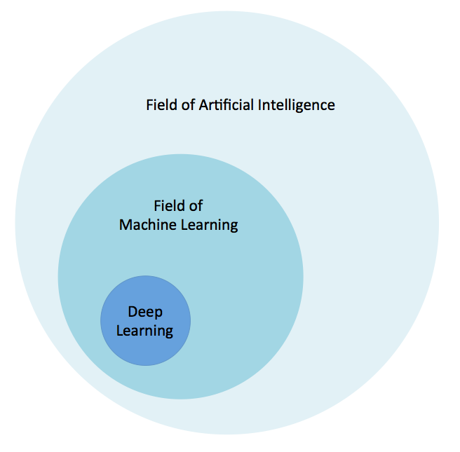
Machine Learning
Machine Learning is a core sub area of AI system that provides computers with the ability to learn without explicitly programing the steps.
Recognizes pattern, and train the algorithms with given input and output.
Deep learning- a subfield of machine learning with algorithms structures and function like the brain called Artificial neural network
Notes:
A sub field of AI
Most common tool to develop AI
3 types of learning

Slide 11
More Machine Learning
Easier to learn and use, more performance can be given when large amount of data.
Supervised - Give feedback on right on wrong, and adapt to the feedback
Unsupervised - Give no feedback, the machine should learn the structure of the data to solve the task.
Reinforcement - Isn’t giving feedback, only receive feedback if it achieve the goal.
Notes:
This is what a typical neural network will look like

Slide 12
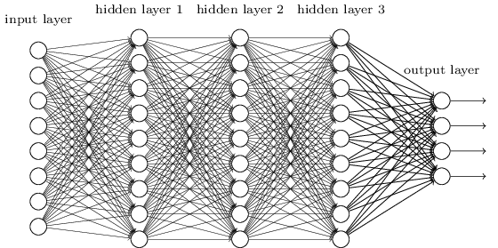
Neural - cerebral cortex
Basic-level is called perceptron
Input layer - gives output
Hidden layer - Only activated by node in previous layer.

Slide 13
By: Slide by Andrew Ng.

Slide 14
AI in our life

Slide 15
Personal assistants
Using ASR (Automatic Speech Recognition)
Send the data to the cloud
Understand meaning, data processed through NLP
Gives the output by performing the understood instruction
Google now, Amazon echo, Cortana, Siri

Slide 16
Face Recognition
Uses Cameras to input dates to the computer
Dynamic information collecting
Data used to determine who you are
Different algorithms were applied.
75 percent
https://www.captionbot.ai/
Facebook, Google, Apple etc
Notes:
Distance between the eyes
Width of the nose
Depth of the eye sockets
The shape of the cheekbones
The length of the jaw line

Slide 17
Approaching AI
Symbolic
Research on making AI based on Human’s symbol representation of world
Logic based- no need for human thought simulation
cognitive simulation- Soar cognitive architecture
Knowledge based
Expert system- a first successful AI software
Need enormous about of knowledge data for simple AI
Sub-symbolic
Research without specific representation of knowledge
Nouvelle AI- produce AI for robot with enough intelligence to control the body.
Soft Computing - use Neural networks that use inexact solution to solve hard logic task that can’t be solve using normal approach, tolerates imprecision.
Notes:
But only two main approaches.

Slide 18
More Approaches
Intelligent agent - create an agent that can use different approach, symbolic or subsymbolic, to solve the given problem.
Agent Architecture- A system uses the interaction between multiple intelligent agent.
Hierarchical control system- a control system where a set of device or agent is arranged in Hierarchical tree.

Slide 19
Pros and Cons
Autonomous transportation popularized
R&D cost will be greatly decreased
Education will be different
Space Exploration will be advanced
Robots and be used to perform dangerous job, and reduce work fatality rate
A “real” human like AI could be catastrophic.
Way faster processing and memory ability.
Emotion and consciousness developed with in AI.
AI is developed as weapon
AI causing dramatic change in Human life and society.

Slide 20
Future perspective
More and more jobs will be replaced by robotics and automation.
AI will replace human specialist such as driver, teacher, It specialist etc.
More ANI such as autonomous car, fridge will be developed for assisting Human in daily life
AI will help accelerate different fields and there will be a boom of innovations and breakthroughs in Medicine, Outer Space exploration etc.

Slide 21
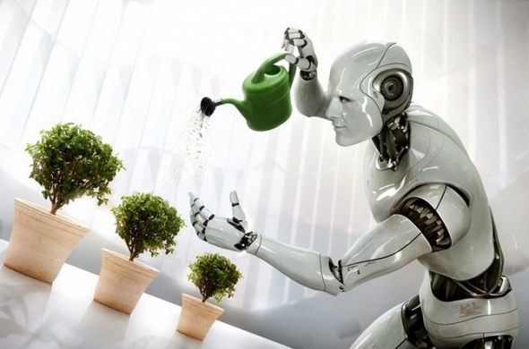

Slide 22
Further reading
The Industries of the Future by Alec Ross
No very technical or dry. New York Times bestseller.
Describes future of economic change with robotic and AI.
Artificial Intelligence: A Modern Approach by Stuart Russell & Peter Norvig
A good comprehensive, introductory book for learning and understanding what is AI.
Superintelligence: Paths, Dangers, Strategies by Nick Bostrom
A book on human minds, superintelligence, biological cognitive etc.
http://www.mitsuku.com/ - a chat bot that will chat with you like a real human, creator “Stephen Worswick”

Slide 23
Citation
http://alternativemindsets.co.uk/different-types-artificial-intelligence/
http://www-formal.stanford.edu/jmc/whatisai/
http://courses.cs.washington.edu/courses/csep590/06au/projects/history-ai.pdf
https://en.wikipedia.org/wiki/Artificial_intelligence#Approaches
http://whatis.techtarget.com/definition/machine-learning
https://en.wikipedia.org/wiki/Expert_system

