Slide 1
Introduction to Python
Part 1: Basic types and control flow
COMP 089H Fall 2015
Credit: Tanya Amert

Slide 2
Intro to Python: part 1
Intro to IDLE, Python
Keyword: print
Types: str, int, float
Variables
User input
Saving your work
Comments
Conditionals
Type: bool
Keywords: and, or, not, if, elif, else

Slide 3
IDLE: Interactive DeveLopment Environment
Shell
Evaluates what you enter and displays output
Interactive
Type at “>>>” prompt
Editor
Create and save .py files
Can run files and display output in shell

Slide 4
Hello, world!
The canonical programming example for a language: write “Hello, world!”
It’s very easy in Python. ☺
>>> print “Hello, world!” Hello, world!

Slide 5
Hello, world!
Syntax highlighting:
IDLE colors code differently depending on functionality
Orange: keyword
Green: string
Blue: output in shell
>>> print “Hello, world!” Hello, world!

Slide 6
Hello, world!
Syntax highlighting:
IDLE colors code differently depending on functionality
Orange: keyword
Green: string
Blue: output in shell
>>> print “Hello, world!” Hello, world!
# Example keywords:
print if else and or
class while for break elif
in def not from import

Slide 7
Hello, world!
Syntax highlighting:
IDLE colors code differently depending on functionality
Orange: keyword
Green: string
Blue: output in shell
>>> print “Hello, world!” Hello, world!
# Example strings:
“Hello, world!”
‘abc 123 lots of stuff’
“This has ‘nested’ quotes”

Slide 8
Hello, world!
Syntax highlighting:
IDLE colors code differently depending on functionality
Orange: keyword
Green: string
Blue: output in shell
>>> print “Hello, world!” Hello, world!
# Any time you have output in
# the shell window, IDLE
# colors it blue by default

Slide 9
Types: str, int, float
We’ve already seen one type in Python, used for words and phrases.
In general, this type is called “string”. In Python, it’s referred to as str.
>>> print “Hello,” + “ world!” Hello, world!
>>> print “a” + ‘b’ + “‘c’” ab’c’

Slide 10
Types: str, int, float
Python also has types for numbers.
int – integers
float – floating point (decimal) numbers
>>> print 4 # int 4
>>> print 6. # float 6.0
>>> print 2.3914 # float 2.3914

Slide 11
Types: str, int, float
When you add two ints you get an int.
When you add two floats or an int and a float, you get a float.
>>> print 4 + 6 # int 10
>>> print 4 + 6. # float 10.0
>>> print 4.0 + 6.0 # float 10.0

Slide 12
Types: str, int, float
When you add two ints you get an int.
When you add two floats or an int and a float, you get a float.
This is true for other operations, too.
>>> print 6. - 3 3.0
>>> print 2 * 10 20
>>> print 2 / 10.0 0.2
>>> print 7 % 2 1
>>> print 2 ** 3 8

Slide 13
Types: str, int, float
When you add two ints you get an int.
Sometimes this leads to unexpected results when dividing ints.
>>> print 2 / 3 0
>>> print 3 / 10 3
# Python rounds down because
# the result of integer division
# is also an int.

Slide 14
Variables
To re-use a value in multiple computations, store it in a variable.
>>> a = 2 >>> print a * a 2
>>> b = 5 >>> print a + b 7

Slide 15
Variables
To re-use a value in multiple computations, store it in a variable.
Python is “dynamically-typed”, so you can change the type of value stored.
unlike Java, C#, C++, …
>>> someVar = 2 >>> print someVar # it’s an int 2 >>> someVar = “Why hello there” >>> print someVar # now str Why hello there

Slide 16
Variables
There are some restrictions on variable names. They must:
be at least 1 character long
contain only A-Z, a-z, 0-9, and _
not start with a number
not be a keyword
# Okay variable names:
banana
i_am_awesome
studentCount
# Not good:
123aaa
print

Slide 17
Variables
There are some restrictions on variable names. They must:
be at least 1 character long
contain only A-Z, a-z, 0-9, and _
not start with a number
not be a keyword
Also, don’t use __stuff__, this could show up in future versions.
# Okay variable names:
banana
i_am_awesome
studentCount
# Not good:
123aaa
print
__bananas__
__student_count__

Slide 18
Intro to Python: part 1
Intro to IDLE, Python
Keyword: print
Types: str, int, float
Variables
User input
Saving your work
Comments
Conditionals
Type: bool
Keywords: and, or, not, if, elif, else

Slide 19
User Input
Two choices for functions:
raw_input
Returns a string
Very handy – always use this!
input
We will not use this. It can be very dangerous if you’re not careful.
>>> color = raw_input(“What is your favorite color? ”) What is your favorite color? Teal
>>> print “Your favorite color is”, color Your favorite color is teal

Slide 20
User Input
Functions are procedures you can call.
They may or may not return a value.
If they do, you are effectively replacing the function call with the result.
>>> color = raw_input(“What is your favorite color? ”) What is your favorite color? Teal
>>> print “Your favorite color is”, color Your favorite color is teal

Slide 21
User Input
Functions are procedures you can call.
You call a function by putting parentheses after its name.
Anything inside the parentheses are parameters, separated by commas.
>>> color = raw_input(“What is your favorite color? ”) What is your favorite color? Teal
>>> print “Your favorite color is”, color Your favorite color is teal

Slide 22
User Input
Functions are procedures you can call.
raw_input only has one argument, prompt, and it is optional (note the [] in the documentation).
See https://docs.python.org/2/library/functions.html

Slide 23
User Input
print can take multiple values, separated by commas
It replaces each comma with a space
>>> color = raw_input(“What is your favorite color? ”) What is your favorite color? Teal
>>> print “Your favorite color is”, color Your favorite color is teal
>>> print 4, 2, 9 4 2 9

Slide 24
User Input
print can take multiple values, separated by commas
It replaces each comma with a space
If you don’t want spaces, use the built-in str function to convert values to strings, then add them.
>>> color = raw_input(“What is your favorite color? ”) What is your favorite color? Teal
>>> print “Your favorite color is”, color Your favorite color is teal
>>> print 4, 2, 9 4 2 9
>>> print “a” + str(1) + “b” + str(2) a1b2

Slide 25
Creating a .py file
File -> New Window

Slide 26
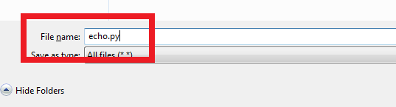
Creating a .py file
File -> New Window
Make sure you enter .py as the file extension; IDLE doesn’t always do this, and you will lose syntax highlighting ☹

Slide 27
Creating a .py file
File -> New Window
Make sure you enter .py as the file extension; IDLE doesn’t always do this, and you will lose syntax highlighting ☹
Go to Run -> Run Module (F5) to save and run your program

Slide 28
Comments
# You’ve already seen some!
# Comments in Python are denoted with a #, and are colored red
# They aren’t run, and are used to help with readability

Slide 29
Intro to Python: part 1
Intro to IDLE, Python
Keyword: print
Types: str, int, float
Variables
User input
Saving your work
Comments
Conditionals
Type: bool
Keywords: and, or, not, if, elif, else

Slide 30
Type: bool
Boolean values are true or false.
Python has the values True and False (note the capital letters!).
You can compare values with ==, !=, <, <=, >, >=, and the result of these expressions is a bool.
>>> a = 2 >>> b = 5 >>> a > b False >>> a <= b True >>> a == b # does a equal b? False >>> a != b # does a not-equal b? True

Slide 31
Type: bool
When combining Boolean expressions, parentheses are your friends.
>>> a = 2 >>> b = 5 >>> False == (a > b) True

Slide 32
Keywords: and, or, not
and is True if both parts evaluate to True, otherwise False
or is True if at least one part evaluates to True , otherwise False
>>> a = 2 >>> b = 5 >>> a < b and False False >>> a < b or a == b True >>> a < b and a == b False
>>> True and False False >>> True and True True >>> True or False True

Slide 33
Keywords: and, or, not
and is True if both parts evaluate to True, otherwise False
or is True if at least one part evaluates to True , otherwise False
not is the opposite of its argument
>>> not True False >>> not False True
>>> True and (False or not True) False >>> True and (False or not False) True

Slide 34
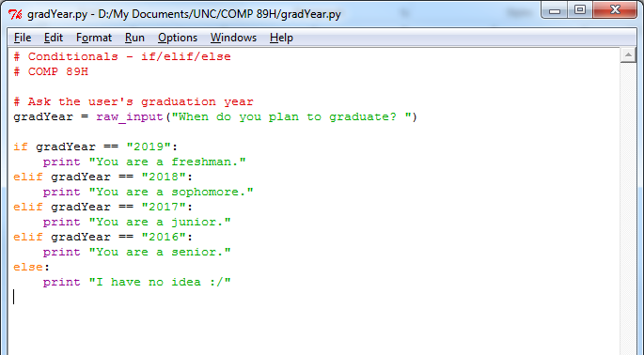
Conditionals: if, elif, else
The keywords if, elif, and else provide a way to control the flow of your program.

Slide 35
Conditionals: if, elif, else
The keywords if, elif, and else provide a way to control the flow of your program.
Python checks each condition in order, and executes the block (whatever’s indented) of the first one to be True.

Slide 36
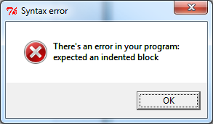
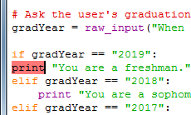
Conditionals: if, elif, else
Indentation is important in Python!
Make sure each if, elif, and else has a colon after it, and its block is indented one tab (4 spaces by default).

Slide 37
Conditionals: if, elif, else
Make sure you’re careful what you compare to the result of raw_input. It is a string, not a number.
# The right way: str to str or int to int >>> gradYear = raw_input(“When do you plan to graduate? ”) When do you plan to graduate? 2019 >>> gradYear == 2019 # gradYear is a string :( False >>> gradYear == “2019” True >>> int(gradYear) == 2019 # cast gradYear to an int :) True

Slide 38
Conditionals: if, elif, else
Make sure you’re careful how to compare the result of raw_input. It is a string, not a number.
Doing it wrong leads to a ValueError:
>>> gradYear = raw_input(“When do you plan to graduate? ”) When do you plan to graduate? Sometime >>> int(gradYear) == 2019
Traceback (most recent call last): File “<pyshell#4>”, line 1, in <module> int(gradYear) == 2019 ValueError: invalid literal for int() with base 10: ‘sometime’

Slide 39
Today we covered:
Intro to IDLE, Python
Keyword: print
Types: str, int, float
Variables
User input
Saving your work
Comments
Conditionals
Type: bool
Keywords: and, or, not, if, elif, else

