Slide 1
YouTube
The Demise of Automation
Matt Schaefer

Slide 2
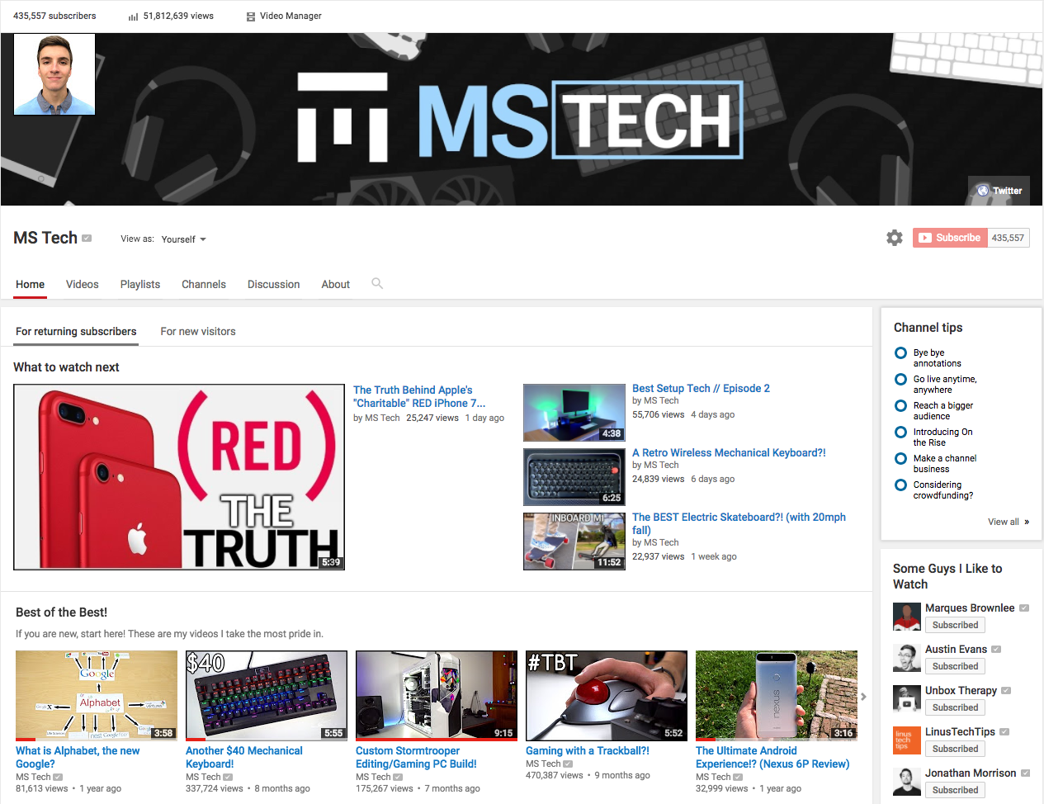
Context
My channel = MS Tech
450,000 subscribers, 50M+ views
Started as a hobby, developed into a functioning business
Focus on business side like content strategy, budgeting, communications, PR, etc
Witnessed changes in the tech behind YouTube first hand, and have felt the effects
Learned how to identify what YouTube does behind-the-scenes

Slide 3
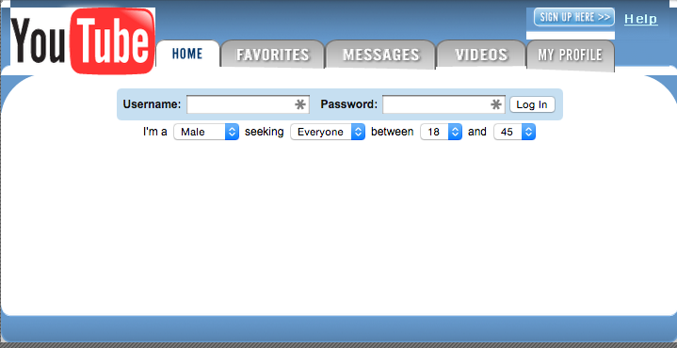
Origins
Created in 2005 by early employees of PayPal - connection to Elon Musk
Meant to be a dating website, quickly developed away from that
Was always based on the purpose to share user-submitted online video
Began with big hit viral videos like “Charlie Bit My Finger”
By 2006, was receiving over 100M+ views every single day
In Oct 2006, bought by Google for $1.65 billion

Slide 4
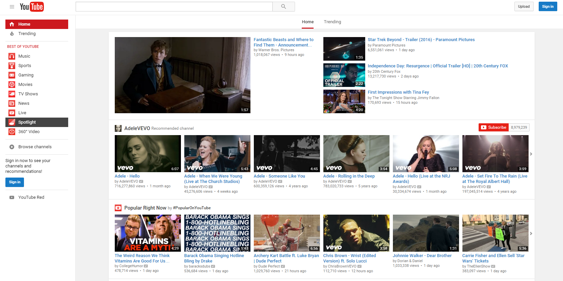
Current State
The site looks almost nothing like it did at the beginning
More user-friendly layouts, suggested videos, etc
Way more varieties of content, personalities, channels
Every month, eight out of every ten 18-49 year olds watch YouTube
300 hours uploaded every minute, almost 5,000,000,000 views per day

Slide 5
Development
So how did it go from an online dating site to the second largest search engine?
A very important step was to deal with copyright through ContentID program
Then establish monetization capability with the Partner Program
And continuously refine the algorithms that determine what videos are suggested, what order videos show up on search, and ultimately determine what videos and what channels find success

Slide 6
ContentID - Viacom Lawsuit
Soon after Google bought YouTube, they were faced with a billion dollar lawsuit from Viacom over copyrighted material
Google believed YouTube’s warning against uploading copyrighted video was enough
To avoid lawsuit, implemented a system to identify copyrighted material and remove it
This is known as ContentID

Slide 7
ContentID - Implementation
At it’s core, ContentID is a database of copyrighted material that YouTube will check a user-submitted video against to see if it contains any copyrighted material
Satisfies the copyright holders, but is not a perfect system at all
Even with permission, a video can still be flagged as copyright and taken down
Or, even a video that complies to Fair Use policies could be removed
Fair Use = copyrighted material may be used for “purposes such as criticism, news reporting, teaching, and research”

Slide 8
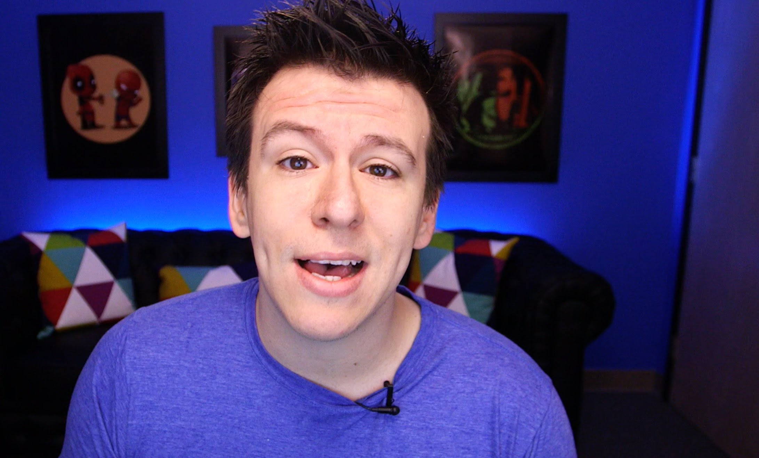
ContentID - Old System
Video gets flagged for copyright or violation of fair use
Video is taken down, or video is left up and copyright holder earns all revenue
Video uploader can appeal the copyright claim, lengthy process
IF the uploader wins and it was fair use, only then at the end of the process do they get to receive revenue again
HUGE problem for news channels, reaction channels, etc

Slide 9
ContentID - Recent Adjustments
Problem: how can YouTube make sure copyright holder’s still get the revenue they deserve, but also not hurt creators that operate under the fair use policy?
Obvious Answer: only take down videos that violate fair use
Complication: fair use is a judgement, not as black/white as copyrighted material
YouTube’s Solution: when a copyright claim is made and the user appeals the claim, the revenue that is earned during the appeal process is held and given to the winner of the appeal
Requires more human work from YouTube to review each claim, but their copyright identification technology was not capable enough to consistently determine fair use correctly

Slide 10
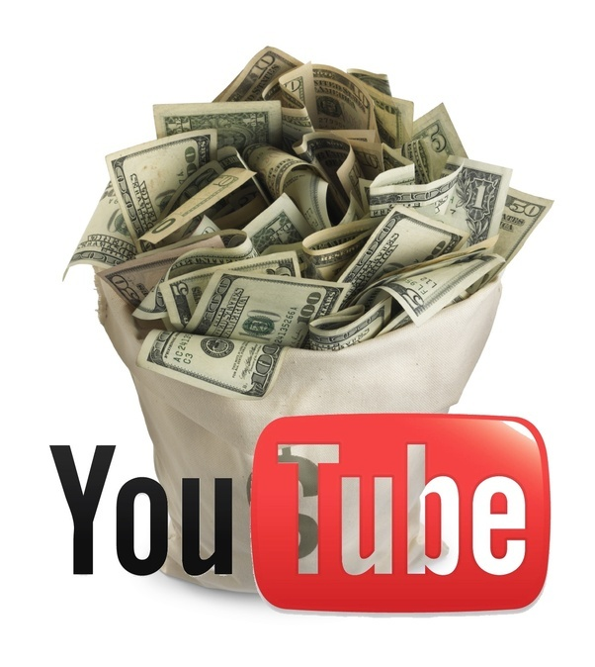
Monetization - Partner Program
YouTube needed to figure out a way to make money
Developed the Partner Program, utilizing Google’s AdSense to pay creators for the advertisements viewed before their videos
YouTube takes 45%, only 55% goes to creator
Creators receive a variable rate per 1000 views, known as CPM, can range from $0.50-10
Depends on area -- tech is very bad, gaming is better, family friendly is great
Has to be a subject or topic advertisers want to be shown in front of

Slide 11
Monetization - YouTube Networks
YouTube Networks were created to organize YouTube channels under one organization
A network would take another cut of the advertisement revenue, usually 20-30%
In exchange, would provide copyright free music, graphic design, protection, etc
However, networks realized they can make more money if they get a ton of channels and do very little (all automated) for each, instead of doing a lot of work for less channels

Slide 12
Monetization - Issues + Solution
HUGE controversy around largest creator, PewDiePie -> comedy and gaming
Some of his content took a satirical angle towards Hitler, anti-semitism, etc
The media found out, asked companies why they are advertising on those videos
PewDiePie dropped by his network, YouTube cancelled 2nd season of his show
This controversy spiralled into tons of advertisers stopping working with YouTube because their ads could be shown in front of videos with sensitive content
Solution: a channel now must reach 10,000 total lifetime views before they can be monetized, at which point the content will be reviewed and considered
Once again, more human work, because automation was not good enough

Slide 13
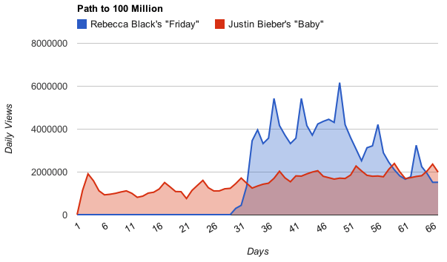
Algorithms - Start Simple
YouTube is also responsible for essentially deciding which videos succeed
What videos show up on home page, suggested videos, etc
At first focused on views in certain time periods, and subject of the video to make sure it is related to whatever content it is displayed next to
This works, but once people figured it out, they were able to latch on to trends and gain success without quality content (not good for YouTube, who needs to sell this content to advertisers)

Slide 14
Algorithms - Change and Trends
YouTube’s algorithm is constantly changing, and only people on the inside know all of the aspects of it - views, comments, likes, topic, length, resolution, metadata
For a while, it was accepted that YouTube really liked audience retention (how far into a video a viewer will watch)
I recently found out from my rep at YouTube that they now really like total session time, being how long a viewer spends on YouTube after watching
With a virtually infinite number of factors that can go into determining how to rank videos, the algorithm behind it must be extremely robust and able to handle all types of complications and comparisons
Are they obligated to share what they prioritize? NO
Leads to channels that cheat the system, one-trick-ponies, bad for advertisers

Slide 15
Conclusion
Automation can be a very good thing
YouTube uses automation and algorithms in a lot of areas very well, so good job
But with such a large database of content to sort through with automation, YouTube got a little ambitious
In the future, need to fully test and examine any changes they may make before implementing such high level automation
Subscribe to MS Tech

