Slide 1
The Impact of Computer Technology in Molecular Biology and Genetics
By Abtahi TISHAd
Talk about Growth hormone

Slide 2
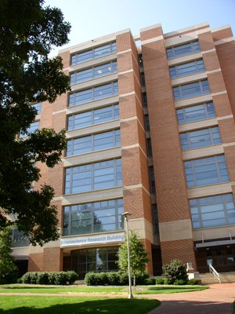
Why this topic?
I am a pre-medical student
I am a research assistant at the UNC School of Medicine (Neuroscience)
PCR
DNA Sequencing
Cryostat-Sectioning
I was mesmerized by the immense role of technology in data collection, storage, and analysis in the scientific world

Slide 3
Overview: Computer Technology in Molecular Biology and Genetics
Topics to Cover
Sequencing DNA
Genomic Databases
BLAST + Basic Algorithm
Identifying Genes
Significance of Genomic Analysis and Future Prospects

Slide 4
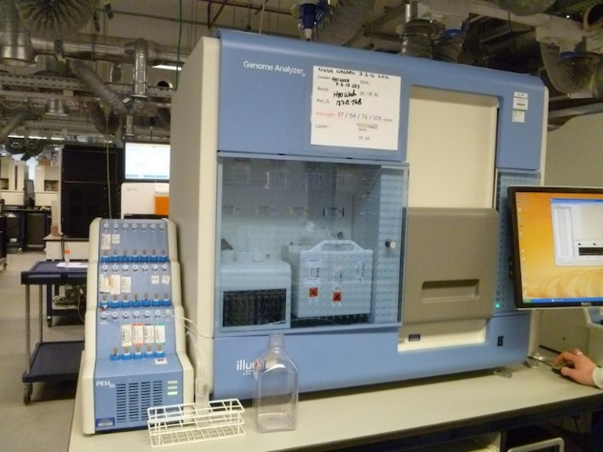
Sequencing DNA
What is DNA sequencing?
It is taking a sample of DNA and unraveling its nucleotide base sequences to be stored or analyzed
Advances in technology has made DNA sequencing faster, cheaper, and more efficient than ever before.
Cost of the Human Genome Project was
$100 million is 2001
It was $1,245 in 2015 (“DNA Sequencing”, 2016)

Slide 5
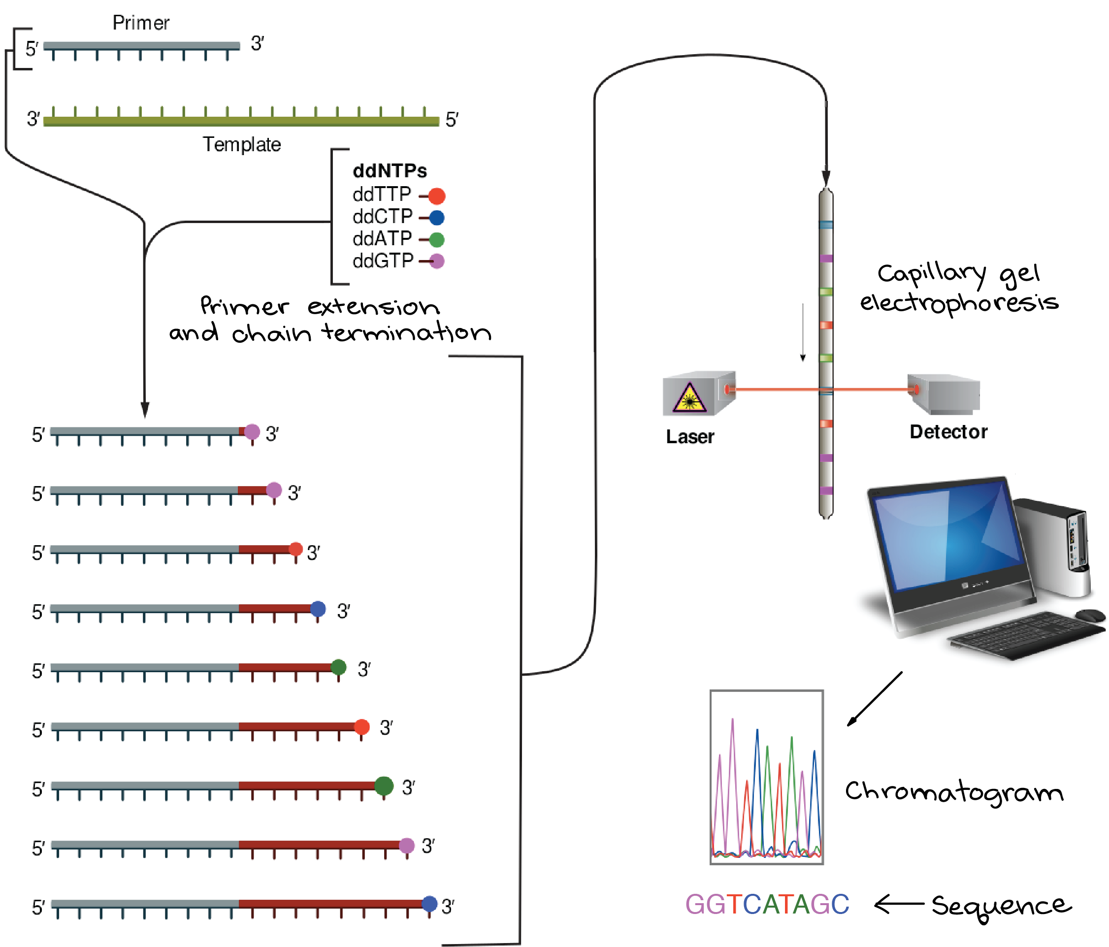
How DNA Sequencing Works- Sanger/Original Method
DNA segment broken into many fragments and extended by identical primers
Extension of DNA ends at selectively marked nucleotides, creating many different length strands
Smallest strand = 1st nucleotide,
2nd smallest = 2nd nucleotide…largest = last nucleotide
Final nucleotide of each strand is marked with a specific color coded dye to be recognized by device
Entire process is automated by the machine
G
G
T
C
A
T
A
G
C

Slide 6
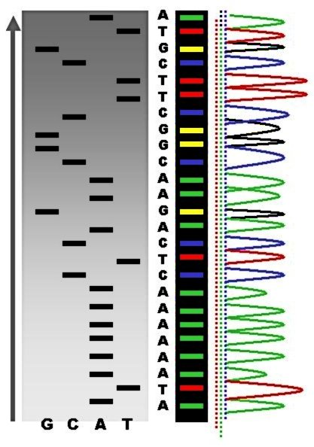

Slide 7
Next Generation Sequencing
Better technological innovation has led to methods which can sequence DNA faster by many magnitudes
Use of fluorescence imaging techniques to capture nucleotide sequences at a rate that can be 200 times faster than the original method!
Again 100% automated, but a lot faster
Many techniques are essentially the Sanger method, but even more compartmentalized for efficiency

Slide 8
Storing the Data: The GenBank
The massive amounts of information gathered from DNA sequencing must be stored
What is the GenBank?
It is a very large database of DNA sequences (Klug, Cummings, Spencer Palladino, 2013)
Run by the National Center for Biotechnology Information(NCBI)
It contains more than 100 billion base pair sequences of DNA, and it doubles in size every 14 to 18 months (Klug, Cummings, Spencer Palladino, 2013)

Slide 9
GenBank (cont.)
Are the DNA sequences just stored?
No they are identified for the genes they code for and that sequence is assigned an accession number
This number is unique to a particular sequence
Used to locate the sequence from the large database
Connection to class: The use of algorithms
Input: Accession Number
Output: Target DNA sequence/gene of interest

Slide 10
DNA vs. Genes
DNA is the vector in which genetic material is stored.
Genes are specific DNA sequences which code for proteins
Protein expression is what causes phenotypic traits (hair color, skin color, etc…)
Only 2% of human DNA consists of genes (Klug, Cummings, Spencer Palladino, 2013)

Slide 11
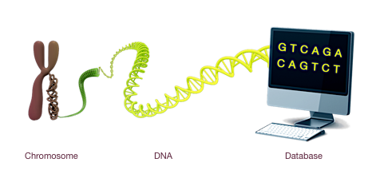
How are the Genes Identified?
Gene identification from DNA sequences is called “annotation”
Annotation heavily relies on computer technology to ensure DNA sequences are identified quickly, efficient, and correctly.
BioInformatics

Slide 12
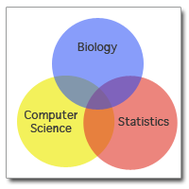
What is BioInformatics?
It is the use of computer hardware and software and mathematics to analyze large quantities of genetic information.
Ex. The GenBank, BLAST
A mesh of biology, computer science,
and mathematics

Slide 13
Basic Local Alignment Search Tool: BLAST
What is BLAST?
It is a computer software which allows for comparison between DNA sequences in search of similarities.
Why is this Useful?
Unknown DNA sequences can be identified by comparing them to already known sequences in different species
Ex. Using known DNA sequence in rats for Gene X to find a similar Gene Y in mice.
The sequences should have a high similarity

Slide 14
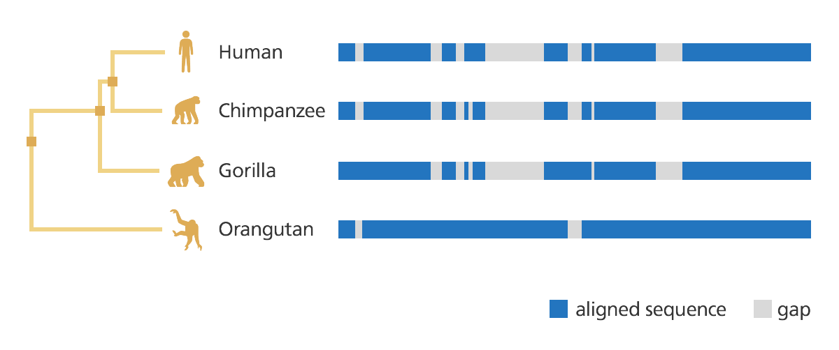
Before Explaining BLAST: How DNA Works
DNA consists of repeating patterns of nucleotides with 4 distinct nitrogenous bases: adenine, thymine, cytosine, and thymine
The order and number of nitrogenous bases are what differentiates the DNA of different organisms
Closely related organisms have very similar DNA sequences, and may even contain some of the same genes

Slide 15
How BLAST Works
BLAST aligns two different DNA sequences and produces an identity value
The identity value is a measure of similarity between the two sequences (Klug, Cummings, Spencer Palladino, 2013)
Example:
If DNA Sequence X in mice contains the insulin gene, and DNA sequence Y in rats is 99% similar to DNA Sequence X, then Y must contain the insulin gene, or a similar equivalent in rats
Thus, using BLAST we just identified the insulin gene in rats from known data about mice
BLAST essentially uses the same mechanism as a primitive search engine

Slide 16
The Basic Algorithm of BLAST
BLAST works similar to most search engines
Users have to input a DNA sequence, and/or the mRNA transcript of a specific gene within an organism
The software contains an index of information (aka the GenBank database)
It reproduces results from the index to the user based on how similar they are to the initial search query
The algorithm of the search can be changed by the user based on what they are looking for in particular

Slide 18
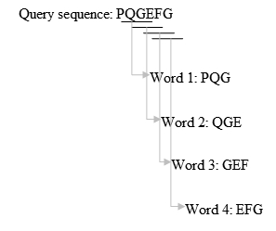
BLAST Algorithm in CS-Speak
Removal of low complexity regions or repeats in query sequence
Prevents false sense of high similarity
Make a k letter word list of the query sequence
i.e. 3 letters
Speeds up the search process
Scan database for matching words
Assign numerical values for results; i.e perfect match = 7, mismatch = -4
Process is repeated for every word in query
The matches are compiled together for statistical analysis based
on matching score

Slide 19
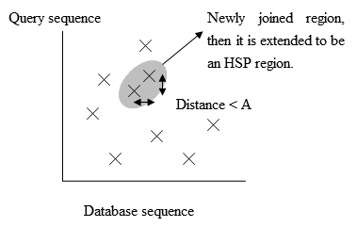
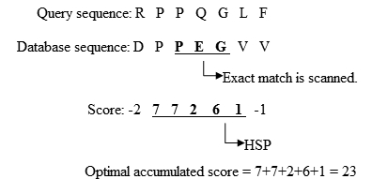
BLAST Algorithm (Cont.)
6. The matched sequences (HSP) which pass the statistical significance test are aligned together if they are continuous
7. These sequences are subsequently further analyzed and reported
http://onlinelibrary.wiley.com/doi/10.1002/9780470015902.a0005253.pub2/full

Slide 20
Demonstration
Human actin Gene mRNA sequence
Link 1: https://www.ncbi.nlm.nih.gov/gene
Link 2: https://blast.ncbi.nlm.nih.gov/Blast.cgi

Slide 21
Potential Problems with the “old” BLAST
Previous versions of BLAST did not account for
Introns: non-coding sequences of DNA
Location of promoters/enhancers/silencers
These are all needed to code a gene into a protein
Two genes could contain similar nucleotide sequences, but code for different proteins
Plus, BLAST requires you to have a template/already identified gene to compare the target gene to

Slide 22
More Complex Organisms Require More Innovative Algorithms for Analysis
There are simply more factors that need to be taken into account when study a complex organism’s DNA such as a human, than when studying a less complex organism like a bacteria
How is this solved?
Many annotation programs have adopted newer algorithms that incorporate many of the factors previously mentioned (Klug, Cummings, Spencer Palladino, 2013)
Introns, promoters, enhancers/silencers, termination regions…etc
BLAST now provides information on mRNA and protein sequences of various genes

Slide 23
Lets Summarize: Computer Technology is Involved in Every Aspect of Genomic Analysis
DNA sequencing machines: Sequence DNA
Online Databases: Store DNA sequences
Computer Softwares: Analyze DNA sequences
Without computers, much of today’s knowledge in genetics would not be possible

Slide 24
Significance of Genomic Analysis
Identifying evolutionary relationship between different organisms
BLAST comparisons
Basic gene to protein relationships
Genomic analysis found that there are significantly more protein than there are genes that code for them
Identifying the origin of genetic diseases and ways to cure/prevent them
Availability of GMOs
Green Revolution in India saved the lives of millions of people through high yielding cereal crops

Slide 25
Development of New Areas of Research Due to Tech Advances
Nutrigenomics- The study of how diet affects the genes
Allows scientists to hypothetically give subjects healthy dietary recommendations based on the analysis of their genes (Klug, Cummings, Spencer Palladino, 2013)
Gene analysis is done through the help of technology to locate specific target sequences pertaining to health
Stone-Age Genomics – The study of ancient DNA from primarily extinct animals (Klug, Cummings, Spencer Palladino, 2013)
Allows for better understanding of the lives of organisms from the past, and similarities they have to organisms of today

Slide 26
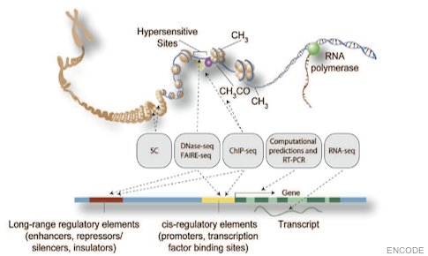
The Future: The Encyclopedia of DNA Elements Project (ENCODE)
Successor of the Human Genome Project
The goal is to identify all promoters, enhancers, silencers, and open reading frames within human genome (Klug, Cummings, Spencer Palladino, 2013)

Slide 27
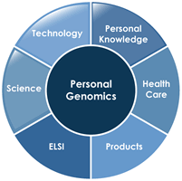
The Future: Personalized Genome Projects
The low cost of DNA sequencing due to newer technology has made it a possibility for individuals to get a read out of their own genome (Klug, Cummings, Spencer Palladino, 2013)
Can lead to personalized medicine and better treatment of diseases

Slide 28
Potential Concerns: Genetic Discrimination
Technology has enabled us to learn more about our genome than ever before, but this can lead to potential concerns such as genetic discrimination.
Current laws do not protect workers within small businesses, nor anyone within the U.S. military (“Genetic Discrimination”, 2016)
Hacking of sensitive genetic information
With greater progress comes greater responsibility

Slide 29
Works Cited
DNA Sequencing. (n.d.). Retrieved March 30, 2017, from https://www.khanacademy.org/science/biology/biotech-dna-technology/dna-sequencing-pcr-electrophoresis/a/dna-sequencing
Genetic Discrimination. (2016, May 2). Retrieved March 30, 2017, from https://www.genome.gov/10002077/
Klug, W., Cummings, M., Spencer, C., & Palladino, M. (2013). Chapters 18.3-18.5. In Essentials of Genetics (8th ed., pp. 362-372). Boston, MA: Pearson.
Altschul, S. F. (2014). BLAST Algorithm. ELS. doi:10.1002/9780470015902.a0005253.pub2

