Slide 1
Cryptography
Benjamin Twara

Slide 2
What is cryptography?
The study and practice of using encryption techniques for secure communication
Mainly about creation and analysis of protocols that keep private messages private
Utilizes mathematics, computer science and electrical engineering in its use.

Slide 3
Applications of cryptography
Military communications
E-commerce
ATM cards
Computer passwords

Slide 4
How does Cryptography work?
Simply, use whatever means are available to prevent the interception of the message
This ranges from just hiding messages in the ancient Greek times to the Caesar cipher to modern methods such as RSA
The classical cipher types include transposition ciphers and substitution ciphers

Slide 5
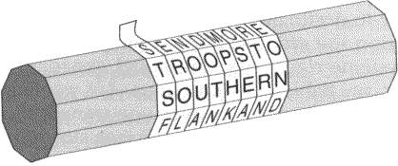
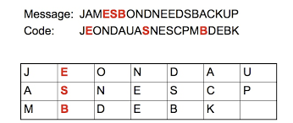
Ciphers

Slide 6
Caesar Cipher
The Caesar cipher was invented by Julius Caesar and was used long after he died
This is a substitution cipher that was broken 800 years later by an Arab mathematician
The weakness of this cipher lies in the frequency of the letters language it is written in
Evolved into a polyalphabetic cipher
Despite shifting frequency of the letters, this polyalphabetic cipher can still be broken

Slide 7
Reducing

Slide 8
Transposition cipher
This method involves having the letters of the message simply rearranged, effectively generating an anagram.
This method is very weak for short messages since there are so many way you can arrange a word like “cow”
As the message length increases the number of possible rearrangements explodes
For example, consider this short sentence. This can be rearranged into more than 50,000,000,000,000,000,000,000,000,000,000 unique letter combinations.

Slide 9
Transposition Cipher
A random transposition of letters seems to offer a very high level of security, because it would be impractical for an enemy interceptor to unscramble even a short sentence
This however also makes it hard for the intended recipient to decode the message
Requires sender and receiver to meet and agree upon a system to shift the letters

Slide 10
The one time pad
Discovered in the 19th century
Engrained in randomness
The generated randomness eliminates the frequency issue of the polyalphabetic cipher
By shifting every letter randomly, the number of possible combinations explode.
A word like Tommy has 11881376 unique combinations

Slide 11
The enigma machine
This is a machine that automates the one time pad and was instrumental in WW2 for the Germans
The reason this code was broken was due to human tendencies. Moving the rotors just a few positions from the initial position or reusing passwords
This allowed for the identification of a pattern due to the altered frequency of the letters and was ultimately the reason it was able to be broken
If the operators of the enigma machine had rolled dice to set the initial starting position of the machine, the frequency would have been uniform and the result of the war could have been very different

Slide 12
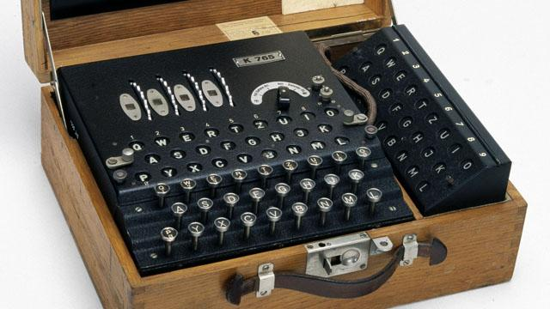

Slide 13
The problem with all these methods?

Slide 14
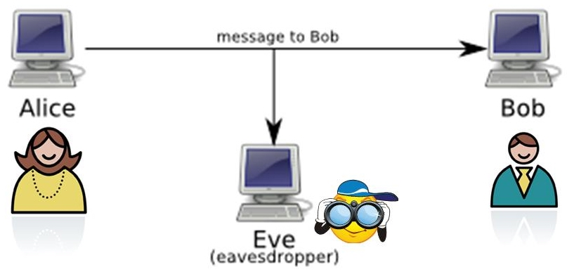
Alice Bob and Eve

Slide 15
Solution
Key Exchange

Slide 16
RSA
$M^{ed}mod N=c$
e and N are sent out publicly
Recipient converts message to a number and raises it to the public exponent e and divides it by N and sends back the result
C to the power of d mod N = the converted number

Slide 17
RSA DEMONSTRATION
Demo

Slide 18
RSA
Modern form of encryption
The most copied code in history
Its not perfectly secure its just practically secure
Banks on the exponential time today’s computers would take to crack it
The amount of time needed to crack will significantly go down once quantum computers are functional

Slide 19
Legality
The power held by encryption has led to many countries around the world to ban its use
This is due to the potential criminal uses
Countries that allow it force the publication of the encryption keys

Slide 20
Future of Cryptography
The current aim of cryptography is to secure data
In the future, an entire software or platform could be safe guarded
The practical safety of RSA will no longer be viable
In quantum cryptography lies the answer.

Slide 21
Works Cited
https://www.khanacademy.org/computing/computer-science/cryptography
https://en.wikipedia.org/wiki/Cryptography
https://en.wikipedia.org/wiki/Strong_cryptography
http://gva.noekeon.org/QCandSKD/QCandSKD-introduction.html

