Slide 1
Cybersecurity in the United States
A Brief History and Overview

Slide 2
Cybersecurity
noun cy·ber·se·cu·ri·ty \-si-ˌkyu̇r-ə-tē\
measures taken to protect a computer or computer system (as on the Internet) against unauthorized access or attack
John Oliver on Cybersecurity Chinese Cyberattack

Slide 3
Origins
In the early 1950s computers start to become more accessible and therefore more abundant. In the decades following the expansion computer security and information protection became and issue. Starting in the 1970s, cybersecurity has evolved alongside computers and similar technologies.

Slide 4
Types of security
There are two areas of cybersecurity:
Private Sector
Public Sector
Notes:
Private Sector is industries such as transportation, healthcare etc
Public is government
Focus on Public
2016- U.S. federal, state and local government agencies rank in last place in cyber security when compared against 17 major private industries, including transportation, retail and healthcare

Slide 5
Issues
With the constant advancement and increased reliance on technology it is hard to combat cyber attacks because hackers evolve alongside technology.

Slide 6
Early Days of Cybersecurity
From its beginnings to the early 2000s

Slide 7
Mid 1970s- The US government first starts to take precautions against network breaches
1977- Senator Ribicoff proposes the Federal Systems Protection Act which sought to define a “Computer Crime”
1983- The movie War Games is released
1983- The “414” hacking collective break into several government computers
1987- Ronald Raegan signs the Computer Security Act
1988- Computer Emergency Response Team is developed by the United States Department of Defense
Notes:
FSPA bill does not pass
War Games (summary)- The film follows David Lightman (Broderick), a young hacker who unwittingly accesses WOPR (War Operation Plan Response), a United States military supercomputer originally programmed to predict possible outcomes of nuclear war. Lightman gets WOPR to run a nuclear war simulation, originally believing it to be a comuter game. The computer, now tied into the nuclear weapons control system and unable to tell the difference between simulation and reality, attempts to start World War III.
CSA protect federal agencies’ computer databases
Early 90s the current legislation is not working well enough and data breaches are a continuing problem
Info from Washington Post 2003 Article

Slide 8
1996-2000- Y2K procedures
2001- Bush establishes President’s Critical Infrastructure Protection Board
2002- Bush signs Cybersecurity Research & Development Act
2002- Cybersecurity departments get absorbed by Homeland Security
2003- Homeland Security creates office specifically for cybersecurity
Notes:
President’s Critical Infrastructure Protection Board- in charge of developing cybersecurity strategy, get advice from private sector
Cybersecurity Research & Development Act- calls for $900 million over five years for security research and education
The HS office carries out the White House’s national cybersecurity strategy

Slide 9
Cybersecurity Policy in more Recent History
Bush , Obama and Trump Administrations

Slide 10
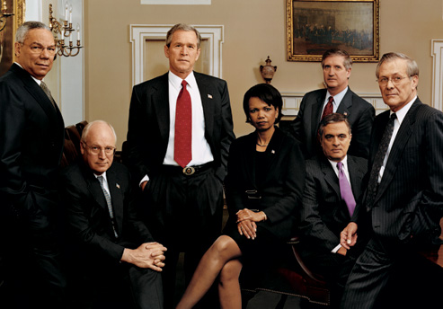
Bush Administration
"Securing cyberspace is an extraordinarily difficult strategic challenge that requires a coordinated and focused effort from our entire society--the federal government, state and local government, the private sector and the American people,"
-President George W. Bush
Notes:
With growing need for cybersecurity bush implemented National Strategy to Secure Cyberspace
The number of incidents reported to the Department of Homeland Security rose by 152% last year, to nearly 13,000, according to a new government report. The security breaches, more than 4,000 of which remain under investigation, ranged from the work of random hackers to organized crime and foreign governments, says Tim Bennett, president of the Cyber Security Industry Alliance.
The increase and severity of data breaches prompted Bush to recommend a 10% increase in cybersecurity funding for the coming fiscal year, to $7.3 billion. That's a 73% increase since 2004.
To test security against about 100 possible attacks, the Department of Homeland Security today is completing a week-long series of simulations called "Cyber Storm II." The event presumed a coordinated cyberattack on information technology, communication, chemical and transportation systems. Participants from five countries, nine states, 18 federal agencies and more than 40 private companies participated.

Slide 11
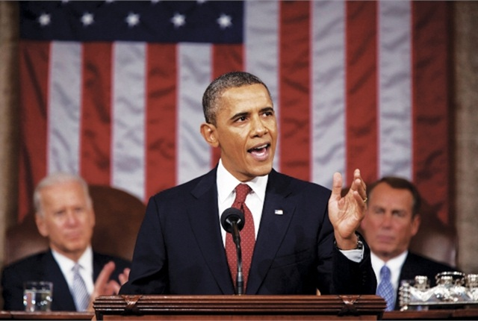
Obama Administration
“So shortly after I took office, before I had gray hair, I said that these cyber threats were one of the most serious economic national security challenges that we face as a nation, and I made confronting them a priority.”
- President Obama
Notes:
The Obama White House decided on Tuesday to declassify the Comprehensive National Cybersecurity Initiative (CNCI), a 2008 report signed by President George W. Bush that has formed the bedrock of the White House's cybersecurity policy.
Establish Commission on Enhancing National Cybersecurity
Invest over $19 billion for cybersecurity as part of the President’s Fiscal Year (FY) 2017 Budget
Modernize Government IT and transform how the Government manages cybersecurity through the proposal of a $3.1 billion Information Technology Modernization Fund
This focus on multi-factor authentication will be central to a new National Cybersecurity Awareness Campaign launched by the National Cyber Security Alliance
The National Cyber Security Alliance will partner with leading technology firms like Google, Facebook, DropBox, and Microsoft to make it easier for millions of users to secure their online accounts, and financial services companies such as MasterCard, Visa, PayPal, and Venmo that are making transactions more secure.

Slide 12
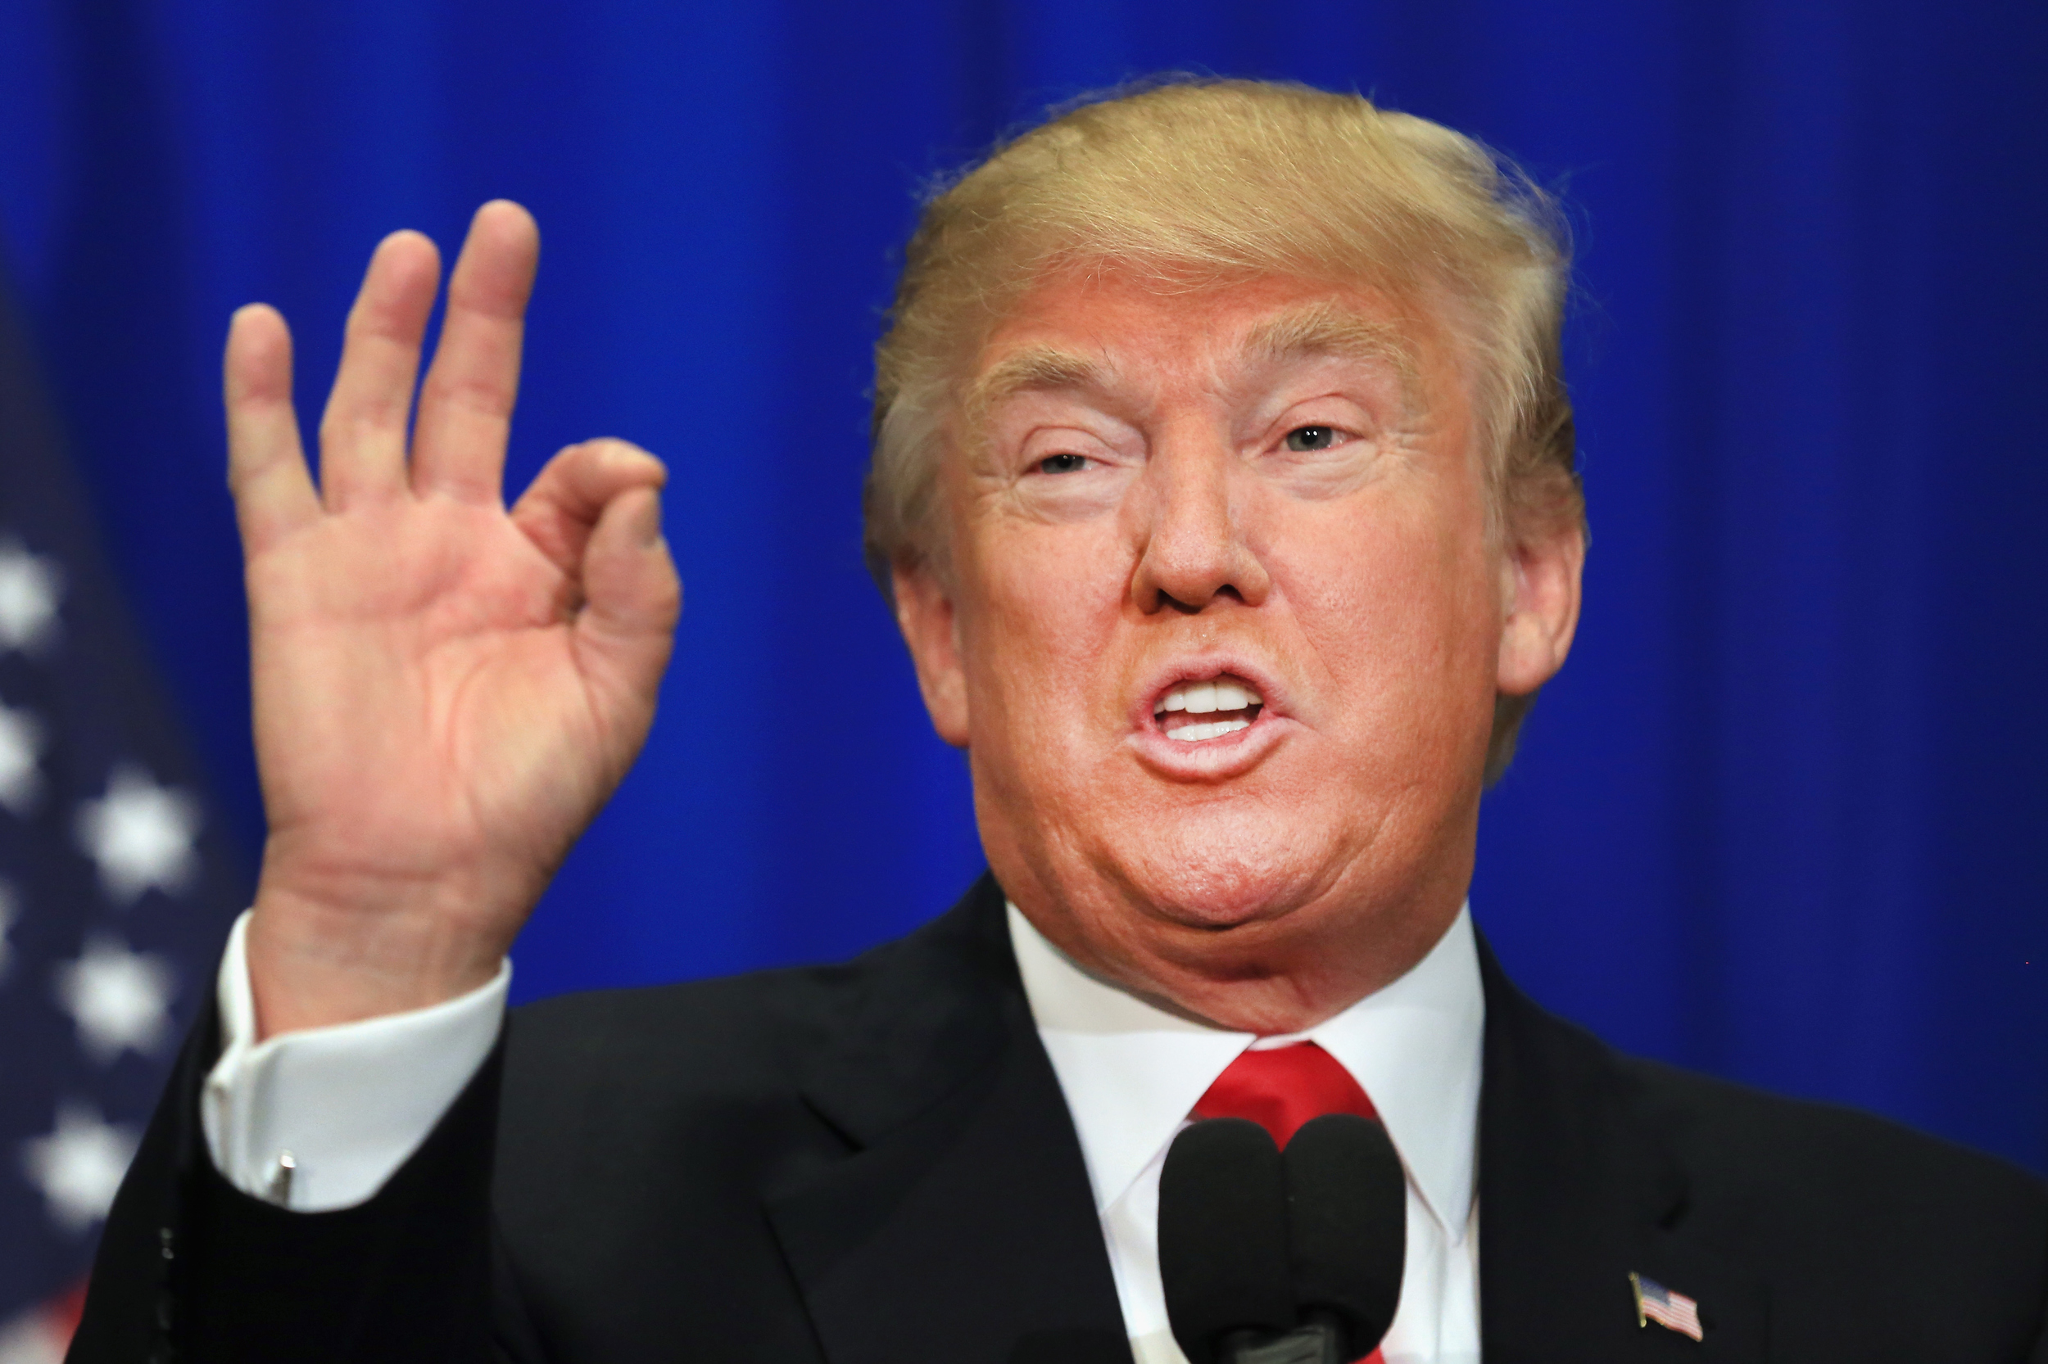
Trump Administration
“My people will have a full report on hacking within 90 days!”
-President Trump
Notes:
Trump was supposed to release a executive order regarding cybersecurity in Jan, it was postponed
Under the order, agency and department heads would be directed by the executive order to use the best practices from the private sector to enhance cyber security. They would also be required to prepare for the modernization of cyber security in their agencies. The Office of Management and Budget would oversee government-wide efforts to enhance cyber security. No vulnerability study has yet been made, according to a White House official said.
Trump made the deadline promise repeatedly. A week after the initial statement, he tweeted on Jan. 13, “My people will have a full report on hacking within 90 days!”

Slide 13
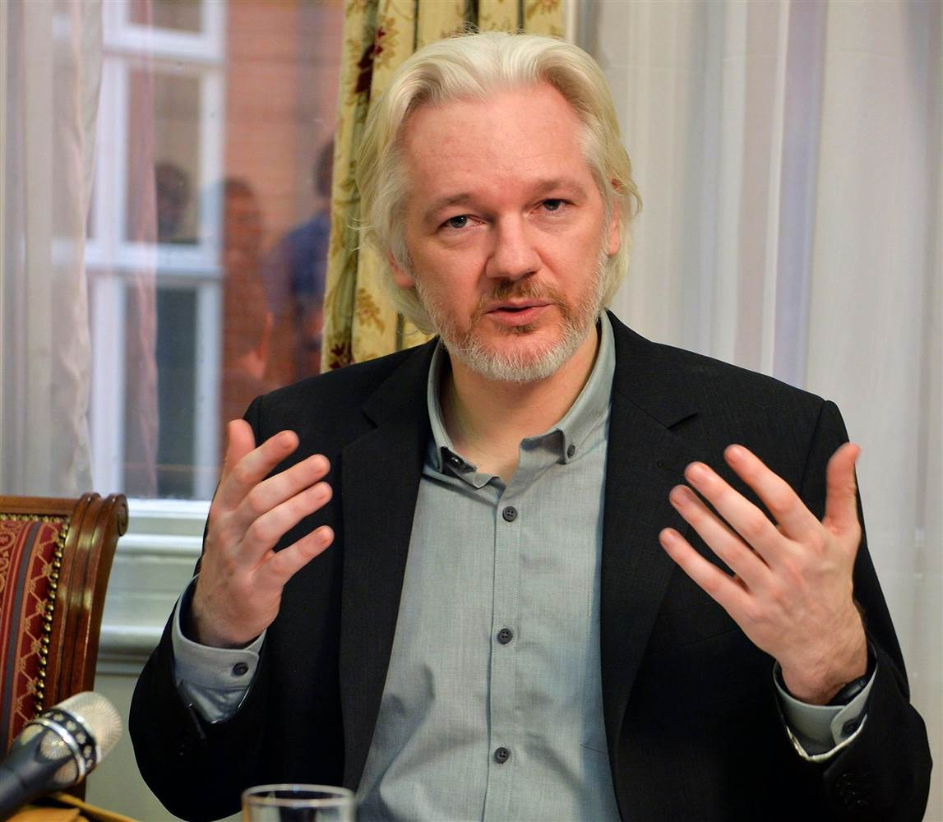
WikiLeaks
“These megaleaks... They're an important phenomenon, and they're only going to increase.” -Julian Assange
WikiLeaks
Notes:
International organization that posts secret info, news leaks and classified media
Started in 2006
Julian assange
Over 10 million documents
Recently CIA hacking tools and Hillary’s campaign emails

Slide 14
Notes:
October is NCSAM
First started in 2006 by Homeland Security
2016 was 10th anniversary
Use different passwords
Don’t share accounts
Avoid phishing
Just don’t give out info

Slide 15
http://www.washingtonpost.com/wp-dyn/articles/A50606-2002Jun26_4.html http://www.cybersecurityhalloffame.com/content/timeline/Cyber-Security-Cyber-Security-Timeline https://www.usnews.com/topics/subjects/cybersecurity https://obamawhitehouse.archives.gov/the-press-office/2016/02/09/fact-sheet-cybersecurity-national-action-plan https://www.dhs.gov/cybersecurity-overview https://www.us-cert.gov/about-us https://www.washingtonpost.com/world/national-security/chinese-hackers-breach-federal-governments-personnel-office/2015/06/04/889c0e52-0af7-11e5-95fd-d580f1c5d44e_story.html?utm_term=.1440478a83cf http://www.reuters.com/article/us-usa-cybersecurity-rankings-idUSKCN0XB27K https://www.dhs.gov/cyber-safety http://abcnews.go.com/Technology/story?id=4457451&page=1 https://www.cnet.com/news/bush-unveils-final-cybersecurity-plan/ http://www.foxnews.com/us/2017/03/07/wikileaks-releases-entire-hacking-capacity-cia.html https://wikileaks.org/ https://www.nytimes.com/2016/06/21/us/politics/china-us-cyber-spying.html?_r=0 http://www.cbsnews.com/news/trump-cybersecurity-executive-order/ http://www.politico.com/story/2017/04/20/trump-cybersecurity-hackers-237385 http://www.economist.com/blogs/analects/2013/02/chinese-cyber-attacks https://georgewbush-whitehouse.archives.gov/infocus/bushrecord/documents/Policies_of_the_Bush_Administration.pdf http://thehill.com/policy/technology/84513-declassified-wh-cybersecurity-report-specifies-10-steps-for-reform
Sources

