Slide 1
The Art of Google-fu
Understanding how Google Search works to better answer your questions

Slide 2
Motivation and Background
Motivation
More than 3.5 billion Google searches occur every day
The practice has become so ubiquitous that the word “Googling” has entered standard vocabulary
We spend so much time on Google. How can we make the most of it?
Background
When Google first started as a Stanford research project - 1996, 1998

Slide 3
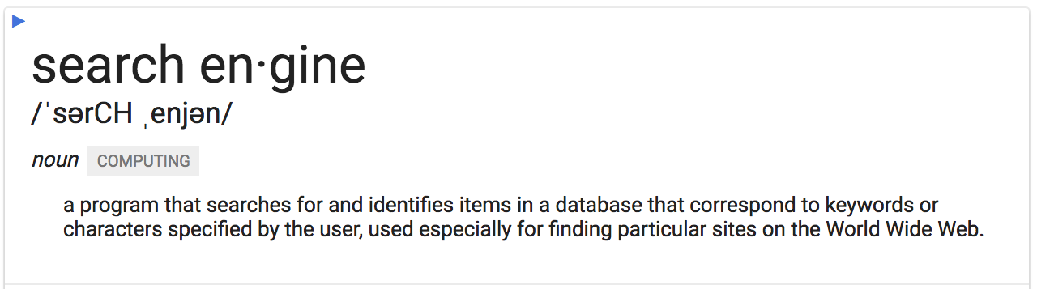
What is a Search Engine?
Notes:
So what is a search engine? Googling it provides us with this definition. [...] But nowadays, we don’t use search engines just to find particular sites. The majority of the time, when we Google things, we don’t have a particular site in mind.
Ironically, this is a perfect example of what search engines have now become --- places to answer all our queries, from word definitions to information research to how to fix this error in python.

Slide 4
Inside Google Search
Breaking down the world’s most popular search engine
Notes:
We don’t normally think about this when we use Google, but there are many parts moving beneath the surface of the interface that we see.

Slide 5
Key Point 1
“The web is like an ever-growing public library with billions of books and no central filing system.”
Google searches don’t actually search the web
Notes:
The index is what you’re actually searching when you hit enter in a Google search bar. Just like the back of a book, to find what you’re looking for its easier to check the back of the book for an index that stores location of what you’re looking for in an ordered way.

Slide 6
Step 1: Crawling with Googlebot
It starts with a web crawler (or spider). Crawlers start from a list of webpages and follow links on these pages to travel to other pages. As it crawls along, it saves information about the pages it encounters and sends it back home to be processed and stored. This process is repeated in intervals to reflect new and updated websites.
Note: crawlers parse raw HTML, so algorithms must be able to separate relevant keywords

Slide 7
Step 2: Creating the Index
After finding a new/updated webpage, Google adds it to their index, a giant list of website links and information about the website (keywords, PageRank)
An “inverted index” identifies locations of documents in the list given a key word or phrase
PageRank, etc.
https://www.reddit.com/r/askscience/comments/16lejv/how_does_google_sort_through_the_whole_internet/

Slide 8
Key Point 2
“For a typical query, there are thousands, if not millions, of webpages with helpful information. Algorithms are the computer processes and formulas that take your questions and turn them into answers.”
Google searches do more than just match keywords

Slide 9
Step 3: Handling the Query
When a query is sent to Google, Google first tries to interpret the query
Query Completion - Autocomplete, Spelling, Synonyms
Query Understanding
After modifying the query, Google searches their giant index.
Finally, Google returns multiple possible answers and sends them back to you, to be displayed on your screen. Google’s algorithms rely on more than 200 unique signals to determine what you might really be looking for.

Slide 10
Key Point 3
“Google now processes over 40,000 search queries every second on average, which translates to over 3.5 billion searches per day.”
Google searches are crazy fast
Notes:
Google processes tens of thousands of queries every second, billions of searches per day.
Google’s index itself is well over 100,000,000 gigabytes, and continually growing. Every search generate millions of results.
Google is big, and big is usually slow. How does Google keep things fast?

Slide 11
Step 4: Making It All Faster
Caching
Parallel computing
Custom file system
A lot of cheap hardware
Load balancing
Network integration
etc.
Notes:
Note that most of the stuff is proprietary and there’s little information besides what they publish - a lot of guesswork

Slide 12
Step 4A: Crawling to Jumping
Web crawling
Parallelize crawlers - Googlebot
Reduce checking of pages that update less frequently - Google Caffeine
Indexing
Custom distributed cloud data-structure - BigTable, hash table
Parallel, distributed computing - MapReduce

Slide 13
Step 4B: Better Networking
Improving network connection
Anycast routing - served by the node with the lowest latency
GGC nodes all around the world
Data centers in the Americas, Europe, and Asia
Direct peering to major networks
Expansive private networks
User > GGC node > Data center > User

Slide 14
Step 4C: Serving Results Faster
Speeding up searches
Parallel, distributed processing using multiple replicas
Lots of cheap hardware, clustered
Load balancing algorithms
Memory

Slide 15
Step 4D: Servings Results Even Faster
Reducing time-intensive searches
Cache common queries
Reduce unique requests - punctuation, capitalization, stop words
Reduce unique requests - synonyms, spelling, related queries
Smart rendering
Light-weight page design (including ads)
Cache common queries in final form
Start returning results early

Slide 16
Challenges of Google Search
Accuracy: Reporting results that are relevant to the search query
Speed: Reporting results in a responsive, convenient time frame
Staying Relevant: Billions of searchable websites, growing every day
Traffic: Handling 40,000 searches per second
Competition: Finding ways to differentiate from competitors
Consistency: Running despite hardware failure
Notes:
This is a hugely complex task, with many challenges that have to be solved. Over time, Google has improved their solutions to develop their product as it looks today.

Slide 17
Using Google Search
A guide to building better searches

Slide 18
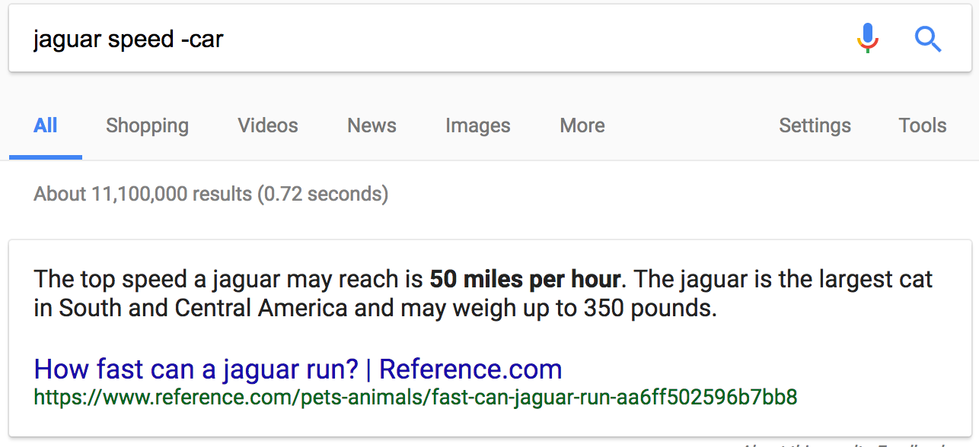
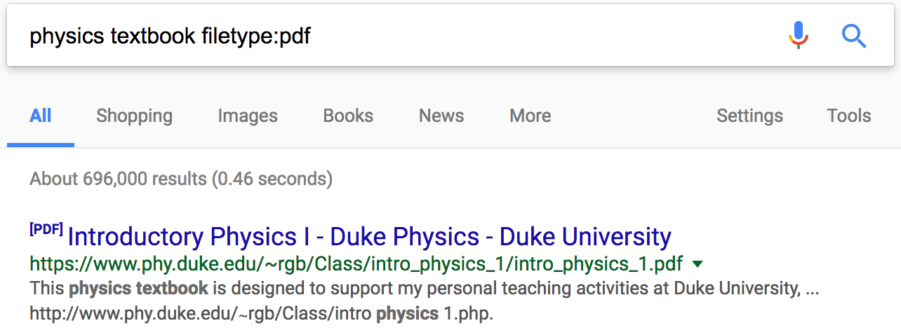
Optimizing
search results
Specify exact phrases
` “to be or not to be” `
Specify inexact phrases
`marathon OR race`
`fastest * in the world`
`~dessert`
Filter unwanted keywords
`(query) -(unwanted)`
Search by site
`site:(domain)`
Search for sites
`related:(domain)`
`related:(webpage)`
Search by file-type
`filetype:(type)`

Slide 19
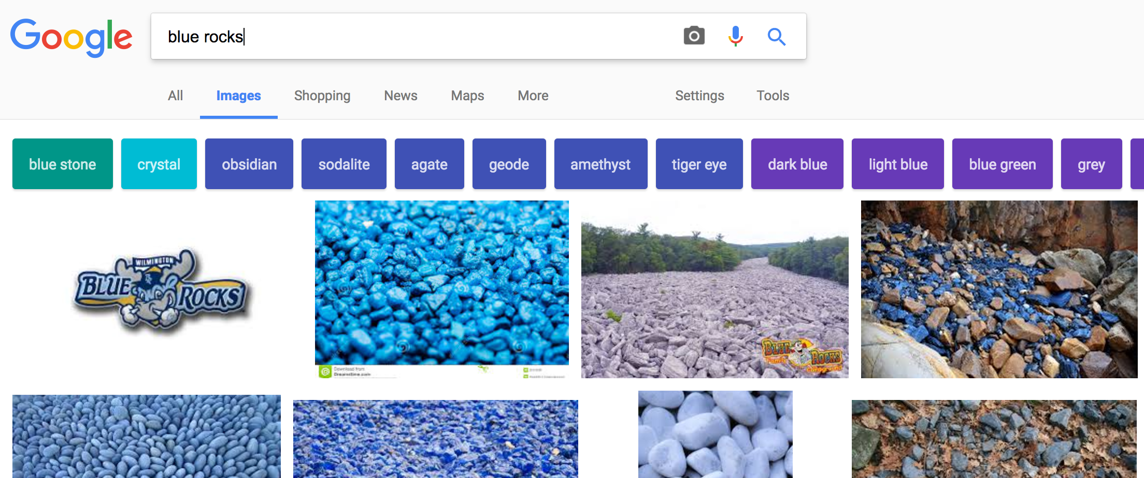
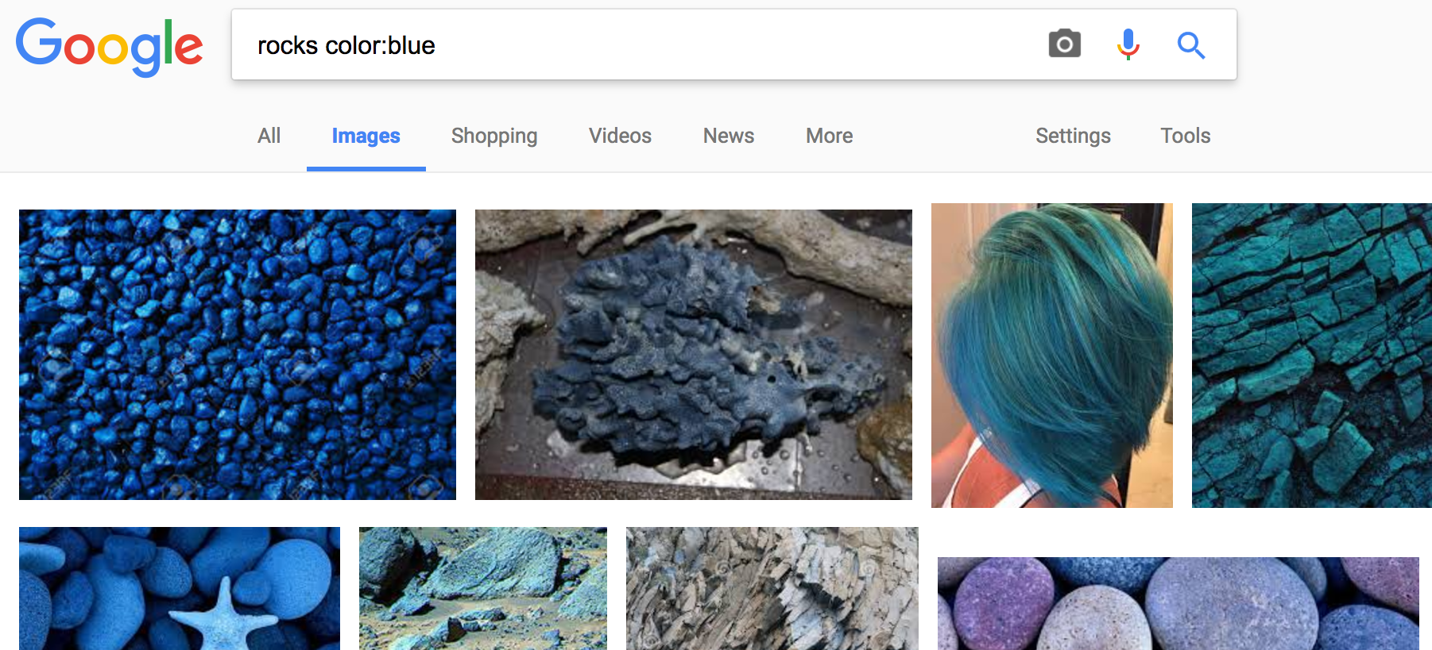
Additional Features
Images
Color, type, size, license
Reverse image search
Image description
Books
Read public domain
Preview, snippet
Find published texts on related subjects

Slide 20
Additional Features
Demo of Reverse Image Search
Image: http://www.unc.edu/~jasonyu/hobbit.png
Google Images: https://www.google.com/imghp
Notes:
Link or Upload
Image recognition
Page results that include given image
Image results of visually similar images
Images
Color, type, size, license
Reverse image search
Image description
Books
Read public domain
Preview, snippet
Find published texts on related subjects

Slide 21
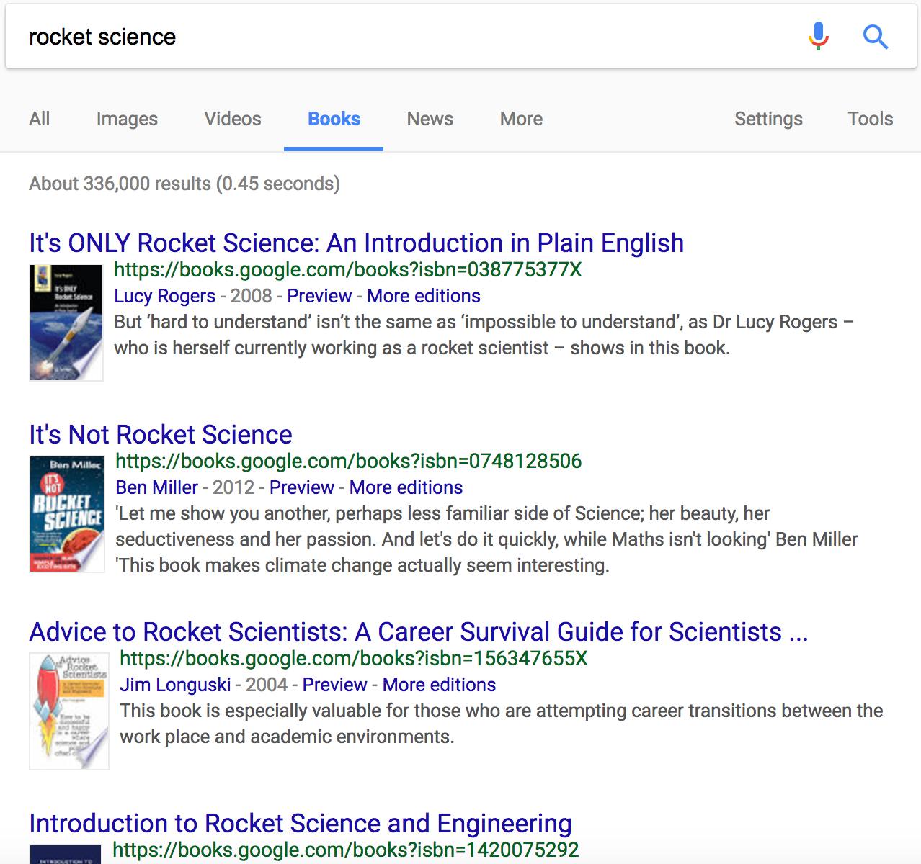
Additional Features
Images
Color, type, size, license
Reverse image search
Image description
Books
Read public domain
Preview, snippet
Find published texts on related subjects

Slide 22
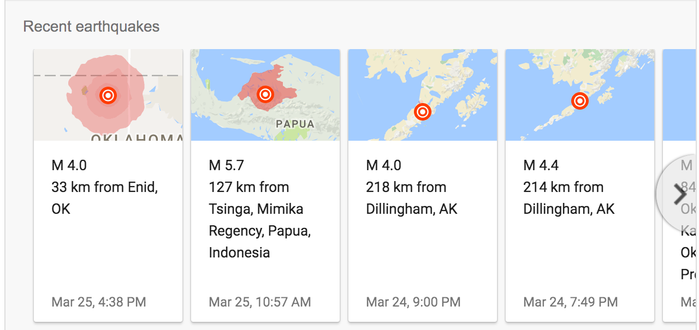
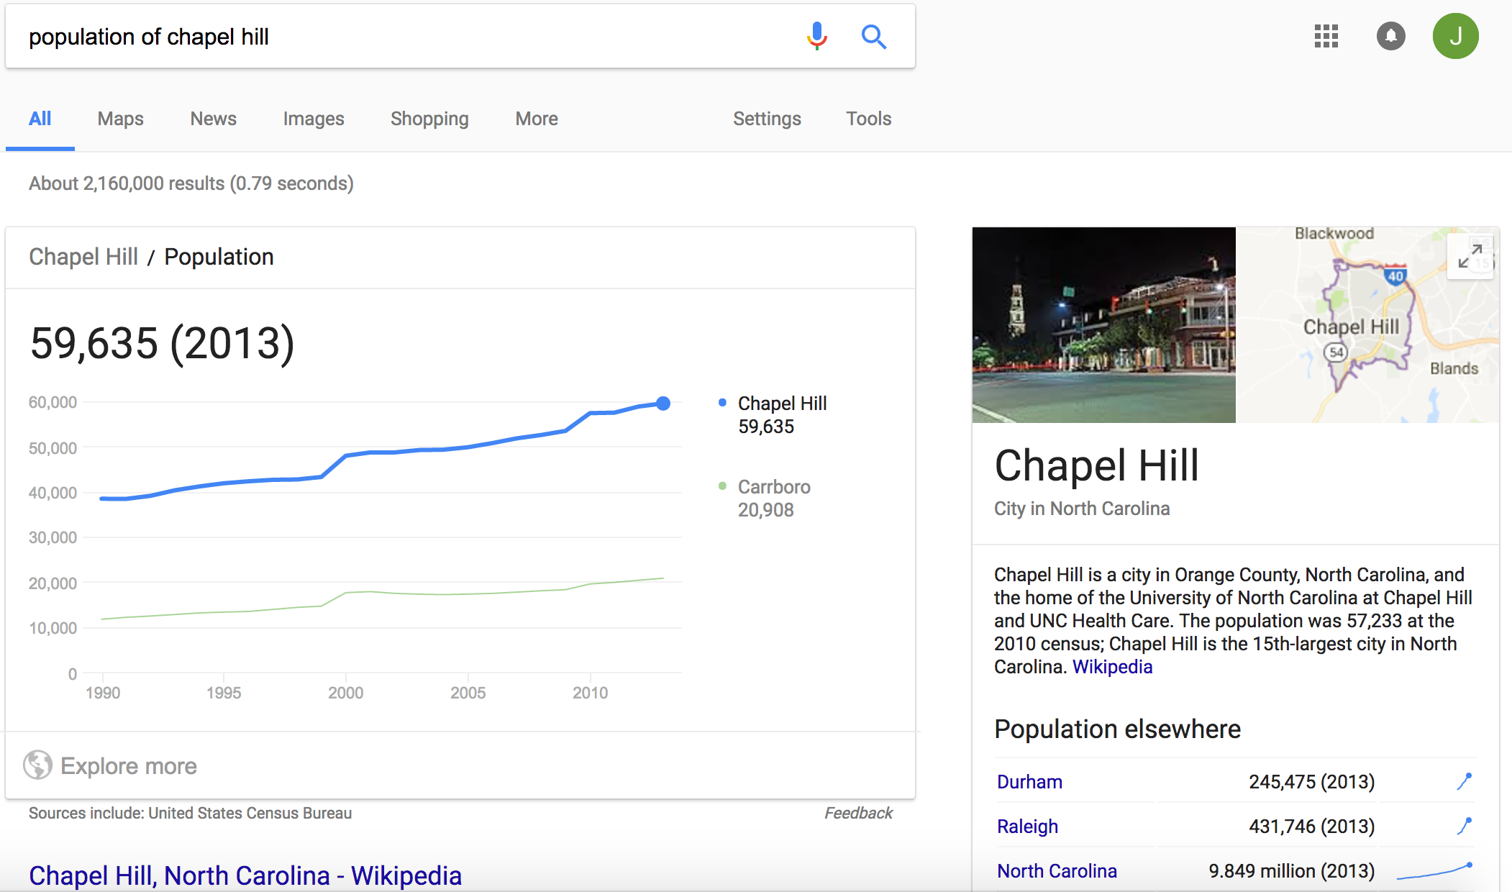
Even More Features
Earthquakes
Time
World
Sunrise, sunset
Movie times
Demographic information
Medical information
Symptoms
Treatments
Drug information
Knowledge Graph
History
Scientific information

Slide 23
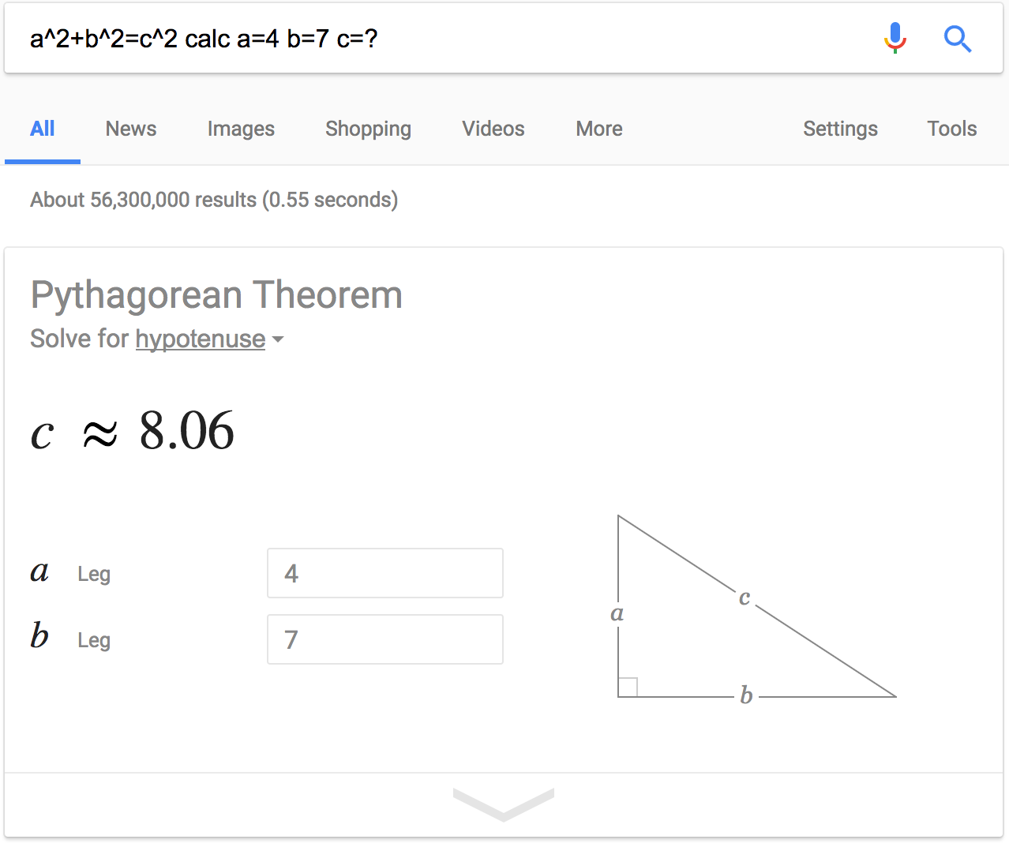
Google can be your
Personal Assistant
Words
Definitions, synonyms
Etymology, usage history
Translation
Calculator
Graphing functions
Known constants
Unit conversion
Geometry problems
Travel
Hotels and flights
Food and attractions
Weather
Time
Stocks, Currency
Sports - realtime scores, stats
Notes:
Using keywords

Slide 24
Tips for Composing Good Queries
Ignore stop words, punctuation, capitalization, spelling
Use keywords that are unique to your topic of interest
Use filtering techniques to remove irrelevant results
Search organically

Slide 25
Key Sources
Google’s own explanation of how Google Search works https://www.google.com/insidesearch/howsearchworks/thestory/
Google’s own explanation of Google’s networks https://peering.google.com/#/
2008 Blog post synthesizing known information about Google architecture http://highscalability.com/google-architecture
StackOverflow general explanation of how Google can be so fast http://stackoverflow.com/questions/132359/how-can-google-be-so-fast
Google Support post on refining search queries and filtering results https://support.google.com/websearch/answer/2466433?hl=en
Wikipedia article describing implementation of a search engine index https://en.wikipedia.org/wiki/Search_engine_indexing

