Slide 1
Introduction to Machine Learning
Vladimir Jojic
March 1st 2017

Slide 2
Machine Learning Applications all around you
Product recommendation
Speech recognition
(News) Feed selection
Traffic prediction
Self-driving cars
Home automation
Automated stock trading
Design of new drugs

Slide 3
Two ways of designing/implementing an algorithm
Given a specification and a few examples
Given a set of correct input-output pairs
Specification:
Function reverse should given an input array a return array b such that :
b[length(a)-i] = a[i]
for i=0,..,length(a)
Illustrative examples:
reverse([1,2,3]) -> [3,2,1]
reverse([1]) -> [1]
reverse([]) -> []
Data:
([1,2,3],[3,2,1])
([10,4,5,23],[23,5,4,10])
([2],[2])
([100,211,1,1],[1,1,211,100])
.
.
.
.
Specification defines the task formally.
Data gives examples of a successfully accomplished task.

Slide 4
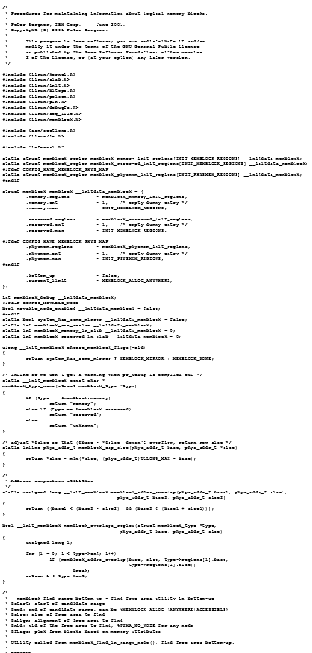
Traditional Programming Approach
Code
Specification
Implementation

Slide 5
Machine Learning Approach
Code
Machine
Learning
Method
Implementation
Data
Machine learning uses examples, DATA, to learn how to accomplish a TASK.

Slide 6
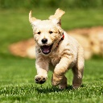
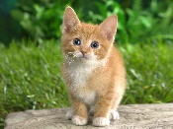
Machine Learning – a toy example
Sample 1
Sample 2
Sample 3
Data: {( , 1), ( ,0), ( ,0) …}
The TASK: Given input image predict label dog or a cat.
A machine learning algorithm produces a function $f$ such that $f(input)$ frequently matches the true label output$.$
input
output
input
output
input
output

Slide 7
A machine learning concept: Features
Input, such as , needs to be distilled into quantities that can be used for prediction – features.
One type of image features: fraction of patches with a particular dominant color
Green fraction: 20/30
Light brown fraction: 9/30
Dark brown fraction: 1/30
Light gray fraction: 0/30
Patches with triangular objects: 3/30
Patches with circular objects: 4/30

Slide 8
Feature mapping
$x$ = [ 0.66, 0.3, 0.03 …]
Raw image
Feature vector

Slide 9
Feature mapping of the dataset
Input
Features
Sample 1
$x^{1}$=[ 0.66, 0.3, 0.03 …]
$x^{2}$=[ 0.7, 0.2, 0.01 …]
Sample 2
$x^{3}$=[ 0.0, 0.4, 0.4, … ]
Sample 3
.
.
.
.
.
.

Slide 10
Feature space
Feature vectors can be fairly long: 10^3 – 10^6
Each sample is a point in a high-dimensional space. But, we can’t visualize that space easily.
Hence, we try to think in lower dimensional space.
$$x_{2}$$
Feature 2
$$x_{1}$$
Feature 1

Slide 11
A simple machine learning algorithm
As a warm-up we will think of a very simple algorithm.
Intuition: Similar inputs produce similar outputs.
New input
$$x_{2}$$
is closest to .
Since is a cat, is a cat as well.
$$x_{1}$$

Slide 12
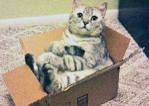
Machine Learning – a toy example
Data
Prediction
=
${input}^{1}$= ${ output}^{1}$=1$f({input}^{1})=1$
=
${input}^{2}$= ${output}^{2}$=0 $f({input}^{2})=0$
$$≠$$
${input}^{3}$= ${output}^{3}$=0$f({input}^{3})=1$
Q: How would you measure performance of function $f$?

Slide 13
Designing exams
Suppose you taught a course. You are selecting question for the final exam
Q: Would you use
the same questions you gave students as homework assignments, or
the same questions you use every year, or
questions that students have never seen in class?
Argue why!

Slide 14
Overfitting
In machine learning, we typically split the Data into a Training and a Test set.
Training set – homework – is used to train the algorithm.
Test set – exam – is used to evaluate the trained algorithm’s performance on unseen data.
Overfitting occurs when performance on the training data is much better than performance on the test data.

Slide 15
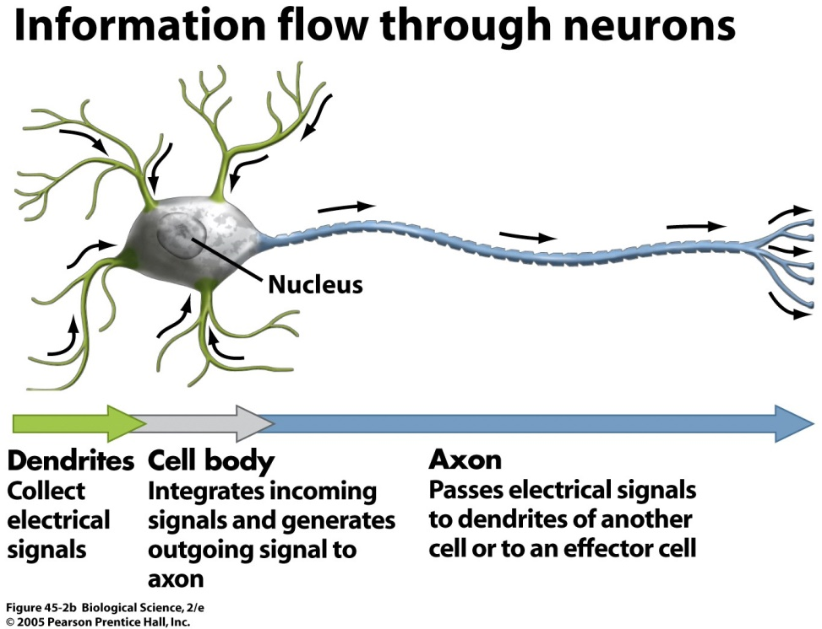
Neural Networks
Neural Networks draw on biological inspiration to achieve astonishing results in machine learning and artificial intelligence.
x₁
1
2
x₂
-0.5
x₃
Artificial neuron

Slide 16
A neural unit example
Input: $z={1∗x}_{1}+2∗x_{2} −0.5∗x_{3}$
Output:
if z<0 then unit outputs 0
if z>0 then unit outputs z
x₁
1
2
x₂
-0.5
x₃

Slide 17
Illustration
0
1
0
1
0
1.5
2
2
0
1
-0.5
-0.5
1
1
z = 0*1 + 0*2 – 1*0.5 = -0.5 <0
z<0 so the neuron outputs 0
z = 0*1 + 1*2 – 1*0.5 = 1.5 > 0
z<0 so the neuron outputs 1.5
Values associated with the edges tell us how important is the connection.
Adjusting these values to make the most accurate prediction is called Learning.

Slide 18
Deep Learning
Recent advances in neural network training have enabled training of deep networks
Deep networks have many intermediate layers
between input and output.
Input Layer
Output Layer
1
…
…
…
…
…
…
…
…
…
…
…
…
…
…
…
…

Slide 19
Deep Networks can write novels after being trained on Shakespeare’s works
At the beginning of training:
tyntd-iafhatawiaoihrdemot lytdws e ,tfti, astai f ogoh eoase rrranbyne 'nhthnee e plia tklrgd t o idoe ns,smtt h ne etie h,hregtrs nigtike,aoaenns lng
After training for a few hours:
"Why do what that day," replied Natasha, and wishing to himself the fact the princess, Princess Mary was easier, fed in had oftened him. Pierre aking his soul came to the packs and drove up his father-in-law women.

Slide 20
How is it done
Learn how to predict the next character given the
previous characters:
(“To be, or not to b”, “e”)
(“That is the questi”, “o”)
“To be, or not to b”
“e”
…
…
…
…
…
…
…
…
…
…
…
…
…
…
…
…

Slide 21
Deep Networks can learn to write Operating Systems code
/*
* If this error is set, we will need anything right after that BSD.
*/
static void action_new_function(struct s_stat_info *wb)
{
unsigned long flags;
int lel_idx_bit = e->edd, *sys & ~((unsigned long) *FIRST_COMPAT);
buf[0] = 0xFFFFFFFF & (bit << 4);
min(inc, slist->bytes);
printk(KERN_WARNING "Memory allocated %02x/%02x, "
"original MLL instead\n"),
min(min(multi_run - s->len, max) * num_data_in),
frame_pos, sz + first_seg);
div_u64_w(val, inb_p);
spin_unlock(&disk->queue_lock);
mutex_unlock(&s->sock->mutex);
mutex_unlock(&func->mutex);
return disassemble(info->pending_bh);
}
static void num_serial_settings(struct tty_struct *tty)
{
if (tty == tty)
disable_single_st_p(dev);
pci_disable_spool(port);
return 0;
}

Slide 22
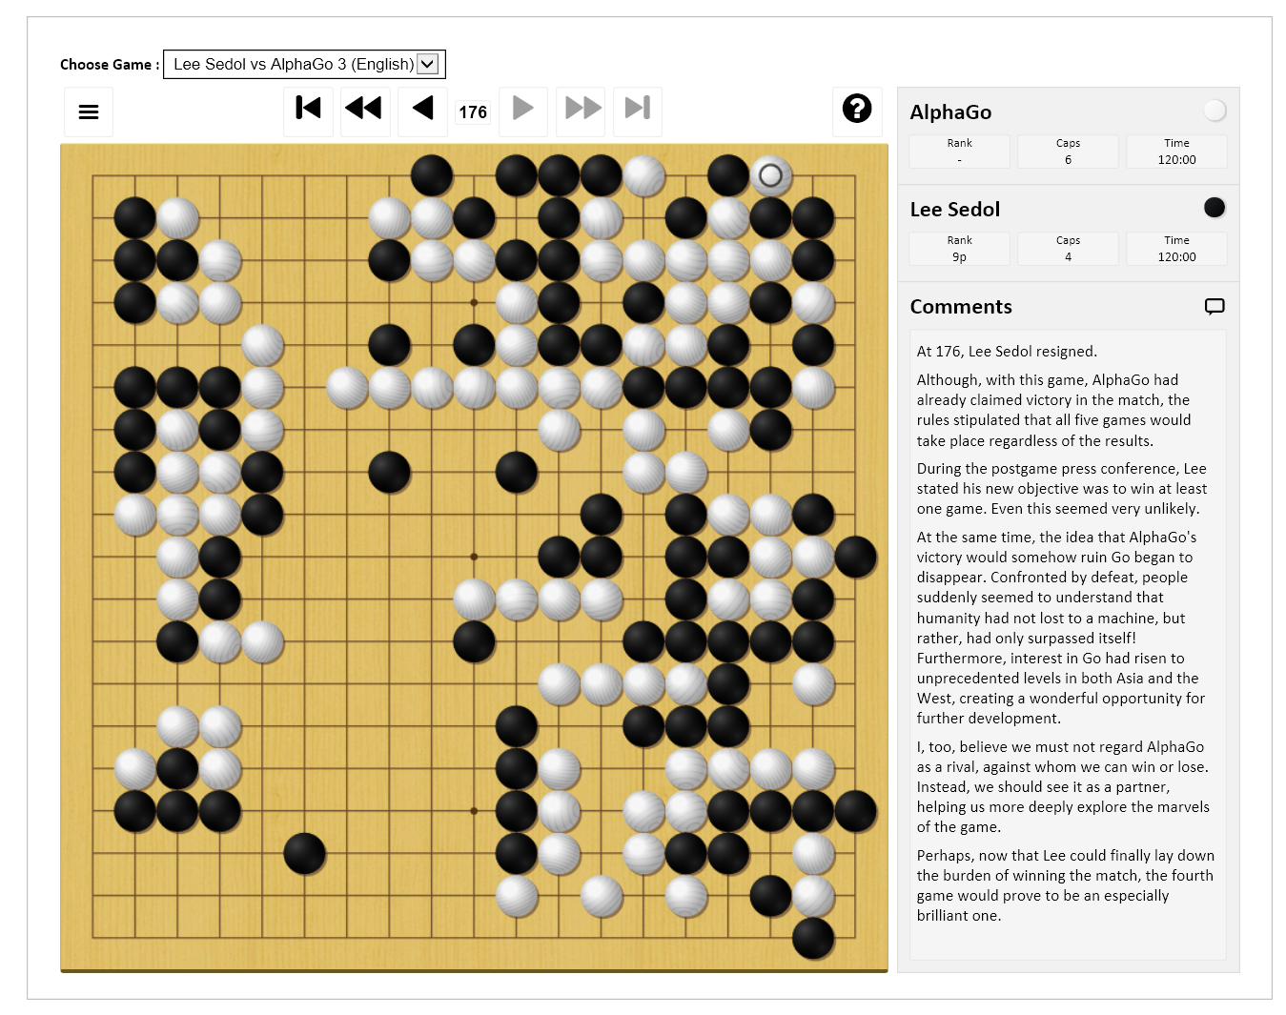
Deep Networks can learn to play Go (AlphaGo)

Slide 23
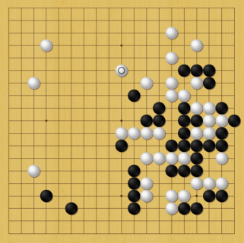
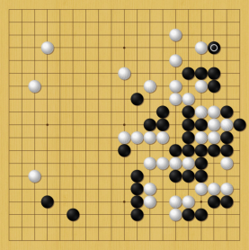
How does it work?
Network plays against itself, by choosing moves based on preferences.
Input is the board state, output next move
Output:
Input:
…
…
…
…
…
…
…
…
…
…
…
…
…
…
…
…

Slide 24
How does it work?
After a game is done:
Moves made by the winner become slightly more preferred.
Moves made by the loser become slightly less preferred.
Over many games good moves become preferred.
Preferences are called a policy, and the procedure of training in such a manner reinforcement learning.

Slide 25
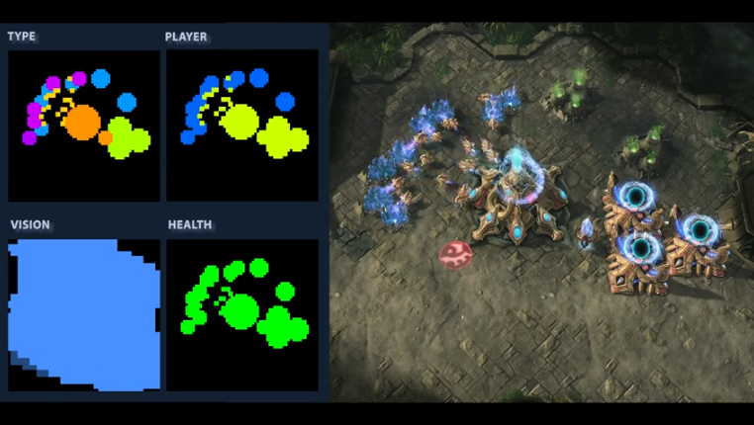
Deep Networks are learning how to play Starcraft II (DeepMind)

Slide 26
How to get started?

Slide 27
How to continue?
Machine Learning requires
Computer science
Mathematics: multivariate calculus, probability and statistics, and linear algebra
Curiosity and tenacity

Slide 28
A group exercise– dreaming up new machine learning applications
In groups of 3-4 come up with one or two ideas for machine learning applications
1) What is the Task?
For example: predicting what you want for breakfast tomorrow
2) What is the Data you would use? Think input-output pairs.
Example: (Ingredients, ratings) Inputs are ingredients, outputs are ratings.
3) How would solving this task change your life and life of others?
Example: Menu design for restaurants with known customers. Personalized meal service. Balancing cost, nutrition, and diversity.
We will take 5-10 minutes and then talk about the ideas you came up with.

