Slide 1
Wearable Technology
By: omsai Meka

Slide 2
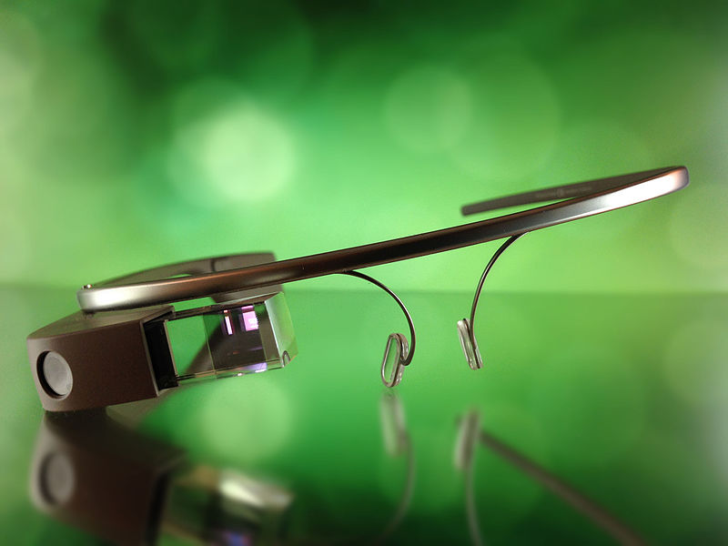
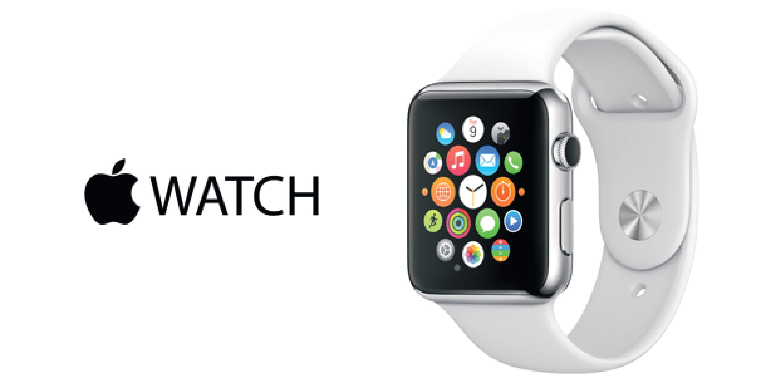
What is Wearable technology?
It is a small computer or other advanced electronic device that can be worn or carried on your body. This tech can be infused with pre-existing items of fashion and culture to create a technologically enhanced society.

Slide 3
Motivations of wearable technology
Wearable technology is an attempt at fulfilling the idea of “ubiquitous computing” which is the notion that computers should be available at all places at all time.
By having computers be placed into multiple daily facets of life, we will be able to compute wherever and whenever we want.
Applications of wearable technology have a wide range from military use to entertainment and healthcare.

Slide 4
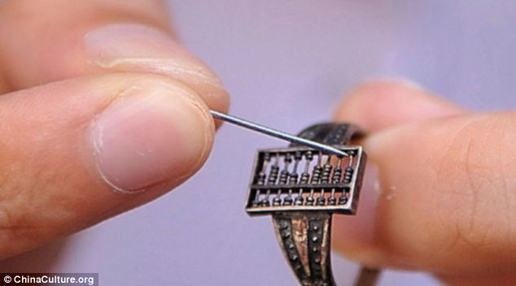
history
The creation of wearable computers is not a novel idea with many historical examples fitting the definition of wearable technology we use today.
For example the Qing Dynasty showed evidence of the development of a “smart” ring abacus that was used by merchants and mathematicians to conduct arithmetic on the go.

Slide 5
Wearable computers
More specifically, wearable computers were developed in the 1980s with the introduction of the WearComp by Steve Mann, who is the Father of Wearable Computing, in 1981 and the Private Eye by Reflection Technology in 1989.
The WearComp was a backpack based computer system with a headset display to view the output graphics of the computer.
The Private Eye was a visual headset that was used to write and read text. However the battery for this device had to be carried in a bag.

Slide 6
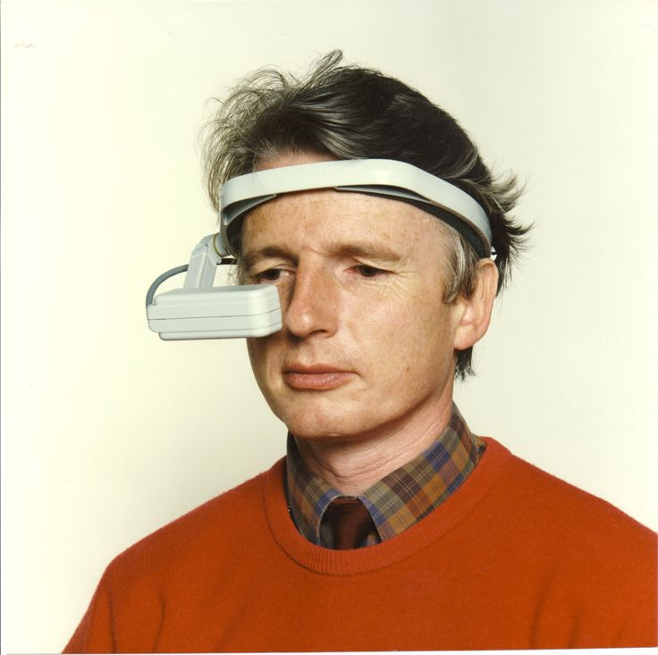
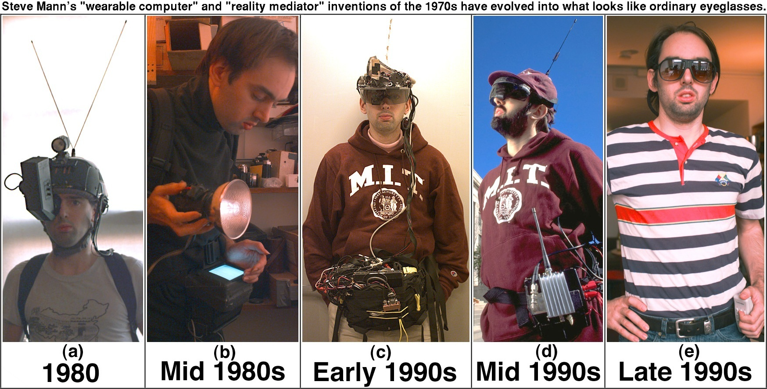
WearComp and Private EYE

Slide 7
Basic smartwatch
In the 1990s a new type of wearable technology was introduced in the form of wrist computers. The main proponent of this technology was the Timex Datalink watch. This was considered to be one of the first smartwatches made and was made in conjunction between TIMEX and Microsoft.
This watch was approved for space travel by NASA and has been worn by astronauts on STS missions and cosmonauts as well.

Slide 8
Timex datalink

Slide 9
TINMITH
In 2000 the Tinmith wearable system was created. This used augmented reality so that the user can see the type of land they are on and what it will be like ahead of them.
This served as a basis for many AR applications today like Pokémon Go.

Slide 10
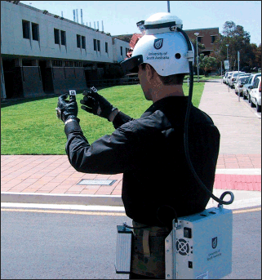
TINMITH WEARABLE AR SYSTEM

Slide 11
2000s
Along with the Tinmith system, GoPro developed and released their first camera called the GoPro HERO 35MM which users could wear on their helmets or attach to their sport equipment to record and capture pictures.
Project Cyborg- Kevin Warwick placed an electrode array into his nervous system which determined the color of a necklace.

Slide 12
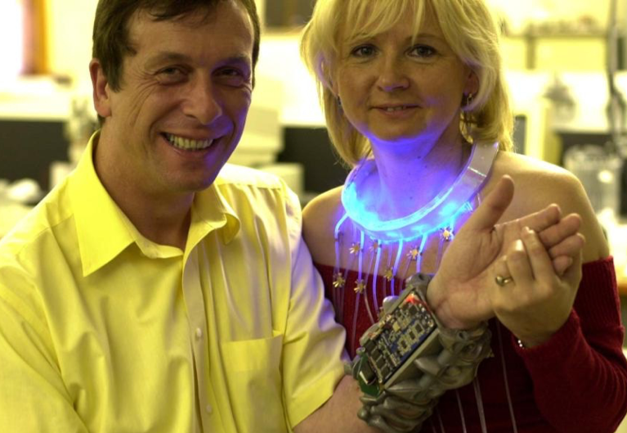
Project cyborg

Slide 13
Notable Recent developments
Nike+
Fitbit
Google Glass
Apple Watch

Slide 14
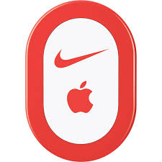
Nike+
In 2009 Nike released the Nike+ iPod Sports Kit which tracks how far and fast you have ran/jogged/walked by measuring the piezoelectric signals in your foot. This device is placed in a slot in the shoe in the sole.
Makes use of GPS and accelerometer of iPhone to work the Nike+ Running App which keeps track of all data and provides connectivity with other runners.

Slide 15
fitbit
Fitbit is a company that makes many types of personal activity trackers that also collect biometric data such as heart rate, sleep quality, and steps climbed.
Uses photoplethysmography (PPG) to measure the heart beat by flashing green light into blood and using photodiodes to measure absorption. The higher the absorption the higher the heart beat.
Uses the heart sensor and motion sensor along with movement algorithms to see how well you sleep at night depending on how much your body moves.

Slide 16
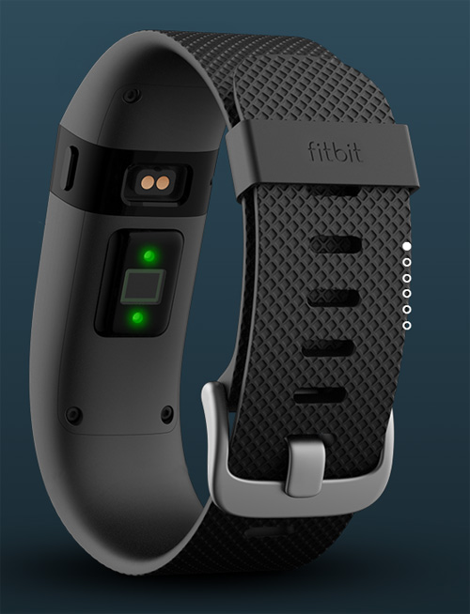
FITBIT

Slide 17
Google glass
A head-mounted display that uses a pair of glasses as its bae structure.
Functions include Google internet access, photo/video capture, notifications of texts, calls, and emails which are essentially the capabilities of a basic smartphone.
One major concern is over the privacy of the user’s data and who will be able to see it.

Slide 18
Google glass

Slide 19
Apple Watch
A smart watch that is compatible with iPhones so that the user can see many of the functions that are available on the phone.
Has many of the functionalities of the Fitbit along with the features you get from an iPhone.
For example, can text from the watch and supported apps can be accessed from watch itself for certain actions.
Supports the Apple Pay function so no need of carrying cash.

Slide 20
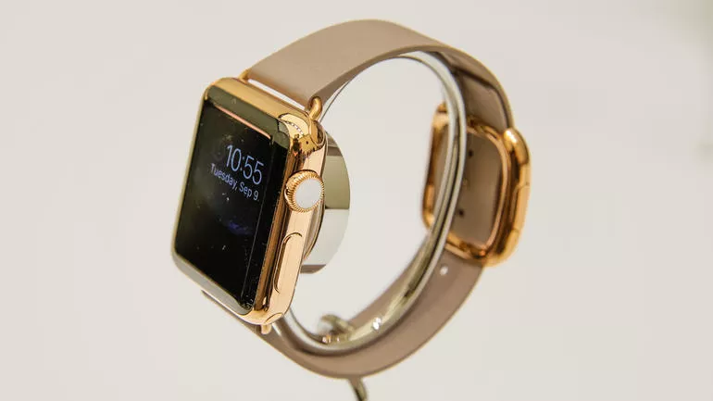
Apple Watch

Slide 21
Privacy Issues with wearable technology
These devices keep track of sensitive data like health statistics and information. This information can be used by health insurance companies to raise premiums or even deny policies.
Also danger of identity theft increases since there are more possibilities of exposure because of increased number of devices.
Wireless connectivity requirements leave the wearable and yourself vulnerable to the risk of being hacked and having identity stolen over Bluetooth.
-Problem of privacy can be solved by having regulation and compliance standardized across the industry so that manufacturers have to follow strict guidelines to ensure data is protected correctly.

Slide 22
Current Research
At NC State, they have developed a “pulse dress” which changes the frequency of light flashes based on your heart rate.
Uses a screen printed sensor that picks up the heart beat and sends that information to various LEDs placed throughout the dress through the use of conductive threads.
Displays potential of using technology to create new type of technologically-enhanced fashion style.

Slide 23
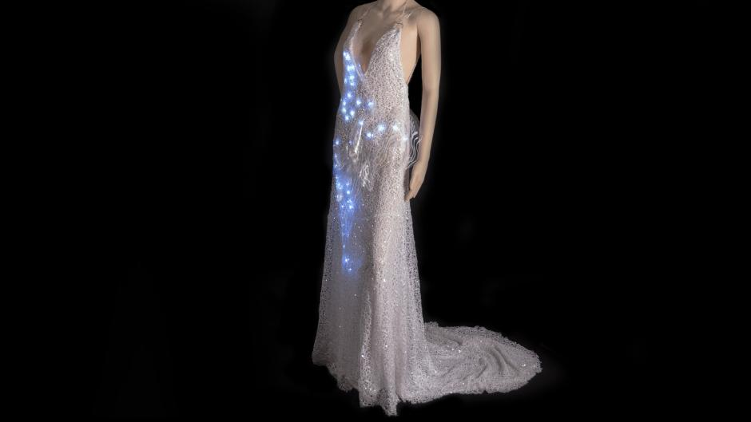
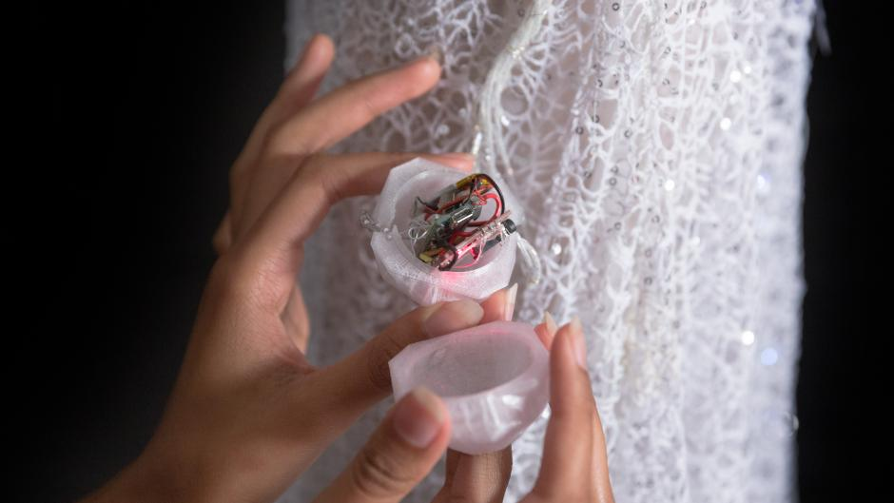
PULSE DRESS

Slide 24
Making Electricity from shirts
Researchers from NC State have made t-shirts and arm bands. with embedded thermoelectric generators that use your body heat as you exercise to create energy efficiently.
The conductive layer of the heat is on this inside of the shirt and picks up the heat which is then transferred to the TEG which converts it into energy.
This energy is then used to power other wearable technology on the person.

Slide 25
TEG T-Shirts

Slide 26
Dehydration sensors
A medical application of wearable technology.
The sensors are made of 2 polymer electrodes with silver nanowires that will collect data of the electrical details of the skin.
These details change based on how much water is available in body so that hydration level can be monitored.
The sensors can be applies as a skin patch to the chest area or in the form of a watch on the wrist. This will allow data to be viewed both by wearer and by another person to monitor vital signs.

Slide 27
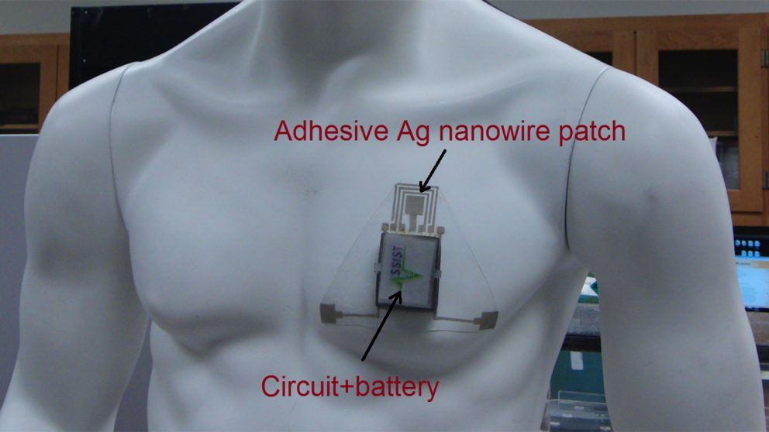
DEHYDRATION SENSORS

Slide 28
Future of wearable technology
From a stylistic standpoint, future wearable technology has to be designed so that it feels seamless and as if it is a natural extension of the body.
Can be designed to work with other technologies around you. For example should be able to connect with home assistants like Alexa, future smart cars, and computers to create an technologically integrated life style.
Has to be more intuitive and can include an integrated AI system that will become your personal assistant everywhere you go.

Slide 29
Electronic skin

Slide 30
Sources
http://www.dictionary.com/browse/wearable-technology
https://en.wikipedia.org/wiki/Wearable_technology
https://www.theodysseyonline.com/apple-watch-worth-it-or-no
https://en.wikipedia.org/wiki/Google_Glass#/media/File:Google_Glass_photo.JPG
http://www.dailymail.co.uk/sciencetech/article-2584437/Is-wearable-computer-300-year-old-Chinese-abacus-ring-used-Qing-Dynasty-help-traders.html
http://wearcam.org/
http://www.geekwire.com/2015/reviewing-worlds-first-smartwatch-timex-datalink/
http://www.tinmith.net/
https://www.snyxius.com/blog/the-future-of-wearable-technology-in-healthcare/#.WNvygPnyvIU

Slide 31
Sources
http://www.nike.com/us/en_us/c/nike-plus
http://www.pcadvisor.co.uk/review/activity-trackers/fitbit-charge-hr-review-3585633/
https://en.wikipedia.org/wiki/Google_Glass#Healthcare_applications
http://mashable.com/2014/09/09/apple-watch-tools/#dNKQjV2VMaqC
https://news.ncsu.edu/2017/01/hydration-sensor-2017/
https://news.ncsu.edu/2016/09/wearable-teg-heat-harvesting-2016/
https://www.lib.ncsu.edu/stories/threading-the-needle-fostering-student-success-through-making
https://news.ncsu.edu/2017/03/composite-metal-foams-2017/

