Slide 1
Restaurant Web App
Project Proposal
Ravi Malik

Slide 2
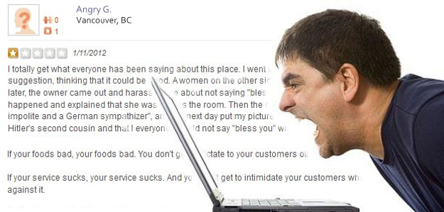
Problem
Delayed Customer Feedback
Online Reviews Hurt Business (Yelp)
Frustrated Customers
Disconnected Management

Slide 3
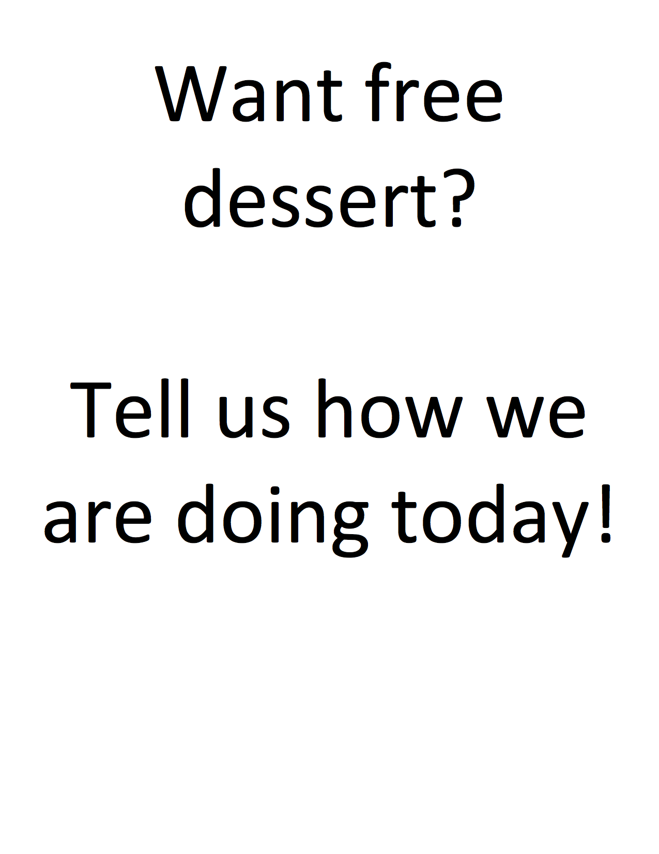
Solution
Easy Access Web App
Real – Time Customer Feedback
Instant Data Analytics
Preemptive Action

Slide 4
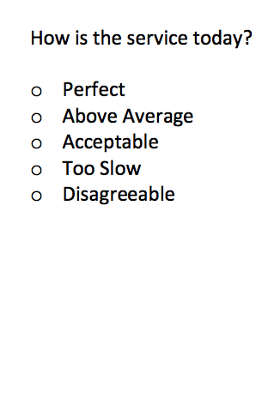
Survey
Several Simple M/C Questions
Quick & Convenient
Customers Voice Heard
Retains anonymity

Slide 5
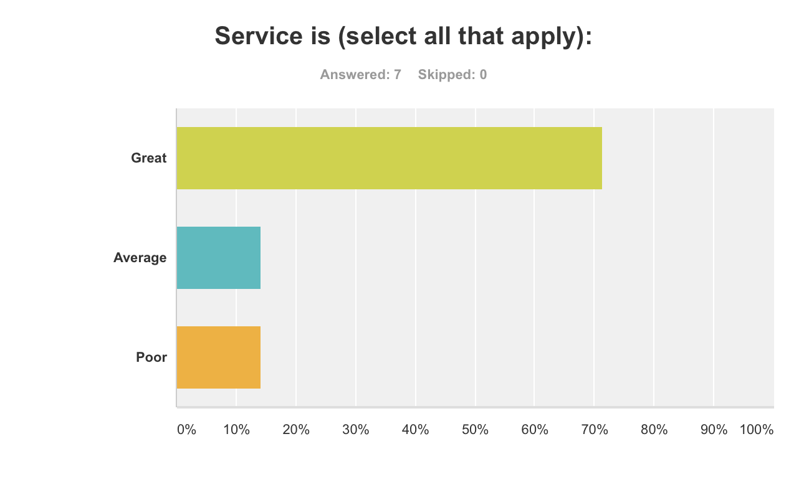
Feedback Analysis
Instant Results
Comprehensive Charts
Individual Statistics
Displays Improvement & Successful Areas

Slide 6
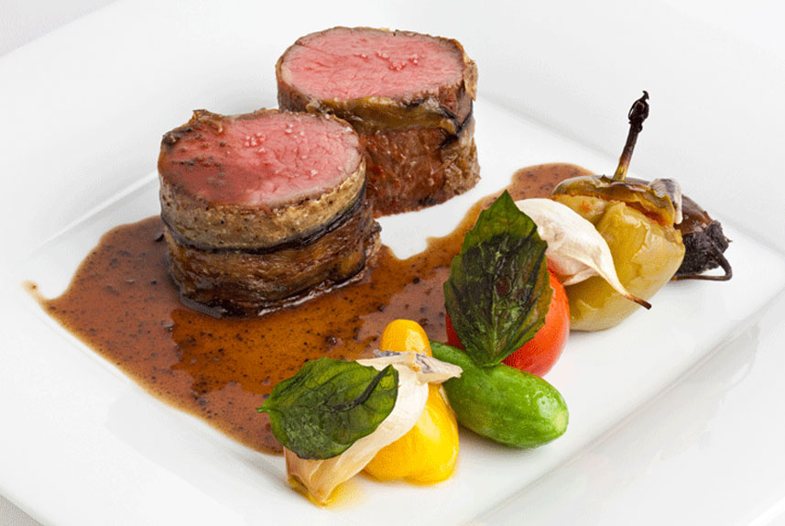
Customizable
Potential Features:
Menu Pictures
Integrated Open Table
Allergen Menu
Restaurant Request

Slide 7
Incentives
Discounts
Free Appetizer / Dessert
Earn Rewards Points

Slide 8
Questions / Comments?

