Slide 1
Project Proposal
Jocelyn Rives

Slide 2
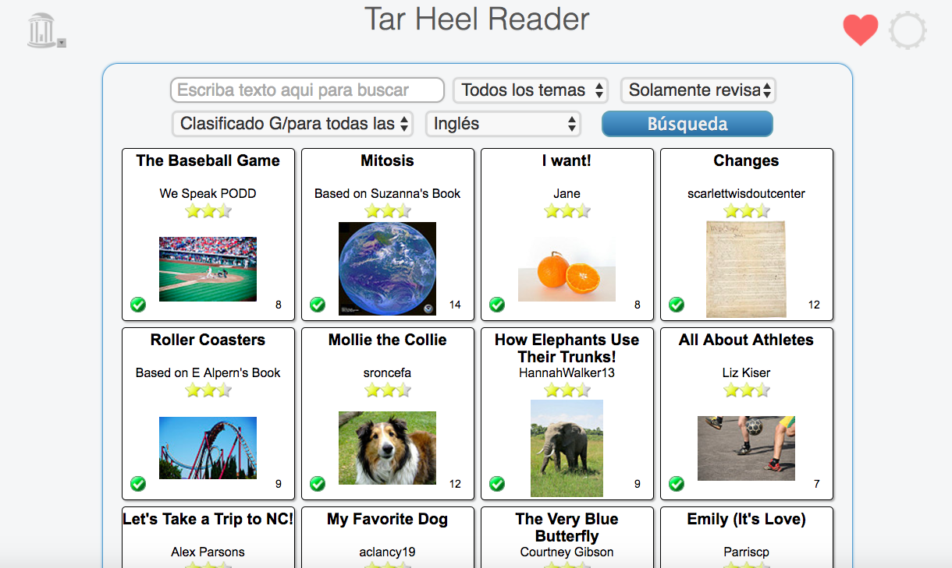
The Tar Heel Reader

Slide 3
Background
Created by the Center for Literacy and Disability Studies and the Department of Computer Science at UNC
Started as a demonstration of a simple way to make books
Try to address the literacy learning needs of learners of all ages with disabilities
  Example: speech enabled
All ages
Over 10 million

Slide 4
Motivation
Daily Tar Heel
Major = Journalism

Slide 5
My Project Plan
Read books
Create/write 2-3 books (pictures)
Life lessons
  Examples: overcoming fear, forgiveness

