Slide 1
Welcome to Comp 411!
Computer Organization and Design
Montek Singh
Aug 23, 2017
Lecture 1

Slide 2
Topics for today
Course Objectives
Course Mechanics
Computer Abstractions

Slide 3
Course Objectives
What You Will Learn:
  How programs are translated into the machine language
    And how the hardware executes them
  The hardware/software interface
  What determines program performance
    And how it can be improved
  What a typical computer processor looks like
  How hardware designers improve performance

Slide 4
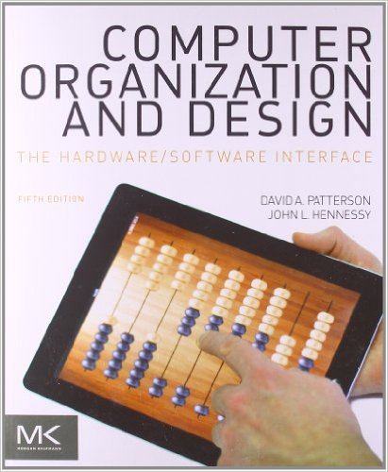
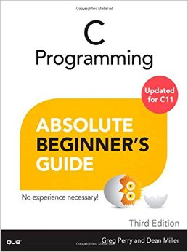
Required Textbooks
Computer Organization and Design: The Hardware/Software Interface
  Patterson and Hennessy
  5th ed., Oct 2013
  ISBN 9780124077263
C Programming:
Absolute Beginner’s Guide
  Greg Perry and Dean Miller
  3rd ed., Aug 2013
  ISBN 978-0789751980

Slide 5
Credits
Some of these slides were developed by Leonard McMillan and adapted by Gary Bishop and me.
Some slides and other materials are from the book publisher.

Slide 6
Course Mechanics
Grading:
  Homework: 25%
  Lab Assignments: 20%
  Lab Mini-Project: 5%
  Quizzes: 15%
  Midterm: 15%
  Final Exam: 20%
50%
50%

Slide 7
Course Mechanics
Policies:
  Lecture Notes:
    I will attempt to make Lecture Slides, and other course materials, available on the web before class.
  Problem Sets:
    Will be distributed on the web. You will typically have 1 week to do them, but sometimes more or less time.
  Quizzes:
    There will be a quiz on Sakai most Fridays.
  Labs:
    Labs on Fridays are compulsory. It is a combined review-quiz-lab session.
  Honor Code:
    The honor code is in effect for all homework, labs, exams etc. Please review the policy on the course website.

Slide 8
Course Policies
Late homework/labs will NOT be accepted
    No exceptions for foreseeable events:
      Religious/cultural holidays
      Family reunions
      Most athletic/club commitments
      Plan ahead!
    No exceptions for:
      out-of-town trips, job interviews, computer crashes, mild sickness, etc.
    For serious medical or other issues etc.
      Will need proof and permission from somebody higher up (chair/dean)
Lowest scores dropped
  2 lowest lab scores dropped
    but scores for “lab mini-project” not dropped
  1 lowest homework score dropped
  1 lowest quiz score dropped

Slide 9
Course Policies
Quizzes and Exams are open-book
  open-book, open-notes, calculator allowed, access to class website allowed
Missed classes, quizzes, exam conflicts
  classes: while attendance is not required, there is no substitute to coming to class if you want a good grade
  labs: skipping a lab (even if you have a good excuse) will make it very hard to complete the lab
  quizzes: since the dates are announced, please see me well in advance if you have a compelling reason for absence
  exams: bring any conflicts to my attention ASAP

Slide 10
Discussion Board
Please post questions (even private ones to instructor) on the discussion board on PIAZZA
  https://piazza.com/unc/fall2017/comp411/home
  Linked from course website

Slide 11
Honor Code
Collaboration:
  Allowed (even encouraged) to discuss basic concepts
    use discussion board on Piazza
    bonus points for active participation!
  BUT: What you hand in must be your own
    write solutions and code individually
  See website for more details and FAQs
Previous Semesters:
  Cannot use homework solutions from previous offerings of this course
  Cannot obtain lab assignments/code from students who have taken this course before
Not following these rules is a violation of honor code

Slide 12
Honor Code
What happens if cheating/copying is suspected?
  reported to the Honor System
  if found guilty: severe penalty
    typically Failing grade on all or part of the course
    probation or suspension depending on severity
  cheating is not worth it
    we have smart TAs and sophisticated tools
Spring 2017
  reported 8 students to Honor System
  all either pleaded guilty or found guilty

Slide 13
Prerequisites
COMP401: Foundations of Programming
  This is a hard prerequisite
  You may be able to substitute another programming course, but please first talk to me!
You need to know at least the following concepts:
  basic data types: integers, characters, Boolean, etc.
  basic arithmetic operators and expressions
  “if-then-else” constructs, and “while”/“for” loops
  function and procedure calls
  basic Boolean operators (AND, OR, XOR, etc.)
If you don’t know many of the above concepts, please talk to me!

Slide 14
Detailed Syllabus / Course Website
See course website:
https://comp411fall17.web.unc.edu
Linked from my home page:
http://www.cs.unc.edu/~montek/

Slide 15
How NOT to do well in this course
BIG mistakes
  Skipping lectures
  Not obtaining the TWO textbooks
  Not reading the books (only reviewing lecture slides)
  Not spending enough time to do homework
    Start early. Many problem sets are too hard to attempt the night before.
  Not asking questions in class
  Not discussing concepts with other students
    But all work handed in must be your own (see Honor Code)
  Looking up solutions from earlier semesters = cheating. Not worth it.

Slide 16
Introductions
Who am I?
Who are you?
  by year
  by major
Why take this course?
  let’s hear from you

Slide 17
Two Goals
Goal 1: Demystify Computers
Goal 2: Learn the Power of Abstraction

Slide 18

Goal 1: Demystify Computers
Strangely, most people (even some computer scientists) are afraid of computers.
  We are only afraid of things we do not understand!
    I do not fear computers. I fear the lack of them. - Isaac Asimov (1920 – 1992)
    Fear is the main source of superstition, and one of the main sources of cruelty. To conquer fear is the beginning of wisdom.
    - Bertrand Russell (1872 – 1970)

Slide 19
Where do you find computers today?
Besides on your desk, or in your lap, of course!
  Let’s hear from you!
How have computers revolutionized life in the 21st century?
  Automobiles
  Mobile phones, PDAs, games
  Massive distributed projects: e.g., human genome project
  World Wide Web
  Search engines
What has fueled progress in computer technology?
  Moore’s Law

Slide 20
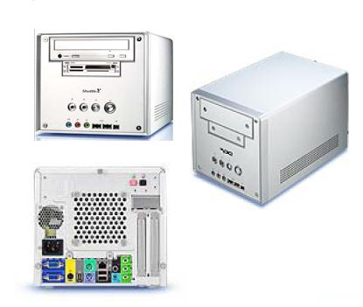
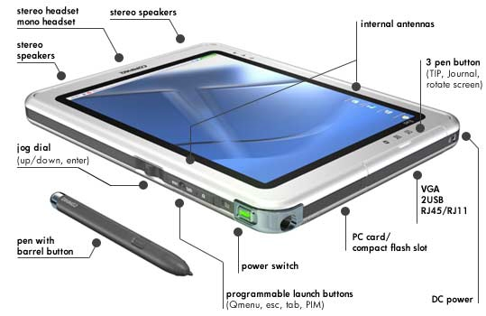
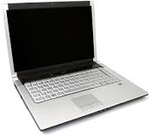
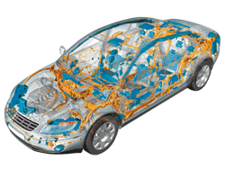
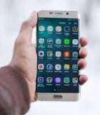
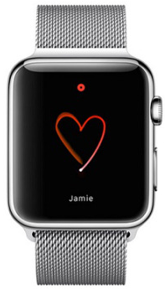
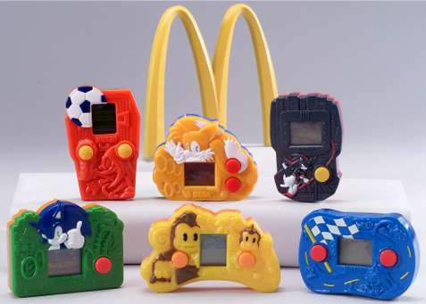
Computers Everywhere
The computers we are used to
  Desktops
  Laptops
  Servers
    Network-based
    “Cloud computers”
  Embedded processors
    Hidden as components inside: cars, phones, toasters, irons, wristwatches, happy-meal toys

Slide 21
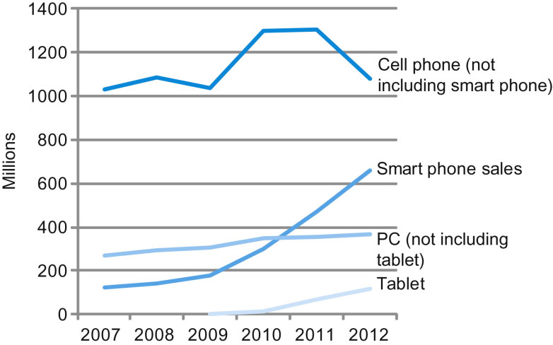
Portable gadgets dominate!
FIGURE 1.2 The number manufactured per year of tablets and smart phones, which reflect the PostPC era, versus personal computers and traditional cell phones. Smart phones represent the recent growth in the cell phone industry, and they passed PCs in 2011. Tablets are the fastest growing category, nearly doubling between 2011 and 2012. Recent PCs and traditional cell phone categories are relatively flat or declining.

Slide 22
Goal 2: Power of Abstraction
What is abstraction?
  Everyday language:
    Move the focus away from details towards the essential idea
  Technical writing:
    Summarize the essential, leave out the detail
  Art:
    represent the original free from adherence to detail
  Programming languages:
    hide all but the relevant internal details of an object
    define a function, develop a robust implementation, and then put a box around it
Why is abstraction useful?
  enables us to create unfathomable machines called computers
  with billions (1,000,000,000s) of components

Slide 23
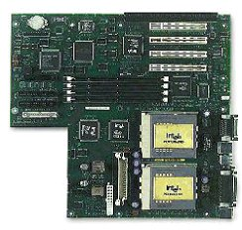
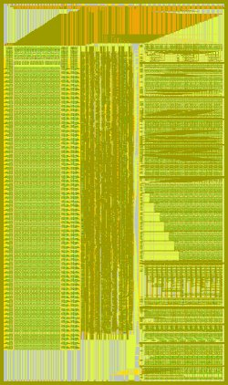
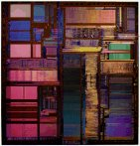
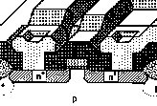

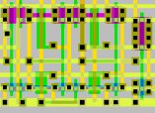

Abstraction: key to building large systems
Personal Computer:
Hardware & Software
Circuit Board:
≈8 / system
1-2G devices
Integrated Circuit:
≈8-16 / PCB
0.25M-16M devices
Module:
≈8-16 / IC
100K devices
MOSFET
="transistor"
="device"
Scheme for
representing
information
Cell:
≈1K-10K / Module
16-64 devices
Gate:
≈2-8 / Cell
8 devices

Slide 24
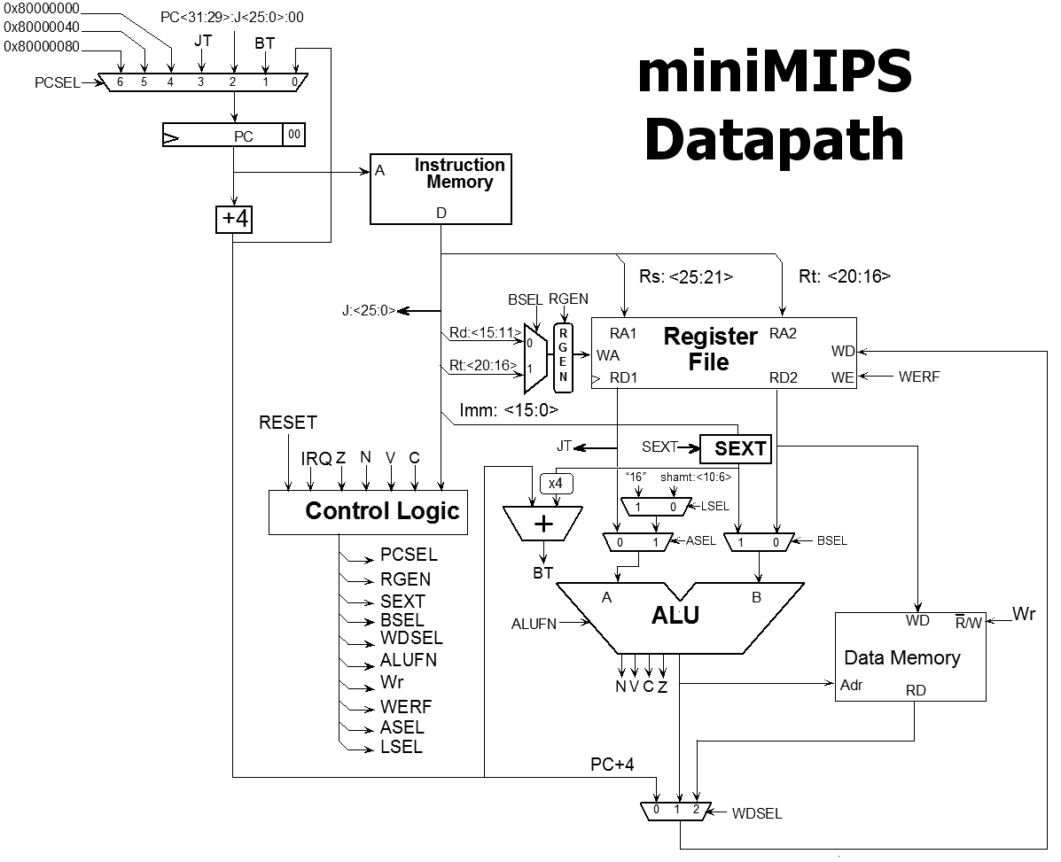
A Computer System
What is a computer system?
Where does it start?
Where does it end?
for (i = 0; i < 3; i++)
m += i*i;
Compiler
Assembler and Linker
addi $8, $6, $6
sll $8, $8, 4
CPU
Module
A
ALU
B
A B
CO CI
S
Cells
FA
Gates
Transistors

Slide 25
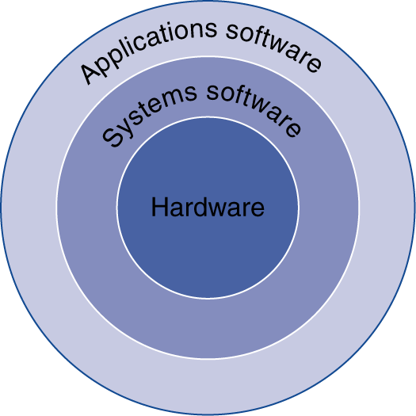
More abstract view!
Application software
  Written in high-level language
System software
  Compiler: translates HLL code to machine code
  Operating System: service code
    Handling input/output
    Managing memory and storage
    Scheduling tasks & sharing resources
Hardware
  Processor, memory, I/O controllers

Slide 26
What determines performance?
Algorithm
  Determines number of operations executed
Programming language, compiler, architecture
  Determine number of machine instructions executed per operation
Processor and memory system
  Determine how fast instructions are executed
I/O system (including OS)
  Determines how fast I/O operations are executed

Slide 27
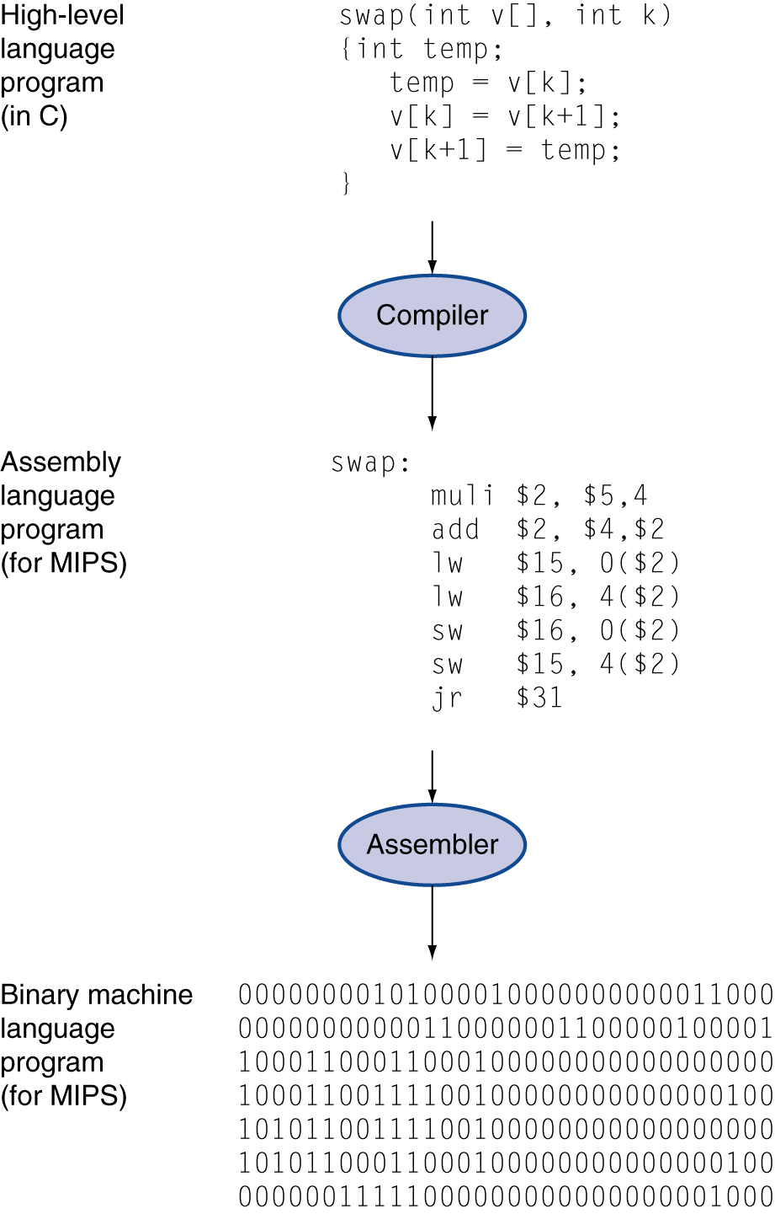
Levels of Program Code
High-level language
  Level of abstraction closer to problem domain
  Provides for productivity and portability
Assembly language
  Textual representation of instructions
Hardware representation
  Binary digits (bits)
  Encoded instructions and data

Slide 28
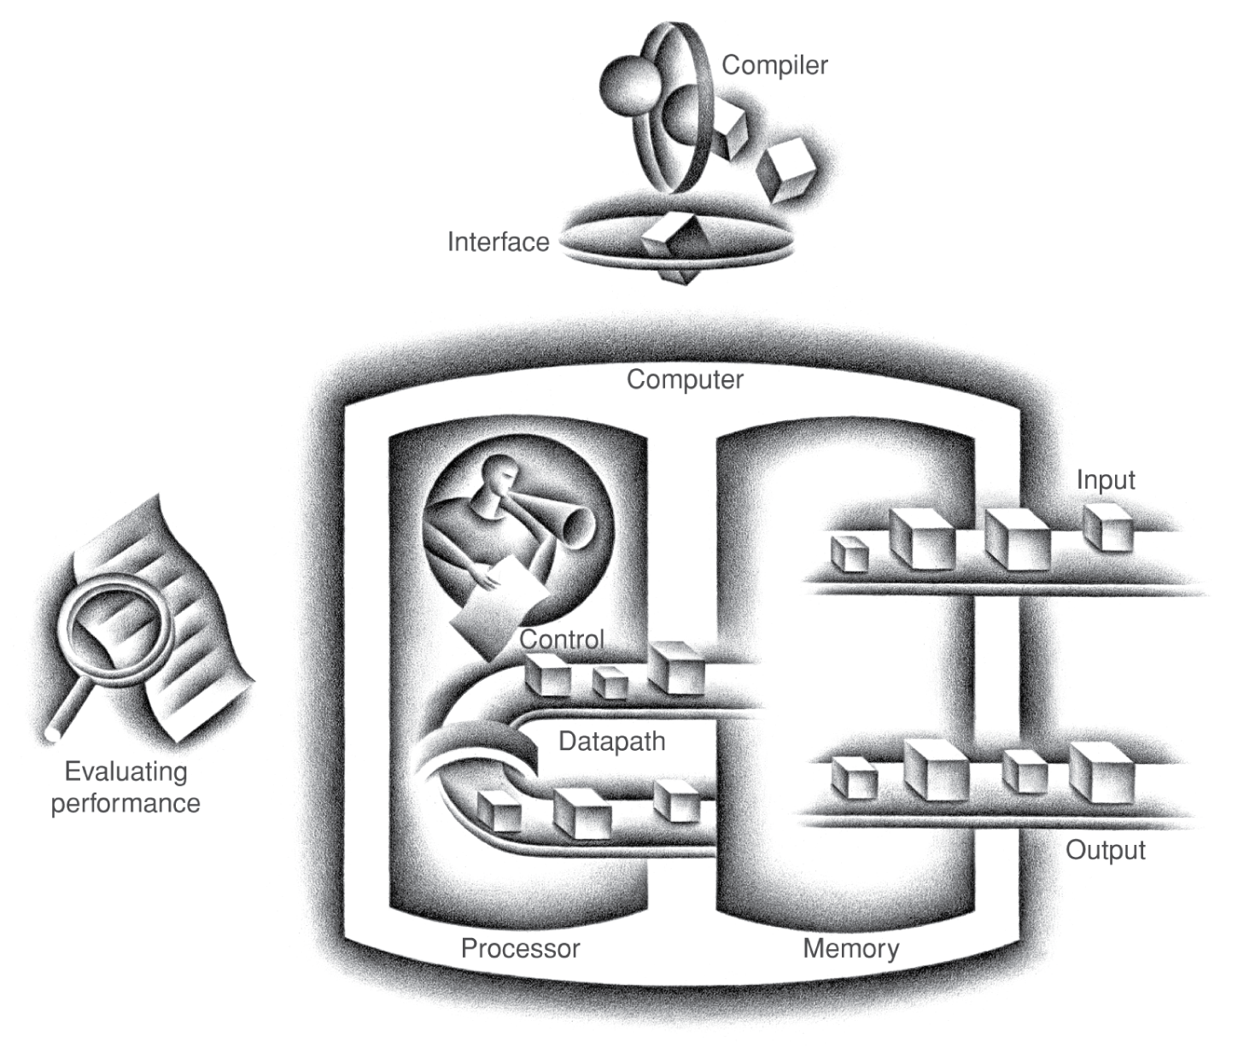
Components of a Computer
Same abstraction applies to all kinds of computers
  Server, personal, phone,
  embedded
Input/output includes
  User-interface devices
    Display, keyboard, mouse
  Storage devices
    Hard disk, CD/DVD, flash
  Network adapters
    For communicating with other computers
The BIG Picture

Slide 29
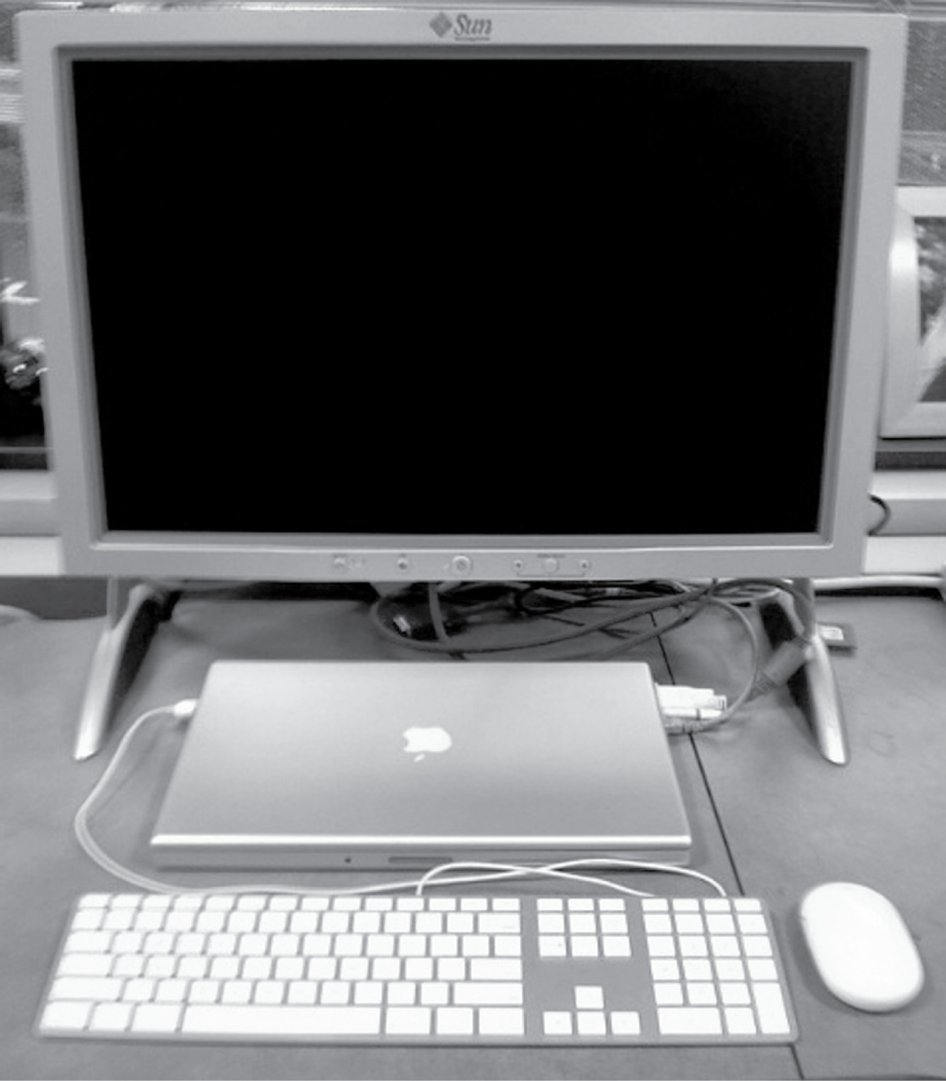
Anatomy of a Computer
Example: Laptop as today’s desktop
Output device
Network cable (I/O)
Input device
Input device
FIGURE 1.5 A desktop computer. The liquid crystal display (LCD) screen is the primary output device, and the keyboard and mouse are the primary input devices. On the right side is an Ethernet cable that connected the laptop to the network and the Web. The lap top contains the processor, memory, and additional I/O devices. This system is a Macbook Pro 15" laptop connected to an external display. Copyright © 2009 Elsevier, Inc. All rights reserved.

Slide 30
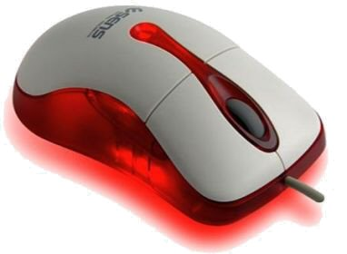
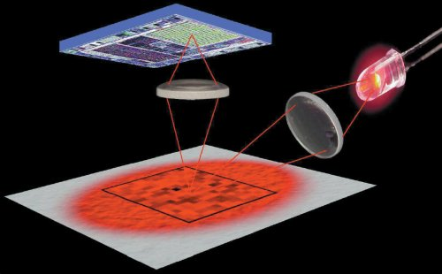
Anatomy of a Mouse
Optical mouse
  LED illuminates desktop
  Small low-res camera
  Basic image processor
    Looks for x, y movement
  Buttons & wheel
Supersedes roller-ball mechanical mouse

Slide 31
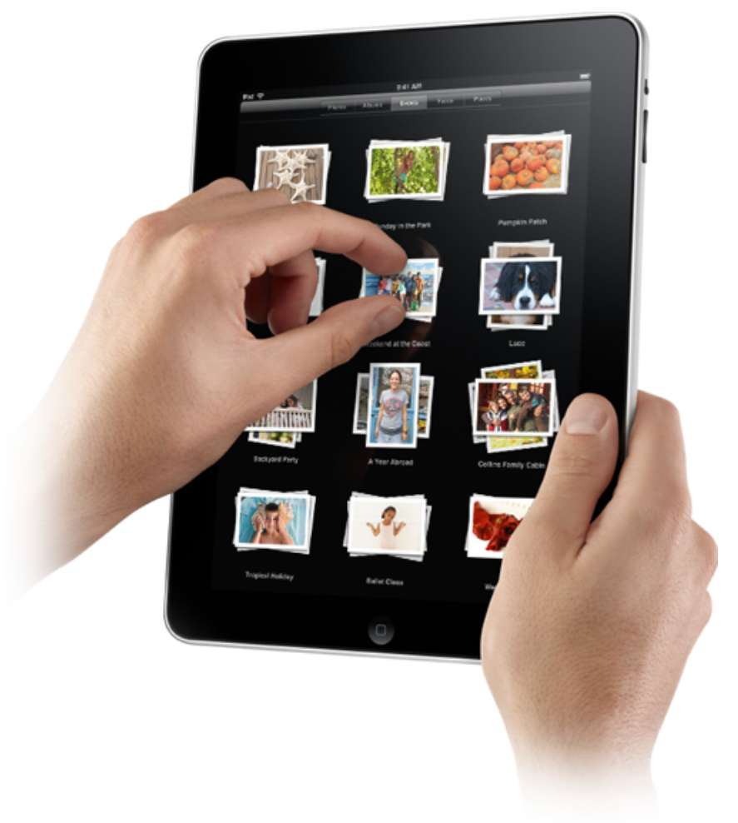
Touchscreen
PostPC device
Supersedes keyboard and mouse
Resistive and Capacitive types
  Most tablets, smart phones use capacitive
  Capacitive allows multiple touches simultaneously

Slide 32
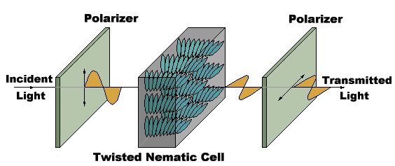
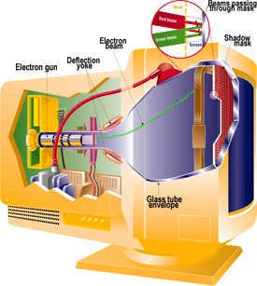
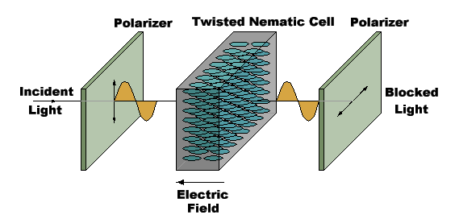
Displays
Cathode Ray Tube (CRT)
  The “last vacuum tube”
  Now nearing extinction
Liquid Crystal Displays (LCDs)

Slide 33
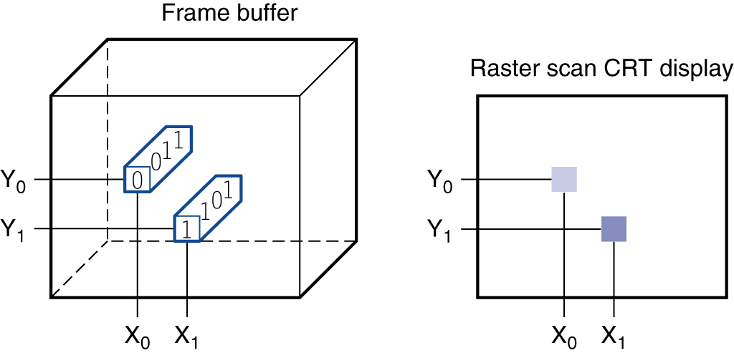
Display Abstraction
Screen: picture elements (pixels)
  Mirrors content of “frame buffer” memory
FIGURE 1.6 Each coordinate in the frame buffer on the left determines the shade of the corresponding coordinate for the raster scan CRT display on the right. Pixel (X₀, Y₀) contains the bit pattern 0011, which is a lighter shade on the screen than the bit pattern 1101 in pixel (X₁, Y₁).

Slide 34
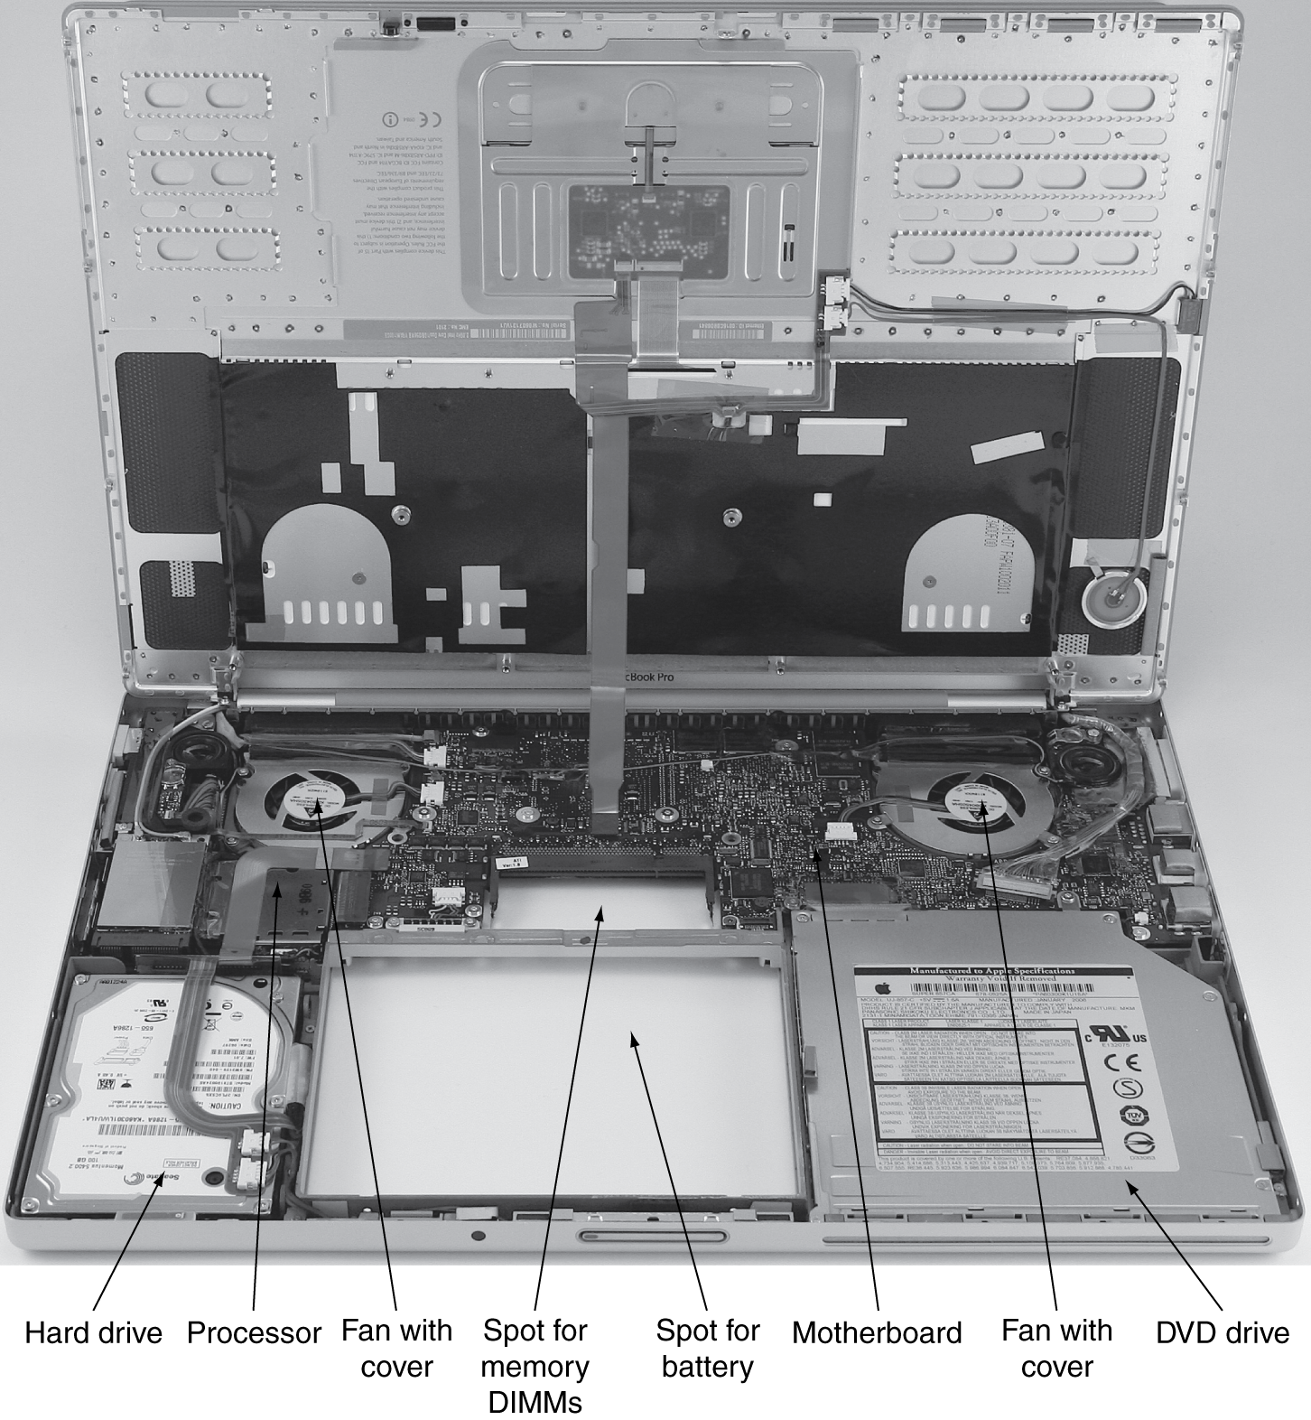
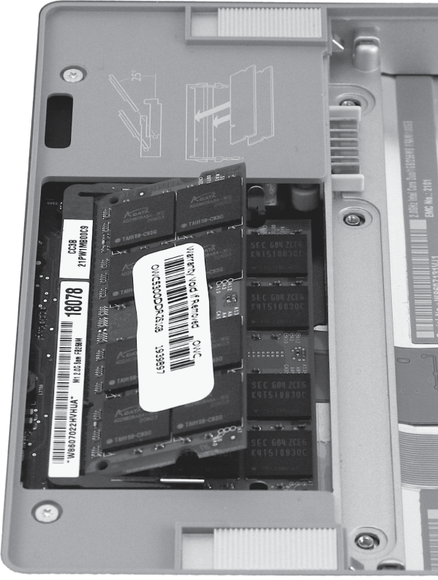
Opening the Box: Laptop

Slide 35
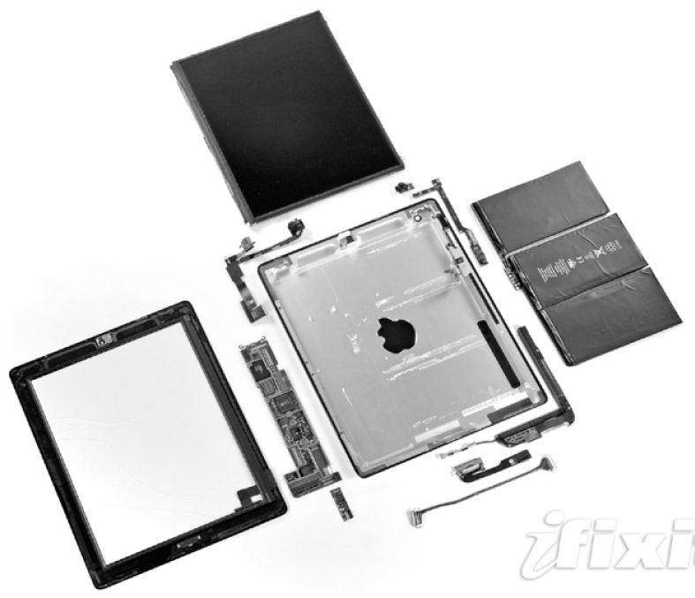
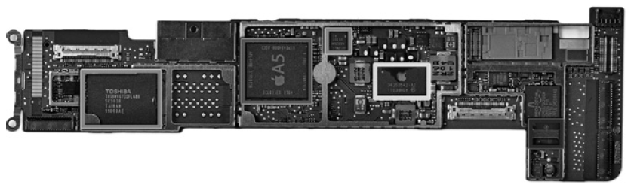
Opening the Box: Tablet
Capacitive multitouch LCD screen
3.8 V, 25 Watt-hour battery
Computer board

Slide 36
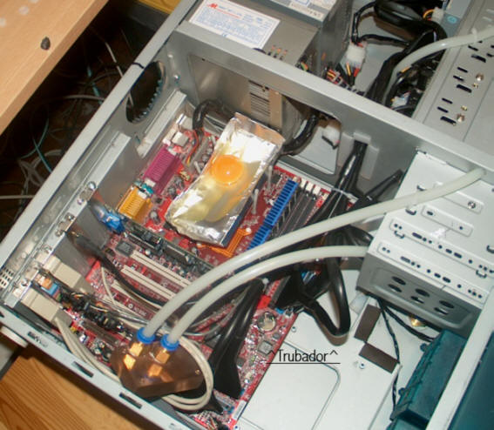
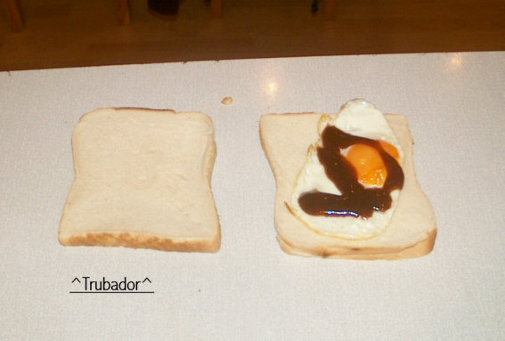
Issues for Modern Computers
  Energy/Power consumption has become a major challenge
    It is now perhaps the limiting factor in most processors
http://www.hotchips.org/
Courtesy Troubador

Slide 37
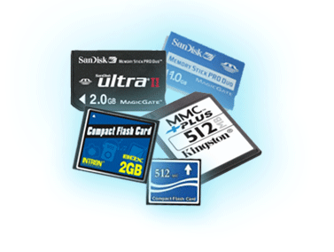
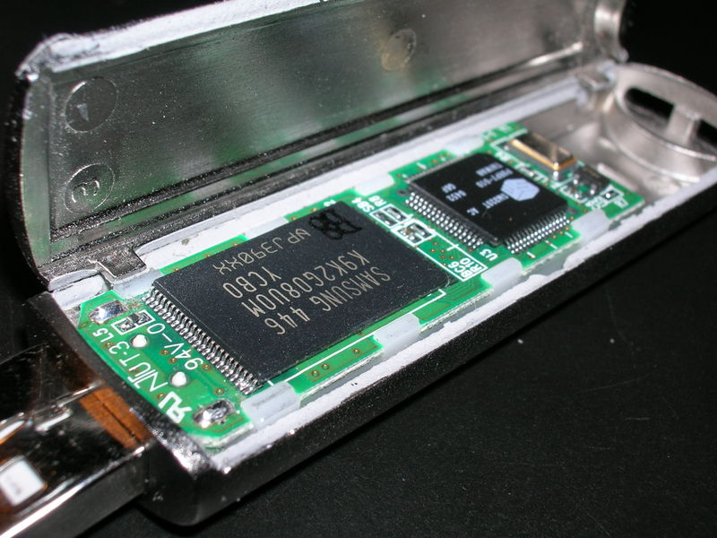
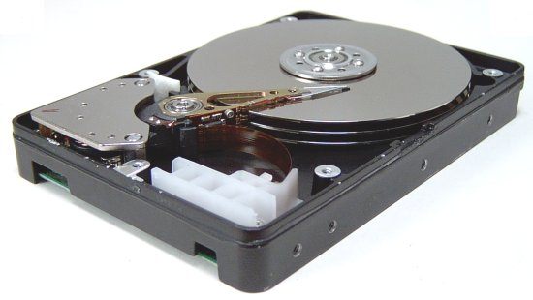
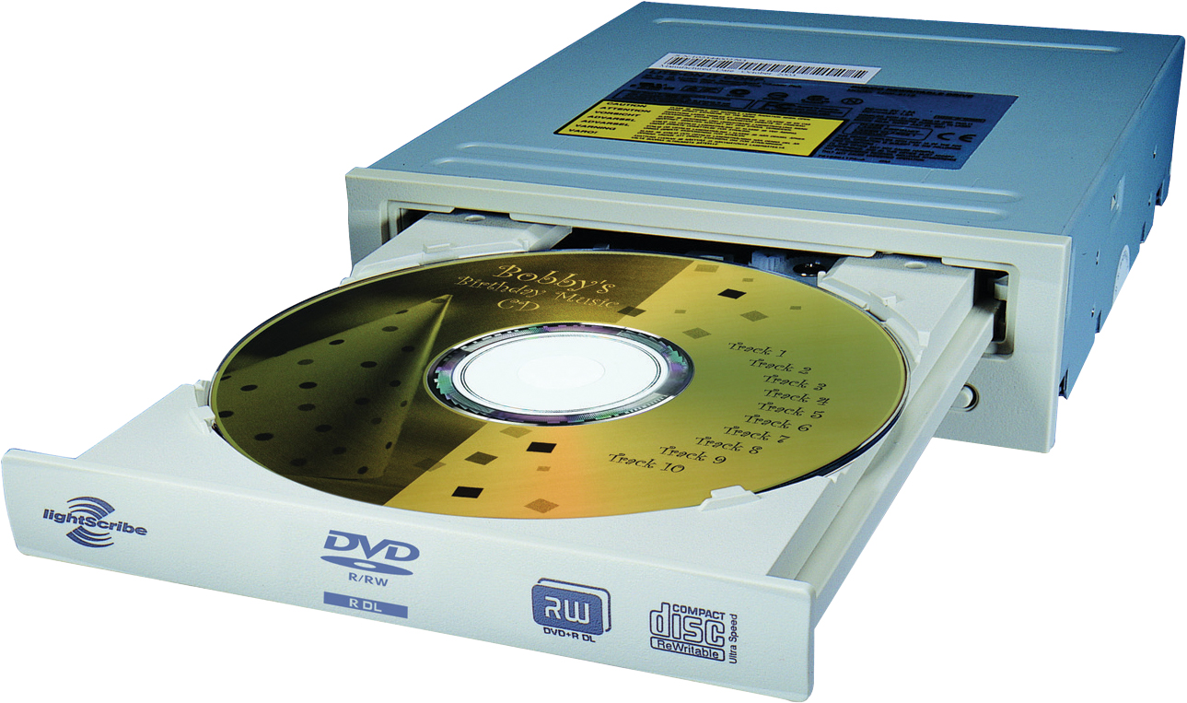
A Safe Place for Data
Volatile main memory
  Loses instructions and data when power off
Non-volatile secondary memory
  Magnetic disk
  Flash memory
  Optical disk (CDROM, DVD)

Slide 38
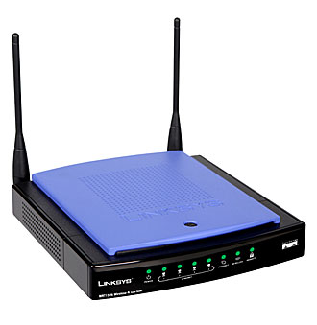
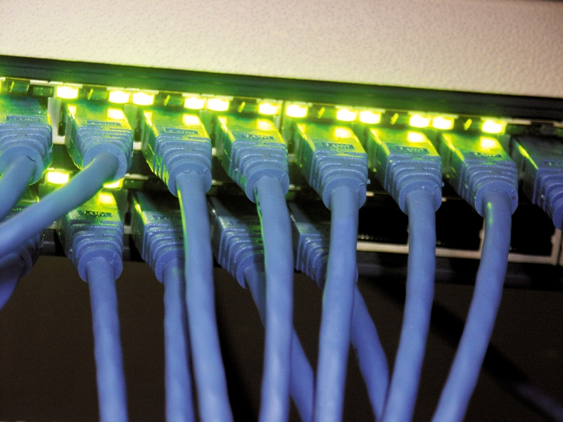
Networks
Communication and resource sharing
Local area network (LAN): Ethernet
  Within a building
Wide area network (WAN): the Internet
Wireless network: WiFi, Bluetooth

Slide 39
Technology Trends
Electronics technology continues to evolve
  Increased capacity and performance
  Reduced cost
Year | Technology | Relative performance/cost
1951 | Vacuum tube | 1
1965 | Transistor | 35
1975 | Integrated circuit (IC) | 900
1995 | Very large scale IC (VLSI) | 2,400,000
2013 | Ultra large scale IC | 250,000,000,000

Slide 40
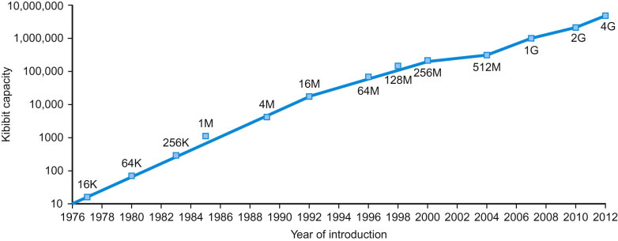
Technology Trends
Memory Capacity:
  Growing exponentially as well
FIGURE 1.11 Growth of capacity per DRAM chip over time. The y-axis is measured in kibibits (2¹⁰ bits). The DRAM industry quadrupled capacity almost every three years, a 60% increase per year, for 20 years. In recent years, the rate has slowed down and is somewhat closer to doubling every two years to three years.

Slide 41
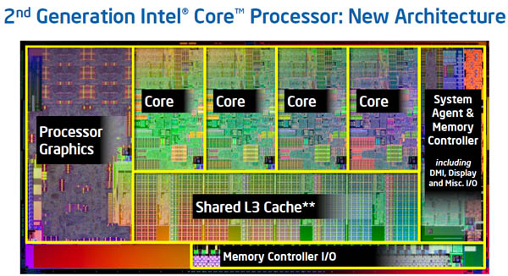
Inside the Processor: Intel Core i7
4 “cores”
  each core is essentially an independent computing engine
  at the top-level, memory and I/O is shared by all cores

Slide 42
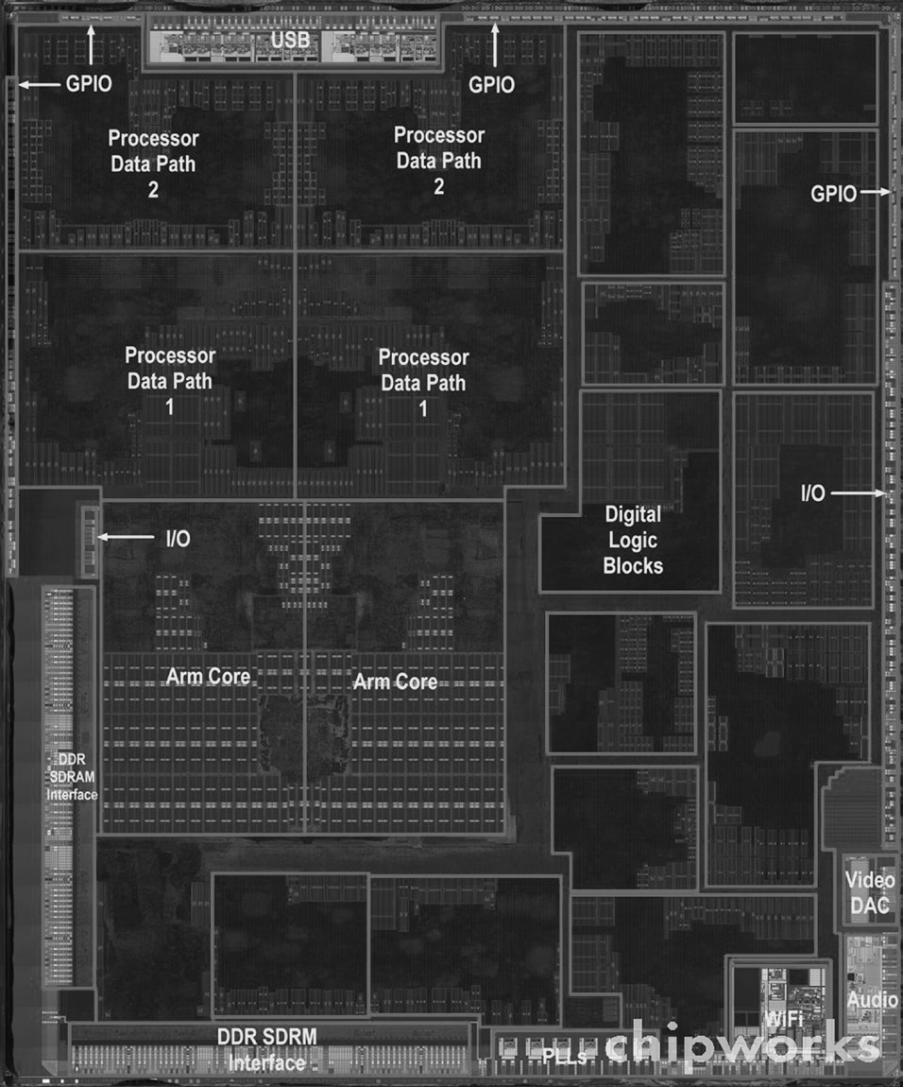
Inside the Processor: Apple
Apple A5
FIGURE 1.9 The processor integrated circuit inside the A5 package. The size of chip is 12.1 by 10.1 mm, and it was manufactured originally in a 45-nm process (see Section 1.5). It has two identical ARM processors or cores in the middle left of the chip and a PowerVR graphical processor unit (GPU) with four datapaths in the upper left quadrant. To the left and bottom side of the ARM cores are interfaces to main memory (DRAM). (Courtesy Chipworks, www.chipworks.com)

Slide 43
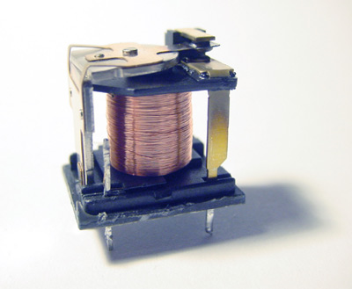
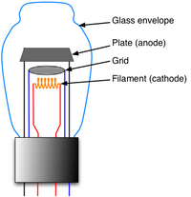
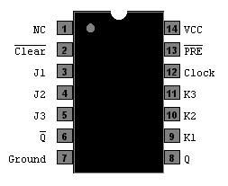
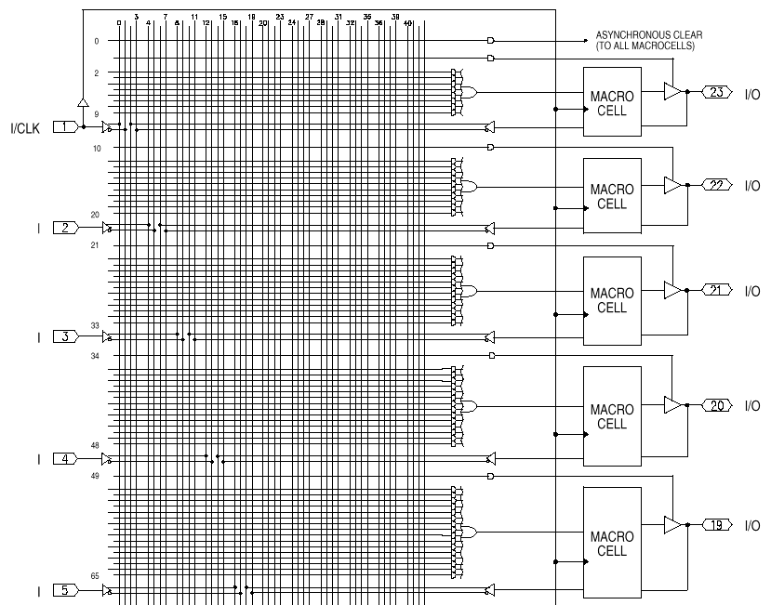
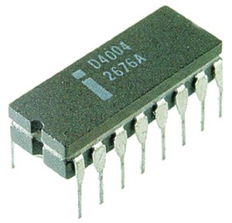
Implementation Technology
Relays
Vacuum Tubes
Transistors
Integrated Circuits
  Gate-level integration
  Medium Scale Integration (PALs)
  Large Scale Integration (Processing unit on a chip)
  Today (Multiple CPUs on a chip)
Nanotubes??
Quantum-Effect Devices??

Slide 44
Implementation Technology
Common Links?
  A controllable switch
Computers are wires and switches
open
open
closed
control

Slide 45
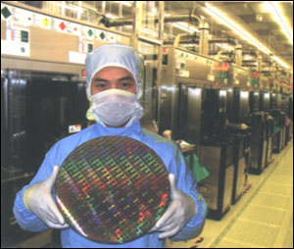
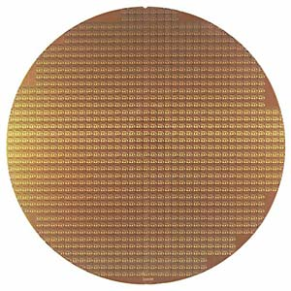
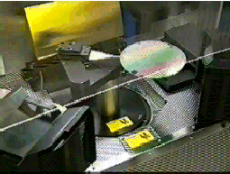
Chips
Silicon Wafers
  Chip manufactures build many copies of the same circuit onto a single wafer.
    Only a certain percentage of the chips will work; those that work will run at different speeds. The yield decreases as the size of the chips increases and the feature size decreases.
  Wafers are processed by automated fabrication lines.
    To minimize the chance of contaminants ruining a process step, great care is taken to maintain a meticulously clean environment.

Slide 46

Chips
Silicon Wafers
IBM photomicrograph
Metal 2
M1/M2 via
Metal 1
Polysilicon
Diffusion
Mosfet (under polysilicon gate)

Slide 47
Next Lecture
Fri, Aug 25: Will be a lecture (not lab)
  Computer Performance
    How to measure performance
    How to compare performance
First lab will be Fri, Sep 1

