Slide 1
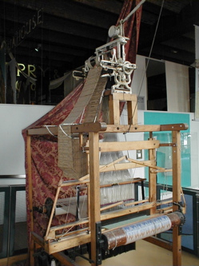
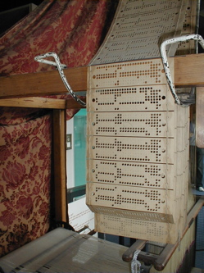
1801, Joseph Marie Jacquard
Jacquard Loom and punch cards to program it.
(George H. Williams, photos from Wikipedia)
Slide courtesy Anselmo Lastra

Slide 2
COMP 740: Computer Architecture and Implementation
Montek Singh
Aug 24, 2016
Lecture 1

Slide 3
What is “Computer Architecture”?
Term coined by Fred Brooks and colleagues at IBM:
“…the structure of a computer that a machine language programmer
must understand to write a correct (timing independent) program for that
machine.”
Amdahl, Blaauw, and Brooks, 1964
“Architecture of the IBM System 360”,
IBM Journal of Research and Development
Do you know about System 360 family?

Slide 4
What is “Computer Architecture”?
Term used differently by Hennessy and Patterson (our textbook)
includes much implementation
Several years ago, the term computer architecture often referred only to instruction set design. Other aspects of computer design were called implementation, often insinuating that implementation is uninteresting or less challenging.
We believe this view is incorrect. The architect’s or designer’s job is much more than instruction set design, and the technical hurdles in the other aspects of the project are likely more challenging than those encountered in instruction set design.
- Patterson & Hennessy

Slide 5
Outline
Course Information
Logistics
Grading
Syllabus
Course Overview
Technology Trends
Moore's Law

Slide 6
Course Information (1)
Time and Place
Mon/Wed 1:25-2:40 pm, FB007
Instructor
Montek Singh
montek@cs.unc.edu
FB234, 919-590-6132
Office hours: TBA
Course Web Page
Linked from mine: http://www.cs.unc.edu/~montek

Slide 7
Course Information (2)
Prerequisites
Undergrad comp. org. (Comp411) and digital logic (Comp541)
I assume you know the following topics
CPU: ALU, control unit, registers, buses, memory management
Control Unit: register transfer language, implementation, hardwired and microprogrammed control
Memory: address space, memory capacity
I/O: CPU-controlled (polling, interrupt), autonomous (DMA)
Pipelining (at least an overview)
Representative books (available in Brauer Library)
Patterson & Hennessy: Computer Organization and Design: The Hardware/Software Interface. Morgan Kaufmann Publishers.
Harris & Harris: Digital Design and Computer Architecture, 2nd ed. (July 2012), Morgan Kaufmann Publishers.

Slide 8
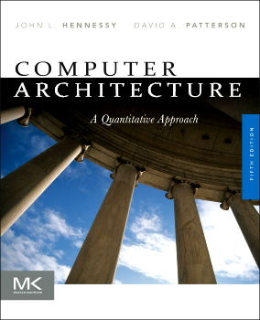
Course Information (3)
Textbook
Hennessy & Patterson: Computer Architecture: A Quantitative Approach (5th edition), Morgan Kaufmann Publishers, Sep 2011
available at amazon.com, bn.com…
Quite different from earlier eds.: more on multiprocessing (multicore)
Notes:
We will cover the green material very quickly, the orange material somewhat quickly, and the red material in great detail.
The additional readings are important. Learning to read technical papers is an important skill that you need to pick up in graduate school.

Slide 9
Course Information (4)
Textbook (contd.)
We will cover the following material:
Fundamentals of Computer Design (Chapter 1)
Instruction Set Principles and Examples (App A & K)
Memory-Hierarchy Design (App B & Chapter 2)
Pipelining: Basic and Intermediate Concepts (App C)
Instruction-Level Parallelism (Chapter 3)
Data-Level Parallelism (Chapter 4)
Thread-Level Parallelism (Chapter 5)
Storage Systems (App D)
On-Chip Networks (selected readings)
Emerging Technologies of Computation (selected readings)
Additional readings/papers may be handed out
e.g., case studies on the last two topics above
Notes:
We will cover the green material very quickly, the orange material somewhat quickly, and the red material in great detail.
The additional readings are important. Learning to read technical papers is an important skill that you need to pick up in graduate school.

Slide 10
Course Information (5)
Grading
30% homework assignments
10% quizzes
20% midterm exam
30% final exam
10% class presentation
e.g., present a survey or case study on multicore
e.g., present a paper on DNA-based computing technologies
Assignments are due at beginning of class on due date
Late assignments: penalty=10%/day or part thereof
Honor Code is in effect: for all homework/exams/projects
encouraged to discuss ideas/concepts with others
work handed in must be your own

Slide 11
What is in COMP 740 for me?
Understand modern computer architecture so you can:
Write better programs
Understand the performance implications of algorithms, data structures, and programming language choices
Write better compilers
Modern computers need better optimizing compilers and better programming languages
Write better operating systems
Need to re-evaluate the current assumptions and tradeoffs
Example: fully exploit multicore/manycore architectures
Design better computer architectures
There are still many challenges left
Example: how to design efficient multicore architectures
Satisfy the Distribution Requirement

Slide 12
Acknowledgements
Material for this class taken from
My old COMP 206 course notes
Prof. Anselmo Lastra's 740 slides
Prof. Sid Chatterjee's old 206 slides
Professor David Patterson's (Berkeley) course notes
Textbook web site
Other websites

Slide 13
Computer Architecture Topics
Input/Output and Storage
Disks, Tape
RAID
Emerging Technologies
Interleaving
Bus protocols
DRAM
Memory
Hierarchy
Coherence,
Bandwidth,
Latency
L2 Cache
Instruction Set Architecture
L1 Cache
Addressing,
Protection,
Exception Handling
VLSI
Pipelining, Hazard Resolution,
Superscalar, Reordering,
Prediction, Speculation
Pipelining
Instruction-Level Parallelism
Multiprocessing/Multicore

Slide 14
Trends of 2000-2015
Technology
Very large dynamic RAM: 256 Mbits to 4Gb and beyond
Large fast static RAM: 16 MB, 5ns
Complete systems on a chip
100+ million to 1+ billion transistors
Parallelism
Superscalar, Superpipelined, Vector, Multiprocessors?
Processor Arrays?
Multicore/manycore!
Special-Purpose Architectures
GPU's, mp3 players, nanocomputers …
Reconfigurable Computers?
Wearable computers

Slide 15
Trends of 2000-2015
Low Power
Over 50% of computing devices portable now (!)
Hand held communicators
Performance per watt, battery life
Transmeta
Asynchronous (clockless) design
Communication (I/O)
Many applications I/O limited, not computation
Computation scaling, but memory, I/O bandwidth not keeping pace
Multimedia
New interface technologies
Video, speech, handwriting, virtual reality, …

Slide 16
Diversion: Clocked Digital Design
Most current digital systems are synchronous:
Clock: a global signal that paces operation of all components
Benefit of clocking: enables discrete-time representation
all components operate exactly once per clock tick
component outputs need to be ready by next clock tick
allows “glitchy” or incorrect outputs between clock ticks
clock

Slide 17
Microelectronics Trends
Current and Future Trends: Significant Challenges
Large-Scale “Systems-on-a-Chip” (SoC)
100 Million ~ 1 Billion transistors/chip
Very High Speeds
multiple GigaHertz clock rates
Explosive Growth in Consumer Electronics
demand for ever-increasing functionality …
… with very low power consumption (limited battery life)
Higher Portability/Modularity/Reusability
“plug 'n play” components, robust interfaces

Slide 18
Alternative Paradigm: Asynchronous Design
Digital design with no centralized clock
Synchronization using local “handshaking”
handshaking
interface
clock
Synchronous System
(Centralized Control)
Asynchronous System
(Distributed Control)
Asynchronous Benefits:
Higher Performance: not limited by slowest component
Lower Power: zero clock power; inactive parts consume little power
Reduced Electromagnetic Noise: no clock spikes [e.g., Philips pagers]
Greater Modularity: variable-speed interfaces; reusable components

Slide 19
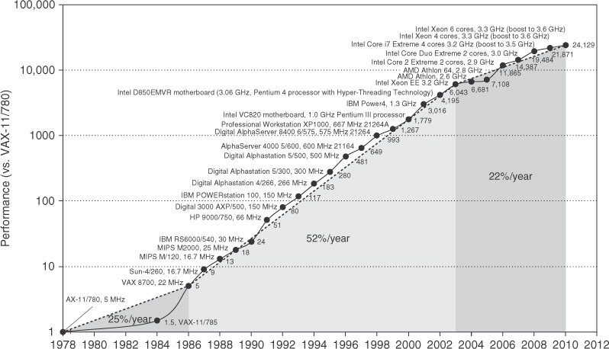
Trends: Performance
Move to multi-processor
RISC
Era of the microprocessor.
Increases due to transistors
and architectural improvements

Slide 20
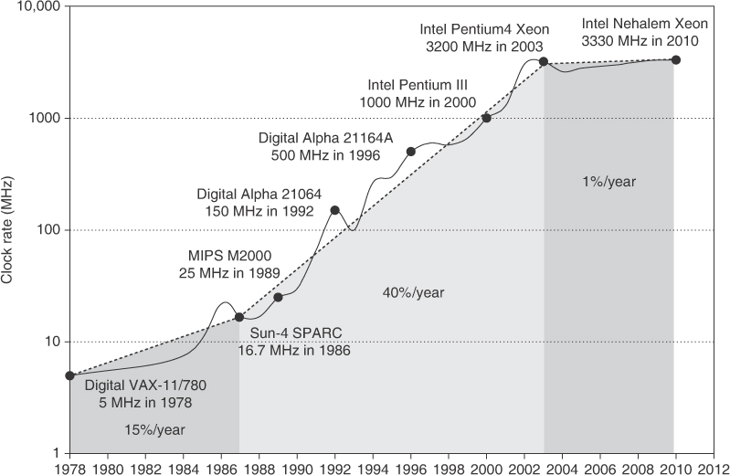
Trends: Clock speed
Figure 1.11 Growth in clock rate of microprocessors in Figure 1.1. Between 1978 and 1986, the clock rate improved less than 15% per year while performance improved by 25% per year. During the “renaissance period” of 52% performance improvement per year between 1986 and 2003, clock rates shot up almost 40% per year. Since then, the clock rate has been nearly flat, growing at less than 1% per year, while single processor performance improved at less than 22% per year.

Slide 21
Performance
Increase by 2002 was much faster than would have been due to fabrication tech (e.g. 0.13 micron) alone
What has slowed the trend?
Note what is really being built
A commodity device!
So cost is very important
Problems
Amount of heat that can be removed economically
Limits to instruction level parallelism
Memory latency

Slide 22
Moore's Law
What is Moore’s Law?
Originally: Number of transistors on a chip
at the lowest cost/component
It's not quite clear what it really is ☺
Moore's original paper, doubling yearly
Didn't make it in 1975
Often quoted as doubling every 18 months
Sometimes as doubling every two years
Moore's article worth reading
http://download.intel.com/research/silicon/moorespaper.pdf

Slide 23
Quantitative Principles of Computer Design
Performance
Rate of producing results
Throughput
Bandwidth
Execution time
Response time
Latency

Slide 24
Quick Look: Classes of Computers
Used to be
mainframe,
mini, and
micro
Now
Desktop
Price/performance, single app, graphics
Server
Reliability, scalability, throughput
Embedded
Not only “toasters”, but also cell phones, etc.
Cost, power, real-time performance
Mobile
smartphones, tablets, fitness devices, etc.

Slide 25
Chip Performance
Based on a number of factors
Feature size (or “technology” or “process”)
Determines transistor & wire density
Used to be measured in microns, now nanometers
Currently: 90 nm, 65 nm, 45 nm, even 22 nm
Die size
Device speed
Note section on wires in textbook
Thin wires → more resistance and capacitance
Wire delay scales poorly
simply making transistors faster is not sufficient anymore
managing connectivity is the big challenge now

Slide 26
ITRS
International Technology Roadmap for Semiconductors
http://www.itrs2.net/
An industry consortium
predicts trends
take a look at the yearly report on their website
take a few minutes to skim the “executive summary”

Slide 27
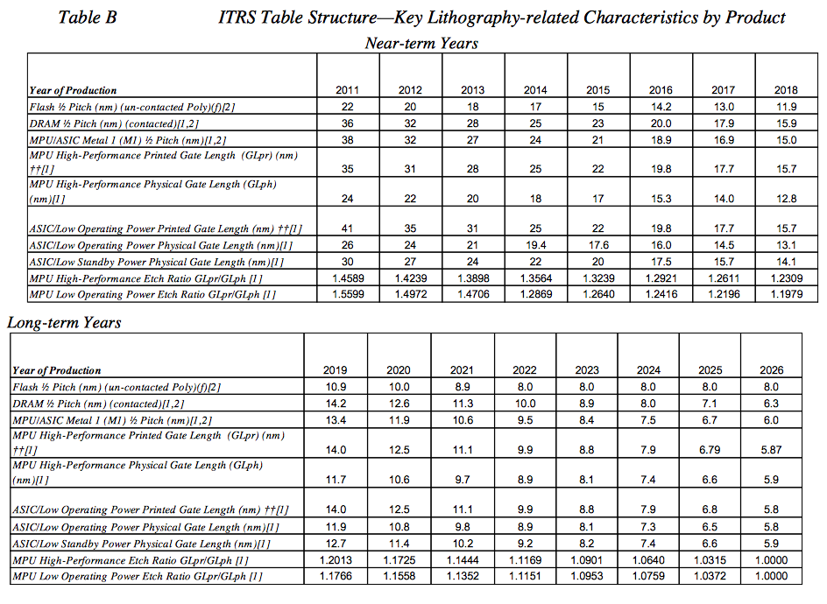
ITRS Predictions (2012 update)

Slide 28
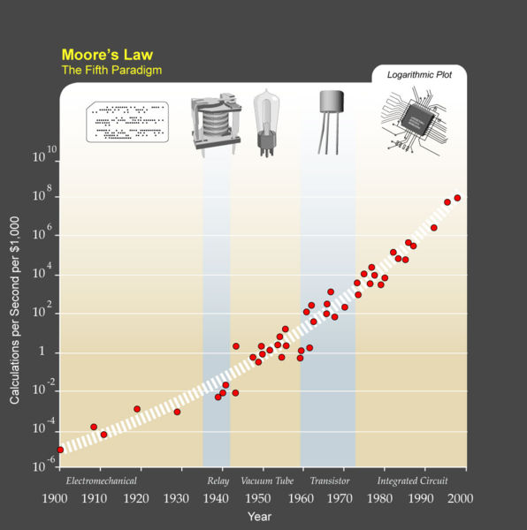
Aside: Ray Kurzweil
Kurzweil: futurist, author
Book in 2005: “The Singularity is Near”
Movie in 2010
Predicts singularity around 2045
[From Wikipedia]
The technological singularity, or simply the singularity, is a hypothetical moment in time when artificial intelligence will have progressed to the point of a greater-than-human intelligence, radically changing civilization, and perhaps human nature. Since the capabilities of such an intelligence may be difficult for a human to comprehend, the technological singularity is often seen as an occurrence (akin to a gravitational singularity) beyond which the future course of human history is unpredictable or even unfathomable.

Slide 29
Trends
Now let’s look at trends in
Bandwidth (Throughput) vs. Latency
Power
Cost
Dependability
Performance

Slide 30
Bandwidth vs. Latency
What is “bandwidth”?
or “throughput”
total amount of work done per time
e.g.: MB/sec for disk or network transfer
e.g.: billions of instructions/sec executed by CPU
What is “latency”?
or “response time”
time between start and completion
e.g.: milliseconds for a disk access
e.g.: time lag for video game to respond to user input
Very important to understand distinction
see textbook, pp. 18-19

Slide 31
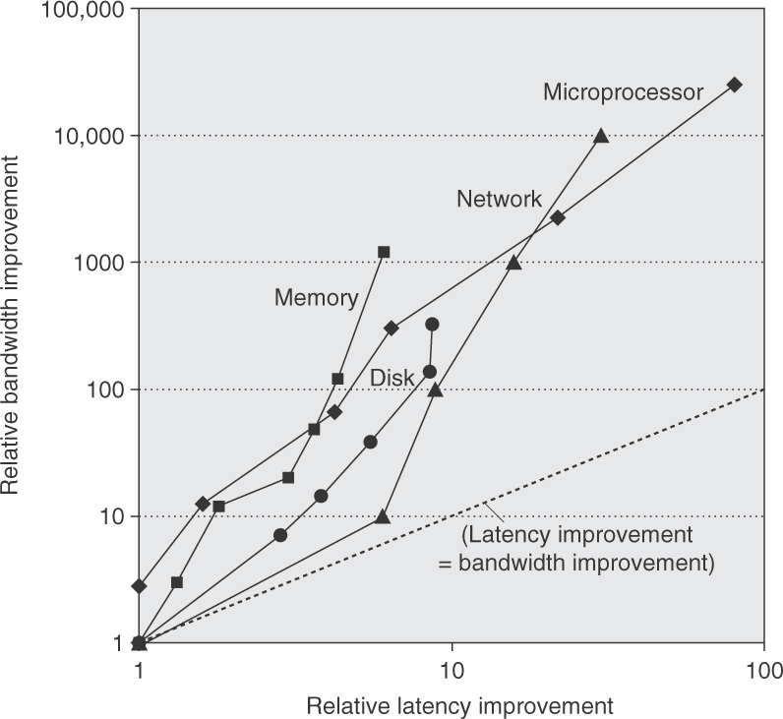
Bandwidth vs. Latency
These metrics apply to various components
microprocessor, memory, disk, network
latency improved 6X to 80X
bandwidth improved about 300X to 25,000X
CPU high,
Memory low (“Memory Wall”)
Textbook Figure 1.9 Log–log plot of bandwidth and latency milestones.
Note that latency improved 6X to 80X while bandwidth improved about 300X to 25,000X.

Slide 32
Bandwidth vs. Latency
Bandwidth improves much faster than latency
In the time that bandwidth doubles, latency improves by no more than a factor of 1.2 to 1.4
(and capacity improves faster than bandwidth)
Or:
bandwidth improves by more than the square of the improvement in latency
what could be the reason for bandwidth to improve faster than latency?
easier to exploit parallelism of more transistors to improve bandwidth
improvements to latency limited by delays, sequentiality, etc.

Slide 33
Why Less Improvement?
Moore’s Law helps bandwidth
Longer distance for signal to travel, so longer latency
Which offsets faster transistors
Distance limits latency
Speed of light lower bound
Bandwidth sells
Capacity, processor “speed” and benchmark scores
Latency can help bandwidth
Often bandwidth is increased by adding latency
OS introduces latency

Slide 34
Techniques to Ameliorate
Caching
Use capacity (“bandwidth”) to reduce average latency
Replication
Again, leverage capacity
Prediction
Use extra processing transistors to pre-fetch
Maybe also to recompute instead of fetch

Slide 35
Trends
Now let’s look at trends in
Bandwidth vs. Latency
Power
Cost
Dependability
Performance

Slide 36
Power
For CMOS chips, traditional dominant energy consumption has been in switching transistors, called dynamic power
For mobile devices, energy is better metric:
For fixed task, slowing clock rate reduces power, not energy
Capacitive load a function of number of transistors connected to output and of technology, which determines capacitance of wires and transistors
Dropping voltage helps both, moved from 5V to 1V
Clock gating

Slide 37
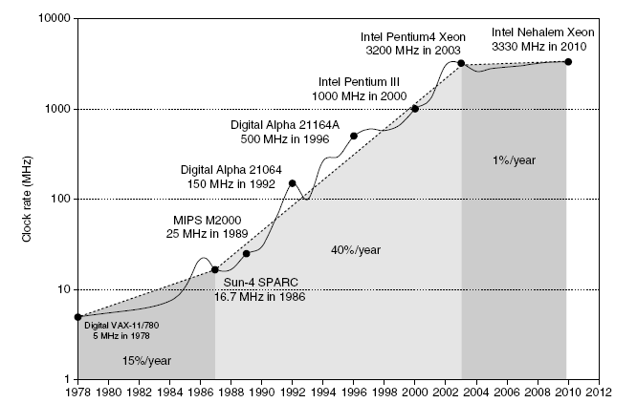
Power
Intel 80386 consumed ~ 2 W
3.3 GHz Intel Core i7 consumes 130 W
Heat must be dissipated from 1.5 x 1.5 cm chip
This is the limit of what can be cooled by air

Slide 38
How to reduce power?
Several techniques
Design circuits to be energy efficient
some clever techniques avoid wasteful energy consumption
other techniques adversely affect performance
Reduce clock rate
frequency scaling
Reduce voltage and clock rate
voltage-frequency scaling
done dynamically, in response to demand
Clock gating and voltage gating
turn off parts of the system
e.g., turn off unneeded cores, put memory/disks in idle

Slide 39
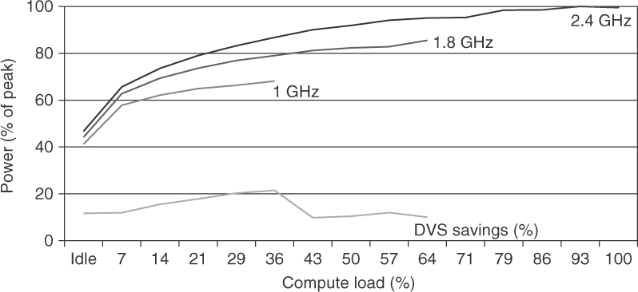
Voltage and Frequency Scaling
Figure 1.12 Energy savings for a server using an AMD Opteron microprocessor, 8 GB of DRAM, and one ATA disk.
At 1.8 GHz, the server can only handle up to two-thirds of the workload without causing service level violations, and, at 1.0 GHz, it can only safely handle one-third of the workload. (Figure 5.11 in Barroso and Hölzle [2009].)

Slide 40
Example: Reducing Power
Suppose 15% reduction in voltage results in a 15% reduction in frequency. What is impact on dynamic power?

Slide 41
Trends in Power
Because leakage current flows even when a transistor is off, now static power important too
Leakage current increases in processors with smaller transistor sizes
Increasing the number of transistors increases power even if they are turned off
In 2006, goal for leakage was 25% of total power consumption; high performance designs at 40%
Very low power systems even gate voltage to inactive modules to control loss due to leakage

Slide 42
Trends
Now let’s look at trends in
Bandwidth vs. Latency
Power
Cost
Dependability
Performance

Slide 43
Cost of Integrated Circuits
Dingwall’s Equation

Slide 44
Explanations
Second term in “Dies per wafer”
corrects for the rectangular dies
near the periphery of round wafers
“Die yield” assumes a simple empirical
model: defects are randomly distributed
over the wafer, and yield is inversely
proportional to the complexity of the
fabrication process (indicated by α)
α=3 for modern processes implies that
cost of die is proportional to (Die area)⁴

Slide 45
Real World Examples
“Revised Model Reduces Cost Estimates”, Linley Gwennap, Microprocessor Report 10(4), 25 Mar 1996

Slide 46
Trends
Now let’s look at trends in
Bandwidth vs. Latency
Power
Cost
Dependability
Performance

Slide 47
Dependability
When is a system operating properly?
Infrastructure providers now offer Service Level Agreements (SLA) to guarantee that their networking or power service would be dependable
Systems alternate between 2 states of service with respect to an SLA:
Service accomplishment, where the service is delivered as specified in SLA
Service interruption, where the delivered service is different from the SLA
Failure = transition from state 1 to state 2
Restoration = transition from state 2 to state 1

Slide 48
Definitions
Module reliability = measure of continuous service accomplishment (or time to failure)
Two key metrics:
Mean Time To Failure (MTTF) measures Reliability
Failures In Time (FIT) = 1/MTTF, the rate of failures
Traditionally reported as failures per billion hours of operation
Derived metrics:
Mean Time To Repair (MTTR) measures Service Interruption
Mean Time Between Failures (MTBF) = MTTF+MTTR
Module availability measures service as alternate between the 2 states of accomplishment and interruption (number between 0 and 1, e.g. 0.9)
Module availability = MTTF / ( MTTF + MTTR)

Slide 49
Example -- Calculating Reliability
If modules have exponentially distributed lifetimes (age of module does not affect probability of failure), overall failure rate is the sum of failure rates of the modules
Calculate FIT and MTTF for 10 disks (1M hour MTTF per disk), 1 disk controller (0.5M hour MTTF), and 1 power supply (0.2M hour MTTF):
1M hours = 114 years!
0.2M hours = 22 years!
Solution next

Slide 50
Solution
If modules have exponentially distributed lifetimes (age of module does not affect probability of failure), overall failure rate is the sum of failure rates of the modules
Calculate FIT and MTTF for 10 disks (1M hour MTTF per disk), 1 disk controller (0.5M hour MTTF), and 1 power supply (0.2M hour MTTF):
less than 7 years!

Slide 51
Trends
Now let’s look at trends in
Bandwidth vs. Latency
Power
Cost
Dependability
Performance

Slide 52
First, What is Performance?
The starting point is universally accepted
“The time required to perform a specified amount of computation is the ultimate measure of computer performance”
How should we summarize (reduce to a single number) the measured execution times (or measured performance values) of several benchmark programs?
Two properties
A single-number performance measure for a set of benchmarks expressed in units of time should be directly proportional to the total (weighted) time consumed by the benchmarks.
A single-number performance measure for a set of benchmarks expressed as a rate should be inversely proportional to the total (weighted) time consumed by the benchmarks.
from “Characterizing Computer Performance with a Single Number”, J. E. Smith, CACM, October 1988, pp. 1202-1206

Slide 53
Quantitative Principles of Computer Design
Performance is in units of things per second
So bigger is better
What if we are primarily concerned with response time?
Performance
Rate of producing results
Throughput
Bandwidth
Execution time
Response time
Latency

Slide 54
Performance: What to measure?
What about just MIPS and MFLOPS?
Usually rely on benchmarks vs. real workloads
Older measures were
Kernels or
Small programs designed to mimic real workloads
Whetstone, Dhrystone
http://www.netlib.org/benchmark
Note LINPACK and Top500

Slide 55
MIPS
Machines with different instruction sets?
Programs with different instruction mixes?
Uncorrelated with performance
Marketing metric
“Meaningless Indicator of Processor Speed”

Slide 56
MFLOP/s
Popular in supercomputing community
Often not where time is spent
Not all FP operations are equal
“Normalized” MFLOP/s
Can magnify performance differences
A better algorithm (e.g., with better data reuse) can run faster even with higher FLOP count

Slide 57
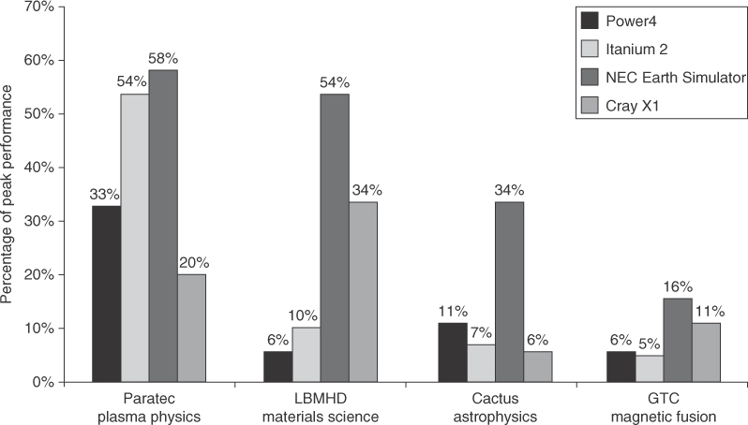
Peak Performance
Figure 1.20 Percentage of peak performance for four programs on four multiprocessors scaled to 64 processors. The Earth Simulator and X1 are vector processors (see Chapter 4 and Appendix G). Not only did they deliver a higher fraction of peak performance, but they also had the highest peak performance and the lowest clock rates. Except for the Paratec program, the Power 4 and Itanium 2 systems delivered between 5% and 10% of their peak. From Oliker et al. [2004].

Slide 58
Benchmarks
To increase predictability, collections of benchmark applications, called benchmark suites, are popular
SPECCPU: popular desktop benchmark suite
CPU only, split between integer and floating point programs
SPECint2000 has 12 integer, SPECfp2000 has 14 integer pgms
SPECCPU2006 was announced Spring 2006
SPECSFS (NFS file server) and SPECWeb (WebServer) added as server benchmarks
www.spec.org
Transaction Processing Council measures server performance and cost-performance for databases
TPC-C Complex query for Online Transaction Processing
TPC-H models ad hoc decision support
TPC-W a transactional web benchmark
TPC-App application server and web services benchmark

Slide 59
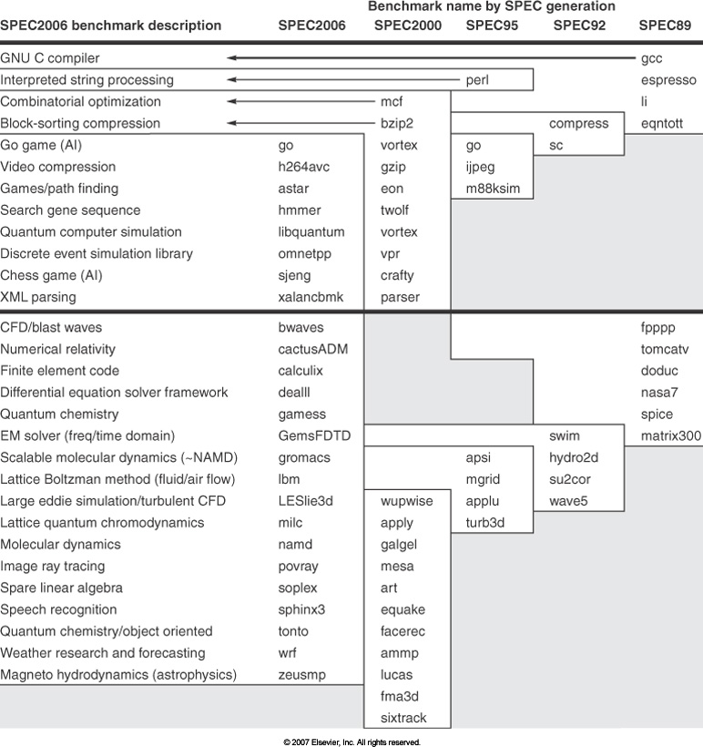
SPEC2006 Programs

Slide 60
How to Summarize Performance?
Arithmetic average of execution times??
But they vary in basic speed, so some would be more important than others in arithmetic average
Could add weights per program, but how to pick weight?
Different companies want different weights for their products
SPECRatio: Normalize execution times to reference computer, yielding a ratio proportional to performance =
time on reference computer / time on computer being rated
Spec uses an older Sun machine as reference

Slide 61
Ratios
If program SPECRatio on Computer A is 1.25 times bigger than Computer B, then
Note that when comparing 2 computers as a ratio, execution times on the reference computer drop out, so choice of reference computer is irrelevant

Slide 62
Review: Different means

Slide 63
Geometric Mean
Since ratios, proper mean is geometric mean (SPECRatio unitless, so arithmetic mean meaningless)
Geometric mean of the ratios is the same as the ratio of the geometric means
Ratio of geometric means = Geometric mean of performance ratios ⇒ choice of reference computer is irrelevant!
These two points make geometric mean of ratios attractive to summarize performance

Slide 64
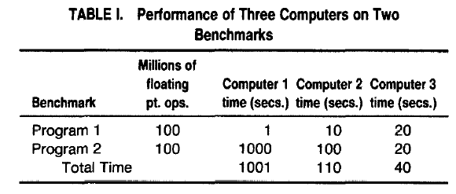
Different Take
Smith (CACM 1988, see references) takes a different view on means
First let’s look at an example

Slide 65
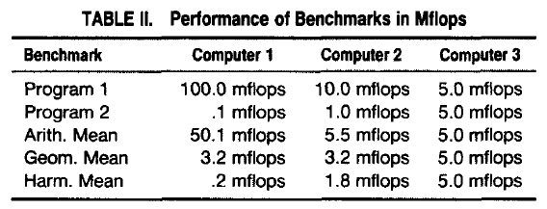
Rates
Change to MFLOPS and also look at different means

Slide 66
Avoid the Geometric Mean?
If benchmark execution times are normalized to some reference machine, and means of normalized execution times are computed, only the geometric mean gives consistent results no matter what the reference machine is
This has led to declaring the geometric mean as the preferred method of summarizing execution time (e.g., SPEC)
Smith’s comments
“The geometric mean does provide a consistent measure in this context, but it is consistently wrong.”
“If performance is to be normalized with respect to a specific machine, an aggregate performance measure such as total time or harmonic mean rate should be calculated before any normalizing is done. That is, benchmarks should not be individually normalized first.”
He advocates using time, or normalizing after taking mean

Slide 67
Variability
Does a single mean summarize performance of programs in benchmark suite?
Can decide if good predictor by characterizing variability of distribution using standard deviation
Like geometric mean, geometric standard deviation is multiplicative rather than arithmetic
Can simply take the logarithm of SPECRatios, compute the standard mean and standard deviation, and then take the exponent to convert back:

Slide 68
Form of Standard Deviation
Standard deviation is more informative if we know distribution has a standard form
bell-shaped normal distribution, whose data are symmetric around mean
lognormal distribution, where logarithms of data--not data itself--are normally distributed (symmetric) on a logarithmic scale
For a lognormal distribution, we expect that
68% of samples fall in range
95% of samples fall in range

Slide 69
Example (1/2)
GM and multiplicative StDev of SPECfp2000 for Itanium 2

Slide 70
Example (2/2)
GM and multiplicative StDev of SPECfp2000 for AMD Athlon

Slide 71
Comments
Standard deviation of 1.98 for Itanium 2 is much higher-- vs. 1.40--so results will differ more widely from the mean, and therefore are likely less predictable
Falling within one standard deviation:
10 of 14 benchmarks (71%) for Itanium 2
11 of 14 benchmarks (78%) for Athlon
Thus, the results are quite compatible with a lognormal distribution (expect 68%)

Slide 72
Next Lecture
Principles of Computer Design
Amdahl’s Law

Slide 73
Readings/References
Gordon Moore’s paper
http://www.intel.com/pressroom/kits/events/moores_law_40th/index.htm
http://download.intel.com/museum/Moores_Law/Articles-Press_Releases/Gordon_Moore_1965_Article.pdf
Paper on which latency section is based
Patterson, D. A. 2004. Latency lags bandwidth. Commun. ACM 47, 10 (Oct. 2004), 71-75.
“Characterizing Computer Performance with a Single Number”, J. E. Smith, CACM, October 1988, pp. 1202-1206

