Slide 1
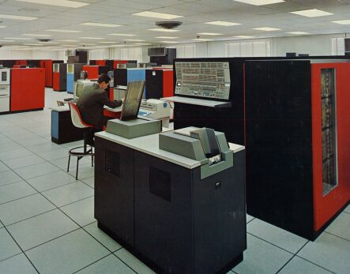


Maurice Wilkes published the first paper on cache memory in 1965. The first computer to actually include one was probably built at Cambridge (a direct mapped cache).
IBM 360 Model 85 (1968) had a cache, which helped it outperform the more complex Model 91 (Tomasulo’s algorithm)

Slide 2
COMP 740:
Computer Architecture and Implementation
Montek Singh
Sep 12, 2016
Topic: Introduction to Caches

Slide 3
Outline
Principle of Locality
Cache Organization
Cache Read/Write Policies
  Block replacement policies
  Write-back vs. write-through caches
  Write buffers
  Read textbook Appendix B.1 through B.2
Notes:
3

Slide 4
The Big Picture: Where are We Now?
The Five Classic Components of a Computer
This lecture (and next few): Memory System
Processor
Input
Control
Memory
Datapath
Output

Slide 5
The Motivation for Caches
Motivation
  Programmers want unlimited amounts of fast memory
  Fast memory technology is more expensive per bit than slower memory
    Large (cheap) memories (DRAM) are slow
    Small (costly) memories (SRAM) are fast
Solution: organize memory system into a hierarchy
  entire addressable memory space
  available in largest memory
  smaller, faster memory closer to
  the processor → cache
Memory System
Processor
Cache
DRAM

Slide 6
The Motivation for Caches
Exploit: Locality of Reference
  service most accesses from the small, fast memory
  reduce the bandwidth required of the large memory
  often multiple levels of caches
Memory System
Processor
Cache
DRAM

Slide 7
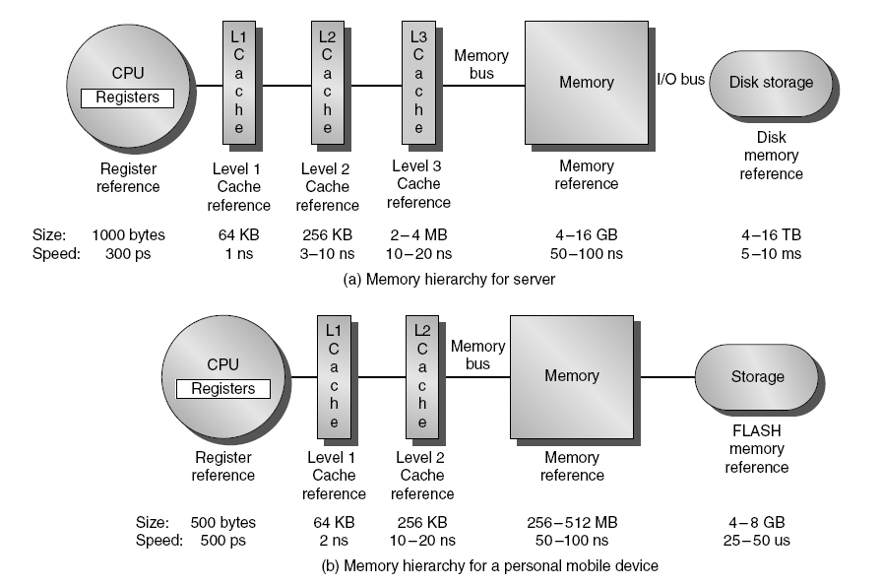
The Memory Hierarchy
Figure 2.1 The levels in a typical memory hierarchy in a server computer shown on top (a) and in a personal mobile
device (PMD) on the bottom (b). As we move farther away from the processor, the memory in the level below becomes slower and larger. Note that the time units change by a factor of 10⁹—from picoseconds to milliseconds—and that the size units change by a factor of 10¹²—from bytes to terabytes. The PMD has a slower clock rate and smaller caches and main memory. A key difference is that servers and desktops use disk storage as the lowest level in the hierarchy while PMDs use Flash, which is built from EEPROM technology.

Slide 8
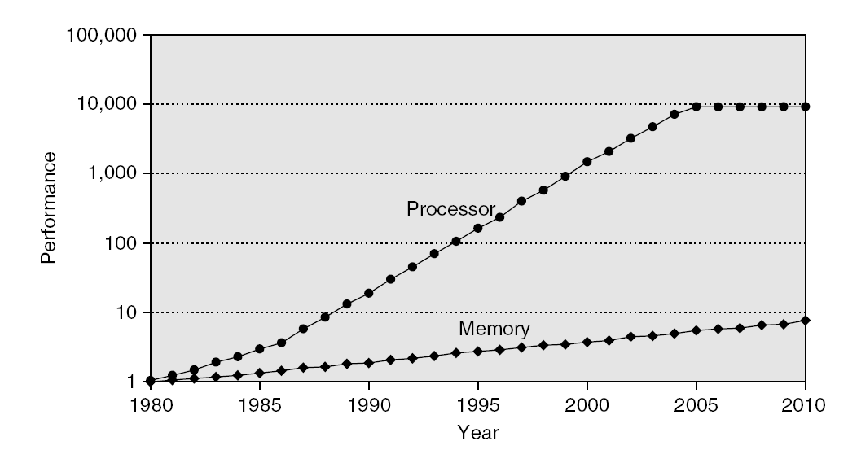
Memory Performance Gap

Slide 9
Memory Hierarchy Design
Memory hierarchy design becomes more crucial with recent multi-core processors:
  Aggregate peak bandwidth grows with # cores:
    Intel Core i7 can generate two references per core per clock
    Four cores and 3.2 GHz clock
      25.6 billion 64-bit data references/second +
      12.8 billion 128-bit instruction references
      = 409.6 GB/s!
    DRAM bandwidth is only 6% of this (25 GB/s)
    Requires:
      Multi-port, pipelined caches
      Two levels of cache per core
      Shared third-level cache on chip

Slide 10
The Principle of Locality
The Principle of Locality
  Program accesses a relatively small portion of the address space at any instant of time
  Example: 90% of time in 10% of the code
Two different types of locality
  Temporal Locality (locality in time):
    if an item is referenced, it will tend to be referenced again soon
  Spatial Locality (locality in space):
    if an item is referenced, items close by tend to be referenced soon
Frequency
of reference
0
Address Space
2^{n}

Slide 11
Levels of the Memory Hierarchy
Capacity
Access Time
Cost/bit
Upper Level
Staging
Transfer Unit
Faster
CPU Registers
500 Bytes
0.25 ns
~$.01
Registers
Words
programmer/compiler
1-8 bytes
Cache
16K-1M Bytes
1 ns
~$.0001
L1, L2, … Cache
cache controller
8-128 bytes
Blocks
Main Memory
64M-2G Bytes
100ns
~$.0000001
Memory
OS
4-64K bytes
Pages
Disk
100 G Bytes
5 ms
10⁻⁵- 10⁻⁷ cents
Disk
user/operator
Mbytes
Files
Tape/Network
“infinite”
secs.
10⁻⁸ cents
Larger
Tape/Network
Lower Level

Slide 12
Memory Hierarchy: Basics
When a word is not found in the cache, a miss occurs:
  Fetch word from lower level in hierarchy, requiring a higher latency reference
  Lower level may be another cache or the main memory
  Also fetch the other words contained within the block
    Takes advantage of spatial locality
  Place block into cache in any location within its set, determined by address
    block address MOD number of sets

Slide 13
Memory Hierarchy: Principles of Operation
At any given time, data is copied between only adjacent levels
  Upper Level (Cache): the one closer to the processor
    Smaller, faster, and uses more expensive technology
  Lower Level (Memory): the one further away from the processor
    Bigger, slower, and uses less expensive technology
Block
  The smallest unit of information that can either be present or not present in the two-level hierarchy
Upper Level
(Cache)
Lower Level
(Memory)
To Processor
Blk X
From Processor
Blk Y

Slide 14
Memory Hierarchy: Terminology
Hit: data appears in some block in the upper level (e.g.: Block X in previous slide)
  Hit Rate = fraction of memory access found in upper level
  Hit Time = time to access the upper level
    memory access time + Time to determine hit/miss
Miss: data needs to be retrieved from a block in the lower level (e.g.: Block Y in previous slide)
  Miss Rate = 1 - (Hit Rate)
  Miss Penalty: includes time to fetch a new block from lower level
    Time to replace a block in the upper level from lower level + Time to deliver the block the processor
Hit Time: significantly less than Miss Penalty

Slide 15
Cache Addressing
Set 0
Set j-1
Block 0
Block k-1
Replacement info
Sector 0
Sector m-1
Tag
Byte 0
Byte n-1
Valid
Dirty
Shared
Block/line is unit of allocation
Sector/sub-block is unit of transfer and coherence
Cache parameters j, k, m, n are integers, and generally powers of 2

Slide 16
Cache Shapes
A = level of associativity
S = number of sets
Direct-mapped
(A = 1, S = 16)
2-way set-associative
(A = 2, S = 8)
4-way set-associative
(A = 4, S = 4)
8-way set-associative
(A = 8, S = 2)
Fully associative
(A = 16, S = 1)

Slide 17
Cache Organization
Direct Mapped Cache
  Each memory location can only mapped to 1 cache location
  No need to make any decision ☺
    Current item replaces previous item in that cache location
N-way Set Associative Cache
  Each memory location have a choice of N cache locations
Fully Associative Cache
  Each memory location can be placed in ANY cache location
Cache miss in a N-way Set Associative or Fully Associative Cache
  Bring in new block from memory
  Throw out a cache block to make room for the new block
  Need to decide which block to throw out!

Slide 18
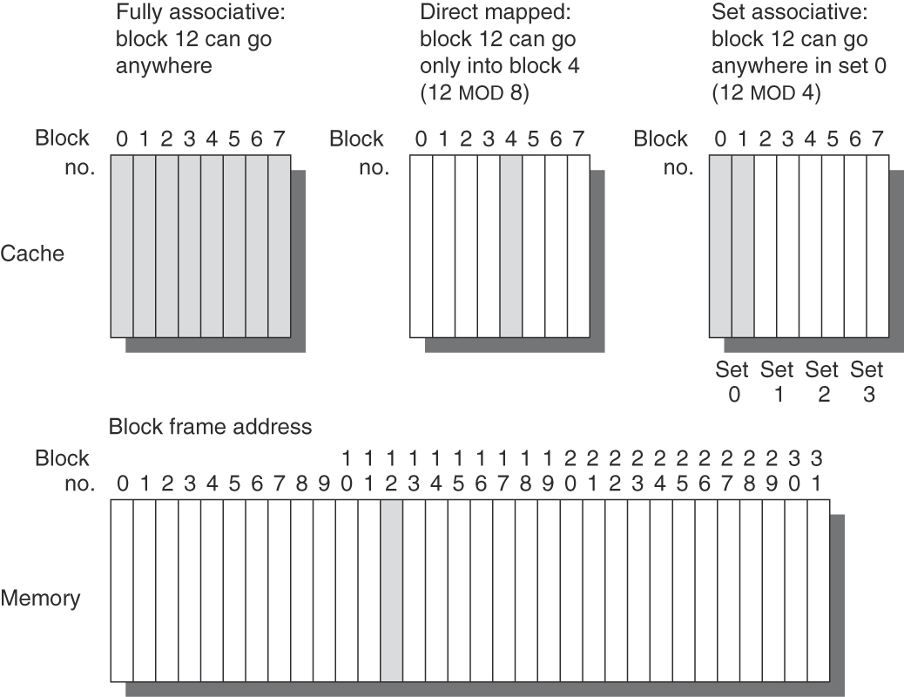
Associativity
Figure B.2 This example cache has eight block frames and memory has 32 blocks. The three options for caches are shown left to right. In fully associative, block 12 from the lower level can go into any of the eight block frames of the cache. With direct mapped, block 12 can only be placed into block frame 4 (12 modulo 8). Set associative, which has some of both features, allows the block to be placed anywhere in set 0 (12 modulo 4). With two blocks per set, this means block 12 can be placed either in block 0 or in block 1 of the cache. Real caches contain thousands of block frames, and real memories contain millions of blocks. The set associative organization has four sets with two blocks per set, called two-way set associative. Assume that there is nothing in the cache and that the block address in question identifies lower-level block 12.

Slide 19
4 Questions for Memory Hierarchy
Where can a block be placed in the upper level? (Block placement)
How is a block found if it is in the upper level?
(Block identification)
Which block should be replaced on a miss?
(Block replacement)
What happens on a write?
(Write strategy)
Q1 and Q2 covered using examples, then Q3 and Q4

Slide 20
Example 1: 1KB, Direct-Mapped, 32B Blocks
For a 1024 (2¹⁰) byte cache with 32-byte blocks
  The uppermost 22 = (32 - 10) address bits are the tag
  The lowest 5 address bits are the Byte Select (Block Size = 2⁵)
  The next 5 address bits (bit5 - bit9) are the Cache Index
31
9
4
0
Cache Tag
Example: 0x50
Cache Index
Byte Select
Ex: 0x01
Ex: 0x00
Stored as part
of the cache “state”
Valid Bit
Cache Tag
Cache Data
Byte 31
:
Byte 1
Byte 0
0
Byte 63
:
Byte 33
Byte 32
0x50
1
2
3
:
:
:
Byte 1023
:
Byte 992
31
Byte Select
Notes:
Let’s use a specific example with realistic numbers: assume we have a 1 KB direct mapped cache with block size equals to 32 bytes.
In other words, each block associated with the cache tag will have 32 bytes in it (Row 1).
With Block Size equals to 32 bytes, the 5 least significant bits of the address will be used as byte select within the cache block.
Since the cache size is 1K byte, the upper 32 minus 10 bits, or 22 bits of the address will be stored as cache tag.
The rest of the address bits in the middle, that is bit 5 through 9, will be used as Cache Index to select the proper cache entry.
+2 = 30 min. (Y:10)

Slide 21
Example 1a: Cache Miss; Empty Block
31
Cache Tag
9
Cache Index
4
Byte Select
0
0x0002fe
0x00
0x00
Valid Bit
Cache Tag
Cache Data
0
0xxxxxxx
Byte 31
:
Byte 1
Byte 0
0
1
0x000050
Byte 63
:
Byte 33
Byte 32
1
1
0x004440
2
3
:
:
:
Byte 1023
:
Byte 992
31
=
Byte Select
Cache Miss

Slide 22
Example 1b: … Read in Data
31
Cache Tag
9
Cache Index
4
Byte Select
0
0x0002fe
0x00
0x00
Valid Bit
Cache Tag
Cache Data
1
0x0002fe
New Block of data
0
1
0x000050
Byte 63
:
Byte 33
Byte 32
1
1
0x004440
2
3
:
:
:
Byte 1023
:
Byte 992
31
=
Byte Select

Slide 23
Example 1c: Cache Hit
31
Cache Tag
9
Cache Index
4
Byte Select
0
0x000050
0x01
0x08
Valid Bit
Cache Tag
Cache Data
1
0x0002fe
Byte 31
:
Byte 1
Byte 0
0
1
0x000050
Byte 63
:
Byte 33
Byte 32
1
1
0x004440
2
3
:
:
:
Byte 1023
:
Byte 992
31
=
Byte Select
Cache Hit

Slide 24
Example 1d: Cache Miss; Incorrect Block
31
Cache Tag
9
Cache Index
4
Byte Select
0
0x002450
0x02
0x04
Valid Bit
Cache Tag
Cache Data
1
0x0002fe
Byte 31
:
Byte 1
Byte 0
0
1
0x000050
Byte 63
:
Byte 33
Byte 32
1
1
0x004440
2
3
:
:
:
Byte 1023
:
Byte 992
31
=
Byte Select
Cache Miss

Slide 25
Example 1e: … Replace Block
31
Cache Tag
9
Cache Index
4
Byte Select
0
0x002450
0x02
0x04
Valid Bit
Cache Tag
Cache Data
1
0x0002fe
Byte 31
:
Byte 1
Byte 0
0
1
0x000050
Byte 63
:
Byte 33
Byte 32
1
1
0x002450
New Block of data
2
3
:
:
:
Byte 1023
:
Byte 992
31
=
Byte Select

Slide 26
Q3: Which block should be replaced on a miss?
Random Replacement
  Hardware randomly selects a cache item and throw it out
Least Recently Used
  Hardware keeps track of the access history
  Replace the entry that has not been used for the longest time
  For 2-way set-associative cache, need one bit for LRU repl.
Example of a Simple “Pseudo” LRU Implementation
  Assume 64 Fully Associative entries
  Hardware replacement pointer points to one cache entry
  Whenever access is made to the entry…
    … move the pointer to the next entry
  Otherwise: do not move the pointer
Entry 0
Entry 1
Replacement
:
Pointer
Entry 63

Slide 27
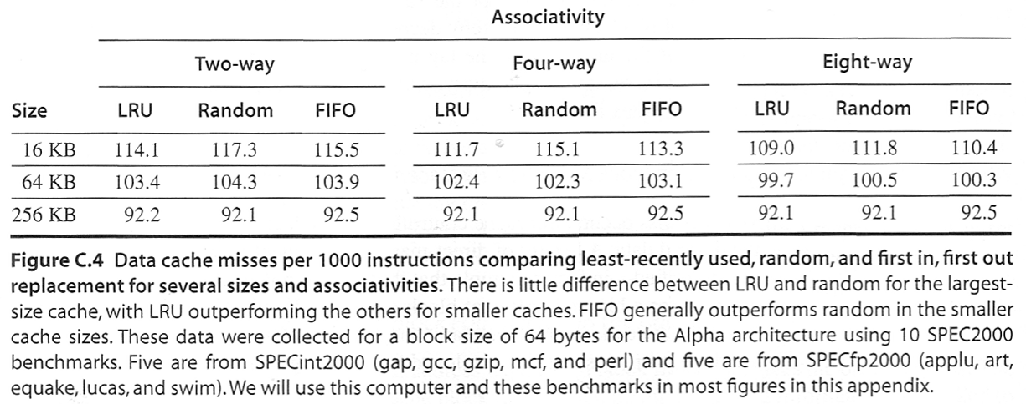
Replacement Policy
Random
  Easy to implement
LRU
  Hard to implement; often approximated
FIFO
  Used as approximation to LRU
Little effect (below); most pronounced with small, low associativity caches

Slide 28
Q4: What happens on a write?
Cache read is much easier to handle than cache write
  Instruction cache is much easier to design than data cache
Cache write
  How do we keep data in the cache and memory consistent?
Two options
  Write Back: write to cache only. Write the cache block to memory when that cache block is being replaced on a cache miss
    Need a “dirty bit” for each cache block
    Greatly reduce the memory bandwidth requirement
    Control can be complex
  Write Through: write to cache and memory at the same time
    What!!! How can this be? Isn’t memory too slow for this?

Slide 29
Write Buffer for Write Through
Write Buffer: needed between cache and main mem
  Processor: writes data into the cache and the write buffer
  Memory controller: write contents of the buffer to memory
Write buffer is just a FIFO
  Typical number of entries: 4
  Works fine if store freq. (w.r.t. time) << 1 / DRAM write cycle
Memory system designer’s nightmare
  Store frequency (w.r.t. time) > 1 / DRAM write cycle
  Write buffer saturation
Cache
Processor
DRAM
Write Buffer

Slide 30
Write Buffer Saturation
Cache
Processor
DRAM
Write Buffer
Store frequency (w.r.t. time) > 1 / DRAM write cycle
  If this condition exist for a long period of time (CPU cycle time too quick and/or too many store instructions in a row)
    Write buffer can always overflow no matter how big you make it
    CPU Cycle Time << DRAM Write Cycle Time
Solutions for write buffer saturation
  Use a write back cache
  Install a second level (L2) cache
Cache
L2
Cache
Processor
DRAM
Write Buffer

Slide 31
On a Write Miss
Write allocate – block is allocated in cache
No-write allocate – no cache block is allocated. Write is only to main memory (or next level of hierarchy)

Slide 32
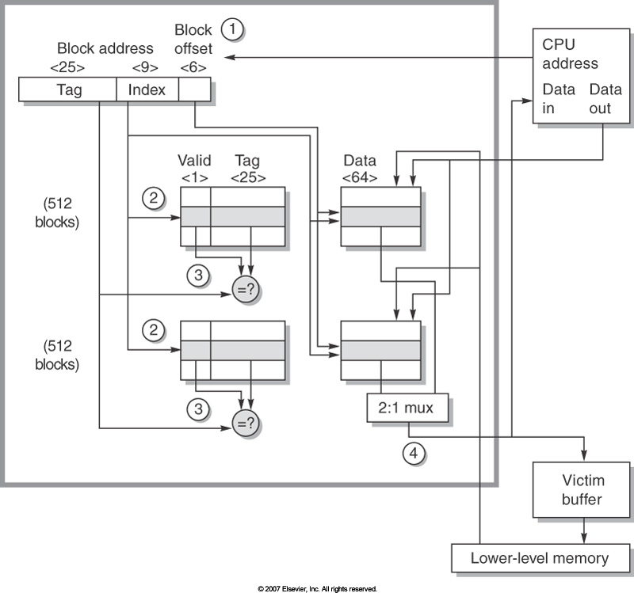
Example: Opteron Cache
40-bit physical address (1)
Tags indexed (2) and compared (3). Note valid bit.
2 clock read on hit.
Miss, 7 clks for 1st 8 bytes, then
2 clk / 8-bytes
Write back
Write allocate on miss
Dirty bit
Victim buffer for replaced blocks
8 blocks
2-way set associative.
LRU replacement
64K bytes in 64 byte blocks

Slide 33
Separate Instruction & Data Caches
Commonly done
Why?
  Increases bandwidth to processor
  Allows for the different access patterns of instructions and data
    why is this a good idea?

Slide 34
Cache Performance

Slide 35
Block Size Tradeoff
In general, larger block size take advantage of spatial locality, BUT:
  Larger block size means larger miss penalty
    Takes longer time to fill up the block
  If block size is too big relative to cache size, miss rate will go up
    Too few cache blocks
Average Access Time
  Hit Time + Miss Penalty x Miss Rate
Average
Access
Time
Miss
Penalty
Miss
Rate
Exploits spatial locality
Fewer blocks:
compromises
temporal locality
Increased Miss Penalty
& Miss Rate
Block Size
Block Size
Block Size

Slide 36
Sources of Cache Misses
Compulsory (cold start or process migration, first reference): first access to a block
  “Cold” fact of life: not a whole lot you can do about it
Conflict/Collision/Interference
  Multiple mem locations mapped to the same cache location
  Solution 1: Increase cache size
  Solution 2: Increase associativity
Capacity
  Cache cannot contain all blocks access by the program
  Solution 1: Increase cache size
  Solution 2: Restructure program
Coherence/Invalidation
  Other process (e.g., I/O) updates memory

Slide 37
The 3C Model of Cache Misses
Based on comparison with another cache
  Compulsory: The first access to a block is not in the cache, so the block must be brought into the cache. These are also called cold start misses or first reference misses.
  (Misses in Infinite Cache)
  Capacity: If the cache cannot contain all the blocks needed during execution of a program (its working set), capacity misses will occur due to blocks being discarded and later retrieved.
  (Misses in fully associative size X Cache)
  Conflict: If the block-placement strategy is set-associative or direct mapped, conflict misses (in addition to compulsory and capacity misses) will occur because a block can be discarded and later retrieved if too many blocks map to its set. These are also called collision misses or interference misses.
  (Misses in A-way associative size X Cache but not in fully associative size X Cache)
Also: Coherence/Invalidation
  Other process (e.g., I/O) updates memory

Slide 38
Possible Solutions
Compulsory (cold start or process migration, first reference): first access to a block
  “Cold” fact of life: not a whole lot you can do about it
Conflict/Collision/Interference
  Multiple mem locations mapped to the same cache location
  Solution 1: Increase cache size
  Solution 2: Increase associativity
Capacity
  Cache cannot contain all blocks access by the program
  Solution 1: Increase cache size
  Solution 2: Restructure program
Notes:
38

Slide 39
Sources of Cache Misses
Direct Mapped
N-way Set Associative
Fully Associative
Cache Size
Big
Medium
Small
Compulsory Miss
Same
Same
Same
Conflict Miss
High
Medium
Zero
Capacity Miss
Low(er)
Medium
High
Invalidation Miss
Same
Same
Same
If you are going to run “billions” of instruction, compulsory misses are insignificant.

Slide 40
3Cs Absolute Miss Rate
Conflict

Slide 41
3Cs Relative Miss Rate
Conflict

Slide 42
Next: How to Improve Cache Performance
Latency
  Reduce miss rate
  Reduce miss penalty
  Reduce hit time
Bandwidth
  Increase hit bandwidth
  Increase miss bandwidth

