Slide 1
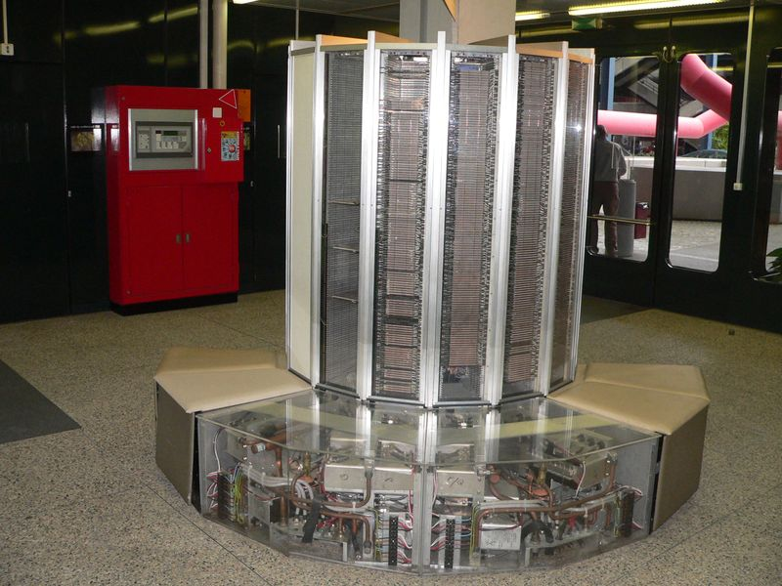
The Cray 1, a vector supercomputer. The first model ran at 80MHz but could retire 2 instructions/cycle for a peak of 160 MIPS. However, it could reach 250 MFLOPS using vectors.

Slide 2
COMP 740: Computer Architecture and Implementation
Montek Singh
Nov 16, 2016
Topic: Vector Processing

Slide 3
Traditional Supercomputer Applications
Typical application areas
Military research (nuclear weapons, cryptography)
Scientific research
Weather forecasting
Oil exploration
Industrial design (car crash simulation)
All involve huge computations on large data sets
In 70s-80s, Supercomputer ≡ Vector Machine

Slide 4
Vector Supercomputers
Epitomized by Cray-1, 1976:
Scalar Unit + Vector Extensions
Load/Store Architecture
Vector Registers
Vector Instructions
Hardwired Control
Highly Pipelined Functional Units
Interleaved Memory System
No Data Caches
No Virtual Memory

Slide 5
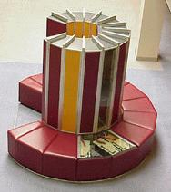
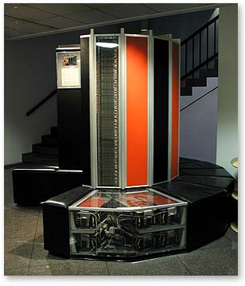
Cray-1 (1976)

Slide 6
Vector Programming Model
Scalar Registers
Vector Registers
r15
v15
r0
v0
[0]
[1]
[2]
[VLRMAX-1]
Vector Length Register
VLR
v1
Vector Arithmetic Instructions
ADDV v3, v1, v2
v2
+
+
+
+
+
+
v3
[0]
[1]
[VLR-1]
Vector Load/Store instr
LVWS v1, (r1, r2)
LV v1, r1
Vector Register
v1
Memory
Base, r1
Stride, r2

Slide 7
Vector Code Example
# C code
for (i=0; i<64; i++)
C[i] = A[i] + B[i];
# Scalar Code
LI R4, 64
loop:
L.D F0, 0(R1)
L.D F2, 0(R2)
ADD.D F4, F2, F0
S.D F4, 0(R3)
DADDIU R1, 8
DADDIU R2, 8
DADDIU R3, 8
DSUBIU R4, 1
BNEZ R4, loop
# Vector Code
LI VLR, 64
LV V1, R1
LV V2, R2
ADDV.D V3, V1, V2
SV V3, R3

Slide 8
Vector Arithmetic Execution
V1
V2
V3
Use deep pipeline (=> fast clock) to execute element operations
Simplifies control of deep pipeline because elements in vector are independent (=> no hazards!)
Six stage multiply pipeline
V3 <- v1 * v2

Slide 9
Vector Instruction Execution
ADDV C,A,B
Execution using one pipelined functional unit
Execution using four pipelined functional units
A[6]
B[6]
A[24]
B[24]
A[25]
B[25]
A[26]
B[26]
A[27]
B[27]
A[5]
B[5]
A[20]
B[20]
A[21]
B[21]
A[22]
B[22]
A[23]
B[23]
A[4]
B[4]
A[16]
B[16]
A[17]
B[17]
A[18]
B[18]
A[19]
B[19]
A[3]
B[3]
A[12]
B[12]
A[13]
B[13]
A[14]
B[14]
A[15]
B[15]
C[2]
C[8]
C[9]
C[10]
C[11]
C[1]
C[4]
C[5]
C[6]
C[7]
C[0]
C[0]
C[1]
C[2]
C[3]

Slide 10
Vector Unit Structure
Functional Unit (e.g., adders)
Vector
Registers
Elements 0, 4, 8, …
Elements 1, 5, 9, …
Elements 2, 6, 10, …
Elements 3, 7, 11, …
Lane
Functional Unit (e.g., multipliers)
Vector load-store unit (Memory Subsystem)

Slide 11
Vector Memory-Memory vs. Vector Register
Vector memory-memory instructions hold all vector operands in main memory
The first vector machines, CDC Star-100 (‘73) and TI ASC (‘71), were memory-memory machines
Cray-1 (’76) was first vector register machine
Vector Memory-Memory Code
Example Source Code
ADDV C, A, B
SUBV D, A, B
for (i=0; i<N; i++)
{
C[i] = A[i] + B[i];
D[i] = A[i] - B[i];
}
Vector Register Code
LV V1, A
LV V2, B
ADDV V3, V1, V2
SV V3, C
SUBV V4, V1, V2
SV V4, D

Slide 12
Vector Memory-Memory vs. Vector Register
Vector memory-memory architectures (VMMA) require greater main memory bandwidth, why?
All operands must be read in and out of memory
VMMAs make if difficult to overlap execution of multiple vector operations, why?
Must check dependencies on memory addresses
↓Apart from CDC follow-ons (Cyber-205, ETA-10) all major vector machines since Cray-1 have had vector register architectures
(we ignore vector memory-memory from now on)

Slide 13
Automatic Code Vectorization
for (i=0; i < N; i++)
C[i] = A[i] + B[i];
Scalar Sequential Code
Vectorized Code
load
load
load
Iter. 1
load
load
load
Time
add
add
add
store
store
store
load
Iter. 1
Iter. 2
Iter. 2
load
Vector Instruction
Vectorization is a massive compile-time reordering of operation sequencing
⇒ requires extensive loop dependence analysis
add
store

Slide 14
Vector Strip Mining
Problem: Vector registers have finite length
Solution: Break loops into pieces that fit into vector registers, “Strip mining”
ANDI R1, N, 63 # N mod 64
MTC1 VLR, R1 # Do remainder
loop:
LV V1, RA
DSLL R2, R1, 3 # Multiply by 8
DADDU RA, RA, R2 # Bump pointer
LV V2, RB
DADDU RB, RB, R2
ADDV.D V3, V1, V2
SV V3, RC
DADDU RC, RC, R2
DSUBU N, N, R1 # Subtract elements
LI R1, 64
MTC1 VLR, R1 # Reset full length
BGTZ N, loop # Any more to do?
for (i=0; i<N; i++)
C[i] = A[i]+B[i];
A
B
C
+
Remainder
+
64 elements
+

Slide 15
Vector Instruction Parallelism
Can overlap execution of multiple vector instructions
example machine has 32 elements per vector register and 8 lanes
Load Unit
Multiply Unit
Add Unit
load
mul
add
time
load
mul
add
Instruction issue
Complete 24 operations/cycle while issuing 1 short instruction/cycle

Slide 16
Vector Chaining
Vector version of register bypassing
introduced with Cray-1
V1
V2
V3
V4
V5
LV v1
MULV v3,v1,v2
ADDV v5, v3, v4
Chain
Chain
Load Unit
Mult.
Add
Memory

Slide 17
Vector Chaining Advantage
Without chaining, must wait for last element of result to be written before starting dependent instruction
Load
Mul
Time
Add
With chaining, can start dependent instruction as soon as first result appears
Load
Mul
Add

Slide 18
Memory operations
Load/store operations move groups of data between registers and memory
Types of addressing
Unit stride
Contiguous block of information in memory
Fastest: always possible to optimize this
LV v1, r1
Non-unit (constant) stride
Harder to optimize memory system for all possible strides
Prime number of data banks makes it easier to support different strides at full bandwidth
LVWS v1, (r1, r2)
32

Slide 19
Vector Memory System
Cray-1, 16 banks, 4 cycle bank busy time, 12 cycle latency
Bank busy time: Cycles between accesses to same bank
Base
Stride
Vector Registers
Address Generator
+
0
1
2
3
4
5
6
7
8
9
A
B
C
D
E
F
Memory Banks

Slide 20
Interleaved Memory Layout
Great for unit stride:
Contiguous elements in different DRAMs
Startup time for vector operation is latency of single read
What about non-unit stride?
Above good for strides that are relatively prime to 16
Bad for: 2, 4, 8
Better: prime number of banks…!

Slide 21
Vector Scatter/Gather
Want to vectorize loops with indirect accesses:
for (i=0; i<N; i++)
A[i] = B[i] + C[D[i]]
Indexed load instruction (Gather)
LV vD, rD # Load indices in D vector
LVI vC, rC, vD # Load indirect from rC base
LV vB, rB # Load B vector
ADDV.D vA, vB, vC # Do add
SV vA, rA # Store result

Slide 22
Vector Conditional Execution
Problem: Want to vectorize loops with conditional code:
for (i=0; i<N; i++)
if (A[i]>0) then
A[i] = B[i];
Solution: Add vector mask (or flag) registers
vector version of predicate registers, 1 bit per element
…and maskable vector instructions
vector operation becomes NOP at elements where mask bit is clear

Slide 23
Masked Vector Instructions
Simple Implementation
execute all N operations, turn off result writeback according to mask
Density-Time Implementation
scan mask vector and only execute elements with non-zero masks
M[7]=1
A[7]
B[7]
M[7]=1
M[6]=0
A[6]
B[6]
M[6]=0
A[7]
B[7]
M[5]=1
A[5]
B[5]
M[5]=1
M[4]=1
A[4]
B[4]
M[4]=1
M[3]=0
A[3]
B[3]
M[3]=0
C[5]
M[2]=0
C[4]
M[1]=1
M[2]=0
C[2]
M[0]=0
M[1]=1
C[1]
C[1]
Write data port
M[0]=0
C[0]
Write Enable
Write data port

Slide 24
Compress/Expand Operations
Compress packs non-masked elements from one vector register contiguously at start of destination vector register
population count of mask vector gives packed vector length
Expand performs inverse operation
M[7]=1
A[7]
A[7]
A[7]
M[7]=1
M[6]=0
A[6]
A[5]
B[6]
M[6]=0
M[5]=1
A[5]
A[4]
A[5]
M[5]=1
M[4]=1
A[4]
A[1]
A[4]
M[4]=1
M[3]=0
A[3]
A[7]
B[3]
M[3]=0
M[2]=0
A[2]
A[5]
B[2]
M[2]=0
M[1]=1
A[1]
A[4]
A[1]
M[1]=1
M[0]=0
A[0]
A[1]
B[0]
M[0]=0
Compress
Expand

Slide 25
Vector Reductions
Problem: Loop-carried dependence on reduction variables
sum = 0;
for (i=0; i<N; i++)
sum += A[i]; # Loop-carried dependence on sum
Solution: Re-associate operations if possible, use binary tree to perform reduction
# Rearrange as:
sum[0:VL-1] = 0 # Vector of VL partial sums
for(i=0; i<N; i+=VL) # Stripmine VL-sized chunks
sum[0:VL-1] += A[i:i+VL-1]; # Vector sum
# Now have VL partial sums in one vector register
do {
VL = VL/2; # Halve vector length
sum[0:VL-1] += sum[VL:2*VL-1] # Halve no. of partials
} while (VL>1)

Slide 26
Vector Execution Time
Time = f(vector length, data dependencies, struct. hazards)
Initiation rate: rate that FU consumes vector elements (= number of lanes; usually 1 or 2 on Cray T-90)
Convoy: set of vector instructions that can begin execution in same clock (no struct. or data hazards)
Chime: approx. time for a vector operation
m convoys take m chimes; if each vector length is n, then they take approx. m x n clock cycles (ignores overhead; good approximization for long vectors)
1: LV V1,Rx ;load vector X
2: MULV V2,F0,V1 ;vector-scalar mult.
LV V3,Ry ;load vector Y
3: ADDV V4,V2,V3 ;add
4: SV Ry,V4 ;store the result
4 convoys, 1 lane, VL=64
=> 4 x 64 = 256 clocks
(or 4 clocks per result)

Slide 27
Older Vector Machines
Machine Year Clock Regs Elements FUs
Cray 1 1976 80 MHz 8 64 6
Cray XMP 1983 120 MHz 8 64 8
Cray YMP 1988 166 MHz 8 64 8
Cray C-90 1991 240 MHz 8 128 8
Cray T-90 1996 455 MHz 8 128 8
Convex C-1 1984 10 MHz 8 128 4
Convex C-4 1994 133 MHz 16 128 3
Fuj. VP200 1982 133 MHz 8-256 32-1024 3
Fuj. VP300 1996 100 MHz 8-256 32-1024 3
NEC SX/2 1984 160 MHz 8+8K 256+var 16
NEC SX/3 1995 400 MHz 8+8K 256+var 16
Notes:
Cray 1; fastest scalar computer + 1st commercially successful vector computer, offered another 10X
6600 1st scoreboard
Cray XMP: 3 LSUs, Multiprocessor 4 way (not by Cray)
=> YMP, C-90, T-90; 2X processors, 1.5X clock
Cray 2 went to DRAM to get more memory, not so great
Like parallel teams as Intel (486, PPro, Pentium, next one)
Japan
Fujitsu, vary number of registers elements (8x1024 or 32x256)
NEC, 8x256 + 8K of varying elements

Slide 28
Newer Vector Computers
Cray X1 & X1E
MIPS like ISA + Vector in CMOS
NEC Earth Simulator
Fastest computer in world for 3 years; 40 TFLOPS
640 CMOS vector nodes

Slide 29
Key Architectural Features of X1
New vector instruction set architecture (ISA)
Much larger register set (32x64 vector, 64+64 scalar)
64- and 32-bit memory and IEEE arithmetic
Based on 25 years of experience compiling with Cray1 ISA
Decoupled Execution
Scalar unit runs ahead of vector unit, doing addressing and control
Hardware dynamically unrolls loops, and issues multiple loops concurrently
Special sync operations keep pipeline full, even across barriers
⇒ Allows the processor to perform well on short nested loops
Scalable, distributed shared memory (DSM) architecture
Memory hierarchy: caches, local memory, remote memory
Low latency, load/store access to entire machine (tens of TBs)
Processors support 1000’s of outstanding refs with flexible addressing
Very high bandwidth network
Coherence protocol, addressing and synchronization optimized for DM

Slide 30
Cray X1E Mid-life Enhancement
Technology refresh of the X1 (0.13μm)
~50% faster processors
Scalar performance enhancements
Doubling processor density
Modest increase in memory system bandwidth
Same interconnect and I/O
Machine upgradeable
Can replace Cray X1 nodes with X1E nodes

Slide 31
Earth Simulator
A general-purpose supercomputer:
Processor Nodes (PN) Total number of processor nodes is 640. Each processor node consists of eight vector processors of 8 GFLOPS and 16GB shared memories. Therefore, total numbers of processors is 5,120 and total peak performance and main memory of the system are 40 TFLOPS and 10 TB, respectively. Two nodes are installed into one cabinet, size is 40”x56”x80”. 16 nodes are in a cluster. Power consumption per cabinet is approximately 20 KW.
2) Interconnection Network (IN): Each node is coupled together with more than 83,000 copper cables via single-stage crossbar switches of 16GB/s x2 (Load + Store). The total length of the cables is approximately 1,800 miles.
3) Hard Disk. Raid disks are used for the system. The capacities are 450 TB for the systems operations and 250 TB for users.
4) Mass Storage system: 12 Automatic Cartridge Systems (STK PowderHorn9310); total storage capacity is approximately 1.6 PB.
From Horst D. Simon, NERSC/LBNL, May 15, 2002, “ESS Rapid Response Meeting”

Slide 32
Earth Simulator

Slide 33
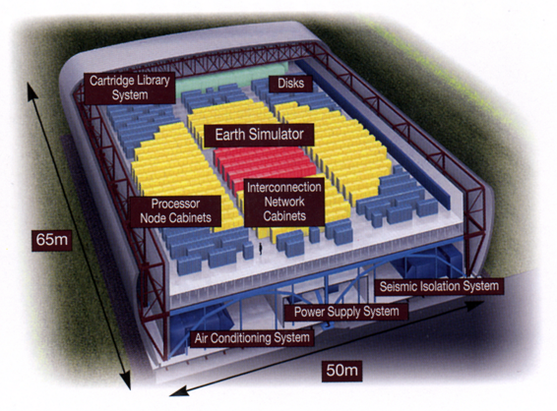
Earth Simulator Building

Slide 34
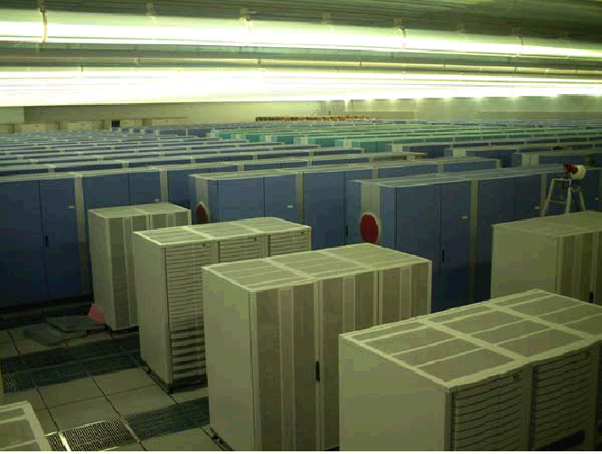
ESS – complete system installed 4/1/2002

Slide 35
Multimedia Extensions
Very short vectors added to existing ISAs for micros
Usually 64-bit registers split into 2x32b or 4x16b or 8x8b
Newer designs have 128-bit registers (Altivec, SSE2)
Limited instruction set:
no vector length control
no strided load/store or scatter/gather
unit-stride loads must be aligned to 64/128-bit boundary
Limited vector register length:
requires superscalar dispatch to keep multiply/add/load units busy
loop unrolling to hide latencies increases register pressure
Trend towards fuller vector support in microprocessors

Slide 36
Vector Instruction Set Advantages
Compact
one short instruction encodes N operations
Expressive, tells hardware that these N operations:
are independent
use the same functional unit
access disjoint registers
access registers in the same pattern as previous instructions
access a contiguous block of memory (unit-stride load/store)
access memory in a known pattern (strided load/store)
Scalable
can run same object code on more parallel pipelines or lanes

Slide 37
Operation & Instruction Count: RISC v. Vector Processor
Spec92fp Operations (Millions) Instructions (Millions)
Program RISC Vector R/V RISC Vector R/V
swim256 115 95 1.1x 115 0.8 142x
hydro2d 58 40 1.4x 58 0.8 71x
nasa7 69 41 1.7x 69 2.2 31x
su2cor 51 35 1.4x 51 1.8 29x
tomcatv 15 10 1.4x 15 1.3 11x
wave5 27 25 1.1x 27 7.2 4x
mdljdp2 32 52 0.6x 32 15.8 2x
Vector reduces ops by 1.2X, instructions by 20X
(from F. Quintana, U. Barcelona.)

Slide 38
Vectors Lower Power
Single-issue Scalar
One instruction fetch, decode, dispatch per operation
Arbitrary register accesses, adds area and power
Loop unrolling and software pipelining for high performance increases instruction cache footprint
All data passes through cache; waste power if no temporal locality
One TLB lookup per load or store
Off-chip access in whole cache lines
Vector
One inst fetch, decode, dispatch per vector
Structured register accesses
Smaller code for high performance, less power in instruction cache misses
Bypass cache
One TLB lookup per group of loads or stores
Move only necessary data across chip boundary
Notes:
41

Slide 39
Superscalar: Worse Energy Efficiency
Superscalar
Control logic grows quadratically with issue width
Control logic consumes energy regardless of available parallelism
Speculation to increase visible parallelism wastes energy
Vector
Control logic grows linearly with issue width
Vector unit switches off when not in use
Vector instructions expose parallelism without speculation
Software control of speculation when desired:
Whether to use vector mask or compress/expand for conditionals
Notes:
42

Slide 40
Vector Applications
Limited to scientific computing? No!
Multimedia Processing (compress., graphics, audio synth, image proc.)
Standard benchmark kernels (Matrix Multiply, FFT, Convolution, Sort)
Lossy Compression (JPEG, MPEG video and audio)
Lossless Compression (Zero removal, RLE, Differencing, LZW)
Cryptography (RSA, DES/IDEA, SHA/MD5)
Speech and handwriting recognition
Operating systems/Networking (memcpy, memset, parity, checksum)
Databases (hash/join, data mining, image/video serving)
Language run-time support (stdlib, garbage collection)
even SPECint95
Notes:
43

Slide 41
Vector Summary
Vector is alternative model for exploiting ILP
If code is vectorizable, then simpler hardware, more energy efficient, and better real-time model than Out-of-order machines
Design issues include number of lanes, number of functional units, number of vector registers, length of vector registers, exception handling, conditional operations
Fundamental design issue is memory bandwidth
Will multimedia popularity revive vector architectures?

