Slide 1
Welcome to COMP 530
Don Porter

Slide 2
Welcome!
Today’s goals:
Give you a flavor of my teaching style with a mini-lecture
Cover course organization
My high-level goals for the class:
Demystify how computers work (No magic)
Learn core principles: secure multiplexing, scheduling, concurrency, performance analysis
This is a class for everyone, not just gurus
Challenging, but supportive, environment

Slide 3
Waiting List
If you are trying to get into the class, please fill out the form(s) on the course website:
http://www.cs.unc.edu/~porter/courses/comp530/f20

Slide 4
So what is an OS?

Slide 5
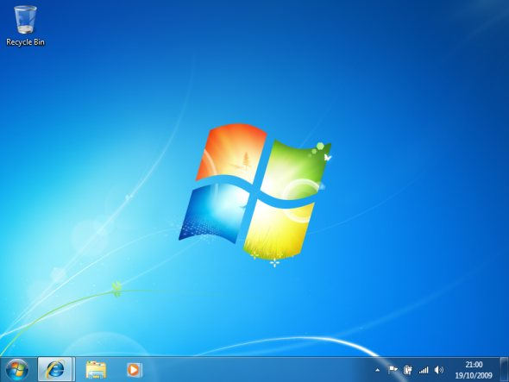
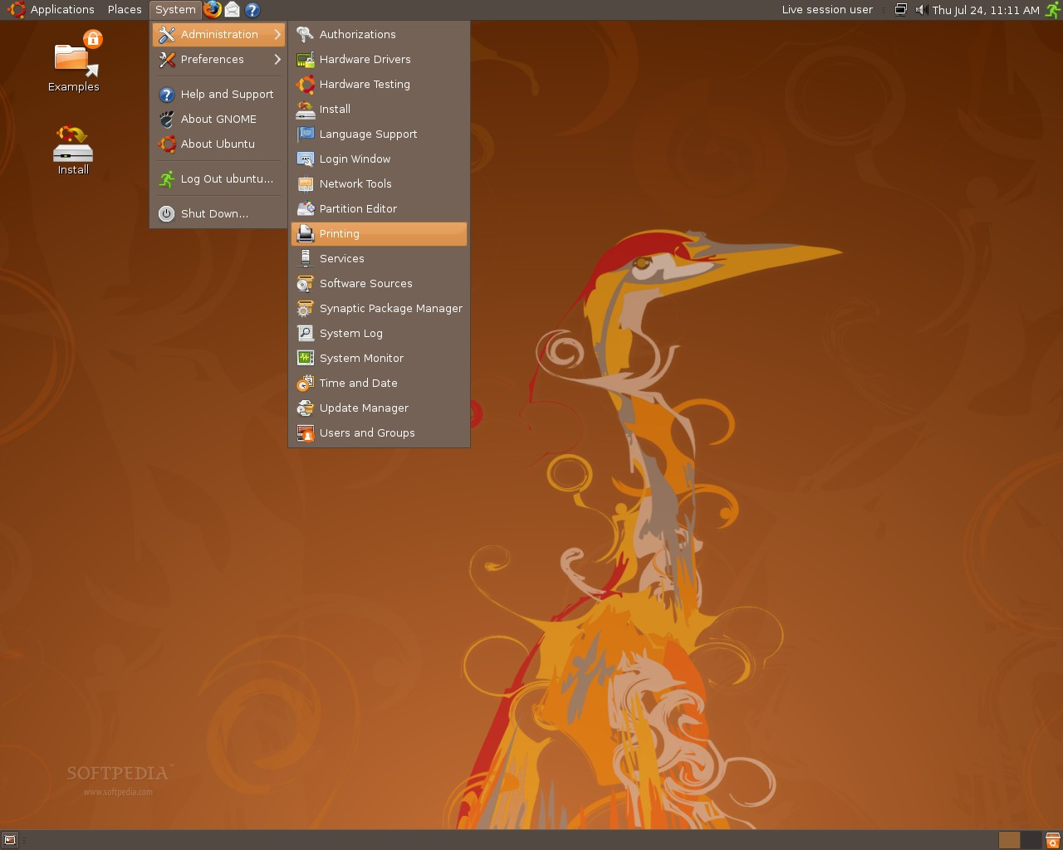
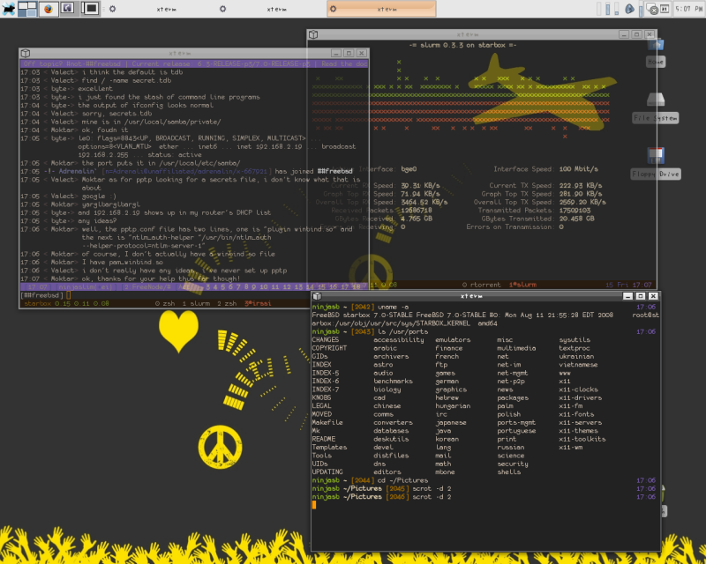
One view of an OS

Slide 6
Another simple view of an OS
App
App
App
App
OS
Hardware
Notes:
But really not quite right

Slide 7
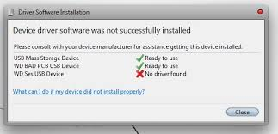
A less happy view of an OS

Slide 8
So which one is right?
They all are

Slide 9
An OS serves three constituencies
Human users: a desktop environment
Application Developers: More usable abstractions of the hardware
Hardware manufacturers: An abstraction of the applications to the device
Notes:
Although these things are bundled into one CD, they need not be
We’ll unpack what each of these looks like, but let’s go back to the architecture picture

Slide 10
Why Study Operating Systems?
Primary Goal: Demystify how computers work
Lots of abstractions and heuristics between your application and the hardware
A good computer scientist should understand what happens inside the system when one types a command
Secondary: Learn how to write robust programs
OSes like Linux have many users and work on a wide range of hardware
Deal with subtle issues: concurrency, consistency, etc.
Notes:
Philosophical issue for any CS degree holder
By the end of the course, you should understand what happens when you type a command, from the hardware through the OS and into the application

Slide 11
Background (1)
CPUs have 2 modes: user and supervisor
Sometimes more, but whatevs
Supervisor mode:
Issue commands to hardware devices
Power off, Reboot, Suspend
Launch missiles, Do awesome stuff
User mode:
Run other code, hardware tattles if you try anything reserved for the supervisor

Slide 12
OS architecture
App
App
App
App
OS
Hardware
Notes:
But really not quite right

Slide 13
OS architecture
App
App
App
App
Libraries
User
Kernel
Super- visor
Hardware
Notes:
So the OS components in user mode are often called libraries, and the part that runs in super-visor mode is called the kernel.
The kernel itself is often conflated with the OS

Slide 14
User #2: Applications
Application Programming Interface (API)
Win32 (Windows)
POSIX (Unix/Linux)
Cocoa/Cocoa Touch (Mac OS/iOS)
Application-facing functions provided by libraries
Injected by the OS into each application

Slide 15
OS architecture
App
App
App
App
Libraries
User
Kernel
Super- visor
Hardware
Notes:
So the OS components in user mode are often called libraries, and the part that runs in super-visor mode is called the kernel.
The kernel itself is often conflated with the OS

Slide 16
OS architecture
App
App
App
Win32
API
Libraries
Libraries
Libraries
User
Kernel
Super- visor
Hardware
Notes:
So the OS components in user mode are often called libraries, and the part that runs in super-visor mode is called the kernel.
The kernel itself is often conflated with the OS

Slide 17
Famous libraries, anyone?
Windows: ntdll.dll, kernel32.dll, user32.dll, gdi32.dll
Linux/Unix: libc.so, ld.so, libpthread.so, libm.so

Slide 18
Caveat 1
Libraries include a lot of code for common functions
Why bother reimplementing sqrt?
They also give high-level abstractions of hardware
Files, printer, dancing Homer Simpson USB doll
How does this work?

Slide 19
System Call
Special instruction to switch from user to supervisor mode
Transfers CPU control to the kernel
One of a small-ish number of well-defined functions
How many system calls does Windows or Linux have?
Windows ~1200
Linux ~350

Slide 20
OS architecture
Open file “hw1.txt”
Ok, here’s handle 4
App
App
App
Libraries
Libraries
Libraries
User
Kernel
Super- visor
System Call Table (350—1200)
Hardware
Notes:
So the OS components in user mode are often called libraries, and the part that runs in super-visor mode is called the kernel.
The kernel itself is often conflated with the OS

Slide 21
Caveat 2
Some libraries also call special apps provided by the OS, called a daemon (or service)
Communicate through kernel-provided API
Example: Print spooler
App sends pdf to spooler
Spooler checks quotas, etc.
Turns pdf into printer-specific format
Sends reformatted document to device via OS kernel

Slide 22
OS architecture
App
App
Daemon
Libraries
Libraries
Libraries
User
Kernel
Super- visor
System Call Table (350—1200)
Hardware
Notes:
So the OS components in user mode are often called libraries, and the part that runs in super-visor mode is called the kernel.
The kernel itself is often conflated with the OS

Slide 23
User 3: Hardware
OS kernels are programmed at a higher low level of abstraction
Disk blocks vs. specific types of disks
For most types of hardware, the kernel has a “lowest common denominator” interface
E.g., Disks, video cards, network cards, keyboard
Think Java abstract class
Sometimes called a hardware abstraction layer (HAL)
Each specific device (Nvidia GeForce 600) needs to implement the abstract class
Each implementation is called a device driver

Slide 24
OS architecture
App
App
Daemon
Libraries
Libraries
Libraries
User
Kernel
Super- visor
System Call Table (350—1200)
HAL
Driver
Driver
Driver
Hardware
Notes:
So the OS components in user mode are often called libraries, and the part that runs in super-visor mode is called the kernel.
The kernel itself is often conflated with the OS

Slide 25
What about User 1
What is the desktop?
Really just a special daemon that interacts closely with keyboard, mouse, and display drivers
Launches programs when you double click, etc.
Some program libraries call desktop daemon to render content, etc.

Slide 26
An OS serves three types of users
Give users a desktop environment
Desktop, or window manager, or GUI
Give applications a more usable abstraction of the hardware
Libraries (+ system calls and daemons)
Give hardware manufacturers an abstraction of the applications
Device Driver API (or HAL)
Notes:
Although these things are bundled into one CD, they need not be
We’ll unpack what each of these looks like, but let’s go back to the architecture picture

Slide 27
Multiplexing Resources
Many applications may need to share the hardware
Different strategies based on the device:
Time sharing: CPUs, disk arm
Each app gets the resource for a while and passes it on
Space sharing: RAM, disk space
Each app gets part of the resource all the time
Exclusive use: mouse, keyboard, video card
One app has exclusive use for an indefinite period

Slide 28
So what is Linux?
Really just an OS kernel
Including lots of device drivers
Conflated with environment consisting of:
Linux kernel
Gnu libc
X window manager daemon
CUPS printer manager
Etc.

Slide 29
So what is Ubuntu? Centos?
A distribution: bundles all of that stuff together
Pick versions that are tested to work together
Usually also includes a software update system

Slide 30
OSX vs iOS?
Same basic kernel (a few different compile options)
Different window manager and libraries

Slide 31
What is Unix?
A very old OS (1970s), innovative, still in use
Innovations:
Kernel written in C (first one not in assembly)
Co-designed C language with Unix
Several nice API abstractions
Fork, pipes, everything a file
Several implementations: *BSDs, Solaris, etc.
Linux is a Unix-like kernel
Notes:
START after this

Slide 32
What is POSIX?
A standard for Unix compatibility
Even Windows is POSIX compliant!

Slide 33
Administrative
Syllabus, schedule, homework, etc. posted on course website
www.cs.unc.edu/~porter/courses/comp530/f20

Slide 34
Prerequisites
COMP 210 – Data Structures
Or 410 in the old numbering
COMP 311 – Computer Organization
Or 411 in the old numbering
The background courses are necessary
In some cases, industry experience is ok
C programming
Basic Unix command-line proficiency

Slide 35
C Programming
You should have learned C in the prerequisite courses
Ok if you are not a C guru (you will be)
A very good resource is “The C Programming Language” by Kernighan and Ritchie
Relatively short, and lots of useful exercises
If you find yourself struggling with C, consider adding some work from this book to be able to complete this course on schedule

Slide 36
Labs: Learn by doing
This course is coding intensive
You should know C, or be prepared to remediate quickly
You must learn on your own/with lab partner
You will write several user-level utilities that exercise OS functionality
Challenging work, but a very marketable skill
Notes:
START HERE

Slide 37
Group Policy
You may do assignments alone, or with up to 3 teammates
You must list all teammates in code
Caveat: All teammates must understand code
I reserve right to ask you about the code; if you can’t explain it to my satisfaction, you will lose points
Also, there may be exam questions on programming assignments
You may change groups on each assignment
Except Labs 0 and 1, where Lab 1 builds on Lab 0
Changes still possible with instructor permission

Slide 38
Productive Frustration
One of the “meta skills” that distinguishes an excellent programmer is the ability to get un-stuck
Fixing a “heisenbug” has this property
How do you learn this skill?
Get stuck on a hard, but solvable problem
Learn which strategies will get you moving again
If you take a quick cheat, you won’t learn the skills to solve truly hard problems
Notes:
START HERE

Slide 39
Academic Integrity
I take cheating very seriously. It can end your career.
I check, and report to Honor Court
In a gray area, it is your job to stay on right side of line
Never show your code to anyone except your team and course staff
Never look at anyone else’s code (incl. other universities or past sections)
Do not discuss code; do not debug each other’s code
Acknowledge students that give you good ideas
Note liberal group and lateness policies

Slide 40
Why do we care?
Analogy: This is the programming dojo
If you don’t do your exercises, you will be unprepared for battle
You’ve wasted your money and both of our time
It brings dishonor on the dojo when you lose every battle
Similarly, a lot of what I teach (and what will make you a valuable employee when you graduate) has no short cut
How do you learn to punch through a board?
You punch a board over and over until your fist goes through it

Slide 41
Integrity Homework
Exercises applying course policies and ethics to several situations
Due in class Tues 8/18, in gradescope
Note: no other assignments will be graded for you until this is completed

Slide 42
Lateness
Each student gets 72 late hours for programming hw
List how many you use in slack.txt
Each day after these are gone costs a full letter grade on the assignment
If you work in a team, each member loses 1 hour for each hour late
It is your responsibility to use these to manage:
Holidays, weddings, research deadlines, conference travel, Buffy marathons, release of the next Zelda game, etc.
3 Exceptions: illness (need doctor’s note), death in immediate family, accommodation for disability
Notes:
If it isn’t on this list, I don’t want to hear about it.

Slide 43
Lateness, continued
Maximum lateness penalty is a ‘D’ on the assignment
Anything may be turned in up until LDOC for up to 60% credit
Challenge problems may be turned in up until LDOC
After midnight on LDOC, remaining late hours may be used, but no other late submissions will be accepted
Resubmissions are allowed, including late ones
We will just grade (and penalize if late) the most recent submission

Slide 44
Challenge Problems
Each lab may include challenge problems, which you may complete for bonus points (generally 5—10 points out of 100)
Unwise to turn in a lab late to do challenge problems
Can complete challenge problems at any point in the semester---even on old labs
Indicate any challenge problems completed in challenge.txt file

Slide 45
Lectures
Discuss and supplement reading material
An important chance to clarify issues
Questions are encouraged!
I expect you to arrive prepared to answer and ask questions about the reading material
Everything in lectures may appear on the exams, even if not in the book
I need you here: Digressions are common to fill in “gaps” and to integrate material from other classes
Notes:
START HERE

Slide 46
Recordings
I usually record lectures for students to review later
I will share on MS Stream
All students in the course should be given access via your ONYEN
Recordings are best effort
Recordings may fail, be unwatchable, or get deleted by accident
Or be discontinued if too many students stop attending
I need your facial expressions and questions to know if lectures make sense
Do not use this as a substitute for class attendance

Slide 47
Textbook
Free online at:
http://pages.cs.wisc.edu/~remzi/OSTEP/
You can buy a hard-copy or ebook format online if you want
Other optional references, definitely not required

Slide 48
Readings
My lectures aren’t perfect; some concepts are subtle
Reading other words can be helpful for reinforcement and clarification
You will learn more in class if you read before class
Can’t ask the textbook questions
1—2 papers will be posted and discussed; these you should read before class

Slide 49
Course email list
We will use Piazza this semester. Link on course website
Will help scale up to a large class
This is the primary announcement medium
And for discussions about course work
Do not post code here or other solutions
Goal: Everyone can learn from general questions
Material discussed on the mailing list can be an exam question

Slide 50
Worksheets
You will get worksheets throughout the semester
And randomly assigned teams
These will not be graded, except for participation
But are valuable practice for the exams
Do not save these until right before the exam
A lot of work
The material is cumulative

Slide 51
Other administrative notes
Read syllabus completely
Subscribe to the class piazza forum
3 exams cover: lectures, labs, mailing list
All staff email goes to comp530ta@cs.unc.edu
Except private issues for instructor only

Slide 52
Special Offer!
You can write your own exam questions
Send them to me in advance of the test, if I like them, I will use them
Do NOT share with anyone else

Slide 53
Getting help
TA’s will keep office hours
See course calendar for times and zoom links
Instructor keeps office hours
Note that “by appointment” means more time available on demand

Slide 54
Github Classroom
This semester: Experiment with github classroom
Worked pretty well in last 530 class
Git/github are powerful and common industry tools
Bear with us as we work out any issues

Slide 55
Questions?
Remember:
Do academic honesty homework
Lab 0 coming soon

