Slide 1
COMP 301 Foundations of Programming
Welcome to
January, 2024
( adapted from K. Mayer-Patel )
Notes:
Slides are available on Sakai in the “resources” folder
You should have access to Sakai
Ask questions!
Today is an “orientation day”
We’re just going to go over the syllabus and rules for the course

Slide 2
Overview of COMP 301
What is it, what will we be doing, policies, procedures, who I am, etc.

Slide 3
Computer science introductory sequence
Freshman year
Sophomore year
Junior/senior year
COMP 110
Intro to Programming
COMP 210
Data Structures
COMP 211
System Fundamentals
COMP 311
Computer Organization
COMP Electives
MATH 231
Calculus I
COMP 283
Discrete Structures
COMP 301
Foundations of Programming
https://cs.unc.edu/undergraduate/

Slide 4
COMP 301 is an applications course
Applications
Systems
Theory
COMP 301
O(n²)
Notes:
Theory: Discrete math, logic, mathematical models of computation, “proving the limits of what can be solved by computers”, algorithm complexity analysis,
Systems: Operating systems, computer engineering, circuit design, networking, “the building blocks for making applications”
Applications: Human-computer interaction, user interfaces, software engineering, app design, “making separate components work together to improve the human experience”

Slide 5
Course objectives
In COMP 301 you will learn how to use
the tools, the terminology, and the approach
that software engineers use
to build large applications
in Java

Slide 6
You Will Use These Industry-Grade Tools in COMP 301
IDE
Language
Java
IntelliJ
Version Control
Git/GitHub
Build Automation
Maven
GUI
JavaFX
Style Guide
Google’s Java Style Guide

Slide 7
A Principled Approach to Software Engineering
When writing code for a large application, figuring out how to do it is the easy part.
Figuring out how to do it in an organized, modular, clear way is the challenge.
Things that help:
Separating code into objects (Module 1)
A robust testing pipeline (Module 2)
Following well-known design patterns (Module 3)

Slide 8
Course Structure
Module 0: Getting started
2 classes
Module 2: Errors and testing
3 classes
Module 4: User interfaces and asynchronous programming
6 classes
Module 1: Object-oriented programming
8 classes
Module 3: Design patterns
6 classes
Midterm Exam 1
Midterm Exam 2
Final Exam
See full schedule complete with dates on Canvas

Slide 9
No Course Textbook
There is no required course textbook
All resources and readings will be posted to the course web site
Recommended reads for those interested in software engineering:
Design Patterns: Elements of Reusable Object-Oriented Software
by Erich Gamma, Richard Helm, Ralph Johnson, and John Vlissides
The Mythical Man-Month: Essays on Software Engineering
by (our very own) Fred Brooks

Slide 10
Course grade breakdown
45% - Assignments
Not all worth the same.
32% - Midterm
Each worth 16%
21% - Final Exam
02% - PollEverywhere
In class many days
Grade | Range
A | >= 95%
A- | [90%, 95.0%)
B+ | [86.66%, 90%)
B | [83.33%, 86.66%)
B- | [80%, 83.33%)
C+ | [76.66%, 80%)
C | [73.33%, 76.66%)
C- | [70%, 73.33%)
D+ | [65%, 70%)
D | [60%, 65%)
F | < 60%

Slide 11
9 Programming Assignments (45%)
Due dates
Mostly due on Sunday night*
Late penalty
25% until end of semester
Grading
Auto-graded with Gradescope
Auto-grader feedback available immediately
No penalty for multiple submissions
Time commitment
A programming assignment is due every 1-2 weeks
Plan to spend 3-6 hours per week working on programming assignments
* Technically due Monday morning at 5 am EST
Warning: Due dates and late penalties are fairly firm in this class. Unexpected things happen to everyone; start your assignments early enough so you can finish on time even when things don’t go as planned.

Slide 12
Programming assignment workflow
1. Click the assignment link in Canvas and accept the assignment
4. Submit to Gradescope for autograding
2. Copy the link and clone the starter code in IntelliJ
3. Read instructions, work on assignment, and push to GitHub
5. Check final grade in Canvas after due date

Slide 13
2 Midterm Exams (32%, 16% each)
Midterm exam format
Timed (75 minutes)
Taken in person, on paper
Closed notes, closed book
Types of questions
Code tracing
True/false
Multiple choice
Review
Review session
Midterm Exam Schedule
Midterm Exam 1 | Thu, MM dd
Midterm Exam 2 | Thu, MM dd
Fill-in-the-blank
Diagram drawing
Short answer
Study guide

Slide 14
1 Final Exam (21%)
Final Exam Schedule
Final Exam | Thu, May 9 4pm – 7pm
Final exam format
Timed (180 minutes)
Taken in person, on paper
Closed notes, closed book
Same format as midterms
Cumulative
The final exam is given in conformance with the UNC final exam calendar and procedures
This means don’t make travel plans
to leave campus before the exam.
We will not be offering it early

Slide 15
Attendance and participation
Attendance
Expected, 2% of total grade
Participation
Short videos assigned to watch before class
PollEverywhere questions asked in class
Other active learning methods
PollEverywhere reviews most classes

Slide 16
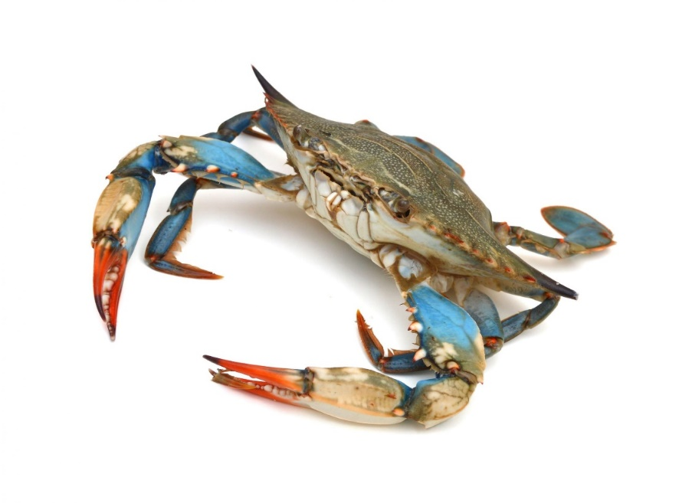
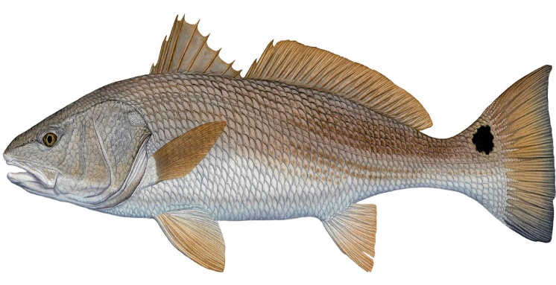
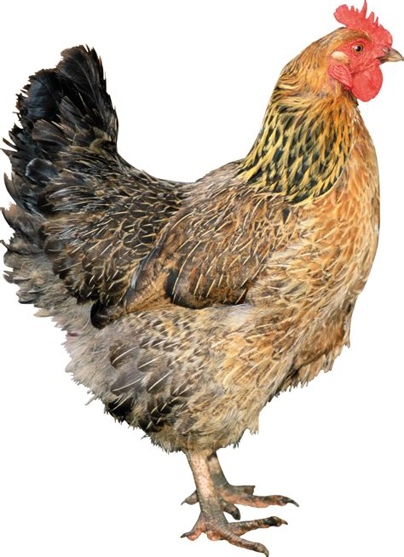
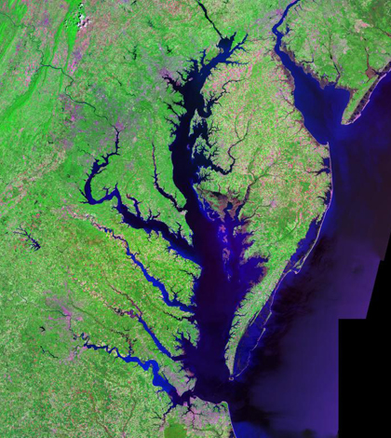
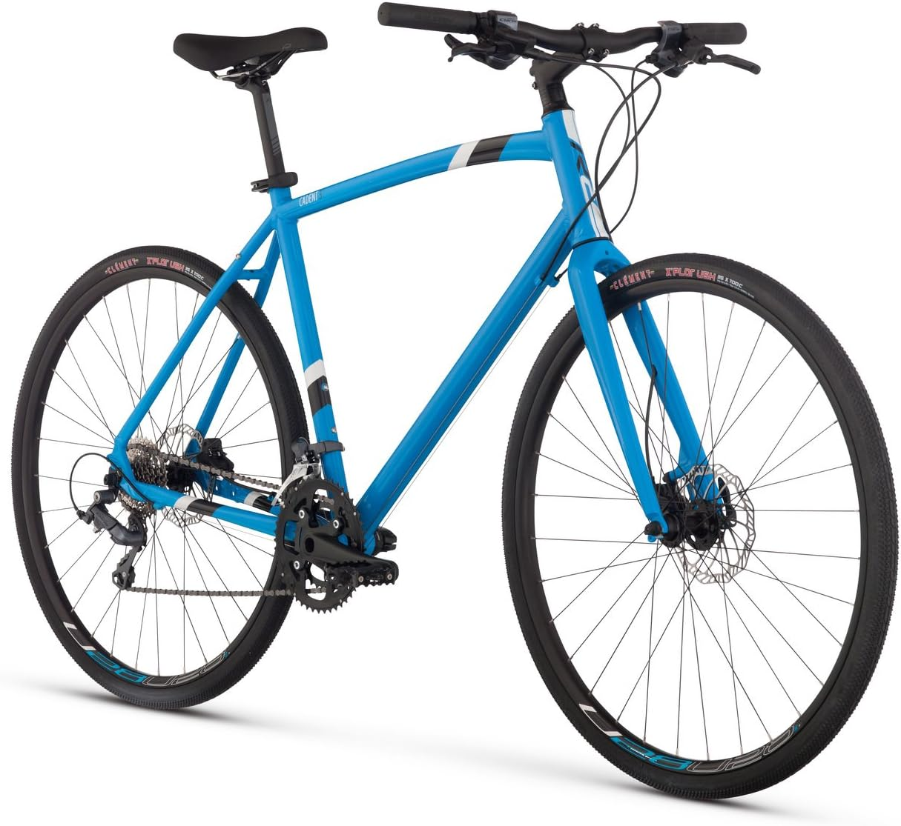
Hello World, I’m Dave Stotts

Slide 17
Today’s Attendance
To get credit for attending class today,
visit https://pollev.com/pds now

Slide 18
Honor Code Policy
Honor code violations are very serious
Please take time to understand the policy details on the syllabus

Slide 19
Honor code policy
Anti-cheating software will be used to analyze all code turned in for quizzes and programming assignments
Fill out the honor code agreement on Canvas this week
(I’ll remind you on Tuesday)
Okay, okay. Collaboration on assignments
is not allowed. I get it.
So where should I go for help?

Slide 20
Where to go for help
Canvas
Canvas is the official source for course information
Due dates, links to assignments, lecture slides, etc.
Office Hours
Mix of virtual and in-person
Office hours offered from 9am – 5pm, M-F (excluding holidays)
We will use the My Digital Hand tool for waiting list (info on Canvas)
Piazza
Online collaborative message board
Type a question, get answers from LAs and classmates ( “email” )
See Canvas for join link

Slide 21
Office hours
My Digital Hand
Online tool for office hours management
Use to get help, see the current (live) waitlist, and see the schedule
Workflow
Go to My Digital Hand and make sure a learning assistant is on duty
Add yourself to the waitlist
When it’s your turn, an LA will notify you and give you a Zoom link or room number

Slide 22
Today’s Homework
Read Unit 0 on Canvas (the syllabus)
Install IntelliJ and the Java JDK
Make a UNC student PollEverywhere account if you don't have one ( I guess you do since we used it )
Complete the honor code agreement quiz on Canvas
Sign up for these tools:
My Digital Hand – see office hours tab on Canvas for code / link.
Piazza - https://piazza.com/unc/spring2024/comp301

Slide 23
It’s going to be a great semester!
The beginning of a fascinating, challenging, and life-long learning career for you

