Slide 1
Java Workflow, Maven, Git
COMP 301
( adapted from K. Mayer-Patel )

Slide 2
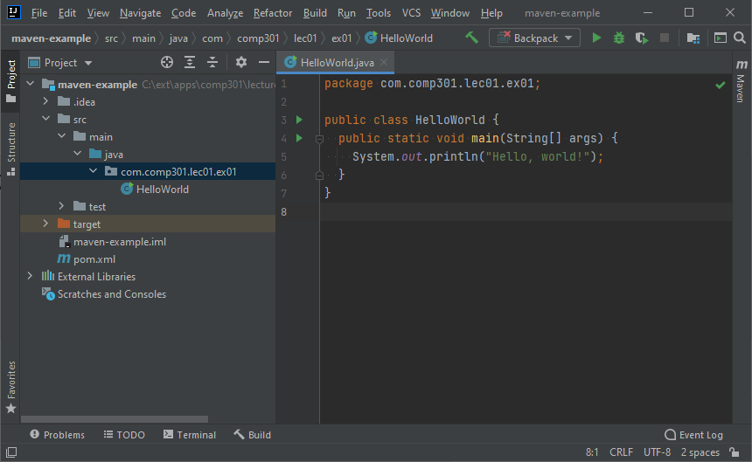
Q: What happens when you press the “run” button in your IDE?

Slide 3
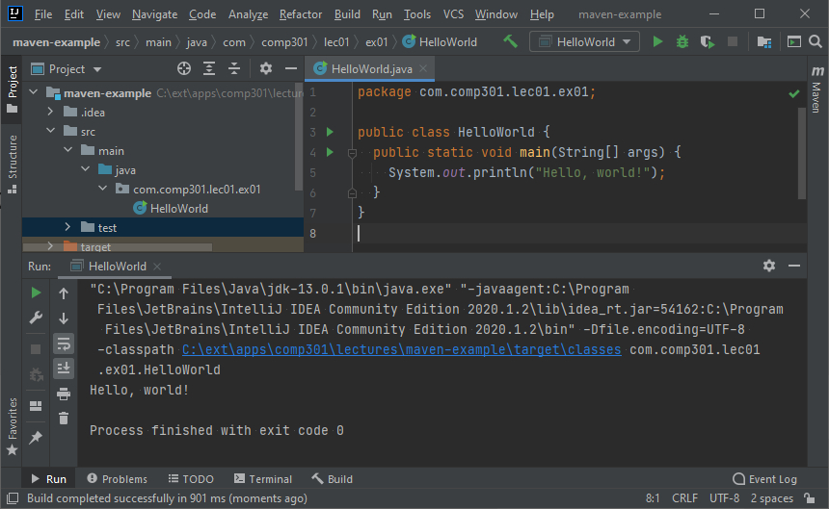
Q: What happens when you press the “run” button in your IDE?
A: After a few seconds, your program is executed
Is this how your users will run the program?
(probably not…)

Slide 4
Introduction
Packaging application code into a final, distributable product is a crucial part of software development
  Code is only useful if it is being used
  Programming languages have different approaches to packaging and distributing code
Let’s learn about Java’s build process
Running Java code is a two-step process
  Compile the source code into bytecode
  Execute the resulting bytecode

Slide 5
Compiling and executing Java code
How to use the Java code you write
Notes:
Writing code is ultimately about improving life! Computers make the world a better place!
But your program doesn’t improve anyone’s life until you can run it!

Slide 6
To Compile or Not To Compile
Interpreted languages
  Python, JavaScript
  Program source code parsed and interpreted for execution by language interpreter
  Advantage: same source code runs on different platforms and processors
  Disadvantage: slower
Compiled languages
  C, C++, Rust
  Compiler parses and translates source code into machine executable code
    Must be done for the specific instruction set architecture (ISA) used by the processor
  Advantage: runs fast, can be highly optimized
  Disadvantage: need to create a machine specific version for every kind of machine.

Slide 7
Java's Big Idea
Best of both worlds.
Compile source code to the "machine code" of a virtual machine
  Java Virtual Machine (JVM)
Provide machine specific implementations of the virtual machine
Advantage: write once, run everywhere.
Disadvantage: some performance hit

Slide 8
Compiling a Java program
Compile – The process of translating a program from source code into a language that a machine can more easily understand
CA FE BA BE 00 00 00 33 00 22 0A 00 02 00 03 00 04 0C 00 05 00 06 01 00 10 6A 61 76 61 2F 6C 61 6E 67 2F 4F 62 6A 65 63 74 01 00 06 3C 69 6E 69 74 3E 01 00 03 28 29 56 09 00 08 00 09 07 00 0C 00 0B 00 0C 01 00 10 6A 61 76 61 2F 6C 61 2F 53 79 74 65 6D 01 00 03 6F 75 74 01 00 15 4C 66 A0 65 63
package com.comp301.lec01.ex01;
public class HelloWorld {
public static void main(String[] args) {
System.out.println("Hello, world!");
}
}
HelloWorld.class (bytecode)
HelloWorld.java (source code)
Java Development Kit (JDK)
The JDK includes a Java compiler to convert Java source code to bytecode
Files ending in .java
contain ASCII Java source code
Files ending in .class
contain binary bytecode

Slide 9
Executing a Java program
Execute – The process of feeding a compiled program into a machine that can follow the instructions
Execute
package com.comp301.lec01.ex01;
public class HelloWorld {
public static void main(String[] args) {
System.out.println("Hello, world!");
}
}
Source code is not needed to execute bytecode
HelloWorld.java (source code)
CA FE BA BE 00 00 00 33 00 22 0A 00 02 00 03 00 04 0C 00 05 00 06 01 00 10 6A 61 76 61 2F 6C 61 6E 67 2F 4F 62 6A 65 63 74 01 00 06 3C 69 6E 69 74 3E 01 00 03 28 29 56 09 00 08 00 09 07 00 0C 00 0B 00 0C 01 00 10 6A 61 76 61 2F 6C 61 2F 53 79 74 65 6D 01 00 03 6F 75 74 01 00 15 4C 66 A0 65 63
HelloWorld.class (bytecode)
Java Development Kit (JDK)
Java Virtual Machine (JVM)
Compiled bytecode can be executed by a JVM

Slide 10
Compiling and executing large Java projects

Slide 11
Compiling and executing large projects
Large projects commonly have:
  Hundreds of .java source files to compile
  External dependencies that must be imported
Dependency – A “third-party” library containing code that you didn’t write yourself, but is used in your project
What does the compilation and execution process look like for large projects?
In COMP 301, we will use two third-party dependencies: JUnit and JavaFX

Slide 12
Compiling a large project
Dependencies and all source code files must be passed to the JDK for compilation
Source Code
(code you wrote)
Java Development Kit (JDK)
Bytecode
(compiled machine instructions)
HelloWorldA.java
package com.comp301.lec01.ex01;
public class HelloWorld {
public static void main(String[] args) {
System.out.println("Hello, world!");
}
}
CA FE BA BE 00 00 00 33 00 22 0A 00 02 00 03 00 04 0C 00 05 00 06 01 00 10 6A 61 76 61 2F 6C 61 6E 67 2F 4F 62 6A 65 63 74 01 00 06 3C 69 6E 69 74 3E 01 00 03 28 29 56 09 00 08 00 09 07 00 0C 00 0B 00 0C 01 00 10 6A 61 76 61 2F 6C 61 2F 53 79 74 65 6D 01 00 03 6F 75 74 01 00 15 4C 66 A0 65 63
HelloWorldB.java
HelloWorldA.class
package com.comp301.lec01.ex01;
public class HelloWorld {
public static void main(String[] args) {
System.out.println("Hello, world!");
}
}
CA FE BA BE 00 00 00 33 00 22 0A 00 02 00 03 00 04 0C 00 05 00 06 01 00 10 6A 61 76 61 2F 6C 61 6E 67 2F 4F 62 6A 65 63 74 01 00 06 3C 69 6E 69 74 3E 01 00 03 28 29 56 09 00 08 00 09 07 00 0C 00 0B 00 0C 01 00 10 6A 61 76 61 2F 6C 61 2F 53 79 74 65 6D 01 00 03 6F 75 74 01 00 15 4C 66 A0 65 63
HelloWorldC.java
HelloWorldB.class
package com.comp301.lec01.ex01;
public class HelloWorld {
public static void main(String[] args) {
System.out.println("Hello, world!");
}
}
CA FE BA BE 00 00 00 33 00 22 0A 00 02 00 03 00 04 0C 00 05 00 06 01 00 10 6A 61 76 61 2F 6C 61 6E 67 2F 4F 62 6A 65 63 74 01 00 06 3C 69 6E 69 74 3E 01 00 03 28 29 56 09 00 08 00 09 07 00 0C 00 0B 00 0C 01 00 10 6A 61 76 61 2F 6C 61 2F 53 79 74 65 6D 01 00 03 6F 75 74 01 00 15 4C 66 A0 65 63
HelloWorldD.java
HelloWorldC.class
package com.comp301.lec01.ex01;
public class HelloWorld {
public static void main(String[] args) {
System.out.println("Hello, world!");
}
}
CA FE BA BE 00 00 00 33 00 22 0A 00 02 00 03 00 04 0C 00 05 00 06 01 00 10 6A 61 76 61 2F 6C 61 6E 67 2F 4F 62 6A 65 63 74 01 00 06 3C 69 6E 69 74 3E 01 00 03 28 29 56 09 00 08 00 09 07 00 0C 00 0B 00 0C 01 00 10 6A 61 76 61 2F 6C 61 2F 53 79 74 65 6D 01 00 03 6F 75 74 01 00 15 4C 66 A0 65 63
Dependencies
(code you didn’t write)
HelloWorldD.class
CA FE BA BE 00 00 00 33 00 22 0A 00 02 00 03 00 04 0C 00 05 00 06 01 00 10 6A 61 76 61 2F 6C 61 6E 67 2F 4F 62 6A 65 63 74 01 00 06 3C 69 6E 69 74 3E 01 00 03 28 29 56 09 00 08 00 09 07 00 0C 00 0B 00 0C 01 00 10 6A 61 76 61 2F 6C 61 2F 53 79 74 65 6D 01 00 03 6F 75 74 01 00 15 4C 66 A0 65 63
JUnit.jar
Multiple source code files
CA FE BA BE 00 00 00 33 00 22 0A 00 02 00 03 00 04 0C 00 05 00 06 01 00 10 6A 61 76 61 2F 6C 61 6E 67 2F 4F 62 6A 65 63 74 01 00 06 3C 69 6E 69 74 3E 01 00 03 28 29 56 09 00 08 00 09 07 00 0C 00 0B 00 0C 01 00 10 6A 61 76 61 2F 6C 61 2F 53 79 74 65 6D 01 00 03 6F 75 74 01 00 15 4C 66 A0 65 63
JavaFX.jar
Dependencies are usually
in .jar file format

Slide 13
Executing a large project
Dependencies and compiled bytecode must be passed to the JVM for execution
Bytecode
(compiled machine instructions)
In summary, all compiled .class files and all dependent .jar files must be present at runtime
CA FE BA BE 00 00 00 33 00 22 0A 00 02 00 03 00 04 0C 00 05 00 06 01 00 10 6A 61 76 61 2F 6C 61 6E 67 2F 4F 62 6A 65 63 74 01 00 06 3C 69 6E 69 74 3E 01 00 03 28 29 56 09 00 08 00 09 07 00 0C 00 0B 00 0C 01 00 10 6A 61 76 61 2F 6C 61 2F 53 79 74 65 6D 01 00 03 6F 75 74 01 00 15 4C 66 A0 65 63
HelloWorldA.class
Java Virtual Machine (JVM)
CA FE BA BE 00 00 00 33 00 22 0A 00 02 00 03 00 04 0C 00 05 00 06 01 00 10 6A 61 76 61 2F 6C 61 6E 67 2F 4F 62 6A 65 63 74 01 00 06 3C 69 6E 69 74 3E 01 00 03 28 29 56 09 00 08 00 09 07 00 0C 00 0B 00 0C 01 00 10 6A 61 76 61 2F 6C 61 2F 53 79 74 65 6D 01 00 03 6F 75 74 01 00 15 4C 66 A0 65 63
HelloWorldB.class
CA FE BA BE 00 00 00 33 00 22 0A 00 02 00 03 00 04 0C 00 05 00 06 01 00 10 6A 61 76 61 2F 6C 61 6E 67 2F 4F 62 6A 65 63 74 01 00 06 3C 69 6E 69 74 3E 01 00 03 28 29 56 09 00 08 00 09 07 00 0C 00 0B 00 0C 01 00 10 6A 61 76 61 2F 6C 61 2F 53 79 74 65 6D 01 00 03 6F 75 74 01 00 15 4C 66 A0 65 63
HelloWorldC.class
CA FE BA BE 00 00 00 33 00 22 0A 00 02 00 03 00 04 0C 00 05 00 06 01 00 10 6A 61 76 61 2F 6C 61 6E 67 2F 4F 62 6A 65 63 74 01 00 06 3C 69 6E 69 74 3E 01 00 03 28 29 56 09 00 08 00 09 07 00 0C 00 0B 00 0C 01 00 10 6A 61 76 61 2F 6C 61 2F 53 79 74 65 6D 01 00 03 6F 75 74 01 00 15 4C 66 A0 65 63
HelloWorldD.class
Luckily, it is possible to package all these files together in a single distributable.jar file
Dependencies
(code you didn’t write)
CA FE BA BE 00 00 00 33 00 22 0A 00 02 00 03 00 04 0C 00 05 00 06 01 00 10 6A 61 76 61 2F 6C 61 6E 67 2F 4F 62 6A 65 63 74 01 00 06 3C 69 6E 69 74 3E 01 00 03 28 29 56 09 00 08 00 09 07 00 0C 00 0B 00 0C 01 00 10 6A 61 76 61 2F 6C 61 2F 53 79 74 65 6D 01 00 03 6F 75 74 01 00 15 4C 66 A0 65 63
JUnit.jar
CA FE BA BE 00 00 00 33 00 22 0A 00 02 00 03 00 04 0C 00 05 00 06 01 00 10 6A 61 76 61 2F 6C 61 6E 67 2F 4F 62 6A 65 63 74 01 00 06 3C 69 6E 69 74 3E 01 00 03 28 29 56 09 00 08 00 09 07 00 0C 00 0B 00 0C 01 00 10 6A 61 76 61 2F 6C 61 2F 53 79 74 65 6D 01 00 03 6F 75 74 01 00 15 4C 66 A0 65 63
JavaFX.jar

Slide 14
Packaging a compiled Java program

Slide 15
Packaging a Java program
A “jar” file contains the bytecode and other assets necessary to execute the project in a distributable format
Bytecode
(compiled machine instructions)
Packaged program
(jar file)
CA FE BA BE 00 00 00 33 00 22 0A 00 02 00 03 00 04 0C 00 05 00 06 01 00 10 6A 61 76 61 2F 6C 61 6E 67 2F 4F 62 6A 65 63 74 01 00 06 3C 69 6E 69 74 3E 01 00 03 28 29 56 09 00 08 00 09 07 00 0C 00 0B 00 0C 01 00 10 6A 61 76 61 2F 6C 61 2F 53 79 74 65 6D 01 00 03 6F 75 74 01 00 15 4C 66 A0 65 63
HelloWorldA.class
HelloWorld.jar
(JAR file)
Java Virtual Machine (JVM)
CA FE BA BE 00 00 00 33 00 22 0A 00 02 00 03 00 04 0C 00 05 00 06 01 00 10 6A 61 76 61 2F 6C 61 6E 67 2F 4F 62 6A 65 63 74 01 00 06 3C 69 6E 69 74 3E 01 00 03 28 29 56 09 00 08 00 09 07 00 0C 00 0B 00 0C 01 00 10 6A 61 76 61 2F 6C 61 2F 53 79 74 65 6D 01 00 03 6F 75 74 01 00 15 4C 66 A0 65 63
HelloWorldB.class
CA FE BA BE 00 00 00 33 00 22 0A 00 02 00 03 00 04 0C 00 05 00 06 01 00 10 6A 61 76 61 2F 6C 61 6E 67 2F 4F 62 6A 65 63 74 01 00 06 3C 69 6E 69 74 3E 01 00 03 28 29 56 09 00 08 00 09 07 00 0C 00 0B 00 0C 01 00 10 6A 61 76 61 2F 6C 61 2F 53 79 74 65 6D 01 00 03 6F 75 74 01 00 15 4C 66 A0 65 63
HelloWorldC.class
CA FE BA BE 00 00 00 33 00 22 0A 00 02 00 03 00 04 0C 00 05 00 06 01 00 10 6A 61 76 61 2F 6C 61 6E 67 2F 4F 62 6A 65 63 74 01 00 06 3C 69 6E 69 74 3E 01 00 03 28 29 56 09 00 08 00 09 07 00 0C 00 0B 00 0C 01 00 10 6A 61 76 61 2F 6C 61 2F 53 79 74 65 6D 01 00 03 6F 75 74 01 00 15 4C 66 A0 65 63
HelloWorldD.class
JAR files can be executed directly
Dependencies
(code you didn’t write)
CA FE BA BE 00 00 00 33 00 22 0A 00 02 00 03 00 04 0C 00 05 00 06 01 00 10 6A 61 76 61 2F 6C 61 6E 67 2F 4F 62 6A 65 63 74 01 00 06 3C 69 6E 69 74 3E 01 00 03 28 29 56 09 00 08 00 09 07 00 0C 00 0B 00 0C 01 00 10 6A 61 76 61 2F 6C 61 2F 53 79 74 65 6D 01 00 03 6F 75 74 01 00 15 4C 66 A0 65 63
JUnit.jar
Challenge question: Is the project source code stored in the output JAR file? Why?
CA FE BA BE 00 00 00 33 00 22 0A 00 02 00 03 00 04 0C 00 05 00 06 01 00 10 6A 61 76 61 2F 6C 61 6E 67 2F 4F 62 6A 65 63 74 01 00 06 3C 69 6E 69 74 3E 01 00 03 28 29 56 09 00 08 00 09 07 00 0C 00 0B 00 0C 01 00 10 6A 61 76 61 2F 6C 61 2F 53 79 74 65 6D 01 00 03 6F 75 74 01 00 15 4C 66 A0 65 63
JavaFX.jar

Slide 16
Compiling and executing Java from the command line

Slide 17
Compiling from the command line
$ javac -classpath C:\proj\deps;C:\proj\junit.jar HelloWorldA.java HelloWorldB.java
  Terminal
“compile a Java program”
List dependencies
to include during compiling
List .java source files
to compile into .class files
Separate multiple dependencies with semicolons
Separate multiple source files with spaces
Dependencies may be .jar files, .zip files, or paths to directories containing .class or .java files
Source files must have .java extension

Slide 18
Executing from the command line
$ java -classpath C:\proj\deps;C:\proj\junit.jar com.comp301.lec01.ex01.HelloWorld arg01
  Terminal
“execute a Java program”
( the JVM )
List of bytecode files
to include during execution
Full name of the class
to be executed
Command line arguments
Separate multiple bytecode locations with semicolons
The specified class must define a main() function
Bytecode locations may be .jar files, .zip files, or paths to directories containing .class files

Slide 19
What is this “first” class?
The specified class must define a main() function
$ java -classpath C:\proj\deps;C:\proj\junit.jar com.comp301.lec01.ex01.HelloWorld arg01
  Terminal
public class HelloWorld {
public static void main (String[] args) {
int x = 5;
int y;
System.out.println(“Hello, World!”);
fooEtc( args[0] );
}
public static void fooEtc(String x) {
System.out.println(x);
}
}
Command line arguments
All tokens here get put into a the String array here in public static void main

Slide 20
Java packages and imports
This is not the same as “packaging” your code in a .jar file!

Slide 21
Java packages
package com.comp301.lec01.ex01;
public class HelloWorld {
public static void main(String[] args) {
// TODO
}
}
HelloWorld.java (source code)
What does this line mean?
It declares which package the class HelloWorld lives in
“A package is a namespace that organizes a set of
related classes and interfaces. Conceptually you can
think of packages as being similar to different
folders on your computer.” – Oracle
https://docs.oracle.com/javase/tutorial/java/concepts/package.html

Slide 22
For package names, think “worldwide”
Companies operate world-wide, and code is used from sites world-wide
Companies will often choose package names to ID their code using naming similar Internet domain name practices
www.cs.unc.edu structure parts go “smaller” to “larger” left to
right, like going from tree leaf up to root
Packages go “the other way”, going larger to smaller (down to class level) as we move left to right, going from corporate level (root) down to classes.
com.ibm.eclipse.proj27.team6.userstuff
Sort of like a tree of all .java files in ibm.com ( and apple.com, meta.com, etc. are all subtrees in the tree rooted at com )
By convention, package names are all lowercase, to avoid conflicts with class names and interface names

Slide 23
Java packages
package com.comp301.lec01.ex01;
public class HelloWorld {
public static void main(String[] args) {
// TODO
}
}
HelloWorld.java (source code)
Packages are for organizing class files into different “units”
  Put related class files in the same package
  Put unrelated class files in different packages
Don’t be afraid to make new packages
  You are in control of your project’s organizational scheme
Package names imply hierarchy
  Use the "." character

Slide 24
Packages on disk
package com.comp301.lec01.ex01;
public class HelloWorld {
public static void main(String[] args) {
// TODO
}
}
HelloWorld.java (source code)
Packages are associated with a particular folder path on disk
  Each package name part is a subfolder
  Class files are placed in the bottom most folder associated with their package name
Based on this rule, what’s
the path of HelloWorld.java?
com/comp301/lec01/ex01/HelloWorld.java

Slide 25
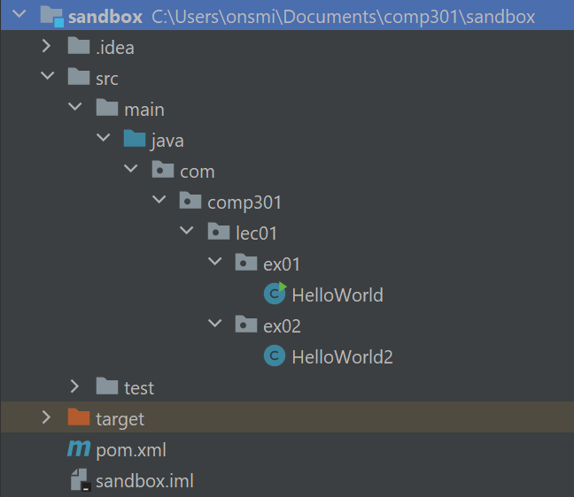
Project folder structure
Root folder is blue
(in IntelliJ)
Subfolders implied by package name

Slide 26
Relation to folders
package com.comp301.lec01.ex01;
import com.comp301.lec01.ex02.HelloWorld2;
public class HelloWorld {
public static void main(String[] args) {
HelloWorld2.sayHello();
}
}
HelloWorld.java (source code)
Packages correspond to a folder path
But, they share common prefix folder path
package com.comp301.lec01.ex02;
public class HelloWorld2 {
public static void sayHello() {
System.out.println("Hello, world!");
}
}
HelloWorld2.java (source code)
Different packages,
different folders

Slide 27
Referencing across packages
HelloWorld.java (source code)
package com.comp301.lec01.ex01;
public class HelloWorld {
public static void main(String[] args) {
com.comp301.lec01.ex02.HelloWorld2.sayHello();
}
}
HelloWorld has a main() method
HelloWorld.main() calls HelloWorld2.sayHello()
package com.comp301.lec01.ex02;
public class HelloWorld2 {
public static void sayHello() {
System.out.println("Hello, world!");
}
}
HelloWorld2.java (source code)

Slide 28
Importing across packages
package com.comp301.lec01.ex01;
import com.comp301.lec01.ex02.HelloWorld2;
public class HelloWorld {
public static void main(String[] args) {
HelloWorld2.sayHello();
}
}
HelloWorld.java (source code)
Import statement reduces verbosity of referring to names in other packages
package com.comp301.lec01.ex02;
public class HelloWorld2 {
public static void sayHello() {
System.out.println("Hello, world!");
}
}
HelloWorld2.java (source code)

Slide 29
Java build process

Slide 30
What is the “build process”?
In software engineering, the “build process” is the act of converting a project’s source material into a shippable software product
Source material refers to any resources stored in the project’s GitHub repository, such as source code, image files, raw data, etc.
Shippable means the output is packaged up and ready to be sent to the customer

Slide 31
Java’s build process
Build process tasks vary from project to project
and from language to language
Here are common build process tasks for Java projects:
  clean Delete any leftover temporary files from the project folder
  compile Compile the project source code into bytecode
  test Run the unit tests for the project
  package Pack the compiled code into a distributable format
  verify Check that the packaged output meets quality criteria
  site Generate documentation for the produced code
  deploy Send the packaged output to customers
  maintain fix bugs, updates, add funcs for customer, etc. … ongoing

Slide 32
Build automation tools
Different programming
languages use different
“build automation tools”
Java
Ant
Gradle
JavaScript
Grunt
Gulp
C/C++
make
Ruby
Maven
Rake

Slide 33
Maven
Build automation tool for Java

Slide 34
Maven terminology
pom.xml
Dependency
Archetype
Artifact
Lifecycle
Main project config file ( Project Object Model )
An external module or library that your project uses
A template for creating new Maven projects
The packaged output file(s) produced by the project
A configurable build process task

Slide 35
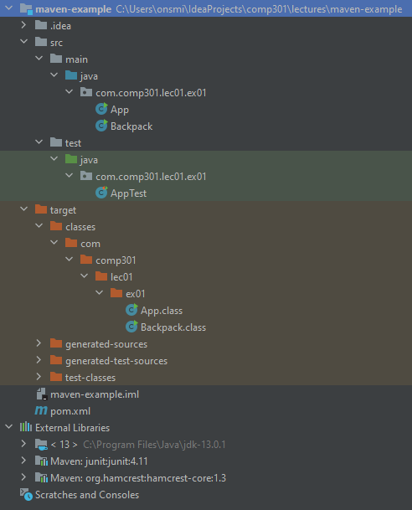
This is a typical example of how a Maven project directory might be organized
Source code
(.java files)
Test code
(.java files)
Compiled output
(.class files)
All COMP 301 programming assignments will follow this structure
Configuration file
Dependencies

Slide 36
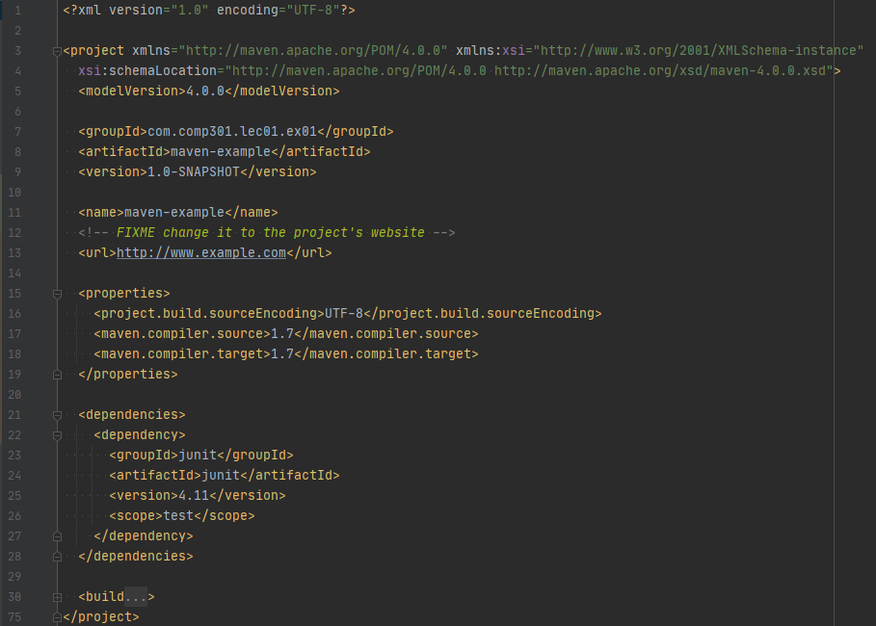
This is an example Maven configuration file (pom.xml)
  Written in XML
  Typically placed in the root of the project folder
  Specifies various settings for the project

Slide 37
Project version and artifact information
Project name
Java version and other properties
Dependencies
Lifecycle configuration

Slide 38
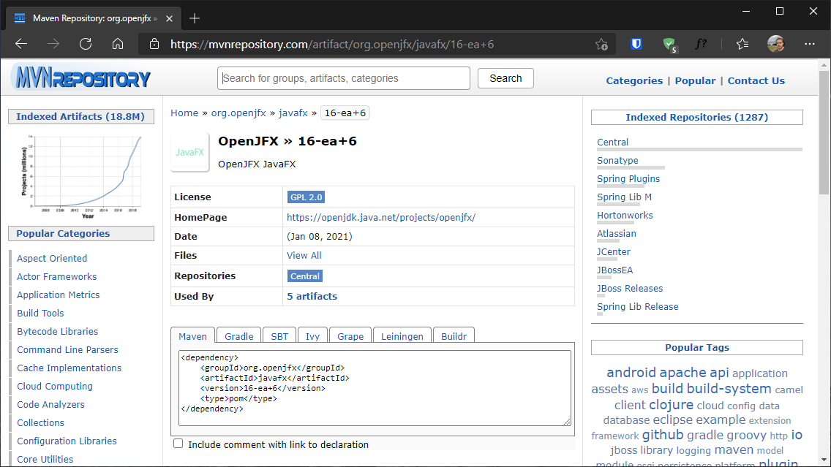
Many public Java libraries provide a Maven dependency snippet that you can copy and paste into your pom.xml configuration file

Slide 39
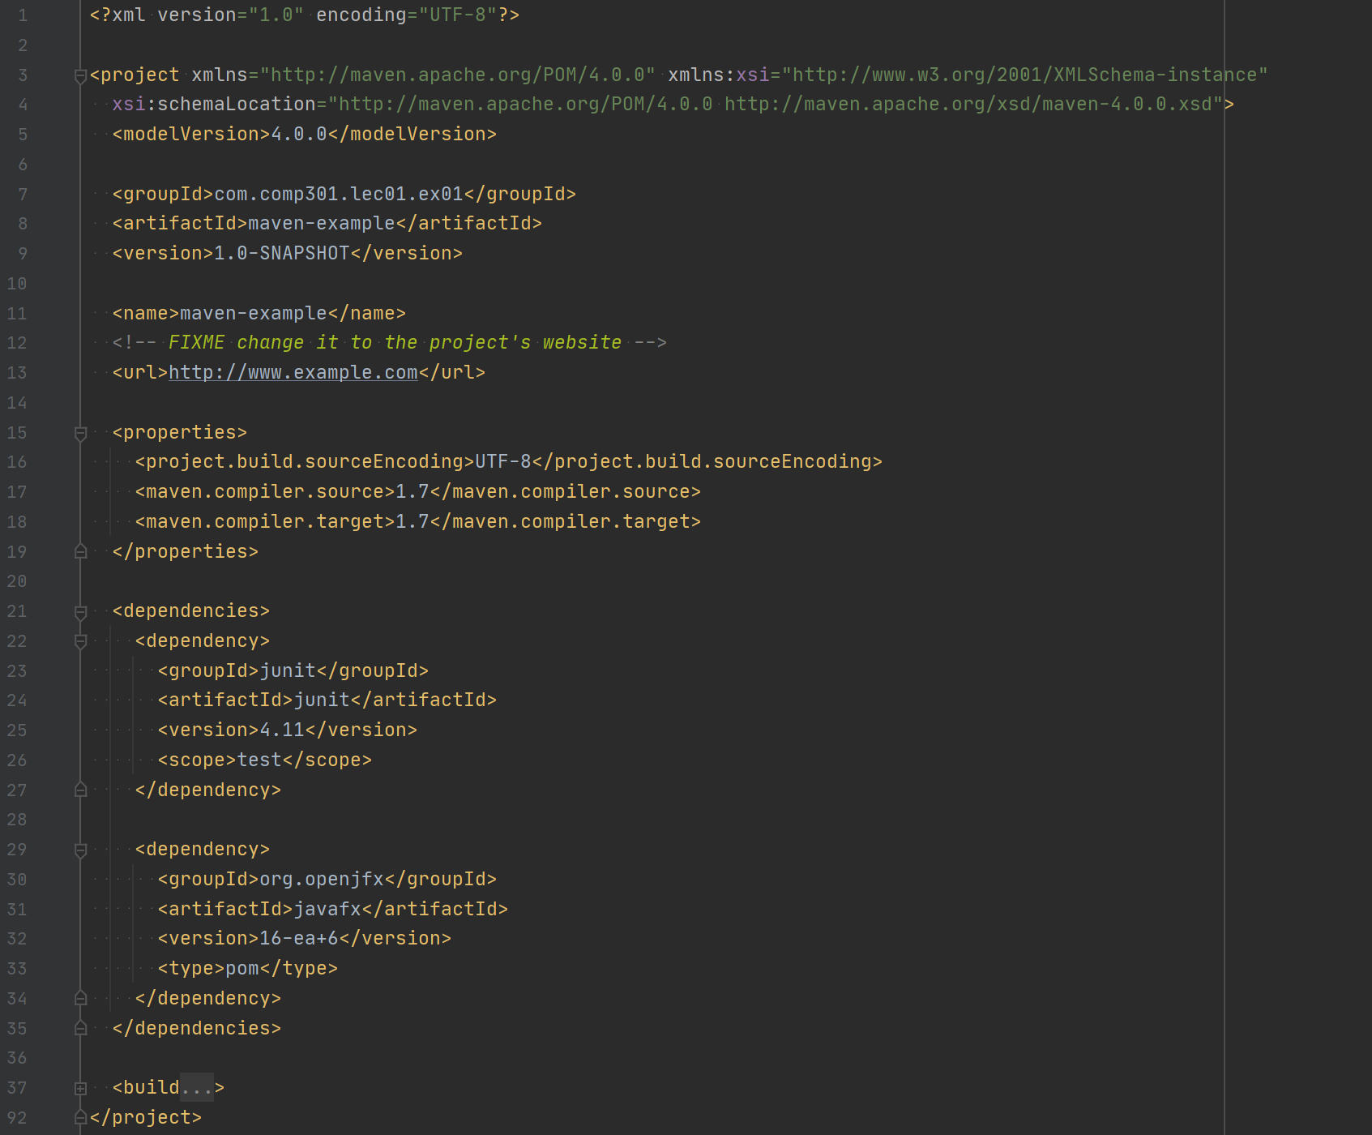
JavaFX has been added to pom.xml
Maven will automatically download the correct .jar file and link it during compilation/execution

Slide 40
Maven config uses “convention over configuration”
That means most settings are optional and have reasonable default values

Slide 41
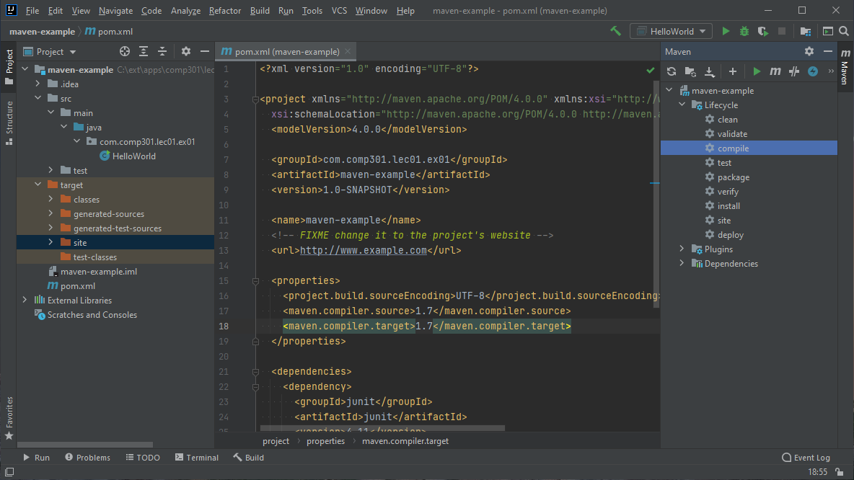
Pressing this button in IntelliJ opens a drawer where you can execute Maven lifecycles (aka build tasks)

Slide 42
The Git version control system
Version control – The practice of tracking changes made to a codebase
An introduction to version control

Slide 43
Introduction
Version control is the practice of tracking changes made to a codebase
Periodically capture a “snapshot” of the code
Archive all snapshots taken in case you need to refer back to them
Why is this a good idea?
All software companies have a version control system in place
Well-known version control systems
Git
CVS
Apache Subversion (SVN)
Mercurial
Git is by far the most well-known version control system, and is the one we will use in COMP 301

Slide 44
What is a “commit”?
Commit (noun) – A “snapshot” of the files in a codebase
at a point in time
When a commit is created, it is given a unique identifier generated based on the content of the files stored inside
This unique identifier can be used to reference the commit
Every commit has a parent commit, forming a graph
Commit f22c9a3
Commit ac901f8
Commit d0a7bc1
folder
folder
folder
folder
folder
folder
file
file
file
file
file
file
file
file
Make some changes
Create a new commit
Make some more changes
Commit those changes, too

Slide 45
What is a “repository”?
Repository ( repo ) – A “storage unit” for tracking and storing commits related to a project
Usually, a remote repository is stored on GitHub, and a local repository is stored on your computer
Repository
Commit f22c9a3
Commit ac901f8
Commit d0a7bc1
folder
folder
folder
folder
folder
folder
file
file
file
file
file
file
file
file

Slide 46
What is a “branch”?
Branch (noun) – A movable label that points to a particular commit
Every time a new commit is made,
the current branch is moved forward
main
branch
New branches can be created, and multiple branches may even point to the same commit
Commit
f22c9a3
Commit
ac901f8
Commit
d0a7bc1
$ git branch dev
dev
branch

Slide 47
“Checkout” operation
Checkout a commit or branch to reset your working folder there
$ git checkout dev
$ git checkout ac901f8
$ git checkout main
main
branch
Warning: This operation will modify the files in your working folder!
Commit
f22c9a3
Commit
ac901f8
Commit
d0a7bc1
dev
branch

Slide 48
Staging and committing
After making changes to the code, stage them with the add command
Stage modified files individually by name, or all at once with “.”
$ git checkout dev
(now make changes to code)
$ git add "file1.txt" "file2.txt"
$ git add .
$ git commit –m "Commit message"
main
branch
Then, make a new commit that incorporates the staged changes
Commit
f22c9a3
Commit
ac901f8
Commit
d0a7bc1
Commit
80ce97a
dev
branch
Since the dev branch is active, it moves forward to track the new commit

Slide 49
Branching and merging
Git operations

Slide 50
Branching
Two branches pointing at the same commit can create diverging versions of the code
Switch back to the main branch and commit different changes
$ git checkout main
(now make different changes)
$ git add .
$ git commit –m "Commit message"
main
branch
Commit
158ac9e
Commit
ac901f8
Commit
d0a7bc1
Commit
80ce97a
dev
branch

Slide 51
Merging
Divergent branches can be merged back together if they share a common ancestor
main
branch
Git will try to merge the two versions automatically into a new commit, but there might be merge conflicts that must be resolved by hand
Commit
158ac9e
Common ancestor
The main branch was merged into the dev branch
Commit
ac901f8
Commit
d0a7bc1
Commit
80ce97a
Commit
cc917de
dev
branch
$ git checkout dev
$ git merge main

Slide 52
Fetching, pulling, and pushing
More git operations

Slide 53
Local and remote repositories
GitHub (remote)
Origin
repository
Your computer will also have a “working folder (HEAD)” where you can view and edit the project code
There are usually at least two copies of the repository: one on GitHub, and one in the .git folder on your computer
Your computer (local)
Working folder (HEAD)
.git folder
folder
Local
repository
.git folder
file
file

Slide 54
Fetch operation
$ git fetch
GitHub (remote)
Downloads new commits from GitHub to the local repository
Origin
repository
Does not affect files in your working folder (HEAD)
Your computer (local)
Working folder (HEAD)
.git folder
folder
Local
repository
.git folder
file
file

Slide 55
Pull operation
$ git pull
GitHub (remote)
Downloads new commits from GitHub to the local repository, and tries to integrate them into your working folder
Origin
repository
Warning: This operation can fail if there are merge conflicts
Your computer (local)
Working folder (HEAD)
.git folder
folder
Local
repository
.git folder
file
file

Slide 56
Push operation
$ git push
GitHub (remote)
Uploads commits made in the local repository to GitHub
Origin
repository
Warning: This operation can fail if there are merge conflicts
Your computer (local)
Working folder (HEAD)
.git folder
folder
Local
repository
.git folder
file
file

Slide 57
Forking a repository
Fork (verb) – to make a disconnected clone of the entire repository
GitHub (remote)
Project #1
Project #2 (forked from #1)
Forking must be done from the GitHub interface
(it is not a git command)
Origin
repository
Origin
repository
These two repos are now completely separate
Different URLs
Different project pages on GitHub
Commits to one do not affect commits to the other

Slide 58
Continuous Integration
The practice of regularly pushing your changes as you work, even multiple times a day, so the rest of your team can integrate your changes into their local versions.
Many dev teams adopt the practice of continuous integration to minimize merge conflicts
Could real-time collaboration one day be used for development?

Slide 59
Git terminology
Word | Definition
repository | A data structure containing an entire project, including every commit made
branch | A “version” of the code that is tracked as changes are made
local | Your personal computer
remote | A cloud-based git server that stores your repository
commit | A snapshot of the project codebase at a point in time
push | The act of uploading the latest committed version of your branch to the remote machine
pull | The act of integrating changes that were pushed by someone else into your local copy
merge | The act of combining changes that you made with changes that someone else made
checkout | The act of selecting which branch to view and work on
track | When a local branch follows along with changes to a corresponding remote branch
fork | (github) Making your own personal copy of an entire existing repository

Slide 60
Automatic code formatting
Did you know your IDE (IntelliJ) can auto-format your code?

Slide 61
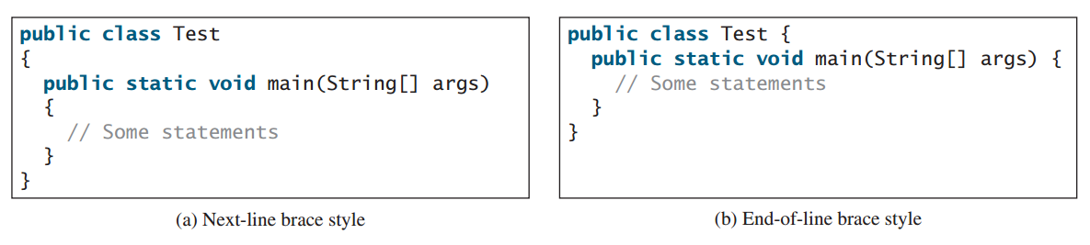
Style guides
Which one is correct?
(Does it really matter?)

Slide 62
Following a style guide
Why use a style guide?
  Consistency
  Fewer decisions to make
  Faster
  Automatic
Who uses a style guide?
  Software developers
  All major tech companies
  You, and me
(Programming assignment submissions
that do not follow Google’s Java style guide
will not earn full credit)
In COMP 301, we will follow Google’s Java style guide

Slide 63
Google’s Java style guide
Let’s set up IntelliJ
to auto-format our code
according to Google’s style guide!
Google’s Java style guide
  https://google.github.io/styleguide/javaguide.html
Auto-formatting configuration for various IDEs
  https://github.com/google/styleguide
IntelliJ plugin for auto-formatting using Google’s style guide
  https://plugins.jetbrains.com/plugin/8527-google-java-format

Slide 64
Using an auto-formatter does not guarantee that your code will have good style!
It’s just a tool. It’s typography.
Developers are still responsible for the thinking … for writing readable, clean code.
This is designing .

Slide 65
Today’s Attendance
To get credit for attending class today, visit https://pollev.com/pds now
https://pollev.com/pds

