Slide 1
Notes on Inheritance vs. Interfaces
COMP 301

Slide 2
Inheritance and Interface
How are they similar?
both are mechanisms in Java for
creating abstraction
code reuse
polymorphism
They serve different purposes
Inheritance is more about code reuse and defining an “is-a” relationship among classes
Interface is more about creating a contract for classes that adhere to the specs, a contract enforcing that a class must implement certain methods… making a “can-do” relationship among classes following an interface

Slide 3
What is the difference between them?
Inheritance
extends keyword, new class can extend one class (single inheritance)
requires no new syntax, done with classes alone
Saves re-writing code that is common to two more detailed sub-classes
Interface
implements keyword, new class can do one or more interfaces
interface is a new syntax thing, like a class
You write an interface, and then you write class(es) to implement it
A mechanism for abstraction, esp. when you expect two (or more) ways to provide detailed implementations for the behavior specified in the common interface (e.g. LIST abstraction implemented with array or linked cells)

Slide 4
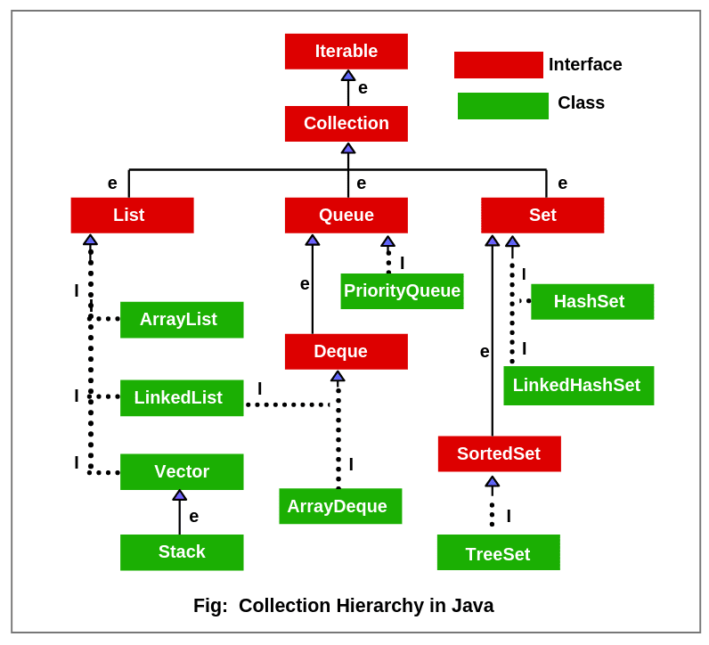
Mixing Interface and Inheritance

Slide 5
Static Fields and Inheritance
What happens to a static field in a superclass vs. subclass

Slide 6
Super and Sub class static fields
Let’s say a class Foo has a static field x (an int)
Let’s say we make a class SubFoo extends Foo
Is x a static class in SubFoo also?
Go to pollev.com/pds to reply

Slide 7
Super and Sub class static fields
Let’s say a class Foo has a static field x (an int)
Let’s say we make a class SubFoo extends Foo
Is x a static class in SubFoo also?
A SubFoo is-a Foo,
so if a Foo has a static (class) field,
then a SubFoo has it too
YES

