Slide 1
Dependency Injection and Inversion of Control
COMP 301
( adapted from Drs. K. Mayer-Patel and A. Smith )

Slide 2
Dependency injection (DI)

Slide 3
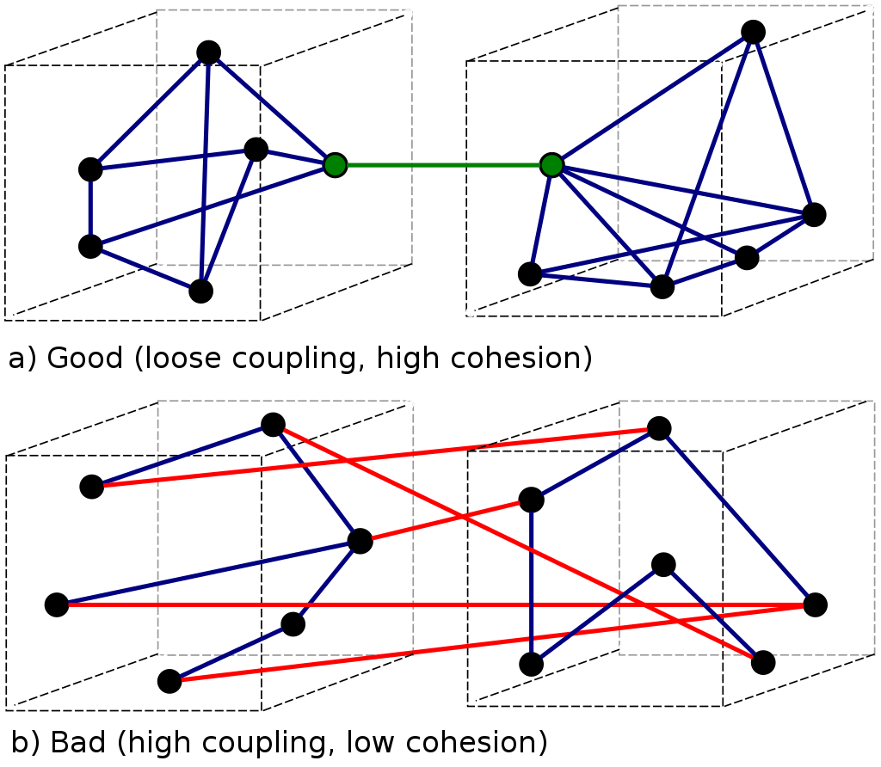
Coupling
Image source: Wikipedia
Each point represents a class
When a line of code in one class file references a different class by name, it enforces a dependence between the two classes
The more dependent a project’s classes are with each other, the harder they are to separate
Classes which reference each other by name cannot be used independently
Each edge represents a named reference

Slide 4
Coupling
Image source: Wikipedia
Each point represents a class
Loosely coupled code is separated into well-defined independent modules
Highly coupled code involves many named references between class files, even if they aren’t closely related
Big idea: Systems that are loosely coupled are easier to maintain, modify, read, etc.
Each edge represents a named reference

Slide 5
Class dependencies
Vehicle
Engine
public class VehicleImpl {
private Engine engine;
private Wheel frontLeft;
private Wheel frontRight;
private Wheel rearLeft;
private Wheel rearRight;
public VehicleImpl() {
engine = new EngineImpl();
frontLeft = new WheelImpl();
frontRight = new WheelImpl();
rearLeft = new WheelImpl();
rearRight = new WheelImpl();
}
// ...
}
Wheel
Wheel
Wheel
Wheel
This VehicleImpl class is tightly coupled with the EngineImpl and WheelImpl classes
Can’t test them in isolation
Can’t swap out for subclasses

Slide 6
Dependency injection
public class VehicleImpl {
private Engine engine;
private Wheel frontLeft;
private Wheel frontRight;
private Wheel rearLeft;
private Wheel rearRight;
public VehicleImpl() {
engine = new EngineImpl();
frontLeft = new WheelImpl();
frontRight = new WheelImpl();
rearLeft = new WheelImpl();
rearRight = new WheelImpl();
}
public void setEngine(Engine e) {
this.engine = e;
}
}
Option 1: Inject Engine and Wheel objects into the class through the constructor
Get rid of this code so that VehicleImpl isn’t tightly coupled with a specific implementation of the Engine and Wheel interfaces
Option 2: Inject Engine and Wheel objects into the class through setter methods

Slide 7
Dependency injection
Vehicle car = new VehicleImpl();
Without dependency injection
Vehicle car = new VehicleImpl();
car.setEngine(new EngineImpl());
car.setFrontLeftWheel(new WheelImpl());
car.setFrontRightWheel(new WheelImpl());
car.setRearLeftWheel(new WheelImpl());
car.setRearRightWheel(new WheelImpl());
With dependency injection
Vehicle car = new VehicleImpl(
new EngineImpl(),
new WheelImpl(),
new WheelImpl(),
new WheelImpl(),
new WheelImpl()
);
With dependency injection

Slide 8
Dependency injection
Vehicle car = new VehicleImpl();
car.setEngine(new EngineImpl());
car.setFrontLeftWheel(new WheelImpl());
car.setFrontRightWheel(new WheelImpl());
car.setRearLeftWheel(new WheelImpl());
car.setRearRightWheel(new WheelImpl());
With dependency injection, the constructors are all called in the same place
Vehicle car = new VehicleImpl(
new EngineImpl(),
new WheelImpl(),
new WheelImpl(),
new WheelImpl(),
new WheelImpl()
);
This gives more control to the code calling the object (for example, the unit tests or main() method)

Slide 9
Dependency injection bottom line
Advantages
Makes objects more configurable
Easier to write isolated unit tests
Promotes loose coupling of classes
Disadvantages
Requires more code to construct a new object
Requires more development effort
Goes against “convention over configuration”

Slide 10
Inversion of Control

Slide 11
Traditional Control Flow
Consider writing a traditional, procedural program
Where does execution start?
In the main() method
Or, possibly in the unit testing method (if you are writing a test)
Since you wrote the first procedure on the stack frame,
you have full control over execution of the program
This is “traditional” control flow

Slide 12
Inversion of Control (IoC)
Sometimes, you don’t get to control top-level execution
You may not control execution flow inside classes that are used in service of other classes / code.
Someone else decides when to call your methods
You are only allowed to respond to the method calls
Execution jumps in and out of your methods
This is a common programming pattern for frameworks
This is “inverted” control flow

Slide 13
DI and IoC
Dependency injection is a useful paradigm for programs that embrace inversion of control
The caller injects any necessary dependencies as parameters into the method or constructor
Any important (or expensive) services are injected as part of the method call
public boolean isMisspelled(SpellChecker dict, String word) { // Implementation omitted }

Slide 14
Oracle Is Wrong
Question: are private members inherited by a subclass?
What do we mean by member?
What do we mean by inherited?
If we understand inheritance to mean whether or not those fields and methods are part of the object created in memory, the answer is yes.
If we understand inheritance to mean whether or not those fields and methods are accessible by the code in a subclass, the answer is no.
In this class, we will take inheritance to mean those fields and methods that are included as part of a subclass instance in memory that were defined or specified in a parent / ancestor class.
Even if we can't access those parts from code in the subclass.

Slide 15
Using inheritance
Example starts with several related classes that are implemented independently.
BlackBear
PolarBear
Python
Robin
u05p2.v1

Slide 16
Common behavior
Refactor common behaviors into a common parent interface.
Animal interface
u05p2.v2

Slide 17
Common object state
Refactor common object fields into a common parent class
AnimalImpl
Pull common fields id and location to here
Need to make protected in order to allow subclass access.
u05p2.v3

Slide 18
Common implementation
Refactor common method implementations into parent class.
Use overriding if subclasses need to do something special or different.
AnimalImpl
Constructor in parent class used by subclass constructor to initialize common fields at this level.
getID() and getLocation() moved here
Common portion of move() put here
Subclass-specific override of move
Calls common portion through super keyword
u05p2.v4

Slide 19
Common behavior with uncommon implementation
Notice speak() is a common behavior.
So we want it to be part of Animal interface
That way if we can have a reference to an Animal object and ask it to speak() without having to know what subclass it is.
But no common implementation.
Each subclass of animal will have a different way of speaking.
No good default or commonalities in way of speaking that can be specified at parent class.

Slide 20
Example Revisited
AnimalImpl
Declare implementation of Animal here where it belongs since AnimalImpl is matching implementation.
Declare AnimalImpl as abstract
Prevents direct instantiation
Declare speak() method as abstract
No common implementation, but needs to be declared here as part of common interface.
Declaring as abstract forces subclass to override.
u05p2.v5

Slide 21
Repeat Exercise with Bears
What is the common public behavior between the two types of bear?
Draw that out into a new interface.
What is the common implementation between the two bear classes?
Refactor that into a new class.
Rewrite original classes as subclasses

