Slide 1
Error handling
COMP 301
( adapted from Drs. K. Mayer-Patel and A. Smith )

Slide 2
Mistakes in software
Mistakes in computer software can have serious consequences
Software controls hardware
Hardware can be dangerous: vehicles, robots, medical devices, etc.
THERAC-25
Java terminology: What is an exception ?
An exception is an unexpected, unusual, or abnormal situation which arises during execution of a program
Sometimes, these situations can be anticipated by the programmer and handled so the program may continue on
Other times, they cause the program to crash

Slide 3
Early error handling strategies
Mostly outdated, but still in use today

Slide 4
Early error handling strategy #1
Global error code
Add a well-documented global variable
Change the variable value when something goes wrong
Define and use a system of error codes to indicate what error occurred
The programmer is responsible for checking the value when appropriate

Slide 5
Global error code example
Eeek! If the programmer forgot to check for error values, the program would simply continue on unaffected
1. Define a “global” error code variable
public class Main { public static int error_code; public static void main(String[] args) { Scanner s = new Scanner(System.in); while (s.hasNextInt()) { do_something(s.nextInt()); if (error_code != 0) { if (error_code == -1) { System.out.println("Negative number error."); } else if (error_code == -2) { System.out.println("Even number error."); } error_code = 0; } } s.close(); } }
2. When appropriate, check the value of the error variable and handle any errors that occurred

Slide 6
Global error code example
Eeek! The programmer is responsible for keeping track of all possible error codes that may occur
public class Main { public static int error_code; public static void do_something(int a) { // Clear out error code error_code = 0; if (a < 0) { // a should not be negative. Set error code and return. error_code = -1; } else if (a % 2 == 0) { // a should not be even. Set error code and return. error_code = -2; } else { System.out.println("Successfully did something because a was odd!"); } }
}
3. When an error is detected, manually set the error code variable

Slide 7
Early error handling strategy #2
Special return value
Designate special return values meant to be interpreted as errors
Procedure conventions (void methods which do not produce a result)
0 indicates success
Less than 0 indicates an error
Different negative values indicate different errors (as documented)
Function conventions (non-void methods which do produce a result)
If a reference type is returned, then use null to signal an error
If a value type is returned, then use an “out of bounds” value to indicate an error

Slide 8
Special return value example
public class Main { public static void main(String[] args) { String haystack = "This is my haystack"; Scanner s = new Scanner(System.in); while (s.hasNext()) { String needle = s.next(); int position = haystack.indexOf(needle); if (position == -1) { System.out.println("Error: could not find needle in haystack"); } else { System.out.println("Found needle at " + position); } } s.close(); } }
The String.indexOf() method uses this technique
If the search value is found, indexOf() returns the index
If the search value is not found, indexOf() returns -1

Slide 9
Drawbacks to early strategies
Inconsistent, convention-based
Methods must have out-of-range return values to use for indicating that an error occurred
Relies on documentation to explain what each error value means
The programmer must remember to check for errors
Difficult to extend in future development

Slide 10
Modern error handling
Introducing exceptions

Slide 11
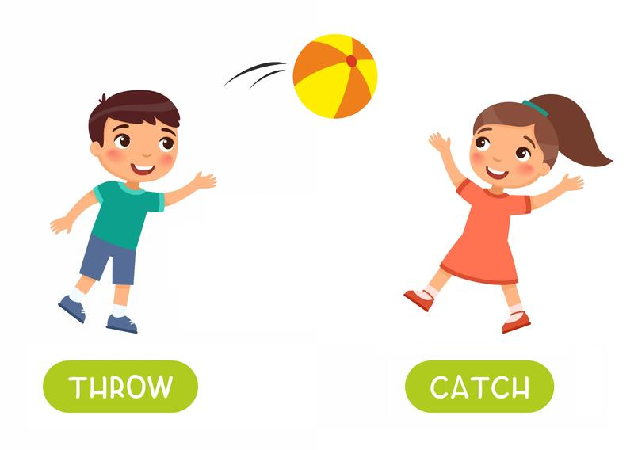
Modern error handling
Exception handling
A formal method for detecting, signaling, and responding to errors
Built in to the programming language
Supported by Java, C++, C#, Python, JavaScript, Ruby, etc.
Two parts:
“throwing” an exception (detection)
“catching” an exception (handling)
Separates detection from handling

Slide 12
Benefits of exceptions
Consistent, extensible, modular
Expressive
Can express exactly what type of error occurred
Can encapsulate details about the error
Dependable, obvious behavior
If an error occurs, the programmer will know about it
Programmer can decide whether to handle the error
Safe
Can designate critical code to execute no matter what, even if an error occurs

Slide 13
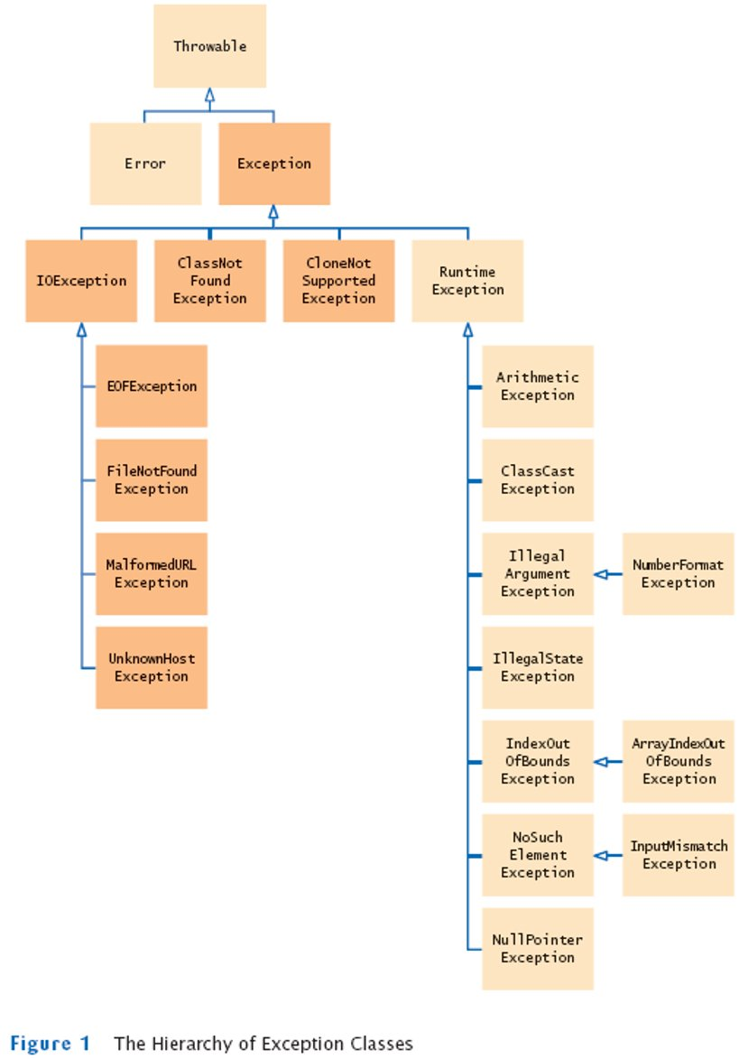
Exceptions are objects
It is object-oriented programming, after all!
Exception objects use encapsulation to store details about the specific error that occurred
Exception objects use inheritance to classify what kind of error occurred
Java provides these
built-in exception classes
to address common errors

Slide 15
Throwing an exception

Slide 16
Throwing an exception
Encapsulated values can also inform the caller about what happened
The exception subclass type can inform the caller about what happened
Maybe use a better message like “age can’t be negative”
private void setAge(int age) { if (age < 0) { throw new IllegalArgumentException("Error description"); } this.age = age; }
After throw, specify
an Exception object
The throw keyword indicates that an error occurred
The exception object will be sent up to the caller, so be descriptive about what error occurred!

Slide 17
Throwing an exception
As soon as the throw line occurs, the method stops executing
private void setAge(int age) { if (age < 0) { throw new IllegalArgumentException("Error description"); } this.age = age; }
See how this is safer than the early approaches?
…exceptions force the issue by throwing the exception and threatening to stop the program if the error isn’t handled.
Instead of setting a return value or a global variable…

Slide 18
Catching an exception

Slide 19
Catching an exception
Add code here
that might throw
an exception
try {
methodA();
methodB();
methodC();
} catch (ExceptionType e) {
// code to respond to ExceptionType
} catch (OtherExceptionType oe) {
// code to respond to OtherExceptionType
}
Add code here to
handle the exceptions
that might happen

Slide 20
Catching an exception
Say an exception is thrown by methodB(). What happens?
try {
methodA();
methodB();
methodC();
} catch (ExceptionType e) {
// code to respond to ExceptionType
} catch (OtherExceptionType oe) {
// code to respond to OtherExceptionType
}
1. Execution immediately jumps to the catch statements to handle the exception
2. methodC() will never be executed because the exception happened up in methodB()
3. Only the first catch block with a matching exception type will be executed
4. Inside each catch block is an exception object representing the error
5. If none of the catch blocks match the exception type, then the exception is re-thrown

Slide 21
Catching an exception
Say an exception is thrown by methodB(). What happens?
try {
methodA();
methodB();
methodC();
} catch (ExceptionType e) {
// code to respond to ExceptionType
} catch (OtherExceptionType oe) {
// code to respond to OtherExceptionType
}
“match” means does an “is-a” relationship exist between the type of the exception object thrown, and the type given in a catch block
1. Execution immediately jumps to the catch statements to handle the exception
2. methodC() will never be executed because the exception happened up in methodB()
3. Only the first catch block with a matching exception type will be executed
4. Inside each catch block is an exception object representing the error
5. If none of the catch blocks match the exception type, then the exception is re-thrown

Slide 22
Catching an exception
catch blocks are kind of
like else if statements.
They check top-to-bottom,
one at a time, for a match.
Once a match is found,
the block is executed, and
no other blocks are searched.
try {
methodA();
methodB();
methodC();
} catch (ExceptionType e) {
// code to respond to ExceptionType
} catch (OtherExceptionType oe) {
// code to respond to OtherExceptionType
}

Slide 23
Poll Everywhere (1)
To answer, visit https://pollev.com/pds
public static void main(String[] args) { try { System.out.println("A"); method1(); System.out.println("B"); } catch (RuntimeException e) { System.out.println("C"); } System.out.println("E"); } public static void method1() { throw new RuntimeException(); }
Exception Inheritance Tree
Prompt: What will main() output when executed?

Slide 24
Poll Everywhere (2)
To answer, visit https://pollev.com/pds
public static void main(String[] args) { try { System.out.println("A"); method1(); System.out.println("B"); } catch (ArithmeticException e) { System.out.println("C"); } System.out.println("E"); } public static void method1() { throw new RuntimeException(); }
Exception Inheritance Tree
Prompt: What will main() output when executed?

Slide 25
Poll Everywhere (3)
To answer, visit https://pollev.com/pds
public static void main(String[] args) { try { System.out.println("A"); method1(); System.out.println("B"); } catch (ArithmeticException e) { System.out.println("C"); } catch (RuntimeException e) { System.out.println("D"); } System.out.println("E"); } public static void method1() { throw new RuntimeException(); }
Exception Inheritance Tree
Prompt: What will main() output when executed?

Slide 26
Poll Everywhere (3)
To answer, visit https://pollev.com/pds
If these are reversed, compiler is unhappy… unreachable code
public static void main(String[] args) { try { System.out.println("A"); method1(); System.out.println("B"); } catch (ArithmeticException e) { System.out.println("C"); } catch (RuntimeException e) { System.out.println("D"); } System.out.println("E"); } public static void method1() { throw new RuntimeException(); }
Exception Inheritance Tree
Prompt: What will main() output when executed?

Slide 27
Poll Everywhere (4)
To answer, visit https://pollev.com/pds
public static void main(String[] args) { try { System.out.println("A"); method1(); System.out.println("B"); } catch (Exception e) { System.out.println("C"); } System.out.println("E"); } public static void method1() { throw new RuntimeException(); }
Exception Inheritance Tree
Prompt: What will main() output when executed?

Slide 28
Poll Everywhere (4)
“Throwable” here would match anything at all (since it’s the top of the inheritance tree) but we don’t really do that, we try to get more specific
To answer, visit https://pollev.com/pds
public static void main(String[] args) { try { System.out.println("A"); method1(); System.out.println("B"); } catch (Exception e) { System.out.println("C"); } System.out.println("E"); } public static void method1() { throw new RuntimeException(); }
Exception Inheritance Tree
Prompt: What will main() output when executed?

Slide 29
finally block

Slide 30
A real-world example
What’s wrong with
this example?
try { File file = new File("filename.txt"); Scanner scanner = new Scanner(file); while (scanner.hasNextLine()) { String data = scanner.nextLine(); System.out.println(data); } scanner.close(); } catch (IOException e) { System.out.println("An error occurred."); e.printStackTrace(); }
If an exception is thrown here, while reading the file…
…then the file will never be closed!

Slide 31
Solution: the finally block
try { File file = new File("filename.txt"); Scanner scanner = new Scanner(file); while (scanner.hasNextLine()) { String data = scanner.nextLine(); System.out.println(data); } scanner.close(); } catch (IOException e) { System.out.println("An error occurred."); e.printStackTrace(); } finally { scanner.close(); }
Move the scanner.close() line into a finally block

Slide 32
Solution: the finally block
Code in a finally block will always execute, regardless of whether an exception is thrown
try { File file = new File("filename.txt"); Scanner scanner = new Scanner(file); while (scanner.hasNextLine()) { String data = scanner.nextLine(); System.out.println(data); } scanner.close(); } catch (IOException e) { System.out.println("An error occurred."); e.printStackTrace(); } finally { scanner.close(); }
The finally block goes after the catch statements
Code in the finally block executes last, after the entire try/catch sequence finishes

Slide 33
Solution: the finally block
We’re not done yet! This code won’t work
try { File file = new File("filename.txt"); Scanner scanner = new Scanner(file); while (scanner.hasNextLine()) { String data = scanner.nextLine(); System.out.println(data); } scanner.close(); } catch (IOException e) { System.out.println("An error occurred."); e.printStackTrace(); } finally { scanner.close(); }
The scanner variable is defined in the try block but accessed in the finally block

Slide 34
Solution: the finally block
Now it will work. ☺
Scanner scanner = null; try { File file = new File("filename.txt"); scanner = new Scanner(file); while (scanner.hasNextLine()) { String data = scanner.nextLine(); System.out.println(data); } } catch (IOException e) { System.out.println("An error occurred."); e.printStackTrace(); } finally { if (scanner != null) { scanner.close(); } }

Slide 35
Poll Everywhere (5)
To answer, visit https://pollev.com/pds
public static void main(String[] args) { try { System.out.println("A"); method1(); System.out.println("B"); } catch (NullPointerException e) { System.out.println("C"); } catch (RuntimeException e) { System.out.println("D"); } finally { System.out.println("E"); } System.out.println("F"); } public static void method1() { throw new RuntimeException(); }
Prompt: What will main() output when executed?

Slide 36
Poll Everywhere (6)
To answer, visit https://pollev.com/pds
public static void main(String[] args) { try { return; } catch (Exception e) { System.out.println("A"); } finally { System.out.println("B"); } System.out.println("C"); }
Prompt: What will main() output when executed?

Slide 37
Create your own exception class

Slide 38
Create your own exception type!
If you don’t like any of the built-in Java exceptions, you can create your own!
Just make a class that extends from one of the built-in Java exceptions.

Slide 39
Custom exception class example
It’s fine to leave the body of the exception class empty, or encapsulate details about the error that occurred
Creating a custom exception:
public class NotDankEnoughException extends RuntimeException { }
Throwing a custom exception:
if (dankness <= 9000) { throw new NotDankEnoughException(); }
try { // Code that might throw an exception } catch (NotDankEnoughException ndee) { System.out.println("caught the exception"); }
Catching a custom exception:

Slide 40
Summary
Use throw to throw an exception object
Carefully choose the appropriate exception object to throw, or create your own
Use try/catch to safely run code that might throw an exception
catch blocks are like else-if statements
Use finally for code that must always execute
Usually used for cleaning up and closing system resources

Slide 41
Exception best practices

Slide 42
Exception best practices
Throw exceptions early
Throw an exception as soon as you detect a wrong value
This is defensive programming
Be specific when throwing an exception
Try to use a built-in exception type
But don’t be afraid to make your own to describe a situation
Catch exceptions late
Just because you can catch an exception doesn’t mean you should
Don’t catch an exception unless you know how to deal with the situation

Slide 43
Nested try/catch

Slide 44
Nested try/catch example
This code causes a NullPointerException
public void methodA() {
try {
methodB();
System.out.println("A");
} catch (RuntimeException e) {
System.out.println("B");
} catch (Exception e) {
System.out.println("C");
} finally {
System.out.println("D");
}
System.out.println("E");
}
public void methodB() {
try {
List<String> list = null;
System.out.println(list.size());
} catch (ArithmeticException e) {
System.out.println("F");
} finally {
System.out.println("G");
}
System.out.println("H");
}
Output:

Slide 45
Nested try/catch example
This code causes a NullPointerException
public void methodA() {
try {
methodB();
System.out.println("A");
} catch (RuntimeException e) {
System.out.println("B");
} catch (Exception e) {
System.out.println("C");
} finally {
System.out.println("D");
}
System.out.println("E");
}
public void methodB() {
try {
List<String> list = null;
System.out.println(list.size());
} catch (ArithmeticException e) {
System.out.println("F");
} finally {
System.out.println("G");
}
System.out.println("H");
}
Not caught!
Output:

Slide 46
Nested try/catch example
This code causes a NullPointerException
public void methodA() {
try {
methodB();
System.out.println("A");
} catch (RuntimeException e) {
System.out.println("B");
} catch (Exception e) {
System.out.println("C");
} finally {
System.out.println("D");
}
System.out.println("E");
}
public void methodB() {
try {
List<String> list = null;
System.out.println(list.size());
} catch (ArithmeticException e) {
System.out.println("F");
} finally {
System.out.println("G");
}
System.out.println("H");
}
Not caught!
Output: G

Slide 47
Nested try/catch example
This code causes a NullPointerException
public void methodA() {
try {
methodB();
System.out.println("A");
} catch (RuntimeException e) {
System.out.println("B");
} catch (Exception e) {
System.out.println("C");
} finally {
System.out.println("D");
}
System.out.println("E");
}
public void methodB() {
try {
List<String> list = null;
System.out.println(list.size());
} catch (ArithmeticException e) {
System.out.println("F");
} finally {
System.out.println("G");
}
System.out.println("H");
}
Caught!
Not caught!
Output: G B

Slide 48
Nested try/catch example
This code causes a NullPointerException
public void methodA() {
try {
methodB();
System.out.println("A");
} catch (RuntimeException e) {
System.out.println("B");
} catch (Exception e) {
System.out.println("C");
} finally {
System.out.println("D");
}
System.out.println("E");
}
public void methodB() {
try {
List<String> list = null;
System.out.println(list.size());
} catch (ArithmeticException e) {
System.out.println("F");
} finally {
System.out.println("G");
}
System.out.println("H");
}
Caught!
Not caught!
Output: G B D E

Slide 49
Poll Everywhere (7)
To answer, visit https://pollev.com/pds
try { List<String> list = null; System.out.println(list.size()); } catch (RuntimeException e) { try { System.out.println(5 / 0); } catch (ArithmeticException ae) { System.out.println("A"); } } catch (Exception e) { System.out.println("B"); } finally { System.out.println("C"); } System.out.println("D");
Exception Inheritance Tree
Prompt: What will this program output?

Slide 50
Forwarding Exceptions
We can handle a thrown exception in one catch block and then “pass” that exception “up the chain” to an enclosing catch block
Simply throw an exception in the catch block
public class Main {
public static void main(String[] args) {
try {
int result = divide(10, 0);
System.out.println("Result: " + result);
} catch (ArithmeticException e) {
System.err.println("Caught exception: " + e.getMessage());
throw new IllegalArgumentException("zero is not allowed", e);
}
}
public static int divide(int a, int b) { return a / b; }
}
Example from chatGPT

Slide 51
Forwarding Exceptions
public class Main {
public static void main(String[] args) {
try {
try {
int result = divide(10, 0);
System.out.println("Result: " + result);
} catch (ArithmeticException e) {
System.err.println("Caught exception: " + e.getMessage());
throw new IllegalArgumentException("Division by zero is not allowed", e);
}
} catch (IllegalArgumentException e) {
System.err.println("Caught IllegalArgumentException: " + e.getMessage());
}
}
public static int divide(int a, int b) { return a / b; }
}
Who handles the second thrown exception?
Nothing in the first example
…
Here, an enclosing try block
Example from chatGPT

Slide 52
Forwarding Exceptions
More complex example, showing the flexibility of Java exceptions
From StackOverFlow:
https://stackoverflow.com/questions/5020876/what-is-the-advantage-of-chained-exceptions

Slide 53
Checked exceptions

Slide 54
The Throwable class hierarchy
Throwable is the superclass, representing all throw/catch-able objects
Error represents
externally-caused, unrecoverable
problems that should generally not be caught or handled
Exception is the superclass for errors caused by the program itself, which may be caught and handled if appropriate
Checked exceptions
Unchecked exceptions

Slide 55
Checked and unchecked exceptions
Checked exceptions represent situation that…
…may occur even during “normal” operating conditions
…are usually caused by factors outside the program’s control
…might indicate an unexpected system state
…your program should probably anticipate and be able to respond to
Unchecked exceptions represent situation that…
…are usually caused by factors inside the program’s control
…might indicate a logic error or unexpected variable value
…should only be handled if you know how to fix the situation

Slide 56
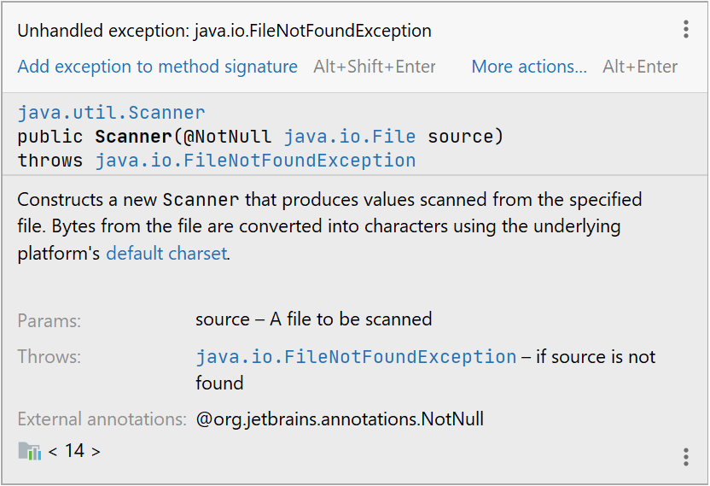
The Scanner constructor is defined such that it might throw a checked exception
Any time you add a line of code that could potentially throw a checked exception to a method…
…then your method must either:
Catch the exception internally
Specify in the method signature that the checked exception might be thrown by the method

Slide 57
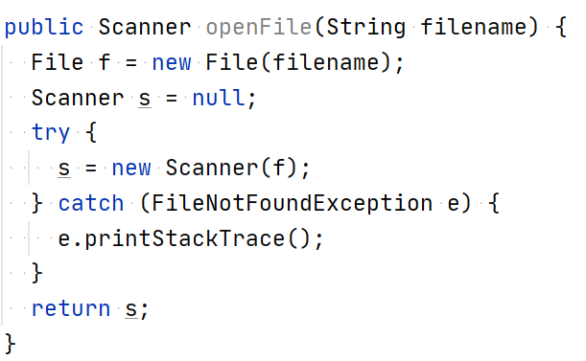
Solution #1: Catch

Slide 58
Solution #2: Specify

Slide 59
The “catch or specify” rule
Checked exceptions must obey the “catch or specify” rule:
If a method contains code that might throw a checked exception, then the method must either:
Catch the exception
Specify that it might throw the exception
Why?
Defensive programming: force the programmer to address the situation
Your program should probably define a strategy for dealing with situations represented by a checked exception

Slide 60
Poll Everywhere (1)
To answer, visit https://pollev.com/pds
1
2
3
4
5
6
7
8
9
public class Example { public static void main(String[] args) { method1(); } public static void method1() throws IOException { System.out.println("Line A was reached"); } }
Prompt: On which line of code is there an error?

Slide 61
Poll Everywhere (2)
To answer, visit https://pollev.com/pds
1
2
3
4
5
6
7
8
9
public class Example { public static void main(String[] args) { method1(); } public static void method1() throws IOException { System.out.println("Line A was reached"); } }
When the program is compiled (at compile time)
When the program is executed (at run time)
Prompt: When will the error occur?

Slide 62
Compile-time vs. Run-time errors

Slide 63
Compile-time and run-time errors
Errors that happen
at compile-time
Errors that happen
at run-time
Syntax errors
Unbalanced braces
Throwable
Missing return statements
Error
Missing class definition
Exception
Static Analysis
Checked exceptions
"Catch or specify" violations
Unchecked exceptions
Unreachable code

Slide 64
Compile-time and run-time errors
Errors that happen
at compile-time
Errors that happen
at run-time
Syntax errors
Unbalanced braces
Throwable
Missing return statements
Error
Missing class definition
IntelliJ might warn you about these, but often you have to run the program
IntelliJ will tell you about these; look for red underlined text in your code
Exception
Static Analysis
Checked exceptions
"Catch or specify" violations
Unchecked exceptions
Unreachable code

