Slide 1
Software Testing and JUnit
COMP 301
( adapted from Drs. K. Mayer-Patel and A. Smith )

Slide 2
Professional software testing

Slide 3
Four levels of software testing
2. Integration testing
1. Unit testing
3. System testing
4. Acceptance testing

Slide 4
Four levels of software testing
Unit testing
Test methods and classes in isolation
Integration testing
Test how new code integrates with existing modules
Occurs during development
System testing
Test the entire system as a whole
Occurs after development
Acceptance testing
Test in a production-like environment
Occurs during development
Occurs before release

Slide 5
Test-driven development (TDD)
Define the software requirements
Write unit tests according to the requirements
Write code to make the unit tests pass

Slide 6
JUnit setup

Slide 7
What is JUnit?
JUnit is:
a library for helping you write unit tests
extremely well-known in the Java world
developed by Kent Beck and Erich Gamma, 1997
JUnit provides:
assertion methods
the @Test annotation
the ability to automate testing
easy regression testing
…and more

Slide 8
What is JUnit?
JUnit encourages a testing practice called
Regression testing
This means keep all your tests, grow the pile of them ever larger, and run them ALL when you add new code
Your new tests show you that the new code works correctly
Your regression testing (running previous tests) shows that the new code did not break your old code – code that seemed to already be working
JUnit is:
a library for helping you write unit tests
extremely well-known in the Java world
developed by Kent Beck and Erich Gamma, 1997
JUnit provides:
assertion methods
the @Test annotation
the ability to automate testing
easy regression testing
…and more

Slide 9
Adding JUnit as a dependency in Maven

Slide 10
Adding JUnit as a dependency in Maven
Here, JUnit is added as a dependency to the project in Maven’s POM file

Slide 11
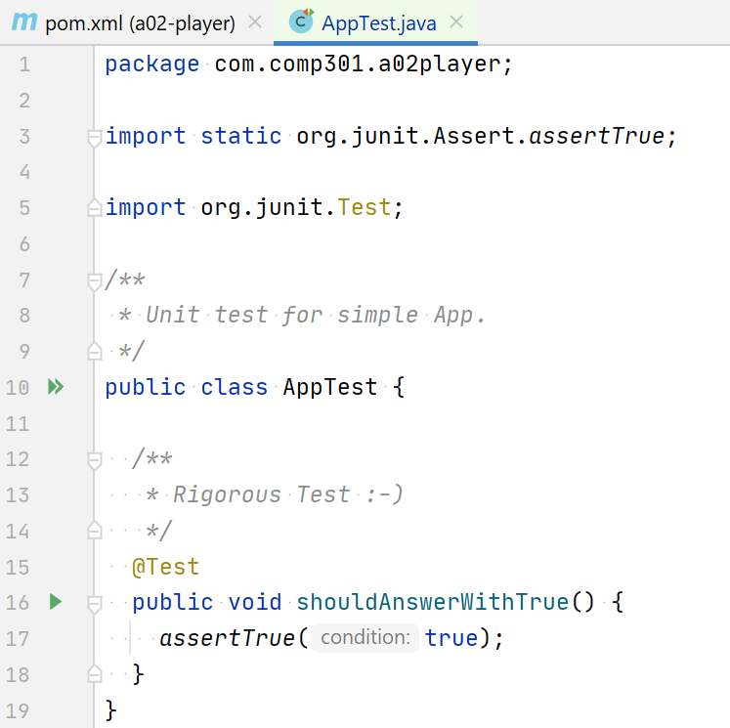
Basic JUnit usage
These imports are only possible because we added JUnit as a dependency
The @Test annotation declares that this instance method is a JUnit unit test
assertTrue() is one of the assertion methods that JUnit provides

Slide 12
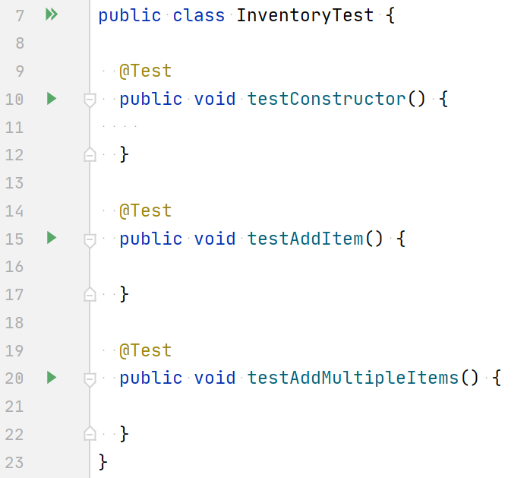
Unit testing structure
Make a separate test class for testing each class in your application
Add methods to the testing class to represent the unit tests you’re going to write
Each unit test method should check a single method, field, or constructor of the class

Slide 13
Running unit tests
Runs every tests in this class
Only runs the single testConstructor() test
In the console, you’ll see the results from running the test(s) (pass or fail)

Slide 14
Writing a unit test

Slide 15
Writing a unit test
The code in here determines whether the unit test will pass or fail
If the code does not throw an uncaught exception, then the test passes
If it does throw an uncaught exception, then the test fails

Slide 16
Writing a unit test
Will this “test” pass or fail?
throw new RuntimeException();
This test will fail

Slide 17
Writing a unit test
Will this test pass or fail?
new InventoryImpl();
This test will pass, as long as the InventoryImpl constructor does not throw an exception

Slide 18
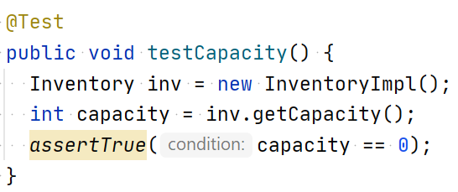
Writing a unit test
What code should go in a unit test method, anyway?
It depends on what you’re trying to test!
Typical JUnit unit test:
Create an instance of the class you are testing
Call some methods to change the instance’s internal state
Use JUnit assertions to verify that the instance methods return the correct values

Slide 19
Writing a unit test
What code should go in a unit test method, anyway?
It depends on what you’re trying to test!
Typical JUnit unit test:
Create an instance of the class you are testing
Call some methods to change the instance’s internal state
Use JUnit assertions to verify that the instance methods return the correct values

Slide 20
JUnit assertions

Slide 21
Assertion statements
JUnit provides a handful of convenient assertion methods like assertTrue()
assertTrue()
assertFalse()
assertEquals()
assertNull()
assertNotNull()
assertSame()
assertNotSame()
fail()
assertArrayEquals()
assertTrue() throws an Exception if the condition is false

Slide 22
Assertion statements
Assertion method | Description
assertTrue( condition ) | Throws an Exception if the condition is false
assertFalse( condition ) | Throws an Exception if the condition is true
assertEquals( expected, actual ) | Throws an Exception if actual is not equal to expected, using the equals() method for content equality
assertNull ( object ) | Throws an Exception if the object is not null
assertNotNull( object ) | Throws an Exception if the object is null
assertSame( expected, actual ) | Throws an Exception if the objects are not the same reference (using reference equality)
assertNotSame( unexpected, actual ) | Throws an Exception if the objects are the same reference (using reference equality)
fail() | Throws an Exception to fail the test
assertArrayEquals( expecteds, actuals ) | Throws an Exception if the arrays do not contain the same elements, using the equals() method for content equality

Slide 23
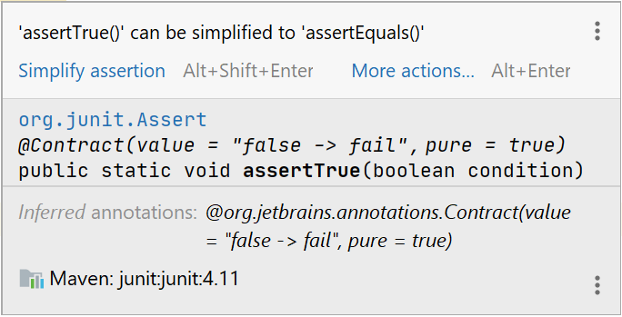
Simplifying assertions
IntelliJ knows this can be converted into assertEquals()
If you hover over the highlighted text,
you can automatically replace the assertTrue() with assertEquals()

Slide 24
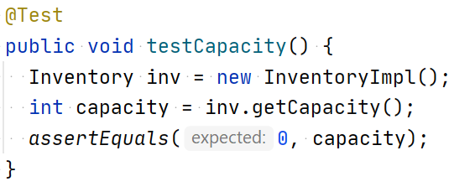
Using assertions semantically
Why is assertEquals() a better choice than assertTrue()?
Because it is more semantic
Hard-coded, expected value goes first
Computed, actual value goes second

Slide 25
Poll Everywhere (1)
To answer, visit https://pollev.com/pds
Prompt: Write your own version of JUnit’s assertNull() method with the following method signature:
public void assertNull(Object o) {
// your code here
}

Slide 26
Poll Everywhere (1)
To answer, visit https://pollev.com/pds
Prompt: Write your own version of JUnit’s assertNull() method with the following method signature:
public void assertNull(Object o) {
if (o != null) {
throw new RuntimeException();
}
}

Slide 27
Poll Everywhere (2)
To answer, visit https://pollev.com/pds
Prompt: Write your own version of JUnit’s assertEquals() method with the following method signature:
public void assertEquals(Object expected, Object actual) {
// your code here
}
assertEquals() checks
content equality (.equals()),
not reference equality (==)

Slide 28
Poll Everywhere (2)
To answer, visit https://pollev.com/pds
Prompt: Write your own version of JUnit’s assertEquals() method with the following method signature:
public void assertEquals(Object expected, Object actual) {
if (expected == null && actual == null) {
return;
} else if (!expected.equals(actual)) {
throw new RuntimeException();
}
}

Slide 29
Unit testing in isolation

Slide 30
Each unit test should aim to test one aspect of the class.
Why?

Slide 31
Poll Everywhere (3)
To answer, visit https://pollev.com/pds
Prompt: Which parts of InventoryImpl are checked by this unit test?
Bottom line: It’s hard to test a method completely in isolation.

Slide 32
Writing multiple unit tests
Try to isolate unit tests as much as possible, but it’s okay to call multiple methods in a test.
Solution: Write multiple unit tests

Slide 33
Test Coverage
How to write good tests for a Java class

Slide 34
Software development
Pro-tip for coding interviews: Never skip this step! Take ample time to understand the algorithm
Start with an algorithm specification
Design an interface with carefully chosen methods
Discuss use cases with stakeholders
Determine desired behavior for edge cases
Make sure you clearly understand how it should work
Walk through a few executions so everyone agrees on what should happen
Write unit tests
Write code that runs through anticipated “normal” situations as well as “abnormal” (edge) cases
Write an implementation
Implement the algorithm according to the specification
These two may happen in any order
Once the implementation passes the unit tests,
the code is ready for the next stage of the software lifecycle

Slide 35
How to ensure correctness
It is impossible to write unit tests which verify that the algorithm works for every situation
So, what can we do?
Solution 1: Formal verification
Consider the algorithm from a mathematical perspective, trace all execution paths, and prove that the result is correct for every possible machine state
Solution 2: Write more tests
Write a large number of unit tests to test a wide variety of expected and edge cases to decrease the probability that a bug exists below a “reasonable” threshold
This approach is time-consuming, but necessary for critical applications. It will not be covered in COMP 301
For low-stakes applications, this is the preferred approach

Slide 36
Test coverage
Test coverage refers to the number and variety of tests written for an algorithm to cover as many expected and edge cases as possible
High test coverage means many tests were written, covering a wide variety of expected and edge cases
Low test coverage means few tests were written, and they do not cover a wide variety of expected or edge cases

Slide 37
Example
Pretend a teammate gives you this task
Prompt: “We need an object that represents an integer which can be increased or decreased by any amount. We also need to be able to test if the current number is prime or not.”
Start with an algorithm specification
Design an interface
public interface PrimeCounter {
void addValue(int value);
boolean isPrime();
}
What now? You could start writing a PrimeCounterImpl class. But instead, let’s work on unit tests for such a class

Slide 38
Exercise
public interface PrimeCounter {
void addValue(int value);
boolean isPrime();
}
Pretend a PrimeCounterImpl class has already been written (it hasn’t). Let’s write some unit tests for it!
Create an instance of the class
Call methods to change the state
Use JUnit’s assertion methods to verify that the methods worked correctly
@Test public void PrimeCounterImplTest01() { // What should go here? Aah! }

Slide 39
Exercise
public interface PrimeCounter {
void addValue(int value);
boolean isPrime();
}
Pretend a PrimeCounterImpl class has already been written (it hasn’t). Let’s write some unit tests for it!
Create an instance of the class
Call methods to change the state
Use JUnit’s assertion methods to verify that the methods worked correctly
@Test public void PrimeCounterImplTest01() { PrimeCounter pc = new PrimeCounterImpl(); assertFalse(pc.isPrime());
}
What parameters should the constructor have? What should the initial value of the integer be?
Already, this exercise is making us carefully define how the PrimeCounterImpl class should work.

Slide 40
Exercise
public interface PrimeCounter {
void addValue(int value);
boolean isPrime();
}
What behavior does this test?
That the constructor doesn’t error
That isPrime() doesn’t error
That isPrime() is initially false
@Test public void PrimeCounterImplTest01() { PrimeCounter pc = new PrimeCounterImpl(); assertFalse(pc.isPrime());
}
Clearly, we need to write more tests!
@Test public void PrimeCounterImplTest02() {
PrimeCounter pc = new PrimeCounterImpl(); pc.addValue(11); assertTrue(pc.isPrime());
}
Assuming the encapsulated integer is initially set to 0, write another unit test which increases the value to 11 and then verifies that isPrime() still works

Slide 41
Exercise
public interface PrimeCounter {
void addValue(int value);
boolean isPrime();
}
Are we done now? If PrimeCounterImpl passes these two tests, does that mean it’s implemented correctly?
@Test public void PrimeCounterImplTest01() { PrimeCounter pc = new PrimeCounterImpl(); assertFalse(pc.isPrime());
}
(Some) behavior not yet tested:
Does it handle negative values?
What if isPrime() is called multiple times?
What if addValue() is called multiple times?
@Test public void PrimeCounterImplTest02() {
PrimeCounter pc = new PrimeCounterImpl(); pc.addValue(11); assertTrue(pc.isPrime());
}

Slide 42
Exercise
public interface PrimeCounter {
void addValue(int value);
boolean isPrime();
}
Write two more unit tests:
One to verify correct behavior with negative values
One to verify correct behavior when both methods are called multiple times
@Test public void PrimeCounterImplTest03() {
PrimeCounter pc = new PrimeCounterImpl();
pc.addValue(-3); assertFalse(pc.isPrime());
}
@Test public void PrimeCounterImplTest04() {
PrimeCounter pc = new PrimeCounterImpl(); pc.addValue(11); assertTrue(pc.isPrime());
pc.addValue(3); assertFalse(pc.isPrime());
}

Slide 43
Exercise
public interface PrimeCounter {
void addValue(int value);
boolean isPrime();
}
If PrimeCounterImpl passes all four tests, it still isn’t guaranteed that the implementation is correct. But we can begin to feel more confident
@Test public void PrimeCounterImplTest03() {
PrimeCounter pc = new PrimeCounterImpl();
pc.addValue(-3); assertFalse(pc.isPrime());
}
If I was writing an autograder for this class, I’d aim to test 5-10 different prime numbers and 5-10 different non-prime numbers, including large and small numbers
@Test public void PrimeCounterImplTest04() {
PrimeCounter pc = new PrimeCounterImpl(); pc.addValue(11); assertTrue(pc.isPrime());
pc.addValue(3); assertFalse(pc.isPrime());
}

Slide 44
Interface, Abstraction, Testing
Interface does not per se enforce abstraction
Interface gives a set of method signatures to implement
Each impl is not required to behave the same
We often want each impl method to behave the same
-- LIST interface
-- ArrayList implements LIST
-- LinkedList implements LIST
Idea is that no matter what the implementation details are, the Interface level abstraction behaves the same… doesn’t matter if we use Array or Links, a LIST always behaves in LIST-like fashion

Slide 45
Interface, Abstraction, Testing
Consider this legal Java
interface Foo {
public int bar (int x);
}
class FooA implements FOO {
public int bar (int x) { return x*x; }
}
class FooB implements FOO {
public int bar (int x) { return x*x*x; }
}
public class MainFoo {
public static void main(String[] args) {
Foo fa = new FooA();
Foo fb = new FooB();
System.out.println(fa.bar(3)); // do we expect these 2 calls to bar to gen the same output?
System.out.println(fb.bar(3)); // to gen the same output? They implement the same interface
}
}

Slide 46
Interface, Abstraction, Testing
What about this?
interface Stack {
public void push (bouble x);
// more stack ops
}
class StackArray implements Stack {
private double[] elts = new double[100];
private tp = 0;
public void push (double x) { elts[tp] = x; tp++ }
// etc… more stack ops
}
public class MainStk {
public static void main(String[] args) {
List sa = new StackArray();
List sb = new StackLinks();
System.out.println(sa.push(3)); // do we expect these 2 calls
System.out.println(sb.push(3)); // to “do the same thing” ?
}
}
class StackLinks implements Stack {
// private links stuff… cells, chain, etc.
public void push (double x) {
// make new link cell, put x in it,
// hook cell into chain
}
// etc… more stack ops
}

Slide 47
Interface, Abstraction, Testing
Use Junit tests to check for abstract behavior
Create 2 Stack vars, one each implementation
Perform the same interface ops on each
Assert (in some form) the claims that each var should end up in the same abstract state (same size, same elts, same order, same top, etc.)
Or at the implementation level, Assert what differences might be expected
For example, an Array Stack will have some “full” limit at array size
A Links Stack might not have this limit…
Check to see if limits are obeyed by ops

