Slide 1
Decorator Design Pattern
COMP 301
Adapted from Drs. Mayer-Patel and A. Smith

Slide 2
Motivating the decorator

Slide 3
Design a framework for making GUI windows
Plain window
Window with border
Closable window with border
Window with scrollbar
Closable window with border and scrollbar

Slide 4
Attempting to use inheritance
https://en.wikipedia.org/wiki/Decorator_pattern
Window
interface
implements
WindowImpl
subclass

Slide 5
Attempting to use inheritance
https://en.wikipedia.org/wiki/Decorator_pattern
Window
interface
implements
WindowImpl
subclass
extends
extends
BorderedWindow
subclass
ScrollingWindow
subclass

Slide 6
Attempting to use inheritance
https://en.wikipedia.org/wiki/Decorator_pattern
Window
interface
implements
WindowImpl
class
extends
extends
BorderedWindow
subclass
ScrollingWindow
subclass
extends
extends
ScrollingBorderedWindow
subclass
extends

Slide 7
Attempting to use inheritance
https://en.wikipedia.org/wiki/Decorator_pattern
Window
interface
implements
WindowImpl
class
extends
extends
extends
BorderedWindow
subclass
ClosableWindow
subclass
ScrollingWindow
subclass
BorderedClosableScrollingWindow
subclass

Slide 8
What’s wrong with this approach?
https://en.wikipedia.org/wiki/Decorator_pattern
Using inheritance, a subclass only has the power to modify one class: its parent
Window
interface
implements
WindowImpl
class
extends
extends
extends
It would be better if these could modify any Window, not only WindowImpl
BorderedWindow
subclass
ClosableWindow
subclass
ScrollingWindow
subclass

Slide 9
The decorator pattern

Slide 10
Decorator pattern is a better approach
Window
interface
implements
implements
Base Classes
Decorator Classes
WindowImpl
class
BorderedWindow
class
Decoupled
ClosableWindow
class
ScrollingWindow
class
Notes:
Highlight how the decorator classes are decoupled from the implementation class.
Highlight how the decorator classes should not worry about how to implement a Window, but instead they should worry about modifying an existing Window.

Slide 11
Anatomy of a decorator class
A decorator class encapsulates an instance of the same interface that it implements
public class BorderedWindow implements Window {
private Window ogWindow;
BorderedWindow(Window ogWindow) {
this.ogWindow = ogWindow;
}
@Override
public double paintWindow() {
// Optionally add behavior before delegating
double result = ogWindow.paintWindow();
// Optionally add behavior after delegating
return result;
}
}
The constructor takes an instance of the interface as a parameter
Instead of implementing functionality directly, methods delegate to the encapsulated instance

Slide 12
Creating and using a decorator object
Window
interface
The base object is wrapped in a decorator object
WindowImpl
class
BorderedWindow
class
Window baseWindow = new WindowImpl();
Window decoratedWindow = new BorderedWindow(baseWindow);
double value = decoratedWindow.paintWindow();
The decorator object is used instead of the base object

Slide 13
Decorator pattern recipe
Implement
Make a new class that implements the interface
Encapsulate
Wrap (encapsulate) another instance of the interface inside the new class
Delegate
Forward (delegate) all methods to the other instance
Modify
Selectively add or change method functionality as desired

Slide 14
Decorator example
Lecture code: https://github.com/comp301unc/lec16-decorator

Slide 15
Example: Price tag
public interface PriceTag {
double getAmount();
void setAmount(double amount);
}
implements
Base Classes
Decorator Classes
PriceTagImpl
class
DiscountedPriceTag
class

Slide 16
PriceTag Interface
public interface PriceTag { void setAmount(double amount); double getAmount(); }
Sets the amount on the price tag
Gets the amount on the price tag

Slide 17
Base price tag implementation
public class PriceTagImpl implements PriceTag { private double amount;
PriceTagImpl(double amount) { this.amount = amount; } @Override
public void setAmount(double amount) { this.amount = amount; }
@Override public double getAmount() { return amount; } }
Encapsulates the amount on the price tag as a double value
Constructor
Getter and setter methods for amount

Slide 18
Decorated price tag
public class DiscountedPriceTag implements PriceTag { private PriceTag tag; private double discount; DiscountedPriceTag(PriceTag tag, double discount) { this.tag = tag; this.discount = discount; }
@Override public void setAmount(double amount) { tag.setAmount(amount); }
@Override public double getAmount() { return Math.max(tag.getAmount() - discount, 0); } }
Encapsulates another PriceTag object together with a discount
111
Constructor takes another PriceTag object as an argument
Instead of re-implementing the PriceTag behavior, the decorated class delegates to the encapsulated PriceTag object

Slide 19
Tracing decorator execution

Slide 20
Tracing method execution
PriceTag basicTag = new PriceTagImpl(100);
basicTag.getAmount();
main()
PriceTagImpl
implements PriceTag
basicTag.getAmount() called
getAmount() executes
Result returned
Execution Time

Slide 21
Tracing method execution
PriceTag basicTag = new PriceTagImpl(100);
PriceTag discountTag = new DiscountedPriceTag(basicTag, 20);
discountTag.getAmount();
main()
DiscountedPriceTag
implements PriceTag
PriceTagImpl
implements PriceTag
discountTag.getAmount() called
Code executes in DiscountedPriceTag before calling base method
tag.getAmount() called
Execution Time
getAmount() executes
Result returned
Code executes in DiscountedPriceTag after calling base method
Possibly adjusted result returned

Slide 22
Poll Everywhere (1)
Prompt: Is it possible to create a decorator instance without first creating a base instance? Why or why not?
To answer, visit https://pollev.com/pds

Slide 23
Chaining decorators

Slide 24
Chained decorators in memory
In memory, we made a linked list of PriceTag objects
PriceTag basicTag = new PriceTagImpl(100);
PriceTag discountTag1 = new DiscountedPriceTag(basicTag, 20);
PriceTag discountTag2 = new DiscountedPriceTag(discountTag1, 20);
discountTag2
discountTag1
basicTag
DiscountedPriceTag
instance
DiscountedPriceTag
instance
PriceTagImpl
instance
discount
20
discount
20
amount
100
tag
tag

Slide 25
Chaining multiple decorators
PriceTag basicTag = new PriceTagImpl(100);
PriceTag discountTag1 = new DiscountedPriceTag(basicTag, 20);
PriceTag discountTag2 = new DiscountedPriceTag(discountTag1, 20);
discountTag2.getAmount();
main()
DiscountedPriceTag
implements PriceTag
DiscountedPriceTag
implements PriceTag
PriceTagImpl
implements PriceTag
Execution Time
getAmount()

Slide 26
Unwrapping decorators

Slide 27
Unwrapping decorators
“Decorating” an object creates a new object
The original object is encapsulated inside
Sometimes, you might need to access the original object
This is called “undecorating” or “unwrapping”

Slide 28
unwrap() method
public class DiscountedPriceTag implements PriceTag { private PriceTag tag; private double discount; DiscountedPriceTag(PriceTag tag, double discount) { this.tag = tag; this.discount = discount; }
public PriceTag unwrap() { return tag; }
// ... }
Exposes the encapsulated price tag

Slide 29
Using the unwrap() method
PriceTag basicTag = new PriceTagImpl(100);
PriceTag discountTag1 = new DiscountedPriceTag(basicTag, 20);
PriceTag discountTag2 = new DiscountedPriceTag(discountTag1, 20);
PriceTag discountRemoval = ((DiscountedPriceTag) discountTag2).unwrap();
PriceTag must be typecast to DiscountedPriceTag to access unwrap()

Slide 30
Limitations of decorator pattern
Multiple decorations must be managed by programmer
Does order matter?
Are some decorations incompatible with each other?
What if the same decoration is added multiple times?
No access to encapsulated object’s protected fields

Slide 31
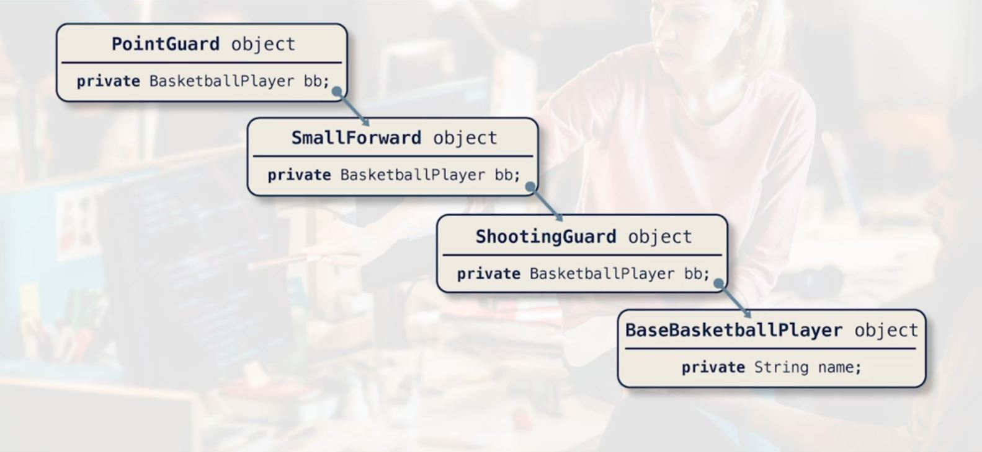
More on unwrapping decorators
What about unhooking the chain and re-arranging it?
Could have “unhook” methods like “unwrap” to manipulate these links
Can alter the order in the chain
Can take a decorator out ( or add one in ) dynamically
Like removing a scroll bar from an existing window in use
Or adding logging capability to an existing window

Slide 32
Decorators in the Java Core

Slide 33
Decorator pattern in the Java Core
java.io.InputStream
java.io.OutputStream
java.io.Reader
java.io.Writer

Slide 34
Java.io.InputStream
InputStream
abstract class
extends
extends
Base Classes
Decorator Classes
FileInputStream
class
PushbackInputStream
class
PipedInputStream
class
BufferedInputStream
class
DataInputStream
class

Slide 35
Example code: chaining decorators
import java.io.*;
public class Main {
public static void main(String[] args) {
try {
// Create a FileInputStream for reading a file
FileInputStream fis = new FileInputStream("example.txt");
// Wrap the FileInputStream in a PushbackInputStream
PushbackInputStream pbis = new PushbackInputStream( fis );
// Read a byte from the stream
int byteRead = pbis.read();
System.out.println("Read byte: " + (char)byteRead);
// etc…
The base object
Decorating…
Using the decorator

Slide 36
Example code: chaining decorators
import java.io.BufferedReader;
import java.io.IOException;
import java.io.InputStreamReader;
public class KeyboardReader {
public static void main(String[] args) {
BufferedReader reader = new BufferedReader( new InputStreamReader(System.in) ) ;
System.out.println("Enter something:");
try {
String input = reader.readLine();
System.out.println("You entered: " + input);
} catch (IOException e) {
System.err.println("Error reading from user input: " + e.getMessage());
} finally {
try {
reader.close();
} catch (IOException e) {
System.err.println("Error closing BufferedReader: " + e.getMessage());
}
}
} }
The base object
Decorating…

