Slide 1
JavaFX
COMP 301
( adapted from Drs. K. Mayer-Patel and A. Smith )

Slide 2
Graphical User Interfaces

Slide 3
Human-Computer Interaction (HCI)
HCI is an active area of CS research
keybd, mic, cam, brain chip, mouse, touch screen, joystick, steering, pedals, motion sensors, etc.
Input
Feedback
Natural language, numeric data, images, video, VR model actions, neural signals, sound, device control, car steering, etc.
Interface
How can we do this exchange efficiently and effectively?
The “computer” may be a robot, a medical device, a car, etc.

Slide 4
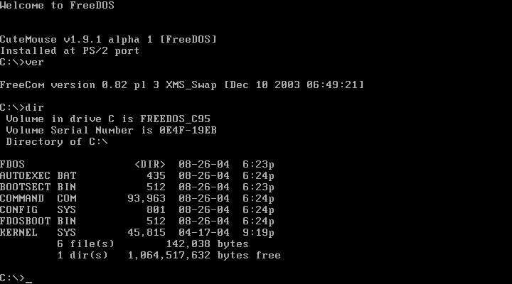
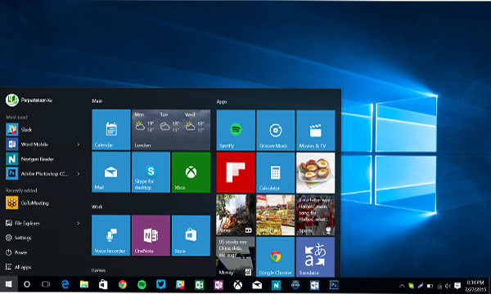
User interfaces
GUIs were first created in the late 1970’s
keyboard input,
printed language feedback (and bells, beeps, boops)
Became well known late 1980’s with Apple, MSFT Windows, X windows (unix)
Command line interface (CLI)
Graphical user interface (GUI)
Two well known, common examples of user interfaces
Keyboard, mouse input,
printed language, images, video etc. feedback (and bells, beeps, boops)

Slide 5
GUIs are made of UI components (widgets)
Here are some common basic UI components:
Text label
Image
Geometric shape
Icon
Button
Basic UI components can be composed together to make compound UI components:
Menu
Pop-up / modal / dialog
Panel
Input slider
Text input field
Password field
Hover tooltip

Slide 6
Java’s GUI libraries
1995
1997
2008
AWT
Java’s original GUI library
Swing
An extension of AWT
JavaFX
Designed to be mobile/web friendly
Basic UI components
Intended for desktop first
Redesigned UI components
Platform-dependent
GUI programming and visual style has evolved a lot in the past two decades

Slide 7
Basic visual differences
AWT
Swing
JavaFX

Slide 8
Basic visual differences
AWT app on a Mac looks like a Mac windows style, on MSFT Windows looks like Windows style
Swing app on a Mac or on MSFT Windows looks like “Java” style
AWT
Swing
JavaFX
Takeaway: JavaFX was influenced by the web and was created with responsive design in mind

Slide 9
Basic visual differences
Interface layout and component structure is adapted to the “real estate” and format of the devices users have
Credit: https://www.interaction-design.org/literature/topics/responsive-design#what_is_responsive_design_(rd)?-0
AWT
JavaFX
Swing
Takeaway: JavaFX was influenced by the web and was created with responsive design in mind

Slide 10
Setting up JavaFX
Today’s lecture code: https://github.com/comp301unc/lec19-javafx

Slide 11
Importing JavaFX as a Maven dependency
<dependencies> <dependency> <groupId>junit</groupId> <artifactId>junit</artifactId> <version>4.11</version> <scope>test</scope> </dependency> <dependency> <groupId>org.openjfx</groupId> <artifactId>javafx-controls</artifactId> <version>14</version> </dependency> </dependencies>
JavaFX is an external library,
so it must be included
as a dependency using Maven
https://openjfx.io/openjfx-docs/#maven

Slide 12
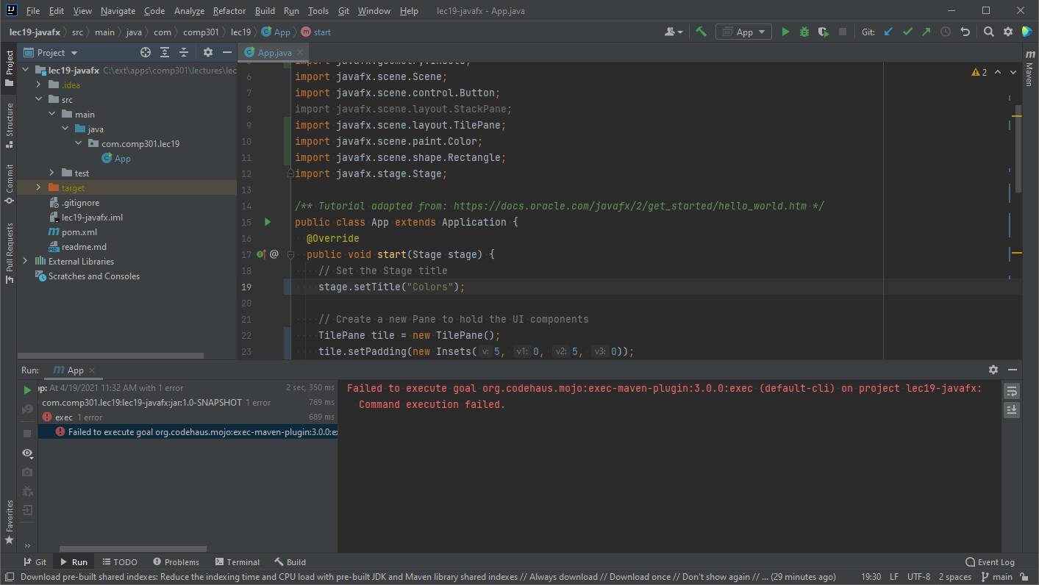
With JavaFX apps, the play button might not work to run the program

Slide 13
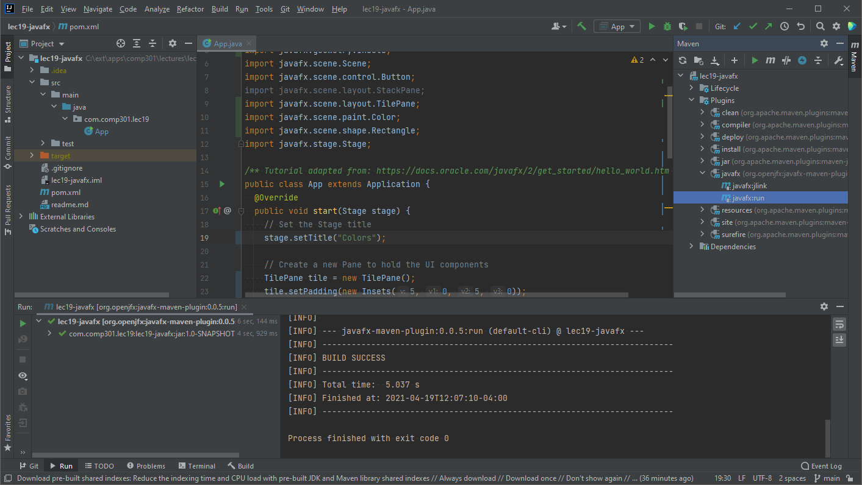
With JavaFX apps, the play button might not work to run the program
Instead, the program must be executed through Maven
Double click javafx:run, and the program will run

Slide 14
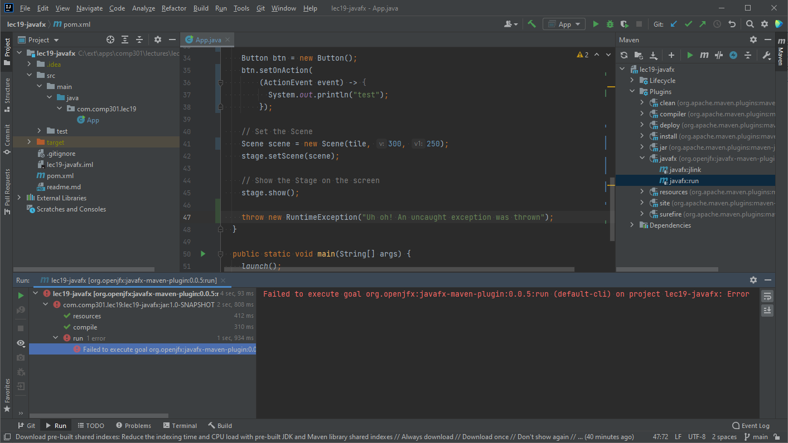
When an exception occurs in your JavaFX program, the error might look unhelpful

Slide 15
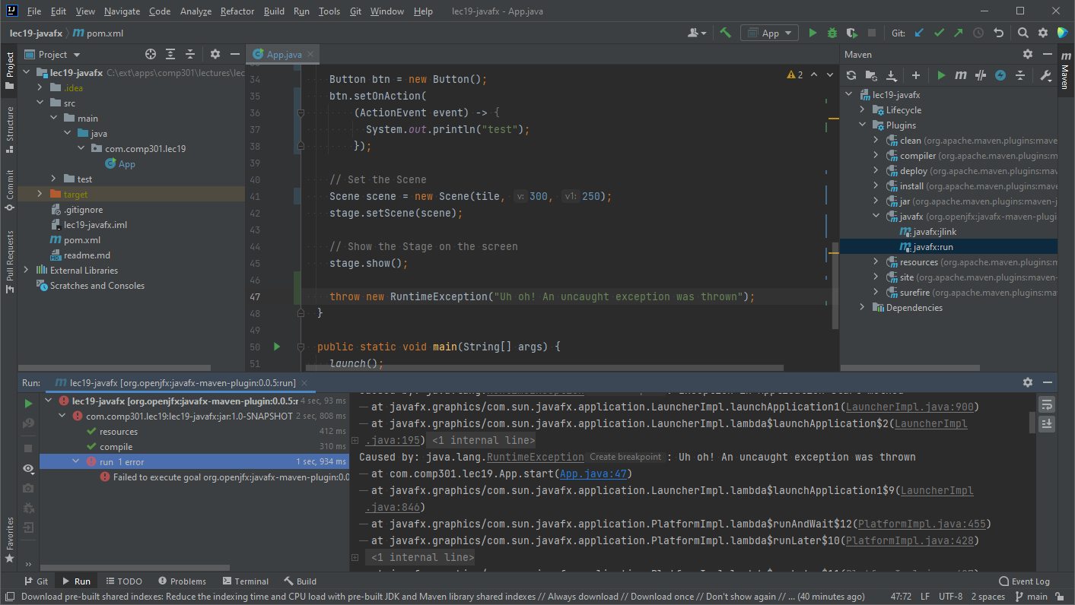
Click “run” in the left panel to show the actual exception output
The printed output might be long, but the exception will be there

Slide 16
Hello, World (JavaFX style)
Tutorial taken from: https://docs.oracle.com/javafx/2/get_started/hello_world.htm

Slide 17
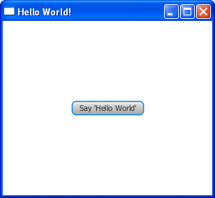
Hello, World (JavaFX style)
public class App extends Application { @Override public void start(Stage stage) { // Set the Stage title stage.setTitle("Hello World!"); // Create a new Pane to hold the UI components StackPane pane = new StackPane(); // Create a Button component Button btn = new Button(); btn.setText("Say 'Hello World'"); // Add a "click handler" action to the button // TODO: This can be simplified to use a lambda expression btn.setOnAction( new EventHandler<ActionEvent>() { @Override public void handle(ActionEvent actionEvent) { System.out.println("Hello World!"); } }); // Add the Button to the Pane pane.getChildren().add(btn); // Set the Scene Scene scene = new Scene(pane, 300, 250); stage.setScene(scene); // Show the Stage on the screen stage.show(); } public static void main(String[] args) { launch(); } }

Slide 18
JavaFX Application class
public class App extends Application { @Override public void start(Stage stage) { // Set the Stage title stage.setTitle("Hello World!"); // Create a new Pane to hold the UI components StackPane pane = new StackPane(); // Create a Button component Button btn = new Button(); btn.setText("Say 'Hello World'"); // Add a "click handler" action to the button // TODO: This can be simplified to use a lambda expression btn.setOnAction( new EventHandler<ActionEvent>() { @Override public void handle(ActionEvent actionEvent) { System.out.println("Hello World!"); } }); // Add the Button to the Pane pane.getChildren().add(btn); // Set the Scene Scene scene = new Scene(pane, 300, 250); stage.setScene(scene); // Show the Stage on the screen stage.show(); } public static void main(String[] args) { launch(); } }
1. A class that extends Application represents the main entry point for a JavaFX app
2. Your Application subclass should override the start() method, which defines how to construct the display window
3. When it’s time to create the window, use the launch() static method

Slide 19
JavaFX Stage parameter
public class App extends Application { @Override public void start(Stage stage) { // Set the Stage title stage.setTitle("Hello World!"); // Create a new Pane to hold the UI components StackPane pane = new StackPane(); // Create a Button component Button btn = new Button(); btn.setText("Say 'Hello World'"); // Add a "click handler" action to the button // TODO: This can be simplified to use a lambda expression btn.setOnAction( new EventHandler<ActionEvent>() { @Override public void handle(ActionEvent actionEvent) { System.out.println("Hello World!"); } }); // Add the Button to the Pane pane.getChildren().add(btn); // Set the Scene Scene scene = new Scene(pane, 300, 250); stage.setScene(scene); // Show the Stage on the screen stage.show(); } public static void main(String[] args) { launch(); } }
The start() method is always given a Stage object as a parameter
The Stage object represents the display window
The Stage object can be used to set the title of the window

Slide 20
JavaFX Pane objects
public class App extends Application { @Override public void start(Stage stage) { // Set the Stage title stage.setTitle("Hello World!"); // Create a new Pane to hold the UI components StackPane pane = new StackPane(); // Create a Button component Button btn = new Button(); btn.setText("Say 'Hello World'"); // Add a "click handler" action to the button // TODO: This can be simplified to use a lambda expression btn.setOnAction( new EventHandler<ActionEvent>() { @Override public void handle(ActionEvent actionEvent) { System.out.println("Hello World!"); } }); // Add the Button to the Pane pane.getChildren().add(btn); // Set the Scene Scene scene = new Scene(pane, 300, 250); stage.setScene(scene); // Show the Stage on the screen stage.show(); } public static void main(String[] args) { launch(); } }
JavaFX uses Pane objects to describe where the components should be placed in the window
Multiple “child” UI components can be added to a Pane object
But Pane objects
are UI components, too
Pane objects can therefore be nested, creating a tree of UI components

Slide 21
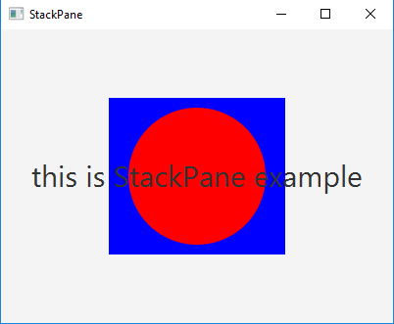
JavaFX Pane objects
StackPane stacks its children directly on top of each other
Different Pane subclasses position their children using different layouts
We’ll learn about other layout types next class

Slide 22
JavaFX Button object
public class App extends Application { @Override public void start(Stage stage) { // Set the Stage title stage.setTitle("Hello World!"); // Create a new Pane to hold the UI components StackPane pane = new StackPane(); // Create a Button component Button btn = new Button(); btn.setText("Say 'Hello World'"); // Add a "click handler" action to the button // TODO: This can be simplified to use a lambda expression btn.setOnAction( new EventHandler<ActionEvent>() { @Override public void handle(ActionEvent actionEvent) { System.out.println("Hello World!"); } }); // Add the Button to the Pane pane.getChildren().add(btn); // Set the Scene Scene scene = new Scene(pane, 300, 250); stage.setScene(scene); // Show the Stage on the screen stage.show(); } public static void main(String[] args) { launch(); } }
A Button object represents a button UI component
If the Button wasn’t added to the Pane, it would never be displayed on the screen!
Just because a UI component object was instantiated, doesn’t mean it will be displayed.

Slide 23
JavaFX Scene object
public class App extends Application { @Override public void start(Stage stage) { // Set the Stage title stage.setTitle("Hello World!"); // Create a new Pane to hold the UI components StackPane pane = new StackPane(); // Create a Button component Button btn = new Button(); btn.setText("Say 'Hello World'"); // Add a "click handler" action to the button // TODO: This can be simplified to use a lambda expression btn.setOnAction( new EventHandler<ActionEvent>() { @Override public void handle(ActionEvent actionEvent) { System.out.println("Hello World!"); } }); // Add the Button to the Pane pane.getChildren().add(btn); // Set the Scene Scene scene = new Scene(pane, 300, 250); stage.setScene(scene); // Show the Stage on the screen stage.show(); } public static void main(String[] args) { launch(); } }
A Scene object is a container for the component tree that will be displayed in the window
The Scene constructor takes as input a root UI component
Optionally, the Scene constructor also takes a width and height,
used to size the window
Apps can have multiple Scene objects that get switched out to change the UI

Slide 24
Button click handler
public class App extends Application { @Override public void start(Stage stage) { // Set the Stage title stage.setTitle("Hello World!"); // Create a new Pane to hold the UI components StackPane pane = new StackPane(); // Create a Button component Button btn = new Button(); btn.setText("Say 'Hello World'"); // Add a "click handler" action to the button // TODO: This can be simplified to use a lambda expression btn.setOnAction( new EventHandler<ActionEvent>() { @Override public void handle(ActionEvent event) { System.out.println("Hello World!"); } }); // Add the Button to the Pane pane.getChildren().add(btn); // Set the Scene Scene scene = new Scene(pane, 300, 250); stage.setScene(scene); // Show the Stage on the screen stage.show(); } public static void main(String[] args) { launch(); } }
This code creates and registers a method to be executed every time the UI button is pressed
What technique is this?
An anonymous class!

Slide 25
Button click handler
public class App extends Application { @Override public void start(Stage stage) { // Set the Stage title stage.setTitle("Hello World!"); // Create a new Pane to hold the UI components StackPane pane = new StackPane(); // Create a Button component Button btn = new Button(); btn.setText("Say 'Hello World'"); // Add a "click handler" action to the button
EventHandler<ActionEvent> clickHandler = (ActionEvent event) -> {
System.out.println("Hello World!");
}; btn.setOnAction(clickHandler);
// Add the Button to the Pane pane.getChildren().add(btn); // Set the Scene Scene scene = new Scene(pane, 300, 250); stage.setScene(scene); // Show the Stage on the screen stage.show(); } public static void main(String[] args) { launch(); } }
Now it uses a lambda expression!

Slide 26
Button click handler
public class App extends Application { @Override public void start(Stage stage) { // Set the Stage title stage.setTitle("Hello World!"); // Create a new Pane to hold the UI components StackPane pane = new StackPane(); // Create a Button component Button btn = new Button(); btn.setText("Say 'Hello World'"); // Add a "click handler" action to the button btn.setOnAction((ActionEvent event) -> {
System.out.println("Hello World!");
});
// Add the Button to the Pane pane.getChildren().add(btn); // Set the Scene Scene scene = new Scene(pane, 300, 250); stage.setScene(scene); // Show the Stage on the screen stage.show(); } public static void main(String[] args) { launch(); } }
For even more concise code, pass the result of the lambda expression directly into the setOnAction() method

