Slide 1
JavaFX Style
COMP 301
( adapted from Drs. K. Mayer-Patel and A. Smith )

Slide 2
Essential JavaFX Classes
Review from last class

Slide 3
JavaFX Application Object
Application object
Extend this class to make a JavaFX application
Override the start() method to set up the GUI
Call the (built-in) launch() class method to launch the app
Example Application usage:
extends Application
public class App extends Application { @Override public void start(Stage stage) { // ... } public static void main(String[] args) { launch(); } }
Overrides start() method
Call launch() to launch the application

Slide 4
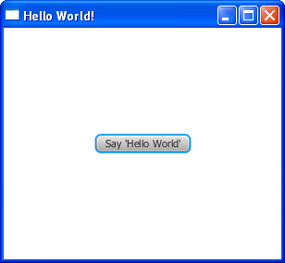
JavaFX Stage Object
Stage object
Represents the window itself
Displays one Scene at a time
The current Scene can be swapped out to change the application’s layout/view
Example Stage usage:
start() method is passed a stage object
@Override public void start(Stage stage) { stage.setTitle("Hello World!");
Scene scene = new Scene(root, 300, 250);
stage.setScene(scene);
stage.show(); }
Use setTitle() and setScene() to change the stage properties
Call show() to make the window appear

Slide 5
JavaFX Stage Object
Stage object
Represents the window itself
Displays one Scene at a time
The current Scene can be swapped out to change the application’s layout/view
Useful Stage setter methods:
setTitle(String value)
setScene(Scene value)
setResizable(boolean value)
setMaximized(boolean value)
setFullScreen(boolean value)
setMinWidth(double value)
setMaxWidth(double value)
setMinHeight(double value)
setMaxHeight(double value)
See all Stage methods here:
https://docs.oracle.com/javase/8/javafx/api/javafx/stage/Stage.html

Slide 6
JavaFX Scene Object
Scene object
Represents the complete contents of the window
Acts as a container for all displayed content
An application can have multiple Scenes, but only one can be displayed per Stage at a time
See all Scene methods here:
https://docs.oracle.com/javase/8/javafx/api/javafx/scene/Scene.html
Example Scene usage:
Pass a UI component tree into Scene’s constructor
@Override public void start(Stage stage) { Scene scene = new Scene(root, 300, 250);
stage.setScene(scene); }
Optionally set the width and height of the Scene

Slide 7
JavaFX Scene Object
Scene object
Represents the complete contents of the window
Acts as a container for all displayed content
An application can have multiple Scenes, but only one can be displayed per Stage at a time
Useful Scene setter methods:
setRoot(Parent value)
See all Scene methods here:
https://docs.oracle.com/javase/8/javafx/api/javafx/scene/Scene.html
Next, let’s talk about the JavaFX scene graph

Slide 8
JavaFX Scene Graph

Slide 9
JavaFX Scene Graph
Application
Stage
The “scene graph” is a tree of UI components that is attached to a Scene object as the root
Scene graph classes:
Node – Base class for every component in the scene graph
Parent – A subclass of Node representing an internal node of the scene graph
Region – A subclass of Parent which can be styled using JavaFX’s implementation of CSS
Pane – A subclass of Region which allows adding/removing children and specifies how they should be positioned on the screen
Scene
Pane
TextField
Pane
Button
Label
Scene graph

Slide 10
JavaFX Scene Graph
Application
Stage
An application can have multiple “scene graphs”, but only one can be displayed in a window at a time!
Scene
Scene scene1 = new Scene(graph1, 350, 450);
Scene scene2 = new Scene(graph2, 500, 500);
Pane (graph1)
Scene
TextField
Pane
Pane (graph2)
Button
Label
TextField
Label
Button

Slide 11
Positioning Components with JavaFX Layout Panes

Slide 12
JavaFX Layout Panes
Built-in layout panes:
BorderPane
HBox
VBox
StackPane
GridPane
FlowPane
TilePane
AnchorPane
8 built-in layout pane classes! Each one provides a different scheme for positioning its children on the screen
For more information on layout panes, see:
https://docs.oracle.com/javafx/2/layout/builtin_layouts.htm

Slide 13
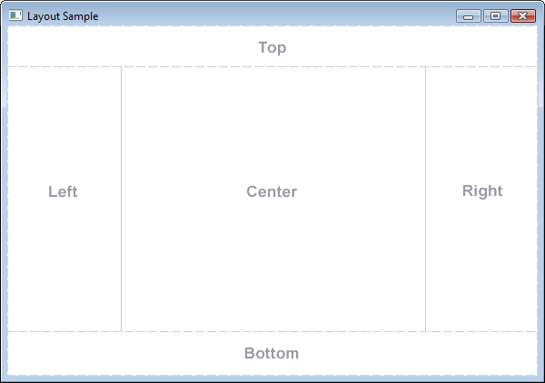
JavaFX Layout Panes
Built-in layout panes:
BorderPane
HBox
VBox
StackPane
GridPane
FlowPane
TilePane
AnchorPane
BorderPane
Five “regions” where children can be positioned
For more information on layout panes, see:
https://docs.oracle.com/javafx/2/layout/builtin_layouts.htm

Slide 14
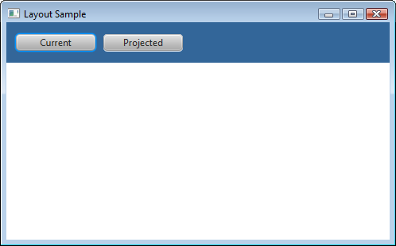
JavaFX Layout Panes
Built-in layout panes:
BorderPane
HBox
VBox
StackPane
GridPane
FlowPane
TilePane
AnchorPane
HBox
Children are positioned horizontally, either left-to-right or right-to-left
For more information on layout panes, see:
https://docs.oracle.com/javafx/2/layout/builtin_layouts.htm

Slide 15
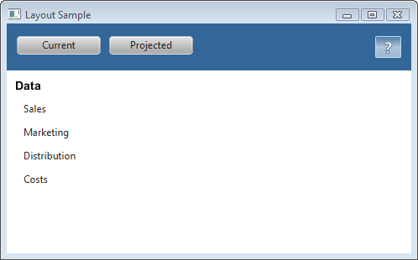
JavaFX Layout Panes
Built-in layout panes:
BorderPane
HBox
VBox
StackPane
GridPane
FlowPane
TilePane
AnchorPane
VBox
Children are positioned vertically, either top-to-bottom or bottom-to-top
For more information on layout panes, see:
https://docs.oracle.com/javafx/2/layout/builtin_layouts.htm

Slide 16
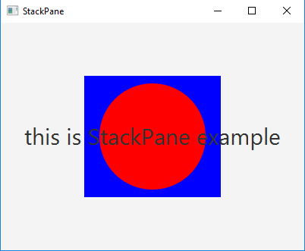
JavaFX Layout Panes
Built-in layout panes:
BorderPane
HBox
VBox
StackPane
GridPane
FlowPane
TilePane
AnchorPane
StackPane
Children are positioned
directly over each other
For more information on layout panes, see:
https://docs.oracle.com/javafx/2/layout/builtin_layouts.htm

Slide 17
JavaFX Layout Panes
Built-in layout panes:
BorderPane
HBox
VBox
StackPane
GridPane
FlowPane
TilePane
AnchorPane
GridPane
Children are positioned
in a grid with rows and columns
For more information on layout panes, see:
https://docs.oracle.com/javafx/2/layout/builtin_layouts.htm

Slide 18
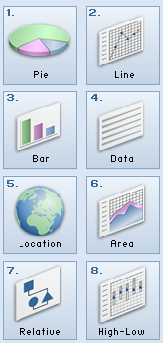
JavaFX Layout Panes
Built-in layout panes:
BorderPane
HBox
VBox
StackPane
GridPane
FlowPane
TilePane
AnchorPane
FlowPane
Children are positioned left-to-right (or top-to-bottom) and wrap to the next row (or column) when the edge is reached
For more information on layout panes, see:
https://docs.oracle.com/javafx/2/layout/builtin_layouts.htm

Slide 19
JavaFX Layout Panes
Built-in layout panes:
BorderPane
HBox
VBox
StackPane
GridPane
FlowPane
TilePane
AnchorPane
TilePane
Children are positioned just like FlowPane, but every child is forced to be the same dimensions
For more information on layout panes, see:
https://docs.oracle.com/javafx/2/layout/builtin_layouts.htm

Slide 20
JavaFX Layout Panes
Built-in layout panes:
BorderPane
HBox
VBox
StackPane
GridPane
FlowPane
TilePane
AnchorPane
AnchorPane
Children are anchored to an
edge of the window
(top, bottom, left, right, or center)
For more information on layout panes, see:
https://docs.oracle.com/javafx/2/layout/builtin_layouts.htm

Slide 21
JavaFX UI Components

Slide 22
JavaFX UI Components
We aren’t going to cover these in class; use Google to look them up if you need to use them!
Label – For displaying text
Button – A clickable button
ToggleButton – A togglable button
TextField – A text input box
Checkbox – A checkbox
Rectangle – A colored rectangle
Circle – A colored circle
Slider – A slider bar
ImageView – For displaying an image
...and more!
For more information about supported UI components, see:
https://docs.oracle.com/javase/8/javafx/user-interface-tutorial/ui_controls.htm

Slide 23
JavaFX Example
Example code: https://github.com/comp301unc/lec20-javafx-style

Slide 24
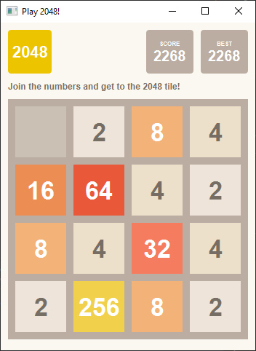
Mock-Up 2048 in JavaFX
Let’s recreate this GUI in JavaFX
https://github.com/comp301unc/lec20-javafx-style

Slide 25
2048 Scene Graph
Application
Stage
Scene
Application
Stage
Scene
A big part of GUI programming is deciding how to best position the content on the screen. I recommend starting by making a sketch on paper!

Slide 26
2048 Scene Graph
Application
Stage
Scene
VBox
HBox
Label
GridPane

Slide 27
2048 Scene Graph
Application
Stage
Scene
VBox
HBox
Label
GridPane
Label
Label
Label
Label
HBox
VBox
VBox
Label
Label
Label
Label
Label
Label

Slide 28
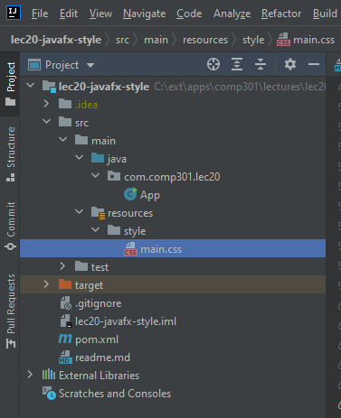
Style in JavaFX
Common GUI programming pattern:
Separate content code from style code
Content code: defines what gets displayed
Style code: defines how to display it (colors, size, etc.)
Maven project organization:
Content code goes in:
/src/main/java/...
Style code goes in:
/src/main/resources/style/...

Slide 29
Connecting components and styles
src/main/resources/style/main.css
.instructions { -fx-text-fill: #766f65; -fx-padding: 10 0 10 0; /* top, right, bottom, left */ }
1. Add style code for a UI component in main.css, and give the style a unique ID/name
2. Link the UI component to the ID/name of its style
src/main/java/com/comp301/lec20/App.java
Label instructions = new Label("Join the numbers and get to the 2048 tile!"); instructions.getStyleClass().add("instructions"); layout.getChildren().add(instructions);
// ...
Scene scene = new Scene(layout, 350, 450); scene.getStylesheets().add("style/main.css"); stage.setScene(scene);
3. Link the stylesheet file to the scene

Slide 30
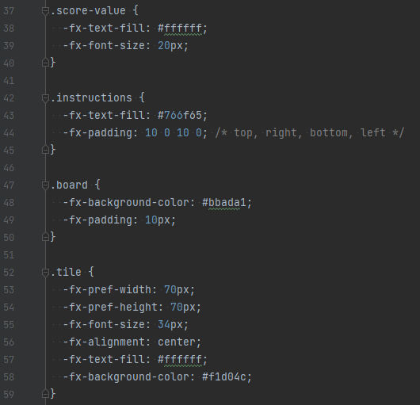
main.css (partial file)
This language is called “CSS”
Cascading Style Sheets
It will not be covered in COMP 301
Take COMP 426 if interested
However, feel free to use it to style your JavaFX components!
One .css file can define multiple styles for multiple components

