Slide 1
Model-View-Controller
COMP 301
( adapted from Drs. K. Mayer-Paterl and A. Smith )

Slide 2
Model-View-Controller
A “super pattern”

Slide 3
Background
What is model-view-controller (MVC)?
MVC is a software design pattern used for structuring and organizing your code for applications with a user interface
Big idea: Separate the app’s UI code from the state management code
History of MVC
Used in the 1970’s and 1980’s when GUIs were first developed
Has remained popular ever since
Has evolved and changed, but the big idea remains the same
MVC can be used in desktop, mobile, and web applications

Slide 4
Model, View, and Controller
Model
Controller
View
Stores the application state
Handles user interactions by calling appropriate model methods
Creates and displays the user interface
Provides algorithms for data manipulation
Observes for user interactions

Slide 5
Decoupling the model, view, and controller
Decoupled
Model
(application state)
View
(user interface)
The model knows how the application works, but not how to show it to the user
The view knows how to show the application to the user, but not how it works
Controller
(event handler)
Controller
(event handler)
Although the model and view are decoupled, they still must interact with each other
The controller translates view events into model commands

Slide 6
The Model
The model knows how the application works … the “business logic”

Slide 7
Model responsibilities
The model encapsulates the application state
public class Model { private List<Player> players; private int turn; public Player getActivePlayer() { return players.get(turn); } public void endTurn() { turn = (turn + 1) % players.size();
}
}
For this example, imagine a multiplayer, turn-based game like poker or D&D

Slide 8
Model responsibilities
The model encapsulates the application state
The model exposes methods to access and modify the state
public class Model { private List<Player> players; private int turn; public Player getActivePlayer() { return players.get(turn); } public void endTurn() { turn = (turn + 1) % players.size(); }
}
For this example, imagine a multiplayer, turn-based game like poker or D&D

Slide 9
Model responsibilities
The model encapsulates the application state
The model exposes methods to access and modify the state
Often, the model is an observable subject
The rest of the app needs to know when the state is changed!
public class Model {
private List<Observer> observers; public void addObserver(Observer observer) { observers.add(observer); } public void notifyObservers() { for (Observer o : observers) { o.update(this); } }
public void endTurn() { turn = (turn + 1) % players.size();
notifyObservers(); }
}
For this example, imagine a multiplayer, turn-based game like poker or D&D

Slide 10
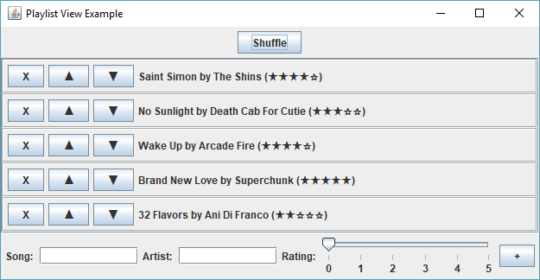
MVC Example 1: Song playlist
The model encapsulates the application state
What values might be part of the application state for this example?
List<Song> songs
What values should be encapsulated in each Song?
String name
String artist
int rating
These values should be stored as fields in the model

Slide 11
MVC Example 1: Song playlist
The model encapsulates the application state
What methods might be exposed by the model in this example for accessing the state?
getSong(int index)
getNumSongs()

Slide 12
MVC Example 1: Song playlist
The model encapsulates the application state
What methods might be exposed by the model in this example for modifying the state?
addSong(Song s)
removeSong(int index)
moveSong(int oldIndex, int newIndex)

Slide 13
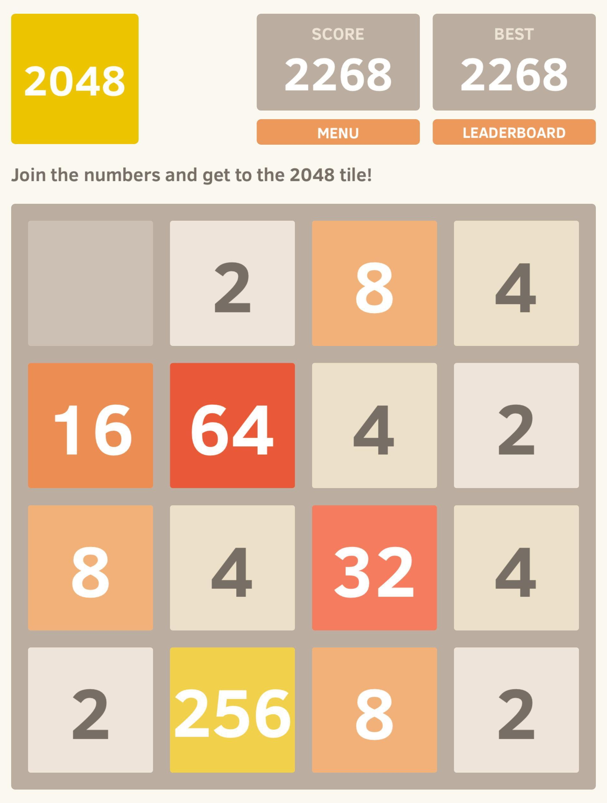
MVC Example: 2048
What values might be encapsulated as part of the application state for this example?
int[][] board
int score
int best
These values should be stored as fields in the model

Slide 14
MVC Example: 2048
What methods might be exposed by the model in this example for accessing the state?
getTile(int x, int y)
getCurrentScore()
getBestScore()
isGameOver()

Slide 15
MVC Example: 2048
What methods might be exposed by the model in this example for modifying the state?
swipeLeft()
swipeRight()
swipeUp()
swipeDown()
reset()
These method names imply some view or UI capability like “swiping”
moveLeft()
moveRight()
moveUp()
moveDown()
reset()
goWest()
goEast()
goNorth()
goSouth()
reset()
Style Note: These names are a bit more “decoupled”

Slide 16
The View
The view knows how the application looks

Slide 17
View responsibilities
We are using JavaFX as our UI library. This means the view package should hold all JavaFX code
The view generates the UI
Uses the current state values from the model
The view refreshes the UI when the app state changes
Needs to observe the model, either directly or through the controller
The view observes for user interactions
Needs to call methods on the controller to handle user interactions

Slide 18
Suggested pattern for view classes
Note this is something WE do, not part of JavaFX… we invent this interface and name it
Define an interface like this for writing your view classes
Better name might be “UICompo” or something more general that does not use “FX” name
public interface FXComponent { Parent render(); }
The render() method returns the generated scene graph
The render() method generates and returns a scene graph representing the UI tree for the view

Slide 19
Implementing the suggested pattern
public class AppView implements FXComponent { private Controller controller; public AppView(Controller controller) { this.controller = controller; } @Override public Parent render() { VBox layout = new VBox(); // Create UI components and add // them to the layout here
return layout; } }
Most UI components need to encapsulate a reference to the controller. Why?

Slide 20
Implementing the suggested pattern
public class AppView implements FXComponent { private Controller controller; public AppView(Controller controller) { this.controller = controller; } @Override public Parent render() { VBox layout = new VBox(); // Create UI components and add // them to the layout here Button button = new Button("click me"); button.setOnAction((ActionEvent event) -> { controller.handleClick(); }); layout.getChildren().add(button); return layout; } }
Most UI components need to encapsulate a reference to the controller. Why?
User interaction events are forwarded to the controller
render() returns the generated scene graph

Slide 21
Compound components
Here’s a great way to split up your view code into smaller classes
public class CompoundView implements FXComponent { private Controller controller;
private FXComponent leftPanel;
private FXComponent rightPanel; public CompoundView(Controller controller) { this.controller = controller; this.leftPanel = new LeftPanel(controller); this.rightPanel = new RightPanel(controller); } @Override public Parent render() { HBox layout = new HBox();
layout.getChildren().add(leftPanel.render());
layout.getChildren().add(rightPanel.render()); return layout; } }
Renders the internal components

Slide 22
The Controller
The controller handles user interactions

Slide 23
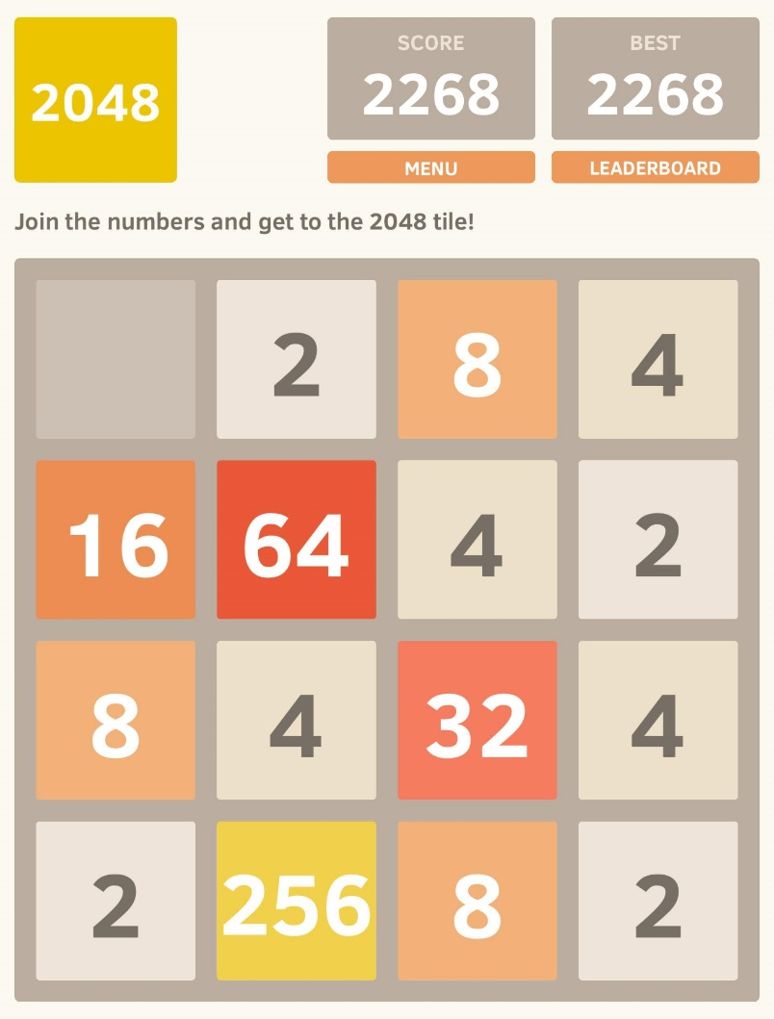
Example controller
public class Controller { private Model model; public Controller(Model model) { this.model = model; } /** Handle the swipe event */ public void handleSwipe(Direction dir) { switch (dir) { case UP: model.swipeUp(); break; case DOWN: model.swipeDown(); break; case LEFT: model.swipeLeft(); break; case RIGHT: model.swipeRight(); break; } } }
The controller usually needs to encapsulate a reference to the model. Why?
The controller consists of methods that translate user interaction events into commands for the model

Slide 24
MVC Interactions
This is where the MVC pattern varies from app to app

Slide 25
Review: Model, View, and Controller
Model
(application state)
Controller
(event handler)
View
(user interface)
Application state
in private fields
Renders UI
produces a scene graph
Handles user events
with public methods
Getter methods
to expose state
Displays UI
Application subclass
Modifier methods
to change state
Controls model
in response to events
Forwards UI events
to the controller
Notify observers
when state changes
Refreshes UI
upon state change

Slide 26
“Classic” MVC
This is one way to organize MVC
Model
(application state)
Controller
(event handler)
View
(user interface)
Application state
in private fields
Renders UI
produces a scene graph
Handles user events
with public methods
Getter methods
to expose state
Displays UI
Application subclass
Modifier methods
to change state
Controls model
in response to events
Forwards UI events
to the controller
Notify observers
when state changes
Refreshes UI
upon state change

Slide 27
Classic MVC
The icon indicates places where the observer design pattern is used
View calls controller methods to handle user interactions
View
(user interface)
Controller
(event handler)
View calls model getter methods to generate the UI
Controller calls model setter methods in response to user interaction
View observes the model for state changes, and refreshes the UI when update() is called
Model
(application state)
http://www.oracle.com/technetwork/articles/javase/mvc-136693.html

Slide 28
Setup for “classic” MVC
Controller calls model methods to handle UI events
View uses model getter methods and forwards UI events to the controller
Model model = new Model();
Controller controller = new Controller(model);
View view = new View(controller, model); model.addObserver(view);
View observes the model

Slide 29
“Alternate” MVC
Here is another way to organize MVC
Model
(application state)
Controller
(event handler)
View
(user interface)
Application state
in private fields
State getter methods
expose state to view
Renders UI
produces a scene graph
Getter methods
to expose state
Handles user events
with public methods
Displays UI
Application subclass
Modifier methods
to change state
Controls model
in response to events
Forwards UI events
to the controller
Notify observers
when state changes
Forwards updates
from model to view
Refreshes UI
upon state change

Slide 30
“Alternate” MVC
Alternate MVC focuses on fully decoupling the model and the view so they never need to reference each other
The icon indicates places where the observer design pattern is used
View forwards user events to controller
Controller handles user events by calling model setter methods
View
(user interface)
Controller
(event handler)
Model
(application state)
Controller notifies view when application state changes
View calls controller getter methods to access application state
Model notifies controller when application state changes
Controller calls model getter methods to access application state
http://www.oracle.com/technetwork/articles/javase/mvc-136693.html

Slide 31
Setup for “alternate” MVC
Controller observes for state changes on
the model
Controller calls model methods to handle UI events
Model model = new Model(); Controller controller = new Controller(model); model.addObserver(controller); View view = new View(controller); controller.addObserver(view);
View observes
for state changes on
the controller
View forwards UI events to the controller

Slide 32
Java Example: Basic
// Model
public class UserModel {
private String name;
private int age;
public UserModel(String name, int age) { this.name = name; this.age = age; }
// Getters and setters
public String getName() { return name; }
public void setName(String name) { this.name = name; }
public int getAge() { return age; }
public void setAge(int age) { this.age = age; }
}
Adapted from ChatGPT example

Slide 33
Java Example: Basic
// View (not a GUI)
public class UserView {
public void renderInfo(String name, int age) {
System.out.println("User: ");
System.out.println("Name: " + name);
System.out.println("Age: " + age);
}
// this could draw the info many different ways
// how the info is rendered is decoupled from the
// controller and the model
}
State of the model is passed in to the view from the controller

Slide 34
Java Example: Basic
// Controller
public class UserController {
private UserModel model;
private UserView view;
public UserController(UserModel model, UserView view) {
this.model = model;
this.view = view;
}
public void setUserName(String name) { model.setName(name);}
public String getUserName() { return model.getName(); }
public void setUserAge(int age) { model.setAge(age); }
public int getUserAge() { return model.getAge(); }
public void updateUserView() {
view.renderInfo(model.getName(), model.getAge());
}
}

Slide 35
Java Example: Basic
// Main class
public class Main {
public static void main(String[] args) {
// Create model, view, and controller
UserModel model = new UserModel("John", 30); // initial state
UserView view = new UserView();
UserController controller = new UserController(model, view);
// Update model data
// is this a view duty? Perhaps the info is coming not
// from a UI but from a stream… data from a lab device, etc.
controller.setUserName("Alice");
controller.setUserAge(25);
// Update view
controller.updateUserView();
}
}

Slide 36
Let’s get more complicated

Slide 37
Java Example: Basic++
// Model
public class UserModel {
private String name;
private int age;
private Controller control; // do we need this?
public UserModel(String name, int age) { this.name = name; this.age = age; }
public regController(Controller control) { this.control = control; }
// Getters and setters
public String getName() { return name; }
public void setName(String name) { this.name = name; }
public int getAge() { return age; }
public void setAge(int age) { this.age = age; }
}

Slide 38
Java Example: Basic++
// View (not a GUI)
public class UserView {
private Controller control;
public void regController(Controller control) { this.control = control };
public void renderInfo(String name, int age) {
System.out.println("User: ");
System.out.println("Name: " + name);
System.out.println("Age: " + age);
}
// this could draw the info many different ways
// how the info is rendered is decoupled from the
// controller and the model
// continued…

Slide 39
Java Example: Basic++
// View (continued)
public void newInfo() {
// query user for new user name and age
control.newInfo(newName, newAge);
}
public void run() {
// loop… ask user… what shall we do? New info, see info, quit
if (“newInfo”) { newInfo(); }
if (“seeInfo”) { renderInfo(control.getName(), control.getAge());
}
else return; // quit
}
}

Slide 40
Java Example: Basic++
// Controller
public class UserController {
private UserModel model;
private UserView view;
public UserController(UserModel model, UserView view) {
this.model = model; this.view = view;
model.regController(this); view.regController(this);
}
public void setUserName(String name) { model.setName(name);}
public String getUserName() { return model.getName(); }
public void setUserAge(int age) { model.setAge(age); }
public int getUserAge() { return model.getAge(); }
public void newInfo(String name, int age); {
setUserName(name); setUserAge(age);
}
public void updateUserView() {
view.renderInfo(model.getName(), model.getAge());
}
}

Slide 41
Java Example: Basic++
// Main class
public class Main {
public static void main(String[] args) {
// Create model, view, and controller
UserModel model = new UserModel("John", 30); // initial state
UserView view = new UserView();
UserController controller = new UserController(model, view);
// Update model data
//controller.setUserName("Alice");
//controller.setUserAge(25);
// Update view
//controller.updateUserView();
view.run();
}
}

Slide 42
Another Variant, using Observer directly

Slide 43
Java Example: MVC w. Observer
// Observer interface interface Observer { void update(int value); }
// Subject interface interface Subject { void addObserver(Observer observer); void removeObserver(Observer observer); void notifyObservers(int value); }

Slide 44
Java Example: MVC w. Observer
import java.util.ArrayList; import java.util.List; // Model class Counter implements Subject { private int count = 0; private List<Observer> observers = new ArrayList<>(); public int getCount() { return count; } public void increment() { count++; notifyObservers(count); } @Override public void addObserver(Observer obs) { observers.add(obs); } @Override public void removeObserver(Observer obs) { observers.remove(obs); } @Override public void notifyObservers(int value) { for (Observer obs : observers) { obs.update(value); } } }

Slide 45
Java Example: MVC w. Observer
// View class CounterView implements Observer {
public void displayCount(int count) { System.out.println("Count: " + count); } @Override public void update(int value) { displayCount(value); }
// this is a “print only” view… gives information to a user,
// does not accept events or input so it does not contact
// the controller }

Slide 46
Java Example: MVC w. Observer
// Controller class CounterController { private Counter counter; private CounterView view; public CounterController(Counter counter, CounterView view) { this.counter = counter; this.view = view; counter.addObserver(view); } public void incrementCounter() { counter.increment(); } }

Slide 47
Java Example: MVC w. Observer
// Main class
public class Main { public static void main(String[] args) { Counter counter = new Counter(); CounterView view = new CounterView(); CounterController controller = new CounterController(counter, view); controller.incrementCounter(); // Increment the counter controller.incrementCounter(); // Increment the counter again
// with a more complicated view, one that allows user events as // input, these would be called from the view, and the controller // then communicates with the model } }

Slide 48
Good Exercise: MVC w. Observer
Main here is acting like View “user input”
Fully develop the view (as a keyboard/screen interface)
Develop a more complicated View with user inputs, and connect it to the Controller
Make the View call Controller methods, and the Controller call Model methods
Then use View as a Model Observer, get changes communicated to the the View for altering the View display

Slide 49
Controller… the middle “adapter”
Having a controller in the middle decouples model from view
Can change one model into several cooperating models… change controller code but not view code
Can have several different views using one controller
Different views can either be total views each, or each view can give part of the ways a model can be manipulated
e.g., instructor view of class materials, vs. student views

Slide 50
Code Example App with MVC pattern
Look this over in IntellliJ
We will develop this code in the next class meetings
https://github.com/COMP301F23/mvc-example

