Slide 1
Concurrent Programming part 3
COMP 301

Slide 2
Concurrency
Concurrency is when two or more different calculations are underway in overlapping time periods
These different activities
      might not interact ( independent, not that interesting )
      might cooperate to accomplish a task together
      might interfere to cause problems or errors
Concurrent activities might be
      chunky, large, coarse-grained, few in number ( processes )
      fine-grained, large in number, small actions ( parallelism )
      in-between ( threads )

Slide 3
Concurrency vs. Parallelism
Parallelism is a form of very fine-grained concurrency that is usually executed on a “parallel architectures”
  Super computers, graphics cards, machines with very large numbers of smaller CPU or cores
  Often applied semi-automatically to highly regular numerical applications (matrix algebra, e.g.) in domains like graphics, image analysis
  Parallelizing compilers can break up loops into coordinated overlapping concurrent executions of the body

Slide 4
Concurrency in PLs
Languages for expressing concurrent computations
  Multi-threaded: Java, Go, Rust, Clojure, Go, C#
  Functional: Clojure, Erlang, Elixir, Haskell
  Message passing: Smalltalk, Rust
  Monitor-based: Conc Pascal, Conc Euclid, Emerald, Java
  CSP-based: Occam, Limbo, Go, Crystal (2014)
  Distributed computing: Julia, Oz, Hermes (IBM), Limbo (Bell)
  Logic: Parlog (Prolog), Mercury
  Coordination language: Linda, CnC
  Dataflow : all concurrency determined by data dependencies

Slide 5
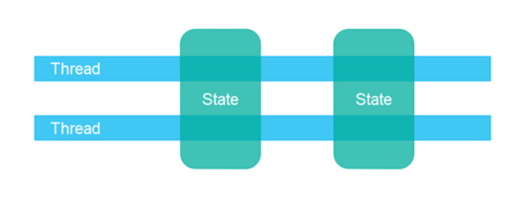
Concurrency Models
Shared Data State
  “Flock of sheep, grazing in the grass”
Threads
Parallelism, to some way of thinking

Slide 6
Concurrency Models
Shared Data State
  “Flock of sheep, grazing in the grass”
Two other models:
-- Message Passing
-- Data Flow
… for another discussion
Threads
Parallelism, to some way of thinking

Slide 7
Shared Data State
Shared read/write variables or data blocks
-- Scoping must allow data visibility to different code blocks
-- Code blocks then “execute” concurrently and all read/write the
shared data to coordinate and communicate
-- Even on single CPU system, “virtual” concurrent execution is a
good way to think of the computation as progressing
-- Concurrent tasks might be larger (processes) or medium (threads)
>> Not usually used for fine-grained parallelism

Slide 8
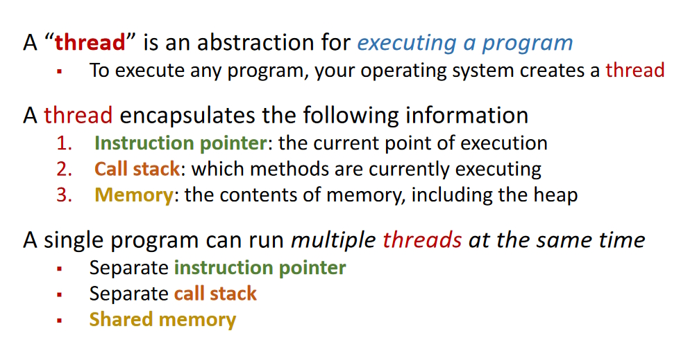
Shared Data State: Threads

Slide 9
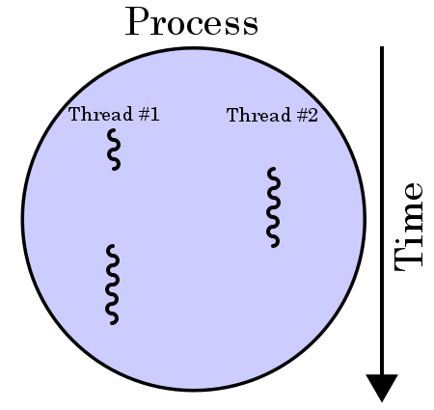
Threads: Concept
“heavyweight” process
comprises one or more “lightweight” threads
computation pieces that can (and usually do) overlap in time
All OS now support threads since we run on multi-core CPUs

Slide 10
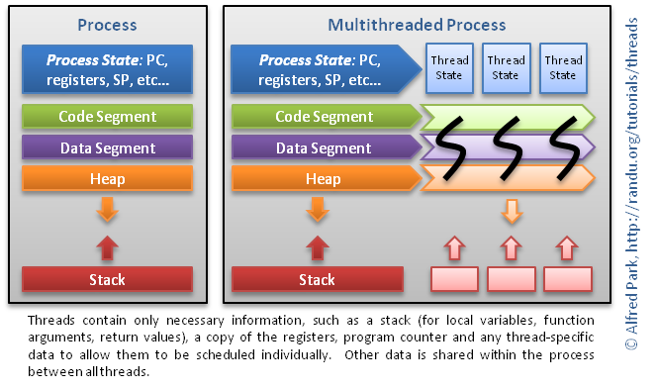
Threads: Run-time

Slide 11
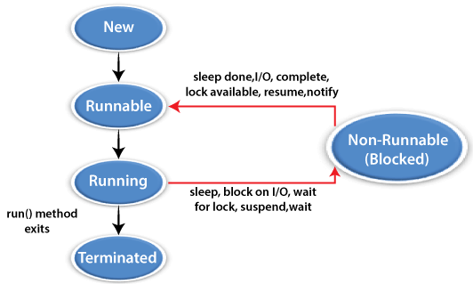
Threads in Java
Java threads are lightweight sub-processes that can share memory
Every Java program has at least one thread… main
Main thread can cause new threads to come into existence and run concurrently
A thread exists in
one of these states

Slide 12
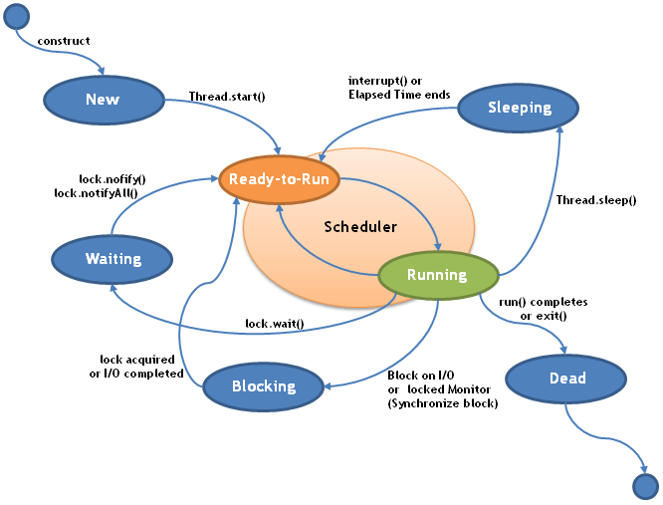
Threads in Java
Java threads are lightweight sub-processes that can share memory
Every Java program has at least one thread… main
A thread can cause new threads to come into existence and run concurrently
A thread exists in
one of these states
https://avaldes.com/java-thread-states-life-cycle-of-java-threads/

Slide 13
Thread Control
Methods to control thread execution and state
Thread tt = new Thread( ); // tt state new
tt.start( ); // tt state runnable, scheduler may move to running
tt.join( );
// current thread (like main) blocked, non-running
Thread.yield( );
// advice to JVM, current thread is willing to give up CPU
// but JVM decides, and may ignore it
Thread.sleep(1000);
// sleeping state, timer awakes back to runnable

Slide 14
Concurrency via Threads
Making a new Thread
Two ways in Java:
Extend the Thread class
Implement the Runnable interface
Extend the Thread class
Create a thread-intended class that extends Thread
Override the run( ) method
Instantiate an object of your thread-intended class
Have that object invoke its start( ) method
  start( ) internally executes the run( ) method you overrode

Slide 15
Concurrency via Threads
public class FooStuff extends Thread {
public void run( ) {
System.out.println(“doing foo stuff”);
}
public static void main (String[] args) {
FooStuff thExt = new FooStuff();
thExt.start();
}
}
Making a new Thread
Two ways in Java:
Extend the Thread class
Implement the Runnable interface
Extend the Thread class
Create a thread-intended class that extends Thread
Override the run( ) method
Instantiate an object of your thread-intended class
Have that object invoke its start( ) method
  start( ) internally executes the run( ) method you overrode

Slide 16
Concurrency via Threads
Making a new Thread ( implement Runnable )
We would use this approach for a class that already extends some parent class, but needs thread capability
  Java wont allow multiple inheritance (extends)
Implement the Runnable interface
Create a thread-intended class that implements Runnable
Code up the run( ) method
Instantiate an object of Thread class, pass a new thread-intended class object to the Thread constructor
Have that object invoke its start( ) method
  start( ) internally executes the run( ) method you overrode

Slide 17
Concurrency via Threads
public class FooStuff implements Runnable {
public void run( ) {
System.out.println(“doing foo stuff”);
}
public static void main (String[] args) {
Thread thRnb = new Thread(new FooStuff());
thRnb.start();
}
}
Making a new Thread ( implement Runnable )
We would use this approach for a class that already extends some parent class, but needs thread capability
  Java wont allow multiple inheritance (extends)
Implement the Runnable interface
Create a thread-intended class that implements Runnable
Code up the run( ) method
Instantiate an object of Thread class, pass a new thread-intended class object to the Thread constructor
Have that object invoke its start( ) method
  start( ) internally executes the run( ) method you overrode

Slide 18
Counting
Java threads
codes from
Marko Dvečko
public class Counting {
public static void main(String[] args) throws InterruptedException {
class Counter {
int counter = 0;
public void increment() { counter++; }
public int get() { return counter; }
}
final Counter counter = new Counter();
class CountingThread extends Thread {
public void run() {
for (int x = 0; x < 500000; x++) {
counter.increment();
} } }
CountingThread t1 = new CountingThread();
CountingThread t2 = new CountingThread();
t1.start(); t2.start();
t1.join(); t2.join();
System.out.println(counter.get());
} }
Run this and we get 673194
Or then 599213 or 879943
We expect 1000000
But get something different every run (non determinism)
This increment is not executing atomically
This is a race condition
One way threads interfere with each others’ correct use of the shared resource

Slide 19
Counting
Java threads
codes from
Marko Dvečko
public class Counting {
public static void main(String[] args) throws InterruptedException {
class Counter {
int counter = 0;
public void increment() { counter++; }
public int get() { return counter; }
}
final Counter counter = new Counter();
class CountingThread extends Thread {
public void run() {
for (int x = 0; x < 500000; x++) {
counter.increment();
} } }
CountingThread t1 = new CountingThread();
CountingThread t2 = new CountingThread();
t1.start(); t2.start();
t1.join(); t2.join();
System.out.println(counter.get());
} }
This increment looks atomic but at the assembly level several distinct things happen
task reads a value into register (R)
add 1 to register (A)
write register back to memory (W)
If R2 happens before W1, any interleaving like this will leave one increment instead of two
Two tasks 1 and 2 doing ++ “same time” might badly interleave these 6 actions
R1, R2, A1, A2, W1, W2
Causes two “increments” to leave the counter with a single increase in value

Slide 20
Counting Better
import java.util.concurrent.atomic.AtomicInteger;
class CountingBetter {
public static void main(String[] args) throws InterruptedException {
final AtomicInteger counter = new AtomicInteger(0);
class CountingThread extends Thread {
public void run() {
for (int i = 0; i < 500000; i++) {
counter.incrementAndGet();
} } }
CountingThread thread1 = new CountingThread();
CountingThread thread2 = new CountingThread();
thread1.start(); thread2.start();
thread1.join(); thread2.join();
System.out.println(counter.get());
} }
One solution: atomic integers in Java for the counter
This method in the class allows only one thread to access the counter object for the duration of the read and update

Slide 21
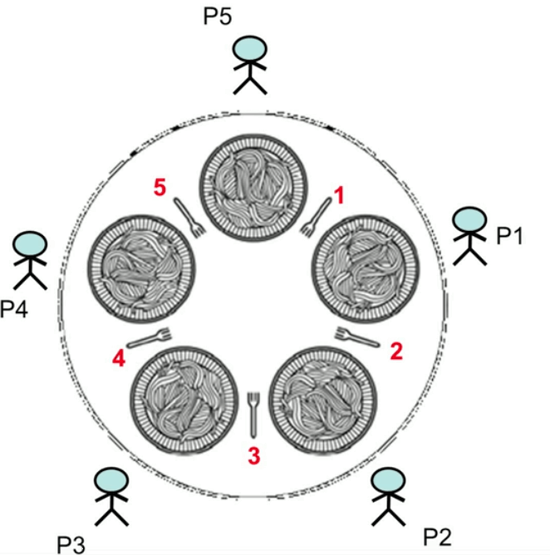
Dining Philosophers
Classic concurrency problem
5 philosophers around a table …
5 plates of food, 5 forks as shown
They think … and they must also eat
Starving to death ends thinking.
Now, to eat a philosopher must take a fork in each hand, eat a while, then put down the forks and go back to thinking
Note that when (say) P3 takes forks 3 & 4, P4 and P2 cannot eat.
The goal is to program this activity so that no philosopher starves ( i.e., never is able to pick up the needed 2 forks )

Slide 22
Dining Philosophers
Classic concurrency problem
Note that no more than 2 philos can be eating at any time (as that uses 4 forks in hand, leaving only 1 fork on the table)
All 5 can be thinking at any one instant, but if they all stay that way (never eat) they all starve.
So we assume a philos has a natural cycle of thinking, trying to eat, eating, and back to thinking.
If Pi is trying to eat, and never gets 2 forks, we say Pi starves
If all 5 manage to each get one fork, then none will ever get another; this is a deadlock… and all starve

Slide 23
Dining Philosophers
Can one Pi starve and the others not?
while ( true ) {
// Initially, thinking about life, universe, and everything
think( ); // lasts a while
// stop thinking, hungry now
pick_up_left_fork( );
pick_up_right_fork( );
eat( ); // lasts a while
put_down_right_fork();
put_down_left_fork();
// Not hungry now, back to thinking!
}

Slide 24
Dining Philosophers
Each Pi is a thread
5 threads trying to pick up 5 (shared) forks
// possible order of events
P1 thinking
P2 thinking
P3 thinking
P4 thinking
P5 thinking
P1 picks up left fork
P2 picks up left fork
P3 picks up left fork
P4 picks up left fork
P5 picks up left fork
// … crickets…
deadlocked
What else might we do?

Slide 25
Dining Philosophers
What about this?
while ( true ) {
// Initially, thinking about life, universe, everything
think( ); // lasts a while
// done thinking, hungry now
pick_up_left_fork( );
pick_up_right_fork( );
eat( ); // lasts a while
put_down_right_fork();
put_down_left_fork();
// Not hungry now, back to thinking!
}
simultaneously
simultaneously

Slide 26
Dining Philosophers
Other issues
We must take care to not serialize it totally
-- don’t synchronize away all concurrency
What about the earlier question:
-- can some starve, while others do not?
This illustrates something else to worry about in concurrency:
fairness

Slide 27
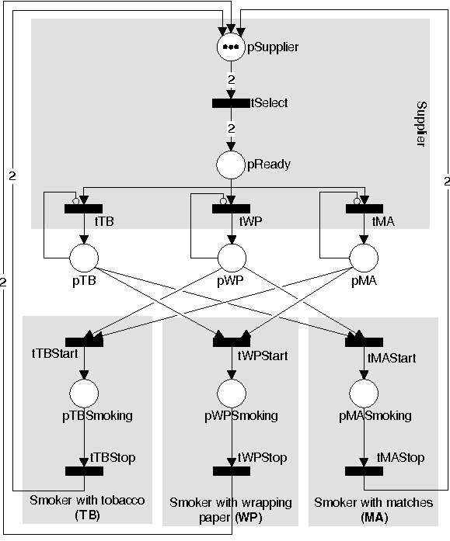
Petri Net Solution
Nets with inhibitor arcs

Slide 28
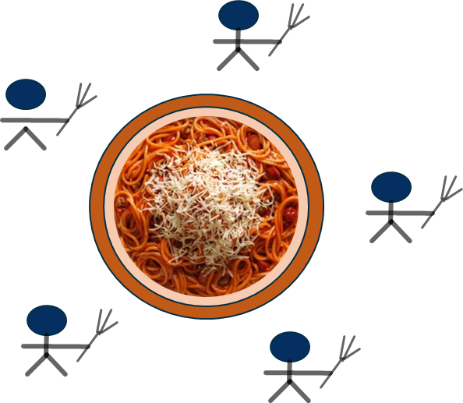
Dining Siblings
Another classic
5 siblings around a table … they share a meal from a communal pot
The pot contains M servings of sibling fodder.
Each sibling has a fork (and we assume, a bowl plate),
which is all one needs to eat.
Each sibling goes to the pot, takes a serving of fodder (if the pot is not empty) and eats
When hungry again, each sibling goes back to the pot to take another portion and eats again.

Slide 29
Dining Siblings
Another classic
The chef keeps the pot filled. Chef fills the pot only when the pot becomes empty, and once cooking, Chef cooks enough to fill the pot full. Chef rests when done cooking.
A sibling wakes Chef when it tries to eat and finds the pot empty. They all then wait for Chef to cook up a pot-full before resuming eating.
As with the other problems, a solution is a program simulating the actors and actions in this scenario, synchronizing them to provide maximal concurrency while avoiding the issues that come with concurrency (deadlock, race conditions, starvation)

Slide 30
Dining Siblings
Another classic
https://stackoverflow.com/questions/70543411/dining-savages-problem-semaphores-and-mutexes

Slide 31
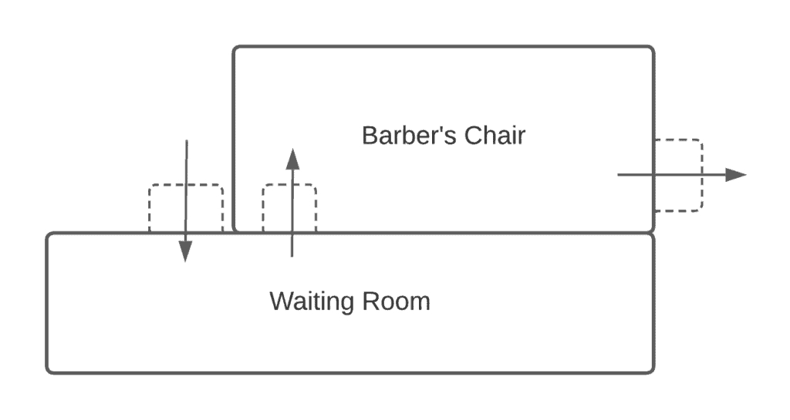

Sleeping Barber Problem
Yet another classic
shaggy
customers
Barber’s Chair
coiffed customers
… z z z z
Waiting Room
A barber has a shop with one chair for service.
The shop has several wait chairs customers can wait in
When the barber finishes one cut, that customer leaves; the barber begins to serve a customer from a waiting chair
When there are no customers, the barber sleeps (in his own chair)

Slide 32

Sleeping Barber Problem
Yet another classic
shaggy
customers
Barber’s Chair
coiffed customers
… z z z z
Waiting Room
Customers arrive randomly… an endless stream of shaggy people
When a customer enters the shop, they find one of 3 things:
barber is busy cutting hair, and a wait chair is open… so they sit and wait
barber is sleeping… so they wake the barber for a cut
barber is busy and all wait chairs are full… so they leave the shop
Solution: We must keep the barber working when there are customers, resting when there are none, and keep the waiting room working in an orderly fashion ( fair like FIFO, or at least no one sits waiting forever )

Slide 33
Cigarette Smokers Problem
And Yet Another Classic
Three smokers are sitting at a table.
One of them has tobacco, another has cigarette papers, and the third one has matches – each one has a different ingredient required to make and smoke a cigarette
Each may not give any ingredient to another
On the table in front of them, two of the three ingredients will be placed (from an infinite supply of all)
This now means one of the three smokers can make and use a complete cigarette

Slide 34
Cigarette Smokers Problem
And Yet Another Classic
The smoker who has the necessary third ingredient should pick up the ingredients from the table, make the cigarette and smoke it
A new 2-set of ingredients will not be placed on the table until this action is completed
The other two smokers who cannot make/smoke a cigarette will wait, and must not interfere with the one who can.
As with Dining Philosophers, a solution is a program that causes this cycle to operate endlessly without race conditions (corruption of the data state) and without deadlocks or starvations.

Slide 35
Readers-Writers Problem
A classic from Operating Systems

Slide 36
Producers-Consumers Problem
A classic from Operating Systems

Slide 37
END

Slide 38
Semaphore ( -ish )
Proposed by E. W. Dijkstra, 1962
Programming mechanism to control mutually exclusive access of concurrent tasks on a shared resource
An integer which in its simplest form is binary… contains 0 or 1
Initialized to 1, and counts the number of available “free” resources
Two standard atomic operations: wait (P), and signal (V)
P (Semaphore s) {
// process wants to use a critical resource
while (s <= 0) {
// no operation
// some other task has shared resource
}
s-- ; // atomic
// num in critical section, has access to
// the shared resource
}
V (Semaphore s) {
s++ ; // atomic
// task doing the V is releasing the shared
// resource, and leaving the critical section
}
almost . . .
“spin waiting”

Slide 39
Semaphore
Fix for spin wait: task queue
Every semaphore has an associated queue of tasks/threads
Spin wait is replaced with a task being suspended and waiting inactive is a queue of tasks; if s == 0 ( the resource is busy ) the task is put on the queue
All tasks in queue are waiting on the same semaphore, waiting for the protected resource to come available
Use FIFO queue to ensure lack of starvation (every task eventually gets the resource)
V op checks queue and wakes first task… or else increments s variable
P (Semaphore s) {
// process wants to use a critical resource
if (s <= 0) {
// this task is put on s wait que
// and suspended
}
// when task gets here, it has been taken
// off s wait que and awakened (OS op)
s-- ; // atomic
}
V (Semaphore s) {
if empty(s.que) { s++ }
else {
// head of s.que is taken off
// and awakened to execute here
}

Slide 40
Semaphore Variant ( generalization )
Mutex, and more than 1 resource
Semaphore initialized to 1 is called a binary semaphore
This often colloquially termed a “mutex” or “mutex lock”
Mutex is binary ... resource is locked, or not
Assumption in using a true mutex is that the task that takes the lock must also be the task that releases the lock
Semaphore can generalize to cover more than one resource
Simply initialize the semaphore value to more than 1… e.g. if you have K of some resource that requires mutual exclusion then set s=K to start.
Each P operation decrements s, until s becomes 0, which signals that K tasks are using the K resources concurrently
Each V operation increments s.
Semaphore initialized to K > 1 is called a counting semaphore

Slide 41
Monitor
( wiki )
Concurrency control mechanism
Per Brinch Hansen, C.A.R. Hoare (c. 1973)
Class-like structure wrapping a shared resource, allowing locking and mutual exclusion (mutex)
Also gives threads the ability to wait (block) for a certain condition to become false.
A monitor consists of a mutex (lock) object and condition variables.
A condition “variable” essentially is a container of threads that are waiting for a certain condition.
Monitors provide a mechanism for threads to temporarily give up exclusive access in order to wait for some condition to be met, before regaining exclusive access and resuming their task.

Slide 42
Monitor
Overall Pattern
monitor class Account {
private int balance := 0 invariant balance >= 0
public method boolean withdraw(int amount)
precondition amount>=0 {
if balance < amount { return false }
else {
balance := balance - amount
return true
}
}
public method deposit(int amount)
precondition amount >= 0 {
balance := balance + amount
}
}

Slide 43
Monitor
Internal effect is this
class Account {
private lock myLock
private int balance := 0 invariant balance >= 0
public method boolean withdraw(int amount) precondition amount >= 0 {
myLock.acquire()
try {
if balance < amount { return false }
else {
balance := balance - amount
return true
}
} finally { myLock.release() }
}
public method deposit(int amount) precondition amount >= 0 {
myLock.acquire()
try { balance := balance + amount }
finally { myLock.release() }
}
}

Slide 44
Mutex not enough
Threads can deadlock
In general, threads attempting some op in a monitor may need to wait until some condition P holds on the state of the monitor’s shared data
A busy waiting loop wont work here
while not( P ) do skip
Why not?
A thread doing this is in the monitor, and has the mutex lock
Thus, no other thread can enter the monitor to change the data state and make P true
Need a way to pause the thread, and then signal it back to running when the condition P is true (or could be true).
condition variables

Slide 45
Example Issues
Busy Waiting
global RingBuffer queue; // A thread-unsafe ring-buffer of tasks
// Method representing each producer thread's behavior
public method producer() {
while (true) {
task myTask = ...; // Produce some new task to be added
while (queue.isFull()) {} // Busy-wait until the queue is non-full
queue.enqueue(myTask); // Add the task to the queue
}
}
// Method representing each consumer thread's behavior
public method consumer() {
while (true) {
while (queue.isEmpty()) {} // Busy-wait until the queue is non-empty
myTask = queue.dequeue(); // Take a task off of the queue
doStuff(myTask); // Go off and do something with task
}
}
race conditions, mess up queue state

Slide 46
Example Issues
Spin Waiting (spin lock)
a mutex is used to protect the critical sections of code
busy-waiting is still used
the lock is acquired and released in between each busy-wait check
global RingBuffer queue; // A thread-unsafe ring-buffer of tasks
global Lock queueLock; // A mutex for the ring-buffer of tasks
// Method representing each producer thread's behavior
public method producer() {
while (true) {
task myTask = ...; // Producer makes some new task to be added
queueLock.acquire(); // Acquire lock for initial busy-wait check
while (queue.isFull()) { // Busy-wait until the queue is non-full
queueLock.release();
// Drop the lock temporarily to allow a chance for other threads
// needing queueLock to run so that a consumer might take a task
queueLock.acquire(); // Re-acquire lock for the next call to "queue.isFull()"
}
queue.enqueue(myTask); // Add the task to the queue
queueLock.release(); // Drop queue lock until we need it again to add the next task
}
}

Slide 47
Example Issues
Spin Waiting
// Method representing each consumer thread's behavior
public method consumer() {
while (true) {
queueLock.acquire(); // Acquire lock for initial busy-wait check
while (queue.isEmpty()) { // Busy-wait until the queue is non-empty
queueLock.release();
// Drop the lock temporarily to allow a chance for other threads
// needing queueLock to run so that a producer might add a task
queueLock.acquire(); // Re-acquire the lock for the next
// call to "queue.isEmpty()"
}
myTask = queue.dequeue(); // Take a task off of the queue
queueLock.release(); // Drop queue lock until need it
// again to take off the next task
doStuff(myTask); // Go off and do something with the task
}
}

Slide 48
Example Issues
Spin Waiting
Well, it’s a solution: assures inconsistent shared state does not occur
But it’s not an efficient solution
wastes CPU resources due to so much busy-waiting
even if the queue is empty and producer threads have nothing to add for a long time, consumer threads are always busy-waiting (for nothing)
likewise, if consumers are blocked for a long time on current tasks and the queue is full, producers are busy-waiting, consuming CPU cycles
need a way to make producer threads block until the queue is non-full, and a way to make consumer threads block until the queue is non-empty.

Slide 49
Monitor Condition Variables
These are pools (queues) of threads
Conceptually a condition variable is a queue of threads, associated with a mutex, on which a thread may wait for some condition to become true
Each condition variable c is associated with an assertion Pc
While a thread is waiting on some c , that thread is not considered to occupy the monitor . . . so other threads may enter the monitor to change the monitor's state
In most types of monitors, these other threads may signal the condition variable c to indicate that assertion Pc is true in the current monitor data state.

Slide 50
signal c, also known as notify c
Monitor Condition Variables
Three main operations on condition variables
wait c, m
where c is a condition var and m is a mutex (lock) of the monitor
signal c ( also known as notify c )
called by a thread to indicate that the assertion Pc is true
broadcast c ( also known as notifyAll c )
similar op to signal, but wakes up all threads in c's wait-queue

Slide 51
Nondeterminism
public class NonDeterminism {
public static void main(String[] args) throws InterruptedException {
class Container { public String value = "Empty"; }
final Container container = new Container();
class FastThread extends Thread {
public void run() { container.value = "Fast"; }
}
class SlowThread extends Thread {
public void run() {
try { Thread.sleep(50); } catch(Exception e) {}
container.value = "Slow";
} }
FastThread fast = new FastThread();
SlowThread slow = new SlowThread();
fast.start(); slow.start();
fast.join(); slow.join();
System.out.println(container.value);
} }

Slide 52
Thread Control
Methods to control thread execution and state
These methods are from Thread class
public static void sleep( long millis ) throws InterruptedException
public static void yield( )
public final void join( ) throws InterruptedException
public final void setPriority( int newPriority )
Methods from Object class
public final void wait( ) throws InterruptedException
public final void notify( )
public final void notifyAll( )

Slide 53
Task Synchronization Issues
Issues of concurrent tasks interfering on shared data
Busy waiting (spin waiting)
Race conditions
Deadlock
Starvation
Ways to keep tasks from doing this
Test-and-set ( hardware atomic, also software version)
Spin waiting
Mutex lock
Semaphores
Monitors

Slide 54
Deadlock
public class Deadlock {
public static void main(String[] args) throws InterruptedException {
class Account {
int balance = 100;
public Account(int balance) { this.balance = balance; }
public synchronized void deposit(int amount) { balance += amount; }
public synchronized boolean withdraw(int amount) {
if (balance >= amount) { balance -= amount; return true; }
return false;
}
public synchronized boolean transfer(Account destination, int amount) {
if (balance >= amount) {
balance -= amount;
synchronized(destination) { destination.balance += amount; };
return true;
}
return false;
}
public int getBalance() { return balance; }
}

Slide 55
Deadlock ( cont. )
final Account bob = new Account(200000);
final Account joe = new Account(300000);
class FirstTransfer extends Thread {
public void run() {
for (int i = 0; i < 100000; i++) {
bob.transfer(joe, 2);
} } }
class SecondTransfer extends Thread {
public void run() {
for (int i = 0; i < 100000; i++) {
joe.transfer(bob, 1);
} } }
FirstTransfer thread1 = new FirstTransfer();
SecondTransfer thread2 = new SecondTransfer();
thread1.start(); thread2.start();
thread1.join(); thread2.join();
System.out.println("Bob's balance: " + bob.getBalance());
System.out.println("Joe's balance: " + joe.getBalance());
}
}

