Slide 1
CollectiveGood MD
Introduction and Usage Tutorial

Slide 2
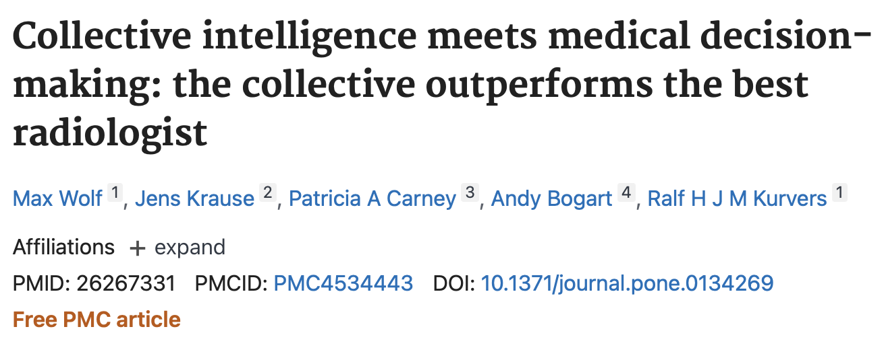
The diagnostic opinions generated from collective intelligence of all levels of medical professionals (registered nurses, physician’s assistants, etc.) are often as accurate as a diagnosis from a higher-ranking physician.

Slide 3
Welcome to CollectiveGood
CollectiveGood MD has been developed to assist physicians in medical decision-making by providing a platform that makes it easier to connect to other physicians and hone your own diagnostic skills.
By using the CollectiveGood interface, you can easily access this collective body of knowledge to support your decision-making without having to consult physicians on your own time.
Notes:
CollectiveGood MD has been developed to assist physicians in medical decision-making by providing a platform that makes it easier to connect to other physicians and hone your own diagnostic skills.
There is an emerging body of literature in medicine showing that diagnostic opinions generated from collective intelligence of all levels of medical professionals (registered nurses, physician’s assistants, etc.) are often as accurate as a diagnosis from a higher-ranking physician.
By using the CollectiveGood interface, you are able to easily access this collective body of knowledge to support your decision-making without having to consult a large number of physicians on your own time.

Slide 4
Three main features:
Skill-Building
Case Submission
Case Review

Slide 5
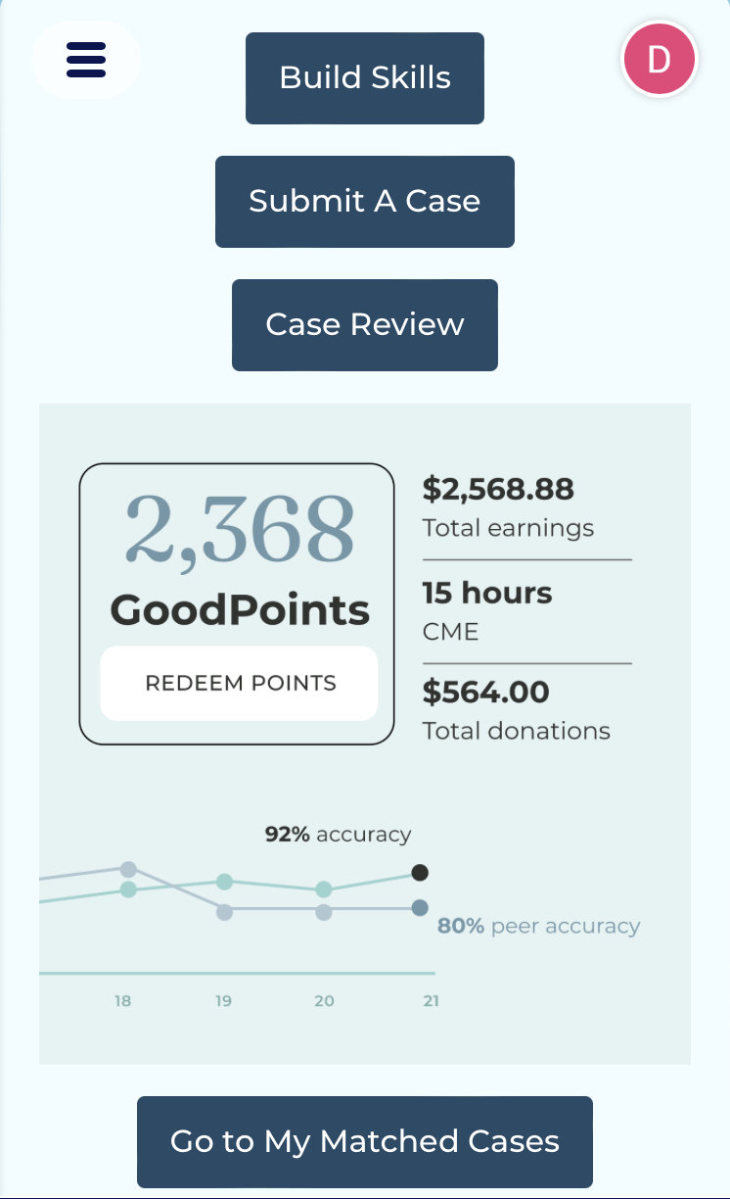
Home Screen
When you first enter the app, you are presented with a summary of your profile statistics.
Your profile can be explored in more depth through the profile page, which can be found through the navigation menu.
There are also buttons on the home page that take you to the different features of the application. Click on the Build Skills button to demo this function.
(SS of home screen)

Slide 6
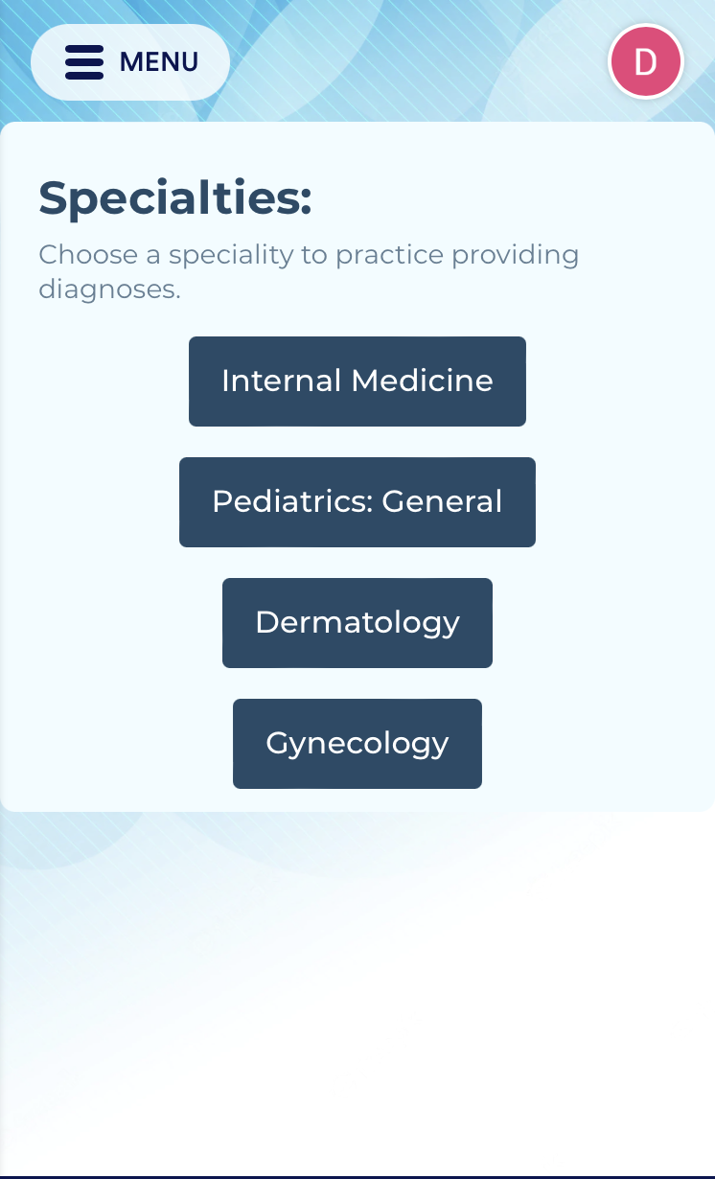
Skill-Building
Upon opening the Build Skills page, you are prompted to select a medical speciality that you would like to focus on for that learning session.
When you choose a speciality, you will only be shown cases from that specialty and will receive scores for the learning session that signify your progress in that area.
For demonstration purposes, each specialty is currently linked to the same form that is not area-specific. In the real application, specialty areas will show cases that are unique to the selected area of medicine.
(SS of build skills page)

Slide 7
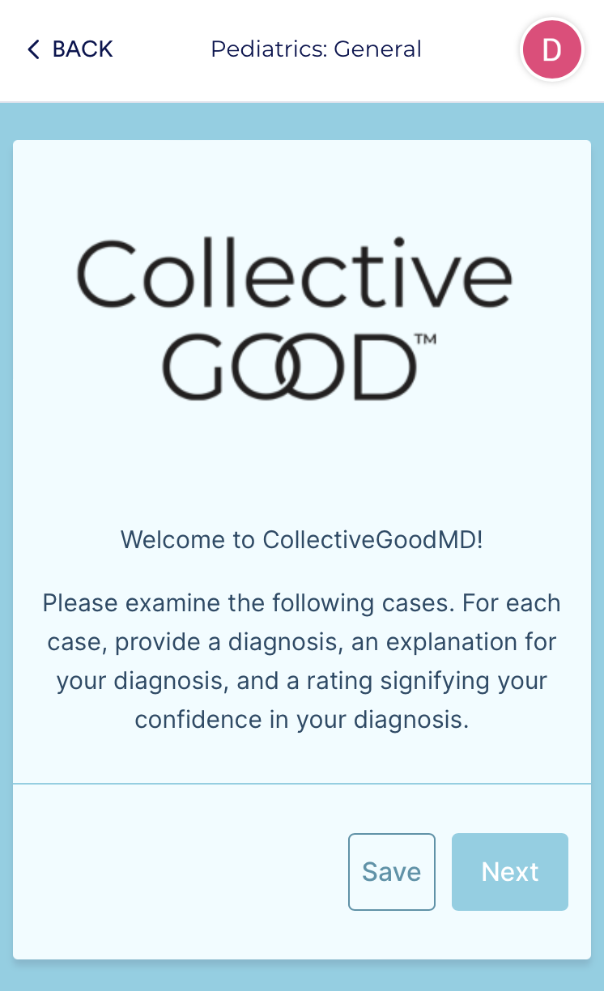
Once you select a specialty, you are shown a page that explains the skill—building functionality. After you have read through the instructions, clicking “next” will take you to your first case.
S of Described

Slide 8
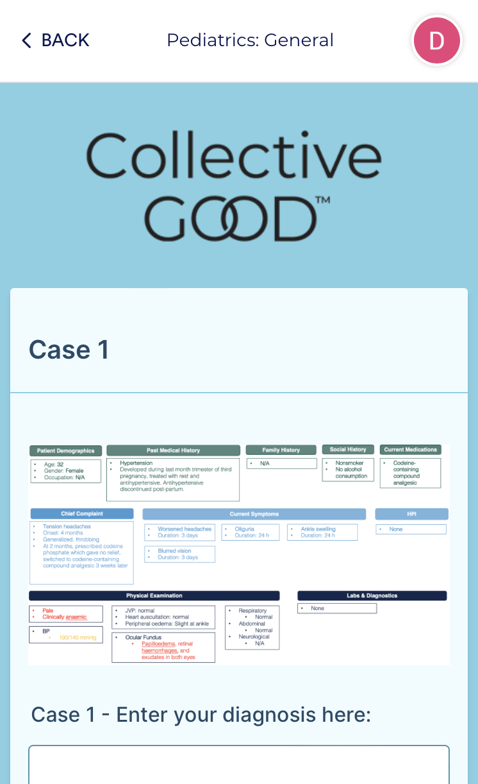
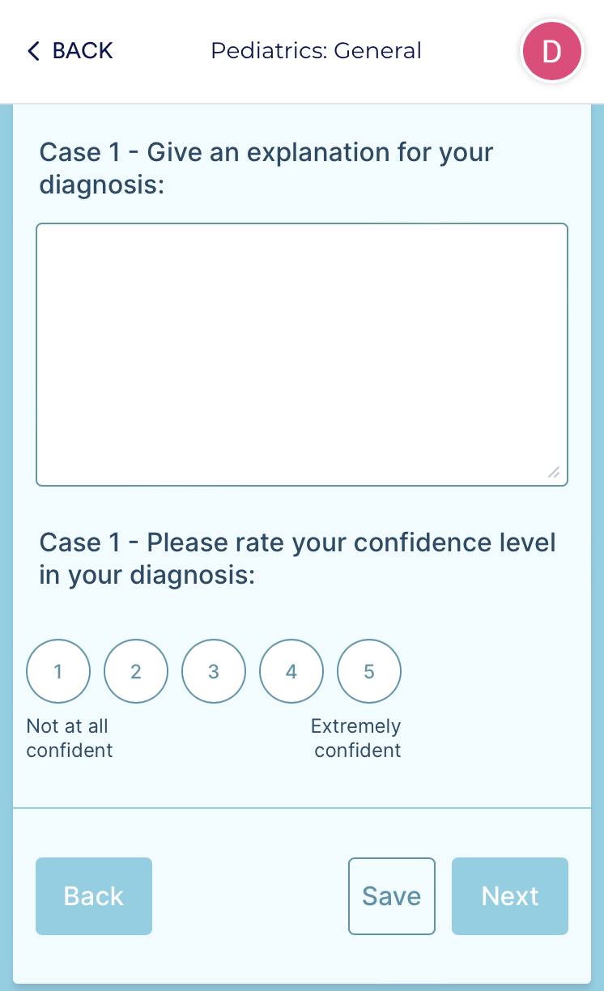
In the text boxes beneath the case, you will enter your diagnosis, as well as an explanation for the response that you provided and a numerical rating to signify how confident you are in your diagnosis.
SS of Described

Slide 9
After completing your first case, click next to save your responses and continue to the next case. You will be presented with a loading screen. Once you see a message that your “case has been found”, click continue to see the case.
Notes:
After completing the first case, click next to progress to the next case. You are shown a page that tells you it is “Finding the next case…” There will be an algorithm that will decide the next case you are shown based on your previous responses and your overall performance in the app. This will continue until you have submitted responses for all the cases in your learning session.

Slide 10
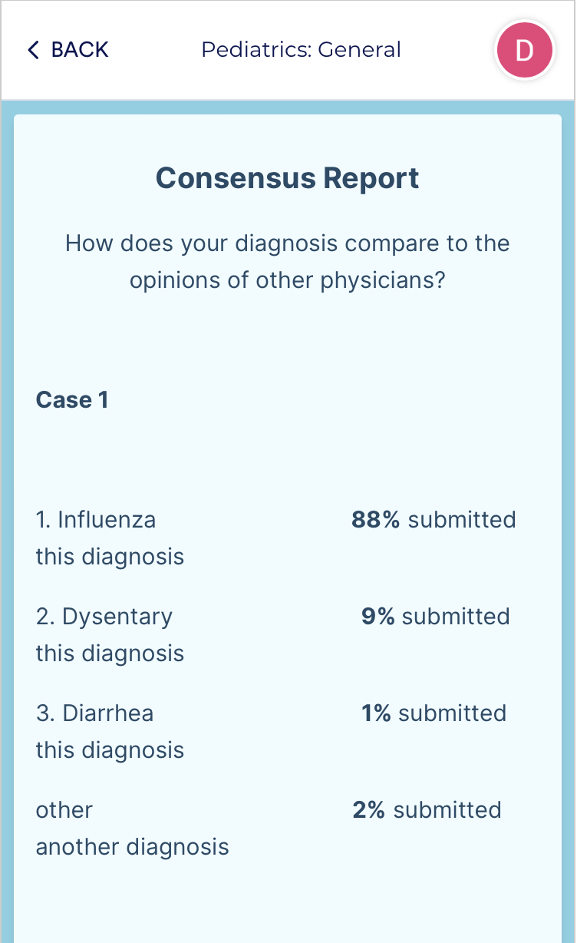
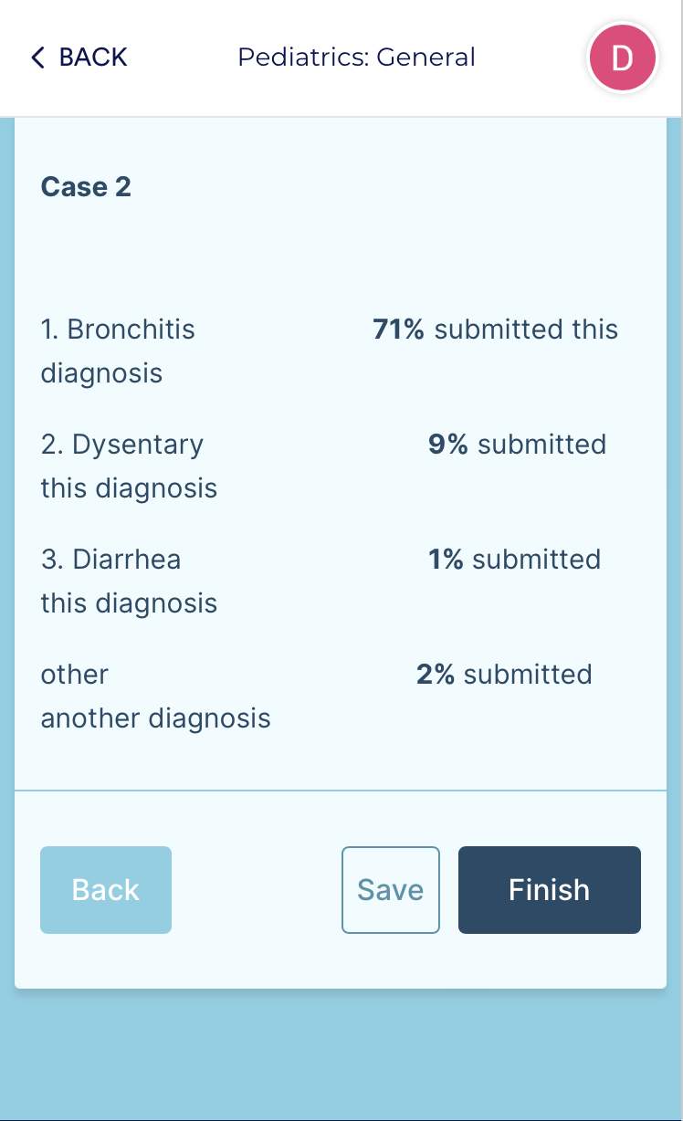
Diagnosis Results
After you have finished the learning session, you will be shown a summary page. The summary shows:
Your diagnosis
The percentage of other clinicians who gave the same diagnosis.
The top 3 other responses given by clinicians.
The percentage of clinicians who responded with a diagnosis other than the previously listed conditions.
(SS of described)
Notes:
After you have finished the learning session, you will be shown a summary page.
First, you are shown the diagnosis you gave, along with the percentage of other clinicians who gave that diagnosis.
Below your diagnosis, you are shown the top 3 other responses given by clinicians.
Finally, you are shown the percentage of clinicians who responded with a diagnosis other than the previously listed conditions.

Slide 11
After you click “Finish” at the bottom of the Diagnostic Results page, you are taken back to the home screen. Once you are back to the home screen, click the Submit a Case button to continue.

Slide 12
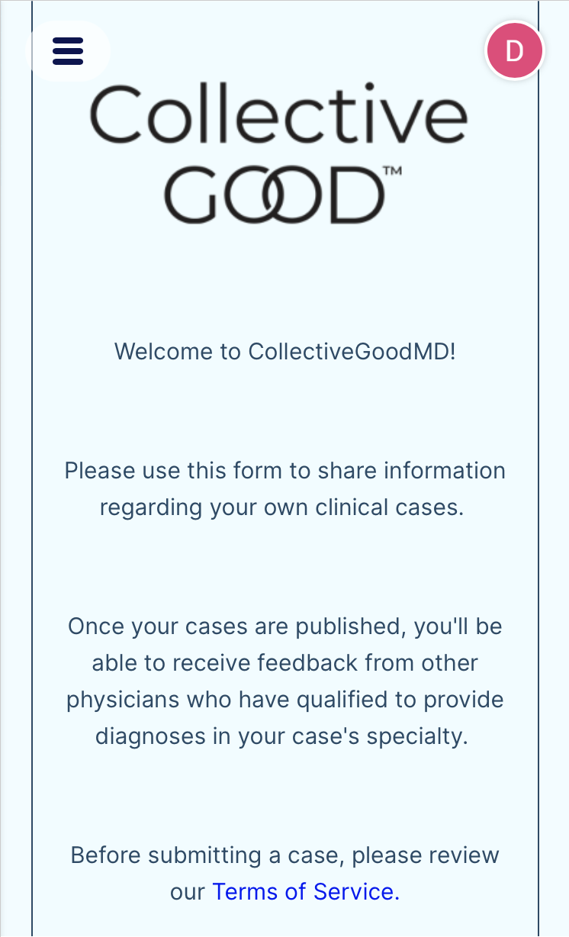
Submit a Case
Once you enter the Case Submission feature, you will be shown a screen with the CollectiveGood terms of services.
Once you have read and agreed to the terms of service, you can proceed to Case Submission
(SS of described)
Notes:
With the Submit a Case feature, you are able to submit cases from your own patients to get diagnostic opinions from other physicians using CollectiveGood MD
Similarly to the Build Skills feature, the process to submit a case also starts with an introductory page explaining the submission process
Begin by clicking “Enter My Case”. Once you begin the submission process, you are first prompted to enter the sex and date of birth of your patient. Please enter values and click next to continue

Slide 13
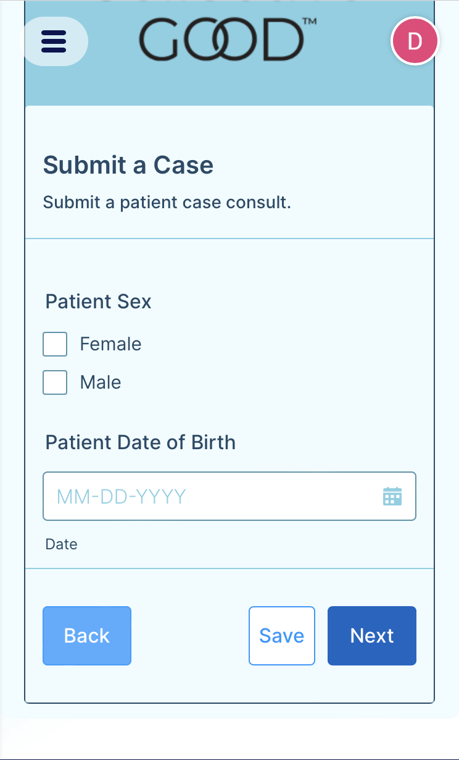
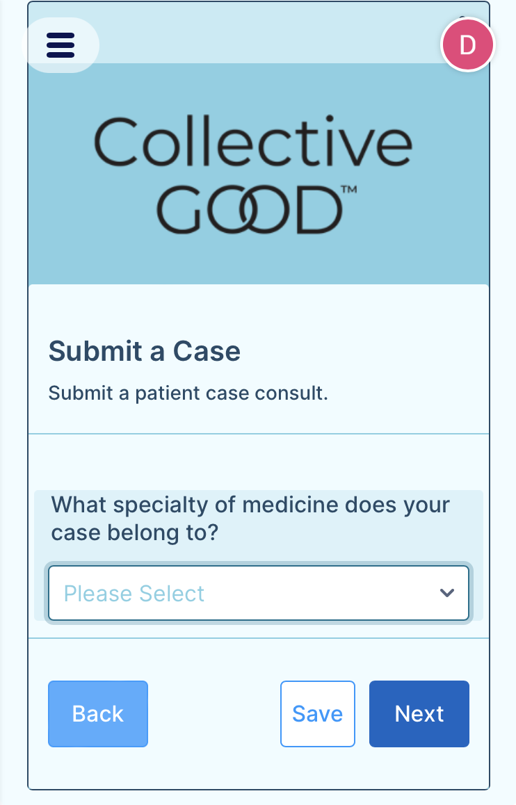
On the first page of the Case Submission feature, you will enter basic demographic information about your patient.
On the second page, you can select a medical specialty to assign to your case.
Notes:
On the following page, you pick a medical specialty to assign to your case. In the real application, you will be able to freely type in a text box and see dropdown options as you type, with the option to create a new specialty if the one you are looking for does not yet exist in our database

Slide 14
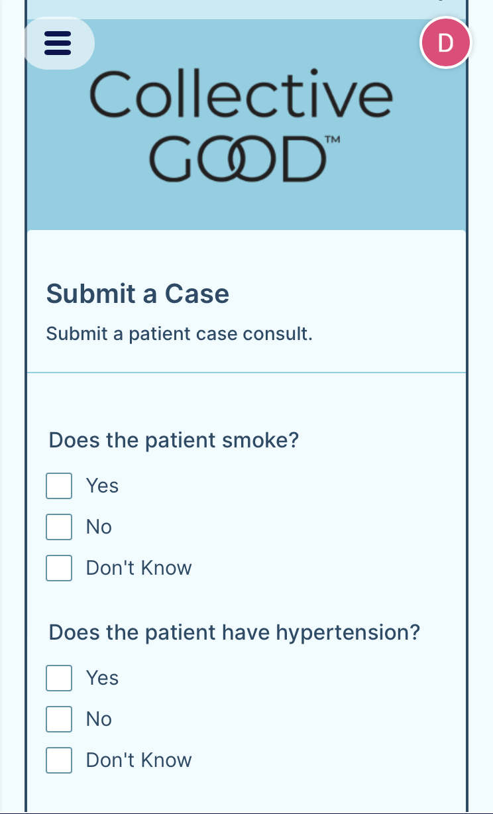
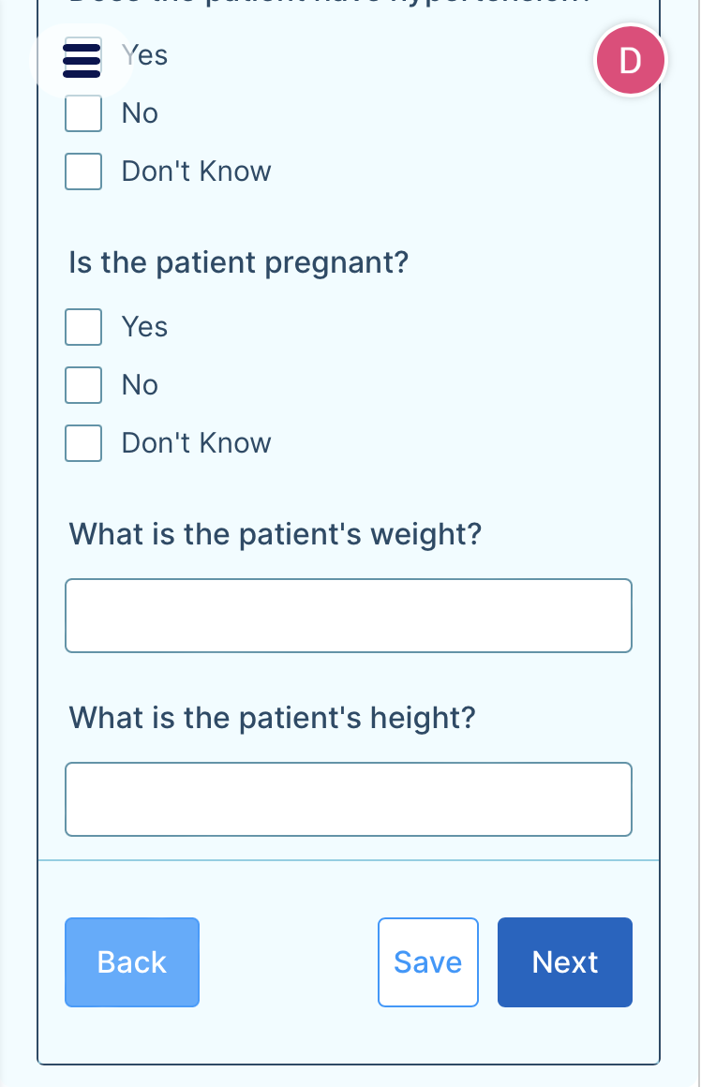
The following page allows you to enter more information about the patient’s health behaviors and basic information.
Notes:
On the following page, you pick a medical specialty to assign to your case. In the real application, you will be able to freely type in a text box and see dropdown options as you type, with the option to create a new specialty if the one you are looking for does not yet exist in our database

Slide 15
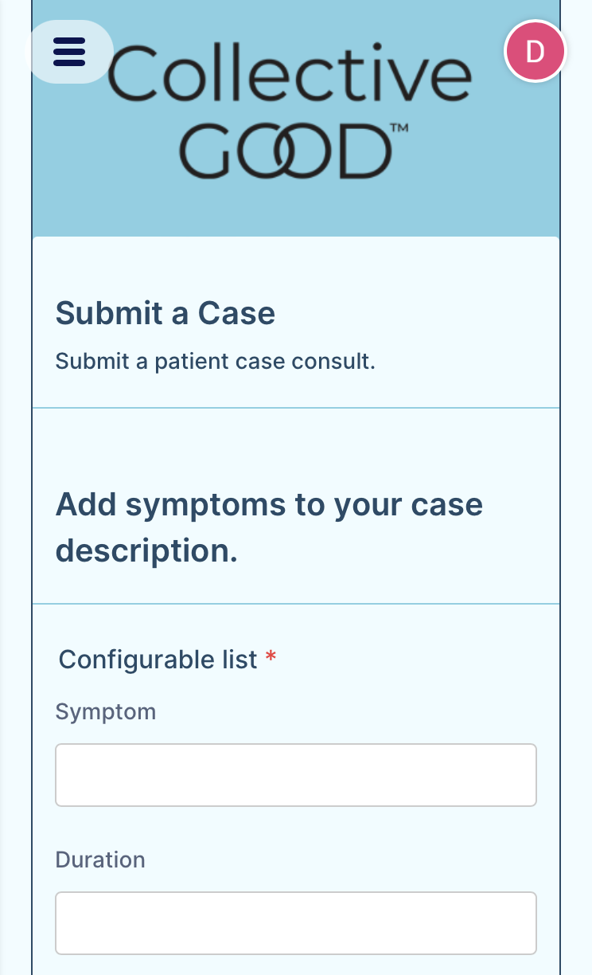
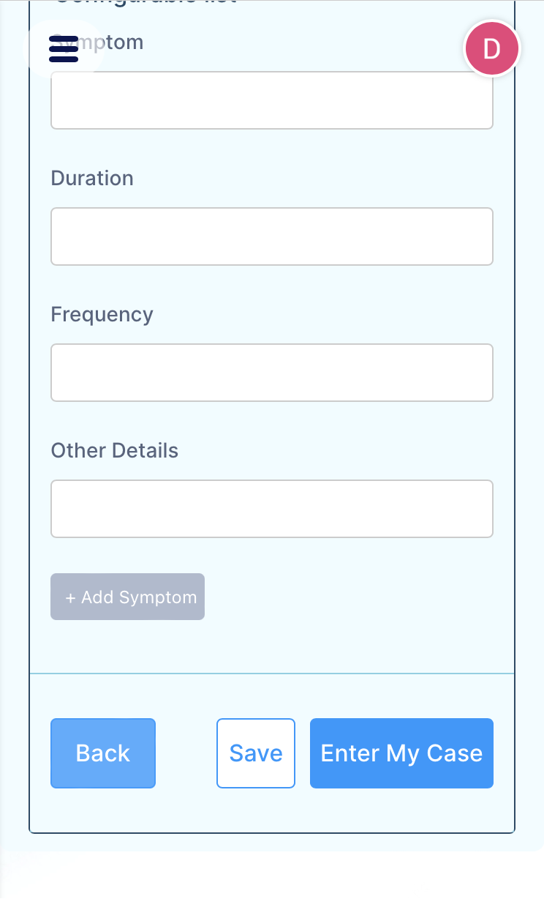
The next screen provides the opportunity to enter custom symptoms for your case.
Once you have entered the information on this page, you are finished with the case submission process. Clicking “Enter My Case” will ensure your case is recording and return you to the homepage.
Notes:
On the following page, you pick a medical specialty to assign to your case. In the real application, you will be able to freely type in a text box and see dropdown options as you type, with the option to create a new specialty if the one you are looking for does not yet exist in our database

Slide 16
Once you have returned the homepage, navigate to the “Case Review” button to explore the diagnostic feature of the application.

Slide 17
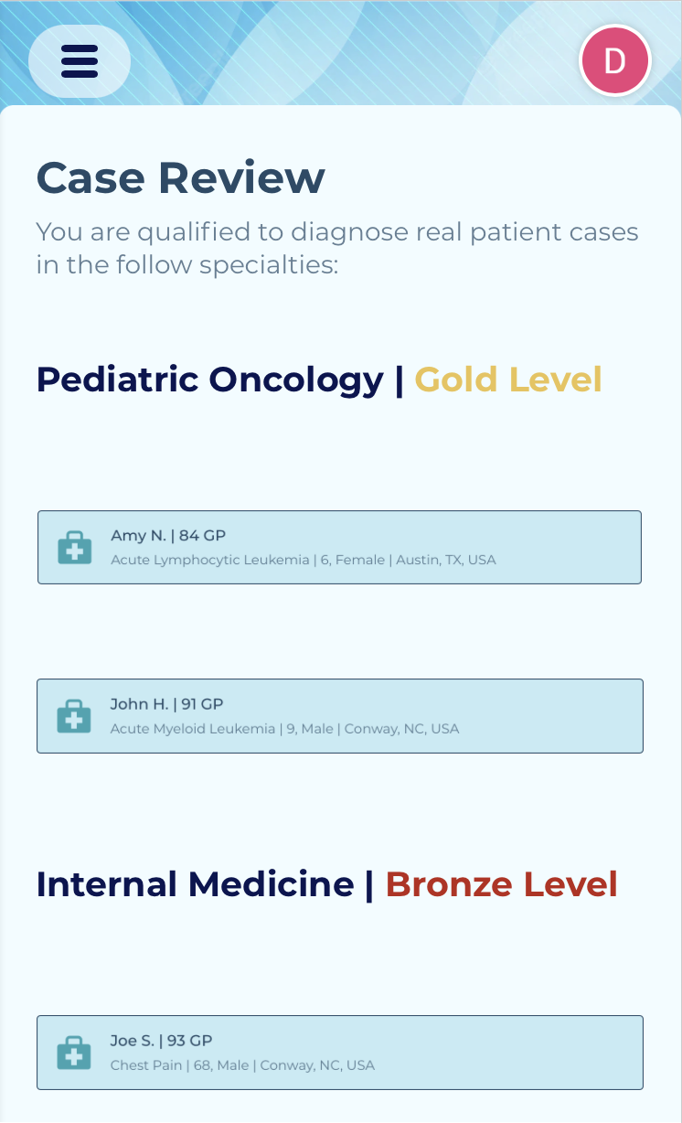
Case Review
(SS of described)
The main page of the Case Review feature displays the cases you are qualified to diagnose based on your performance in the application so far, organized by specialty.
To review a case, simply click on any of the suggested cases to view in more detail.
Notes:
With the Submit a Case feature, you are able to submit cases from your own patients to get diagnostic opinions from other physicians using CollectiveGood MD
Similarly to the Build Skills feature, the process to submit a case also starts with an introductory page explaining the submission process
Begin by clicking “Enter My Case”. Once you begin the submission process, you are first prompted to enter the sex and date of birth of your patient. Please enter values and click next to continue

Slide 18
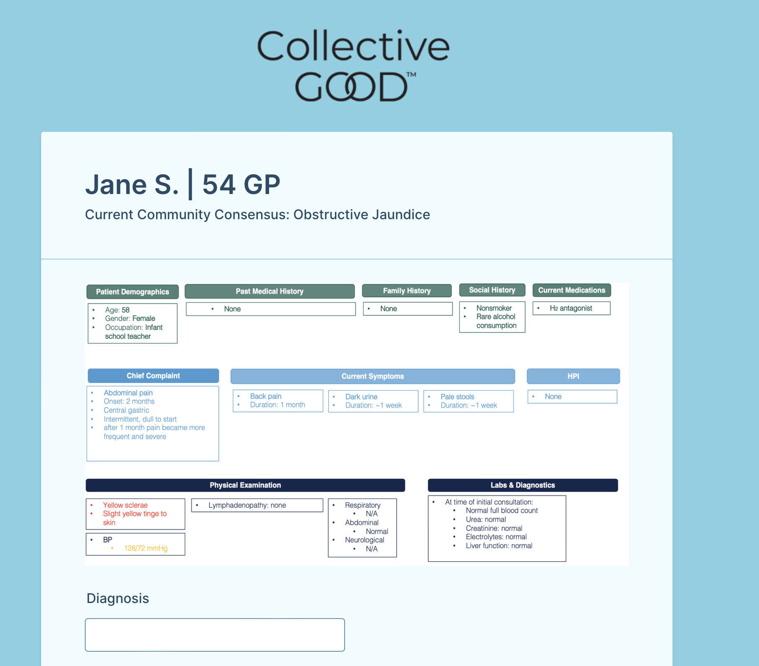
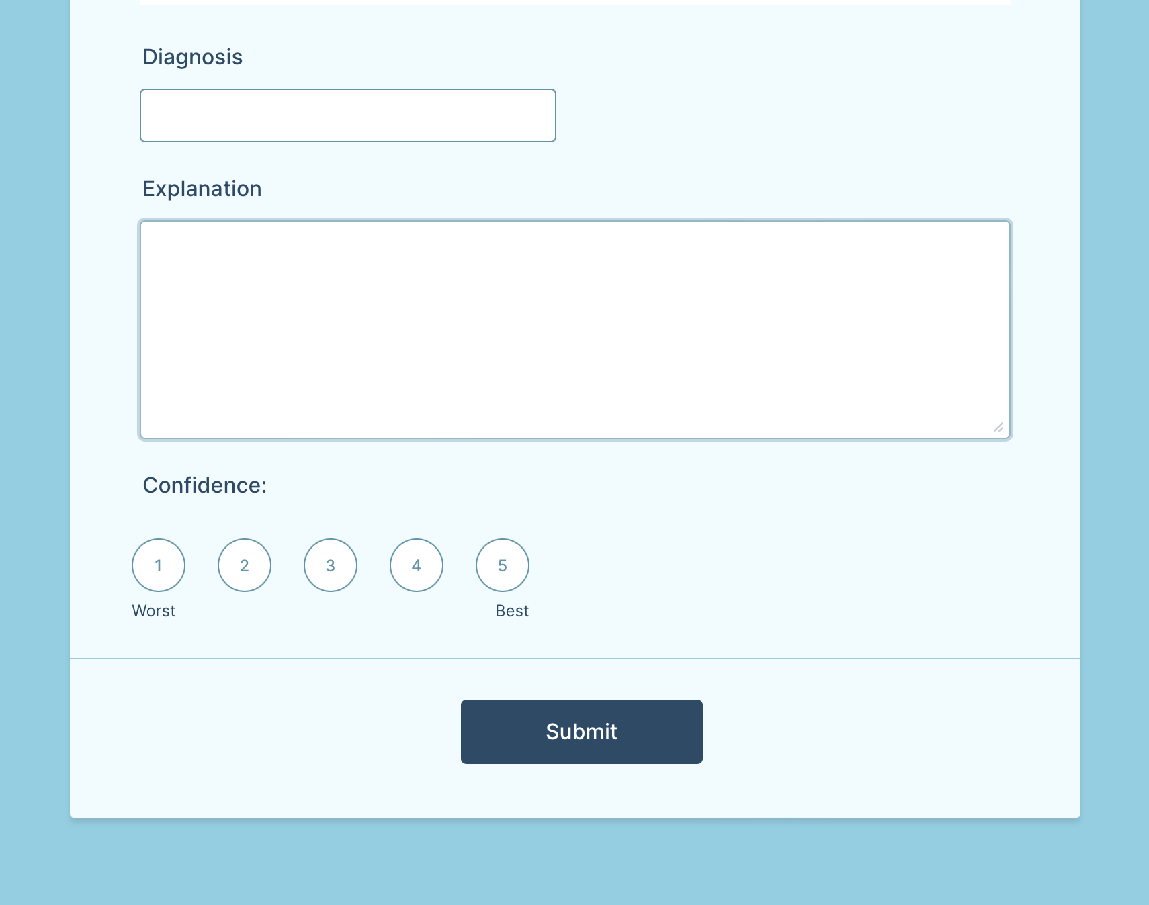
Once you select a case, you will be shown an in-depth database-view description of the case, as well as text boxes to enter a diagnosis, explanation of diagnosis, and confidence level.

Slide 19
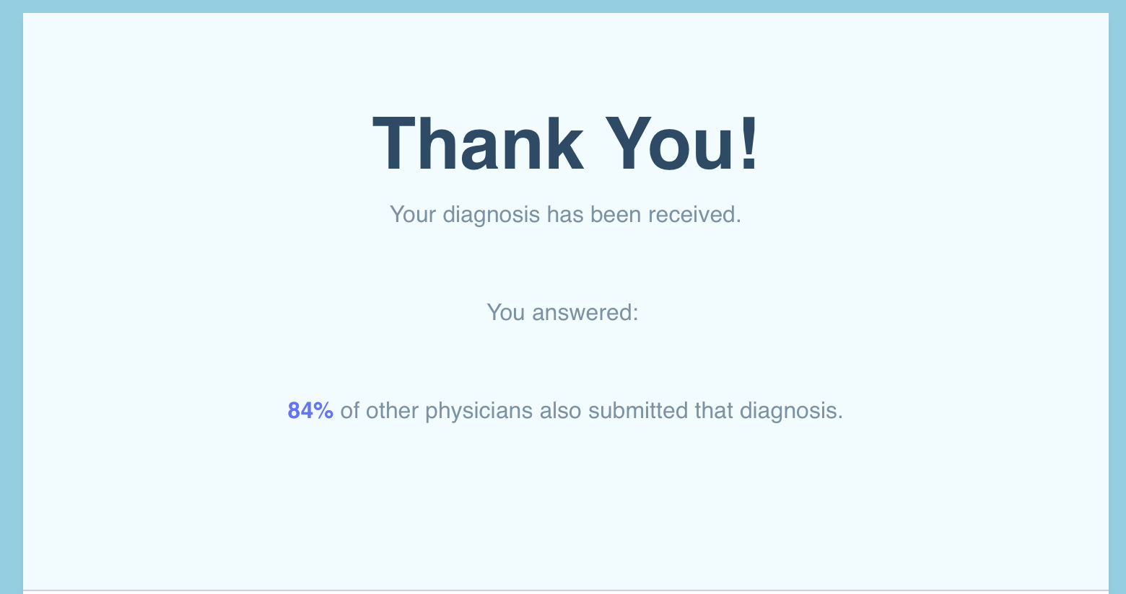
Once you submit your case, you will see a thank you screen confirming your submission, as well a report of the percentage of physicians who submitted the same diagnosis.
Navigate back to the application by closing out of the pop-up tab.

Slide 20
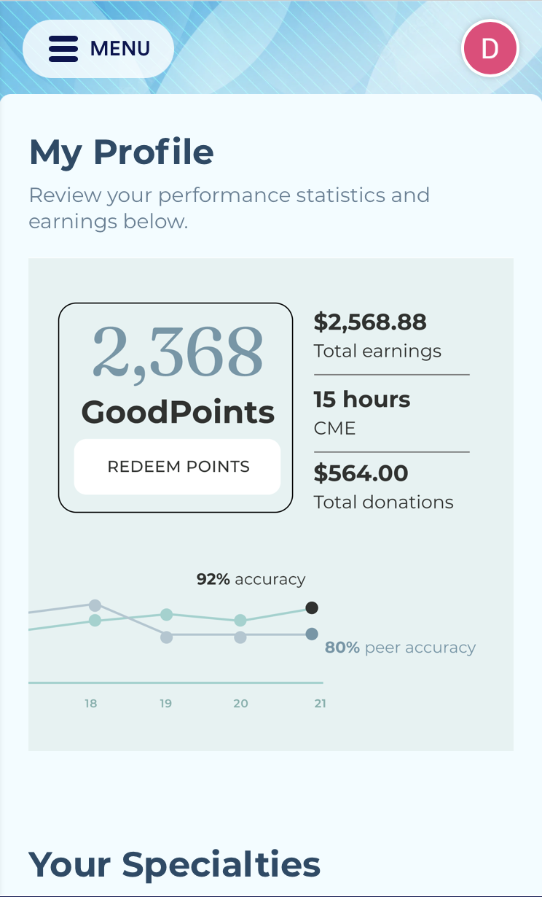
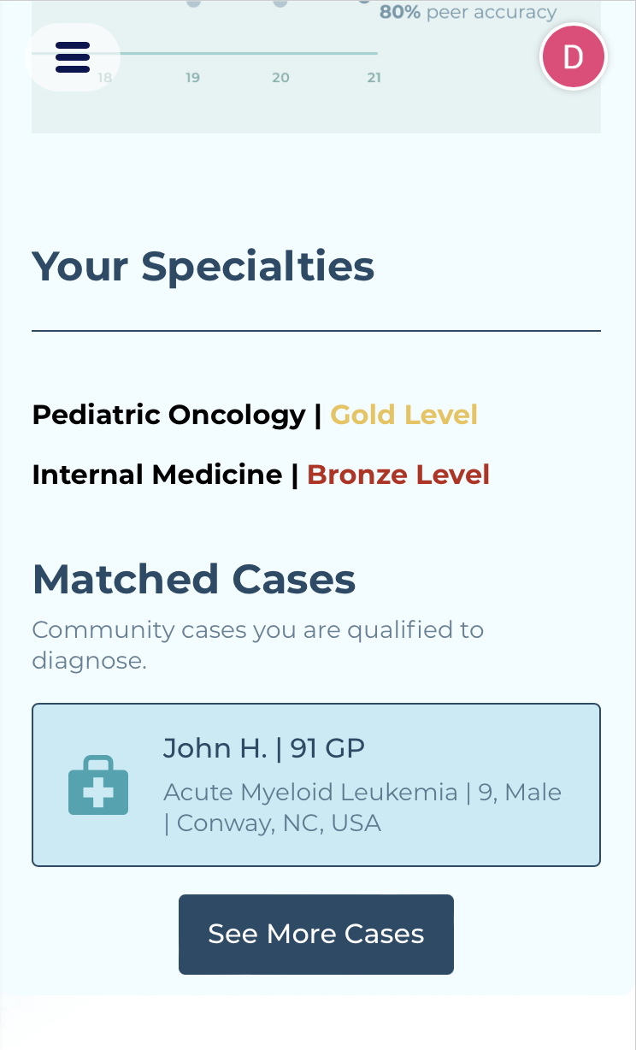
Personal Profile
(SS of personal Profile Page)

Slide 21
Profile
Your account profile will show a summary of your learning progress through multiple statistics.
Running total of GoodPoints
Total monetary earnings from your time on the application
Total continuing medical education (CME) hours you have earned
Total monetary amount of donations you have made through the platform
Ss pointing out statistics on profile
Notes:
These numbers are not accurate in the prototype, but will be a true reflection of your performance in the actual application.

Slide 22
Profile
Ss pointing out statistics on profile
You can also view your progress in different specialties on this page, as well as preview cases that have been matched to you for diagnosis based on your performance on the application.
Notes:
These numbers are not accurate in the prototype, but will be a true reflection of your performance in the actual application.

Slide 23
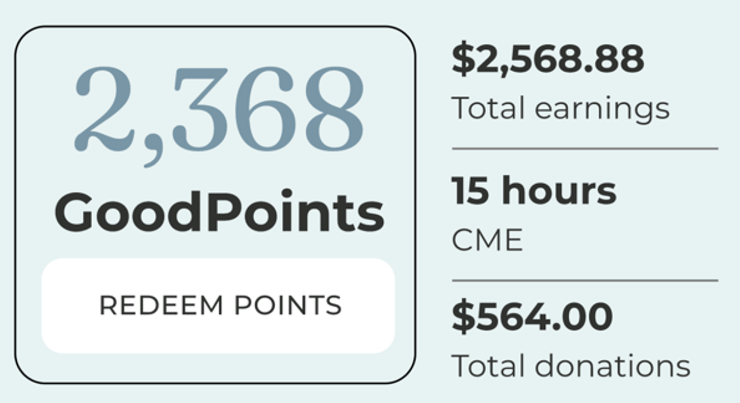
GoodPoints are one of the ways you can reap the benefits of your learning on the CollectiveGood app. As you use the features of the app, you can earn GoodPoints to “cash in” either as personal monetary earnings, CME hours, or donations to a charity of your choice. The value of the recommended case diagnosis is indicated next to the name of the patient Each case that you diagnose will have a different number of GoodPoints available You can also earn GoodPoints by using the Build Skills function to diagnose the practice cases , and by submitting your own cases.

Slide 24
Thank you for taking to time to explore CollectiveGood
We are excited about the prospects this app provides to the medical field and are dedicated to giving this idea a chance to make an impact. We would appreciate your feedback on how to make its interface easier to navigate and effectively use so that the app can reach its full potential.

