Slide 1
Software and System Testing

Slide 2
Why do we care?
Epic Software Fails
Therac-25 (1985)
    6 massive radiation overdoses
Multiple space fiascos (1990s)
    Ariane V exploded after 40 seconds (conversion)
    Mars Pathfinder computer kept turning itself off (system timing)
    Patriot missile misquided (floating point accuracy)
Millenium bug (2000)
Microsoft attacks (ongoing)
NIST: cost to US, $59 billion (2002)

Slide 3
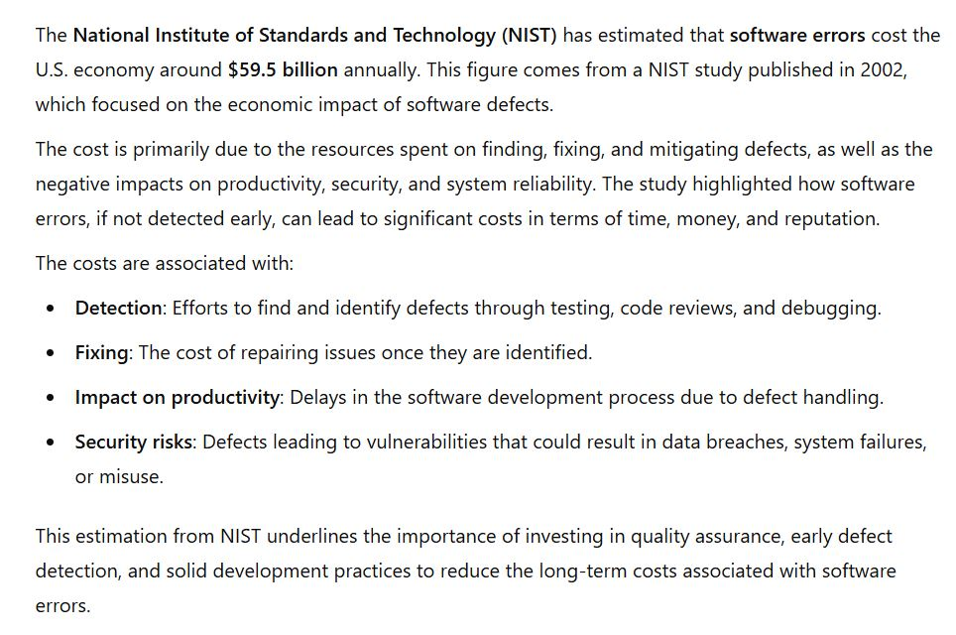
ChatGPT summary

Slide 4
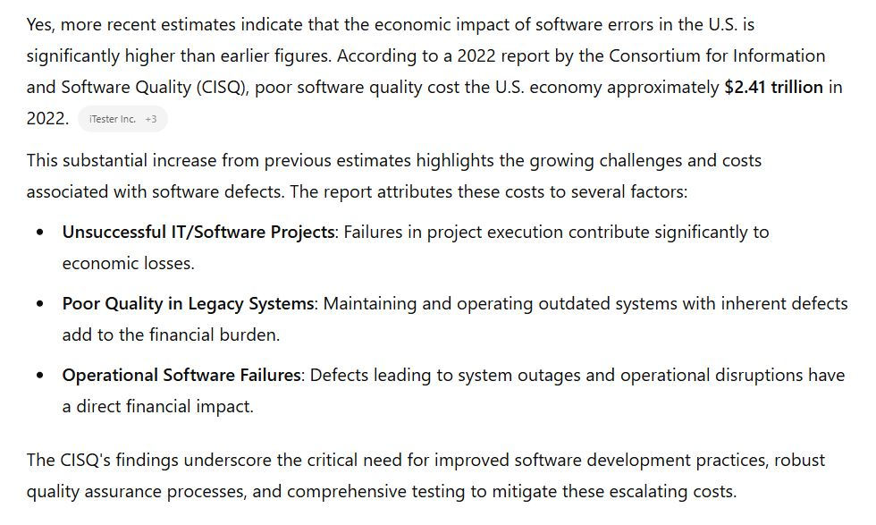
ChatGPT summary
Report link

Slide 5
Quality and testing
“Errors should be found and fixed as close to their place of origin as possible.” Fagan, Brooks, Beck, Boehm, everyone
“Trying to improve quality by increasing testing is like trying to lose weight by weighing yourself more often.” McConnell, in "Code Complete"
Software quality is far more that testing, but testing can contribute towards it
  Code quality, requirements quality, design quality, testing quality (!!)
  Performance, reliability
  Robustness, security
  Usability
  Documentation

Slide 6
Basic Software System Model
User interfaces
APIs
Operating system
Files
environment
capabilities
Input / Output
data structures
algo processing
"business logic"

Slide 7
Terminology
Different things / concepts in “testing”
faults
    - static flaws in source code (or design), findable before execution
errors
    - happen at execution time, when faults (or other issues) cause improper data state
    - also called fault activation
failures
    - visible indication of an error (in program environment)
    - observable deviation from correct behavior
When we say “testing” we often mean a collection of different activities designed to uncover as many of these as possible
Most widely used more specific meaning of “testing”
- executing code to reveal failures

Slide 8
Terminology
Faults → Errors → Failures
When we say “testing” we often mean a collection of different activities designed to uncover as many of these as possible
More specifically, we can make these distinctions
  Finding failures:
  Finding faults:
  Finding errors:
testing
debugging, code review, formal verification
error handlers, fault tolerance in PL

Slide 9
Types of Testing
For Different Purposes
Functional Testing ( unit, integration, system )
Usability testing
Acceptance testing
Performance testing
Stress testing
Reliability testing
Conformance testing (standards)
…

Slide 10
Other classifications
Scope
  unit, module, system, regression (time), …
Time
  after design/coding
  before (test-driven development, agile)
  during / mixed… and post deployment, ongoing
Code visibility / structure
  Black box: code treated as input/output function and no use of code structure is used (programming by contract)
  White box: code structure is used to determine test cases and coverage

Slide 11
How important is unit test?
The Voyager bug (sent the probe into the sun).
‘90: The AT&T bug that took out 1/3 of NYC telephones (crash on receipt of crash notice).
    The DCS bug that took out the another 1/3 a few months later.
‘93: The Intel Pentium chip bug (it was software, not hardware).
‘96: The Ariane V bug: auto-destruct (data conversion).

Slide 12
What are you trying to test?
Basic Functionality?
many techniques
Most common / likely actions?
Cleanroom (Harlan Mills)
Most costly/unacceptable problem areas?
Risk-based testing

Slide 13
Risks
Identify criteria of concern: availability, quality, performance, …
Risk of it not being met
    likelihood
    consequences
If I’m testing code for a grocery store, what is the impact of the code failing (or down)?
What about missile guidance?
What about nuclear power plant control?

Slide 14
Mills: Cleanroom
Test based on likelihood of user input
User profile: study users, determine most probable input actions and data values
Test randomly, drawing data values from the distribution (see monkey testing )
Means most likely inputs occur more often in testing
Finds errors most likely to happen during user executions

Slide 15
How to identify what to test
New features
New technology
Overworked developers
Regression
Dependencies
Complexity
Bug history
Language specific bugs
Environment changes
Late changes
Slipped in “pet” features
Ambiguity
Changing requirements
Bad publicity
Liability
Learning curve
Criticality
Popularity

Slide 16
Four Parts of Testing
Model
  establish the expected behavior ( "oracle" )
Select test cases
  choose the scenarios to test ( e.g., based on requirements )
Execute test cases
  run the tests and observe the results.
Measure
  compare results with expected outcomes to assess software quality

Slide 17
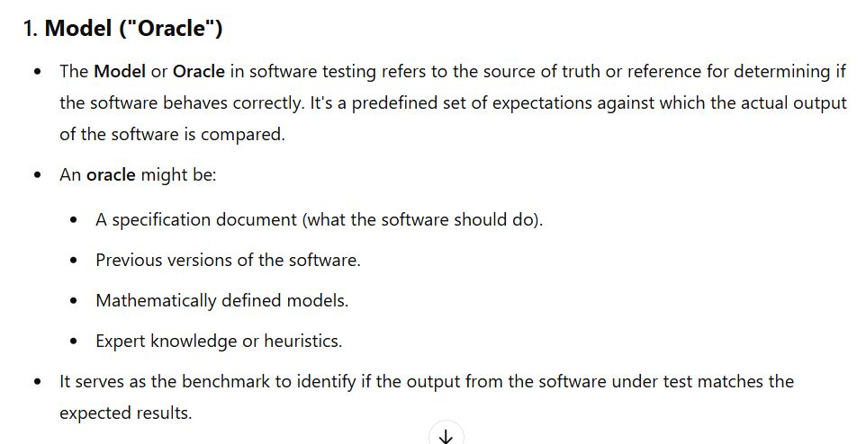
ChatGPT summary

Slide 18
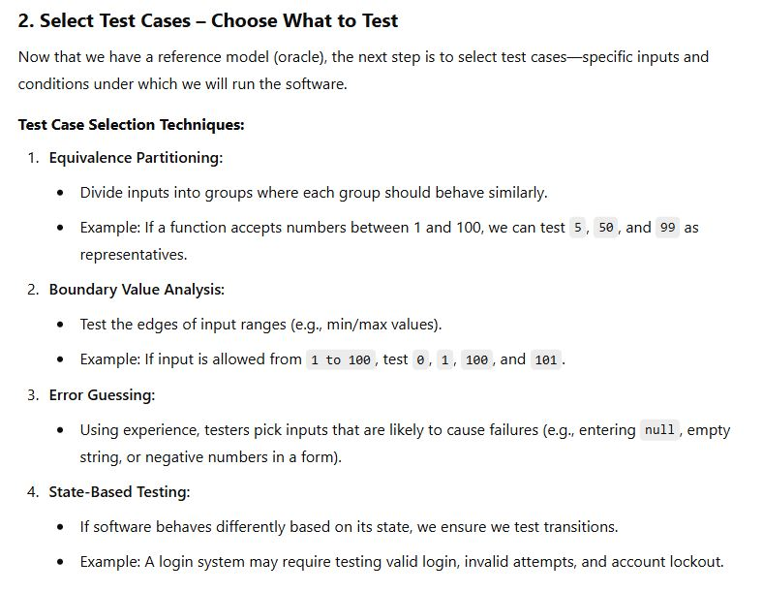
ChatGPT summary

Slide 19
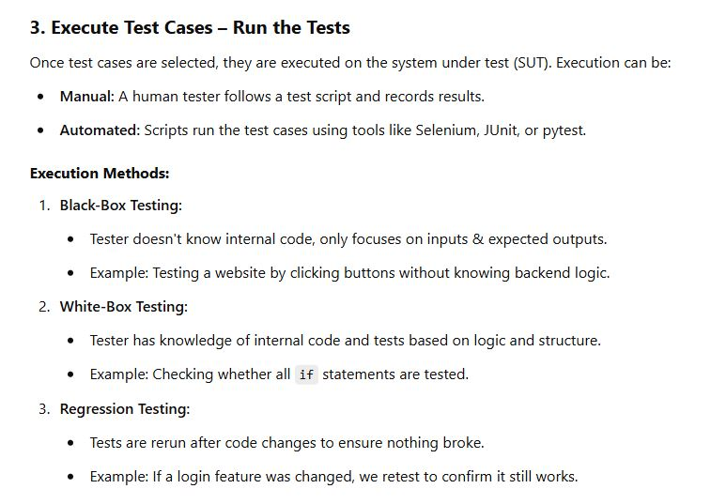
ChatGPT summary

Slide 20
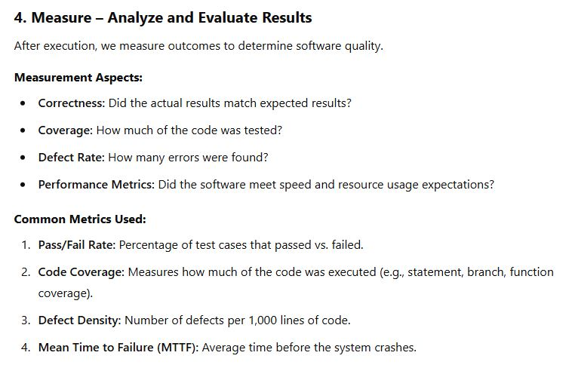
ChatGPT summary

Slide 21
Basic Software System Model
User interfaces
APIs
Operating system
Files
environment
capabilities
Input / Output
data structures
algo processing
"business logic"

Slide 22
Test Case Selection
Environment
  What happens if a file changes out from under you?
  Consider all error cases from system calls
    ( e.g., you can’t get memory allocated )
  Test on different platforms: software and hardware
  Test on different OS versions, and with different languages

Slide 23
Test Case Selection
Capabilities
  Inputs (boundary conditions, equivalence classes)
  What about unexpected inputs
  Outputs (can I generate a bad output?)
  States (reverse state exploration)
  Algo processing

Slide 24
From the User Interface: Inputs
Error messages
Default values
Character sets and data types
Overflow input buffers
Input interactions
Repeated inputs
Unlikely inputs
How easy is it to find bugs in Word?

Slide 25
Questions to Ask for Each Test
How will this test find a defect?
What kind of defect?
What failure or error do I hope to expose?
How powerful is this test against that type of defect? Are there more powerful ones?
Is there a test that will expose the error and give me information to help fix it?

Slide 26
Testing Practices (Boris Beizer)
Unit testing to 100% coverage: necessary but not sufficient for new or changed
Integration testing: at every step; not once
System testing: AFTER unit and integration testing
Testing to requirements: test to end users AND internal users
Test execution automation: not all tests can be automated
Test design automation: implies building a model. Use only if you can manage the many tests

Slide 27
Testing Practices (Boris Beizer)
Stress testing: only need to do it at the start of testing. Runs itself out
Regression testing: needs to be automated and frequent
Reliability testing: not always applicable. statistics skills required
Performance testing: need to consider payoff
Independent test groups: not for unit and integration testing
Usability testing: only useful if done early
Beta testing: not instead of in-house testing

Slide 28
Usability Testing
Evaluating a UI/UX design

Slide 29
Usability Testing
Testers watch for these issues:
Frequency with which the problem occurs
    common, or rare?
Impact of the problem if it occurs
    easy or difficult to overcome?
    insignificant, or damaging?
Persistence of the problem
    one-time occurrence, or repeated?

Slide 30
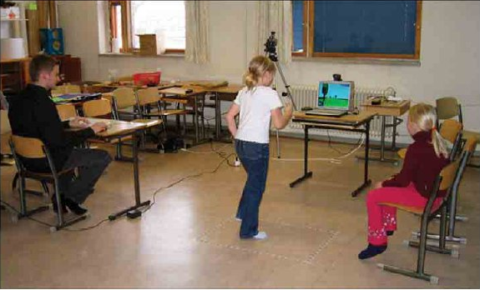
Wizard of Oz Testing
Inputs and outputs are as expected
How you get between the two is “anything that works”
Particularly useful when you have
  an internal interface
  choices to make on user interfaces
Children’s Intuitive Gestures in Vision-Based Action Games
CACM Jan 2005, vol. 48, no. 1, p. 47

Slide 31
Test Measurements

Slide 32
Test Coverage Metrics
Statement coverage
  Basic block coverage, or edges in control flow graph
Decision coverage (branch coverage)
  Each sense of each Boolean expression
Condition coverage
  Each entity varied in each Boolean expressions
Path coverage
  Loops, branch combinations
  Impractical, N items can have 2^N different paths
We get to see the code to guide testing, help with test case gen
These are “white box” methods

Slide 33
Statement/Block Coverage
A
A
x=9
x=2
x=9
x>5
x>5
Bt
Bf
Bt
C
C

Slide 34
Decision Coverage
A
A
x=9
x=2
x=9
x=2
x>5
x>5
Bt
Bf
Bt
C
C

Slide 35
Condition Coverage
A
x=9, y=20
Bt
Ct
x>5 &&
y <100
x<20 &&
y >10
D
Bf
Cf
x=2, y=20

Slide 36
Path Coverage
A
x=9, y=20
Bt
Ct
x>5 &&
y <100
x<20 &&
y >10
D
Bf
Cf
x=2, y=20

Slide 37
When can we stop testing?
Historical data
Capture-recapture model
Error seeding

Slide 38
Historical Data
Lots of variants based on statistical modeling
What data should be kept?
When are releases comparable?
Dangers with a good release (few bugs)
  test forever
  adversarial relation between developers and tester
Dangers with a bad release (lots of bugs)
  stop too soon

Slide 39
Error “seeding”
Also called mutation testing
Deliberately put errors into code (seeding)
Testing finds the seeded errors as well as "real" ones put there by developers
Percentage of seeded errors found is related to percentage of “normal” errors found

Slide 40
Capture-recapture model
Estimate animal populations: How many deer in the forest?
    Tag and recount
    If all tagged, assume you’ve seen them all
Applied to software by Basin in 73
Number of errors = |e₁| * |e₂| / |e₁ ∩ e₂ |
      where e_{n} = errors found by tester n
  2 testers: 25, 27, 12 overlap: 56 total errors
What’s wrong with this model (aside from the fact the denominator can be 0)?
  Assumptions about independence of testers

Slide 41
Test Tools

Slide 42
Unit Test
What do they do?
  Regression testing framework
  Incrementally build test suites
  Typically language specific
What is available?
  JUnit most well known (Java)
  SUnit was the first (Smalltalk)
  xUnit where x is most every language known
  Eclipse has unit test plugins for many languages
  http://en.wikipedia.org/wiki/List_of_unit_testing_frameworks

Slide 43
Regression Test
Automated
Run with every build
Issues
  Time
  GUI based
Tools
  Wide range of capabilities and quality
  Avoid pixel-based tools
  Random vs. scripted testing
One list

Slide 44
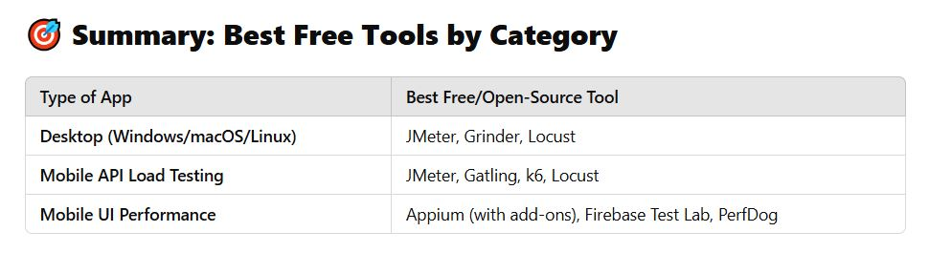
Performance Test Tools
What do they do?
  Orchestrate test scripts
  Simulate heavy loads
  Check software for meeting non-functional requirements (speed, responsiveness, etc.)
What is available?
  JMeter (can do Web apps, mobile, and desktop programs)
  Grinder

Slide 45
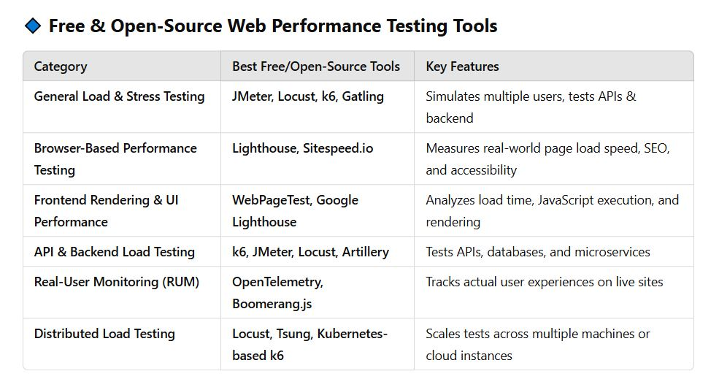
Performance Test Tools

Slide 46
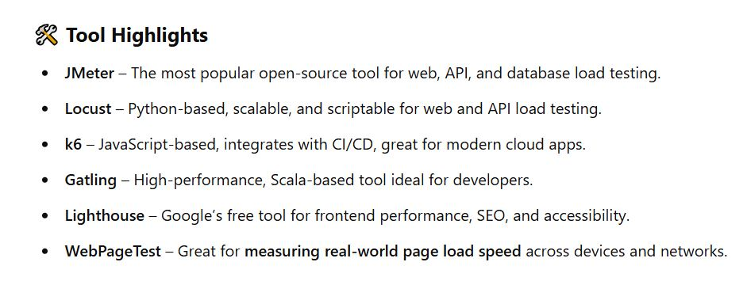
Performance Test Tools

Slide 47
Stress Testing
A kind of performance testing
Determines the robustness of software by testing beyond the limits of normal operation
Particularly important for "mission critical" software, where failure has high costs
“stress” makes most sense for code with timing constraints or resource limits
  servers that are made to handle, say, 1000 requests per minute, etc.
  environments that can handle hundreds of users simultaneously
  multi-player network games… can it handle 5K users? 10k? 50K?
Tests demonstrate robustness, availability, and error handling under a heavy load

Slide 48
Fuzz Testing, or Fuzzing
Involves providing invalid, unexpected, or random data as inputs of a program (or module)
Program is monitored for exceptions such as
    crashes
    failing built-in code assertions
    memory leaks
Fuzzing is commonly used to test for security problems in software or computer systems, or reliability / robustness

Slide 49
Similar Forms
These are black-box methods
Fuzz testing: module level, random data given to the computational engines (modules, methods, etc)
Monkey testing: random UI events given to a system (as if the users are monkeys bashing on the keyboards)
Also called random testing, or ad-hoc testing, or stochastic testing
Chaos testing: random injection of system-level failures (for distributed systems, others with non-determinism)
Tools: Android Monkey Tool, Gremlins.js, MonkeyRunner

Slide 50
Other Test Tools
Tons of test tools
One starting point
    http://www.softwareqatest.com/qatweb1.html

Slide 51
Other Quality Improvers

Slide 52
Other Ways of Improving Quality
Static testing methods (vs. dynamic)
  reviews and inspections
  formal specification
  program verification and validation
Self-checking (paranoid) code
Duplication, voting
Deploy with capabilities to repair

Slide 53
Formal Methods and Specs
Mathematically-based techniques for describing system properties
Used in inference systems
  Do not require executing the program
  Proving something about the specification not already stated
  Formal proofs
  Automatable
  Examples: theorem provers and proof checkers
Model checkers
  FSM-based, not inference

Slide 54
Uses of Specifications
Requirements analysis
  rigor
System design
  Decomposition, interfaces
Verification
  Specific sections
System analysis and evaluation
  Reference point, uncovering bugs
Documentation

Slide 55
Examples
Abstract data types
  Algebras, theories, and programs
  VDM (Praxis: UK Civil aviation display system CDIS), Z (Oxford and IBM: CICS), Larch (MIT)
Concurrent and distributed systems
  State or event sequences, transitions
  Hoare’s CSP, Transition axioms, Lamport’s Temporal Logic
Programming languages!

Slide 56
Self Checking Code
Exploit redundancy
Run multiple copies of the code, vote on critical results and decisions
Identifies erroneous system via its disagreement
Develop functionally identical versions with different code compositions, different teams
Perhaps use different hardware hosts
Used on space shuttle

Slide 57
Self-Repairing Code
http://www.tomsguide.com/us/darpa-self-healing-software,news-17761.html
http://venturebeat.com/2013/09/17/hp-launches-self-healing-computer-start-software/
http://www.technologyreview.com/news/416036/software-that-fixes-itself/

Slide 58
AI in Testing

Slide 59
AI in Software Testing
We know AI has made big inroads into coding and coding support
What about testing code?
Some irony here, as AI code is often wrong, or incomplete
Older tools like ChatGPT even tell you things about PLs that are factually not true
But, they are getting better rapidly

Slide 60
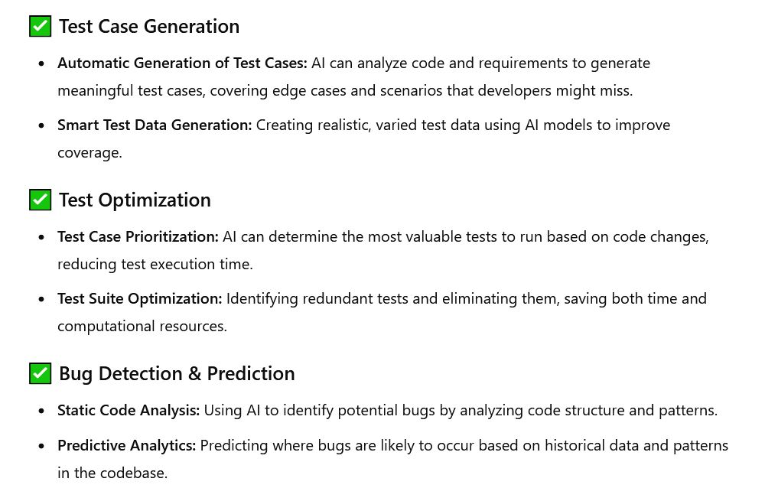
AI in Software Testing
( ChatGPT )

Slide 61
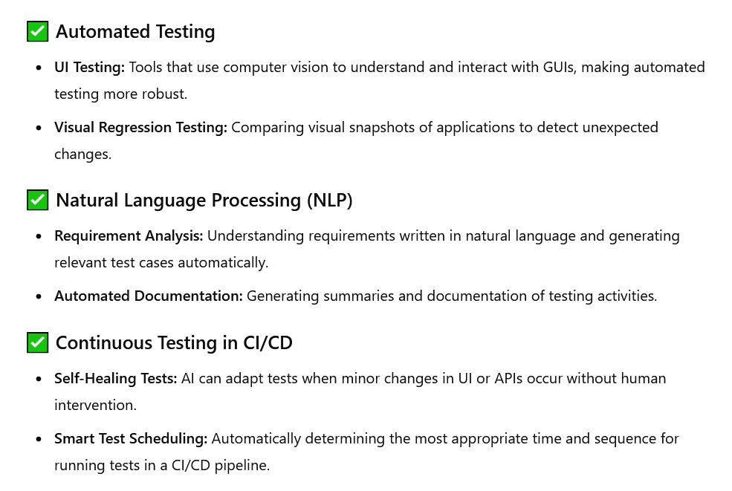
AI in Software Testing
( ChatGPT )

Slide 62
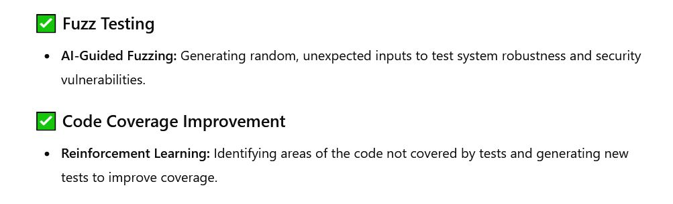
AI in Software Testing
( ChatGPT )

Slide 63
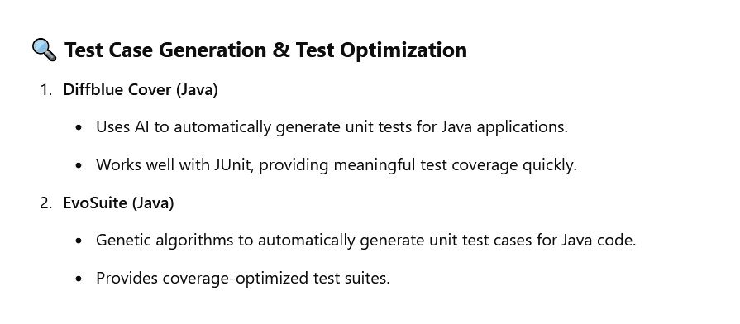
AI Testing Tools
( ChatGPT )

Slide 64
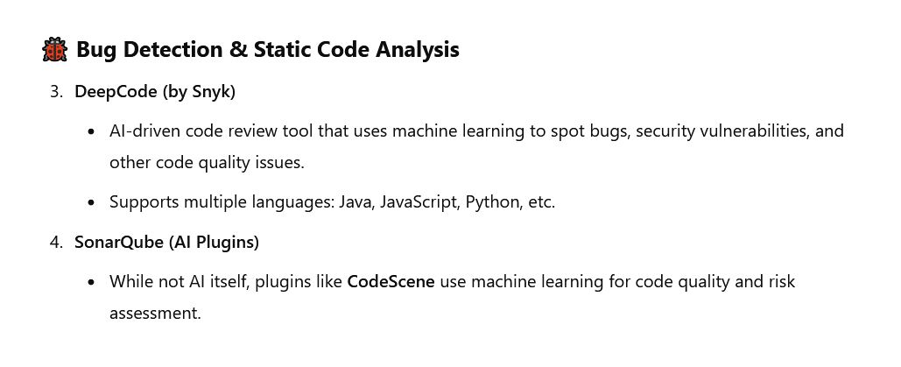
AI Testing Tools
( ChatGPT )

Slide 65
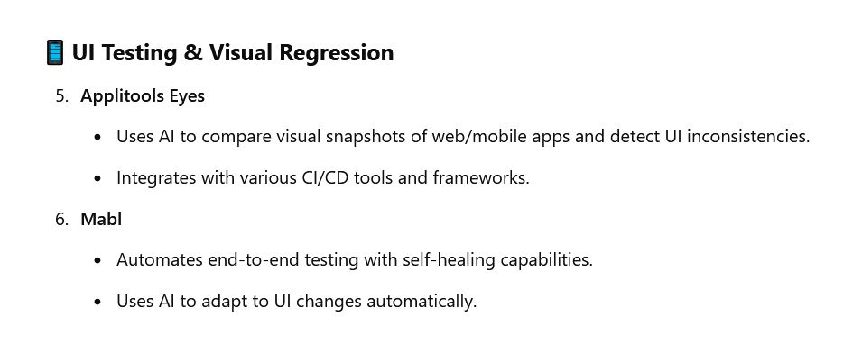
AI Testing Tools
( ChatGPT )

Slide 66
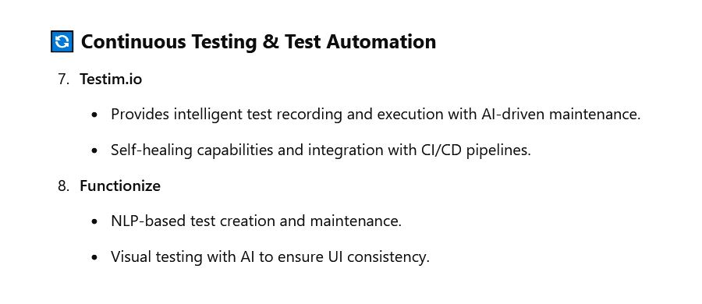
AI Testing Tools
( ChatGPT )

Slide 67
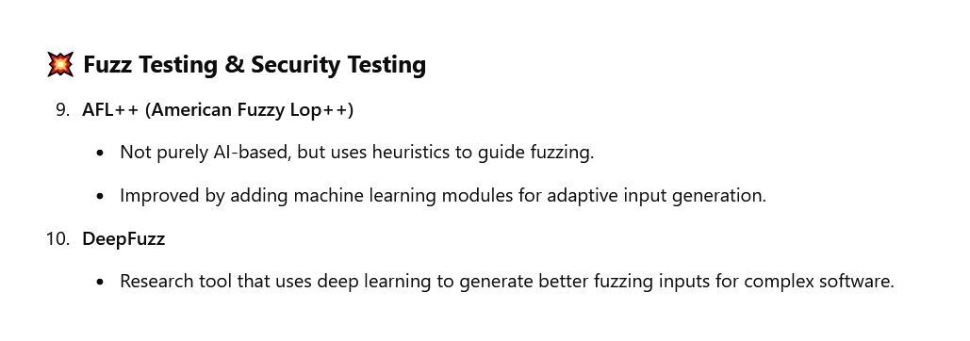
AI Testing Tools
( ChatGPT )

Slide 68
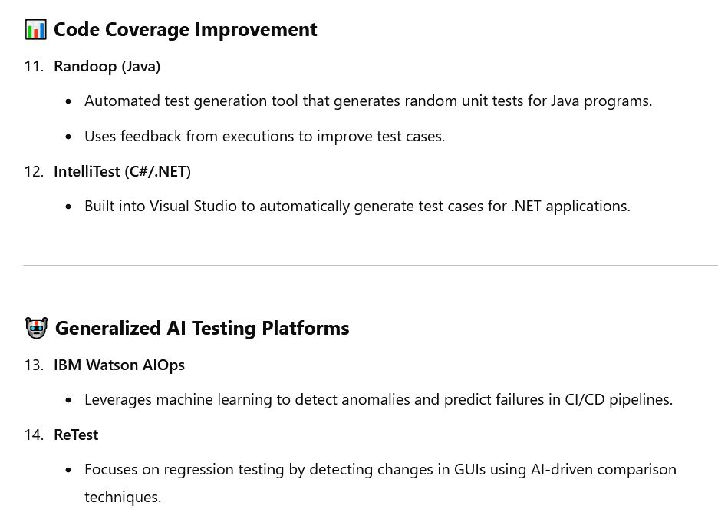
AI Testing Tools
( ChatGPT )

Slide 69
Testing Example (Unit, Integration)
Unit testing is checking the behavior of a method, or a class
  Good for logic of how data protected by the object is manipulated
  Not good for how data is transferred across boundaries of units
Integration testing is checking how well data exchanges work as communication is done among modules, objects, subsystems
  This might be network comms, or method calls across units
  Clearly the boundary across subsystems, like client side to server side

Slide 70
Unit test
// UnitConverter.java
public final class UnitConverter {
private UnitConverter() {}
public static double lbfSecondsToNewtonSeconds(double lbfSeconds) {
return lbfSeconds * 4.4482216152605; // 1 lbf = 4.4482216152605 N
}
}
// UnitConverterTest.java
import static org.junit.jupiter.api.Assertions.*;
import org.junit.jupiter.api.Test;
class UnitConverterTest {
@Test void convertsZero() {
assertEquals(0.0, UnitConverter.lbfSecondsToNewtonSeconds(0.0), 1e-12);
}
@Test void convertsTypicalValue() {
double ns = UnitConverter.lbfSecondsToNewtonSeconds(10.0);
assertEquals(44.482216152605, ns, 1e-9);
}
@Test void handlesPrecision() {
double ns = UnitConverter.lbfSecondsToNewtonSeconds(0.123456);
assertEquals(0.549, ns, 1e-3); // within 1e-3 tolerance
}
}

Slide 71
Unit test
// ThrusterControl.java
public class ThrusterControl {
public double fire(double forceLbf, double durationSeconds) {
if (forceLbf < 0 || durationSeconds < 0) throw
new IllegalArgumentException();
return forceLbf * durationSeconds; // lbfÂ·s
}
}
// GuidanceSubsystem.java
public class GuidanceSubsystem {
private final double vehicleMassKg;
public GuidanceSubsystem(double vehicleMassKg) {
if (vehicleMassKg <= 0) throw new IllegalArgumentException();
this.vehicleMassKg = vehicleMassKg;
}
public double computeDeltaV(double impulseNewtonSeconds) {
return impulseNewtonSeconds / vehicleMassKg;
}
}

Slide 72
Subsystem test
// SubsystemTest.java
import static org.junit.jupiter.api.Assertions.*;
import org.junit.jupiter.api.Test;
class SubsystemTest {
@Test void thrusterPlusGuidance_usingExplicitConversion() {
ThrusterControl thruster = new ThrusterControl();
GuidanceSubsystem guidance = new GuidanceSubsystem(1000.0);
double impulseLbfS = thruster.fire(20.0, 5.0);
double impulseNS =
UnitConverter.lbfSecondsToNewtonSeconds(impulseLbfS);
double deltaV = guidance.computeDeltaV(impulseNS);
assertEquals(0.444822, deltaV, 1e-6);
}
}

Slide 73
Integration test
// ImpulseProvider.java
public interface ImpulseProvider { double lastBurnImpulseNewtonSeconds(); }
// BuggyThrusterService.java
public class BuggyThrusterService implements ImpulseProvider {
private double lastImpulseLbfS = 0.0;
public void fire(double forceLbf, double durationSeconds) {
lastImpulseLbfS = forceLbf * durationSeconds; // lbfÂ·s
}
@Override
public double lastBurnImpulseNewtonSeconds() {
return lastImpulseLbfS; // BUG: no conversion
}
}
// NavigationComputer.java
public class NavigationComputer {
private final ImpulseProvider impulseProvider;
private final double massKg;
public NavigationComputer(ImpulseProvider impulseProvider, double massKg) {
this.impulseProvider = impulseProvider;
this.massKg = massKg;
}
public double deltaVFromLastBurn() {
double impulseNS = impulseProvider.lastBurnImpulseNewtonSeconds();
return impulseNS / massKg;
}
}

Slide 74
Integration test
// IntegrationTest.java
import static org.junit.jupiter.api.Assertions.*;
import org.junit.jupiter.api.Test;
class IntegrationTest {
@Test void detectsUnitMismatchAcrossBoundary() {
BuggyThrusterService thruster = new BuggyThrusterService();
NavigationComputer nav = new NavigationComputer(thruster, 1000.0);
thruster.fire(20.0, 5.0);
double deltaV = nav.deltaVFromLastBurn();
assertEquals(0.444822, deltaV, 0.02,
"Integration should reveal a unit mismatch");
}
}

Slide 75
Integration test
// FixedThrusterAdapter.java
public class FixedThrusterAdapter implements ImpulseProvider {
private final BuggyThrusterService underlying;
public FixedThrusterAdapter(BuggyThrusterService underlying) {
this.underlying = underlying;
}
public void fire(double forceLbf, double durationSeconds) {
underlying.fire(forceLbf, durationSeconds);
}
@Override
public double lastBurnImpulseNewtonSeconds() {
return UnitConverter.lbfSecondsToNewtonSeconds(
underlying.lastBurnImpulseNewtonSeconds()
);
}
}

Slide 76
Integration test
// IntegrationFixedTest.java
import static org.junit.jupiter.api.Assertions.*;
import org.junit.jupiter.api.Test;
class IntegrationFixedTest {
@Test void passesWhenBoundaryAdapterConvertsUnits() {
BuggyThrusterService raw = new BuggyThrusterService();
FixedThrusterAdapter adapter = new FixedThrusterAdapter(raw);
NavigationComputer nav = new NavigationComputer(adapter, 1000.0);
adapter.fire(20.0, 5.0);
double deltaV = nav.deltaVFromLastBurn();
assertEquals(0.444822, deltaV, 1e-6);
}
}

Slide 77
Testing "Pyramid"
Unit testing
  -- Single module, many, fast, precise, "business logic" and ADT behavior
Integration testing
  -- Middle, moderate in number, check contracts, comm interfaces
Subsystem testing
  -- Cluster of modules/services tested together as mini-system
System testing
  -- Near top, fewer, broad coverage
  -- All subsystems integrated together
Acceptance testing
  -- Validation against customer expectations, requirements

Slide 78
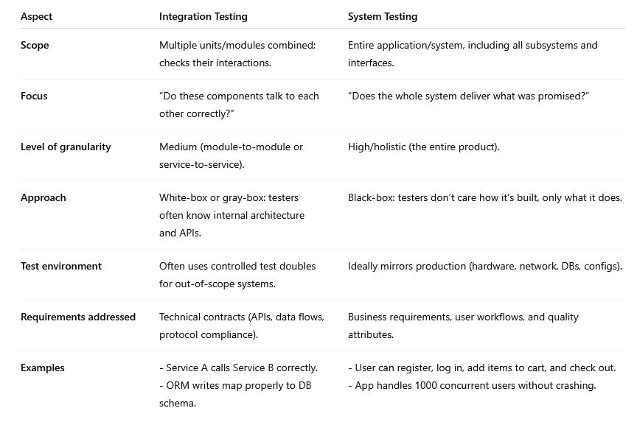
Integration vs. System Test

Slide 79
Unit Test
Scope: Smallest components (functions, classes, modules).
Focus: Does this unit’s logic work correctly in isolation?
Who runs it: Developers
Approach: White-box, heavy mocks/stubs
When: Earliest, runs continuously during development
Example: Cart.addItem() computes total correctly

Slide 80
Integration Test
Scope: Multiple units/modules combined
Focus:
Do components interact correctly across boundaries?
Who runs it: Developers/QA
Approach:
White/gray-box; limited mocks, may stub only external
systems, like real DBs/APIs
When: After unit tests, before subsystem testing
Example: POST/cart/items
calls DB, persists rows, and returns expected JSON

Slide 81
Subsystem Test
Scope
A full subsystem (a set of related modules) treated as a
mini-system.
Focus
Does this subsystem meet its functional requirements end-to-end?
Who runs it: QA team or subsystem development team
Approach:
Black/gray-box; stubs used only for subsystems not under test
When: After integration tests, before full system testing
Example:
Authentication subsystem (login, registration, password reset,
session management) works correctly as a whole.

Slide 82
System Test
Scope: Entire application or software product
Focus: Does the full system meet its technical specifications?
Who runs it: Independent QA team
Approach: Black-box, production-like environment.
When: After subsystem tests, before acceptance testing
Example:
Full e-commerce flow: register → login → add items →
checkout → receive confirmation.

Slide 83
Acceptance Test
Scope: Entire system, from customer/user perspective
Focus:
Does the delivered system satisfy business needs and is it
acceptable for release?
Who runs it: Customers, stakeholders, or user representatives
Approach:
Black-box; requirement-driven; often includes UAT (user
acceptance testing), alpha, beta testing.
When: After system testing, as release/deployment gate
Example:
Business owner verifies that checkout flow meets contractual
requirements and user expectations

Slide 84
END

Slide 85
LeftOvers

Slide 86
References
Bugs
Therac-25: http://courses.cs.vt.edu/~cs3604/lib/Therac_25/Therac_1.html
Patriot missile: http://www.fas.org/spp/starwars/gao/im92026.htm
Ariane 5: http://www.esa.int/export/esaCP/Pr_33_1996_p_EN.html
Testing
  Whittaker, How to Break Software (presentation)

Slide 87
Life Testing
Used regularly in hardware
  Addresses “normal use”
n specimens put to test
Test until r failures have been observed
Choose n and r to obtain the desired statistical errors
As r and n increase, statistical errors decrease
Expected time in test = mu₀ (r / n)
  Where mu₀ = mean failure time

Slide 88
Butler and Finelli
“The Infeasibility of Experimental Quantification of Life-Critical Software Reliability” (1991)
In order to establish that the probability of failure of software is less than 10⁻⁹ in 10 hours, testing required with one computer is greater than 1 million years
http://naca.larc.nasa.gov/search.jsp?R=20040139297&qs=N%3D4294966788%2B4294724588%2B4294587118

Slide 89
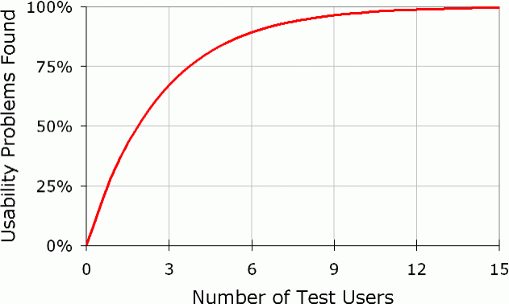
# Usability Test Users Needed
Usability problems found = N(1-(1-L)^{n})
N = total number of usability problems in the design
L = proportion of usability problems discovered by a single user
n = number of users
L=31%

Slide 90
Using as an Estimator
Found 100 problems with 10 users
Assumption: each user find 10% of problems
How many are left?
found = N(1-(1-L)^{n})
  100 = N(1-(1-.1)¹⁰)
  N = 100/(1-.9¹⁰)=154
54 left

