Slide 1
North Carolina Autism Support and Knowledge Tool
Rohan Patel

Slide 2

NC ASK
Mission: To deliver accessible, AI-powered educational resources to families, caregivers, and providers across North Carolina.

Slide 3
Background-The problem we’re trying to solve
Fragmented Systems, Overwhelming Information, Limited Agency
Families face fragmented service landscapes across medical, educational, and insurance systems.
Information is buried across websites, PDFs, and policies — difficult to navigate without expert guidance.
Parents and caregivers often feel disempowered and forced to rely on others for coordination and understanding.
Equality, Geographiacl, accessibility issues across NC.

Slide 4

By using a Large Language Model and AI innovation, we hope to offer Individualized, tailored information to families and providers in a timely manner.
The core of this includes having north Carolina specific information in the Educational, Medical and Insurance realm(TCM)

Slide 5
Terms to Know
Large Language Model (LLM):
"The Brain" of NC ASK.
Understands natural questions and generates human-like responses.
Vector Database + Azure Search:
"The Smart Librarian."
Stores and retrieves information based on meaning and context.
Knowledge Graph (KG):
"The Map."
Organizes autism-related resources by connecting concepts and entities.

Slide 6
How it Works
1. User Interaction
A user types a question into the NC ASK app or website.
2. Query Processing
The LLM interprets the question to understand user intent.
3. Information Retrieval
The vector database and Azure Search find relevant, trusted documents.
The KG supports contextual understanding of relationships and concepts.
4. Response Generation
The LLM uses retrieved data to generate a clear, structured answer.
5. Answer Delivered
The app presents the result in a user-friendly format.

Slide 7
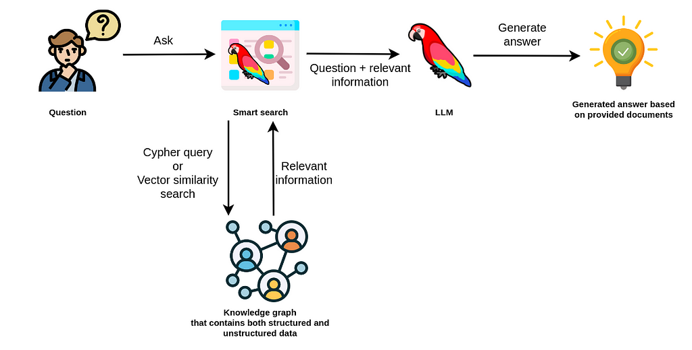

Slide 8
What Makes NC ASK Practical for Families
No login required – Parents can use it without creating accounts or remembering passwords.
Mobile and web access – Designed for smartphones, tablets, and desktops alike.
Plain language responses – No jargon. Just clear, step-by-step guidance.
Always up to date – Pulls directly from trusted sources like NC Medicaid, DPI, and ASNC.
No data storage or tracking – User privacy is protected. Nothing is saved.
Email-to-self – Users can send responses to their own inboxes for later reference.
Equity-first design – NC ASK is built to work for all families, including those with limited digital literacy or internet access.

Slide 9
NC ASK Advisory Commitee
Kerri Erb
Kim Tizzard
Melissa Roper
Whitney Sukonick
Becky Baum
Carl Seashore

Slide 10
Funding
This project is funded by the Junior Faculty Development Grant, UNC Provost Office for the FY26
There is opportunity to apply for potential grants in the future

Slide 11
Next Steps
Finalizing infrastructure setup and Azure licensing under UNC research compliance
Collaboration opportunity
  While NC ASK can connect to public-facing websites via API, there's an opportunity to collaborate more directly.
  This aligns with shared goals to improve access, navigation, and equitable delivery of services.
  Medicaid can shape how its programs and resources are represented in NC ASK, with the potential to elevate IDD-specific pathways.
Think of NC ASK as a proof of concept. We could explore the development of an IDD-specific companion tool or feature within the platform, or something even more robust and like NC ASK in the future

