Slide 1
Pulse Explorer
A virtual patient sandbox for medical education

Slide 2
Background
Pulse is a human physiology modeling and simulation library written in C++
Calculates Heart beat, blood flow, Breathing (O2/CO2 exchange in blood), etc. @50Hz
Different patient parameters (height/weight/blood pressures) affect these calculation
Fully dynamic feedback, actions can have cascading effects on patient well being
Our virtual patient is integrated into serious games, teaching tools, manikins
Without a visualization tool what Pulse provides is difficult to understand

Slide 3
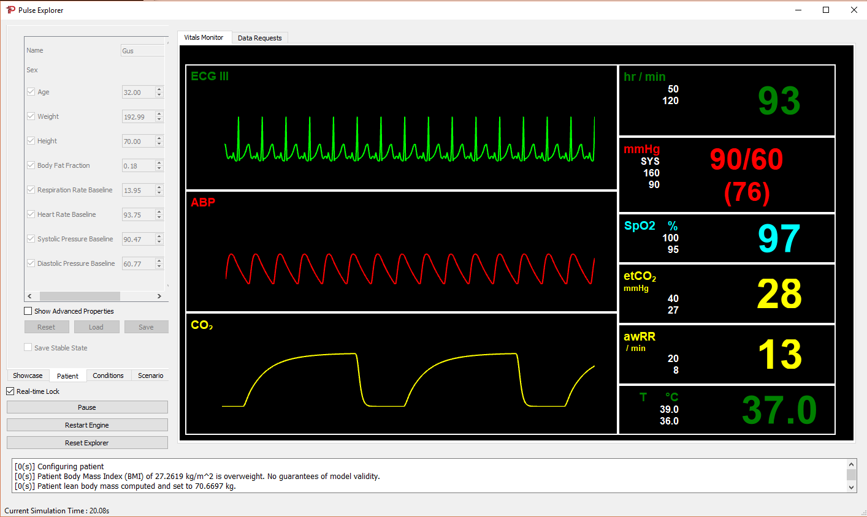
Pulse Explorer
In order to get wider acceptance and adoption, we want to provide a sandbox where users can interact with the virtual patient and explore functionality
e.g. Do our models accurately reflect the physiological changes in a specific states
Built on Qt, provides a way to visualize and interact with our in-silico patient
Currently it provides:
Vitals Monitor
Patient Editor
Basic Data Plots
Simulation Controls
Try it out!

Slide 4
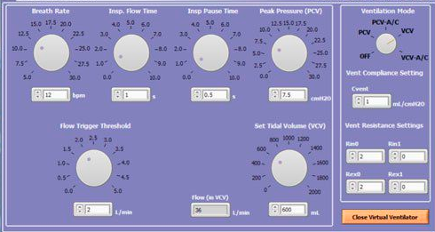
User Interface Help Wanted
Create/edit/display/submit actions to the simulation
Currently only a few actions are provided
Design how to present actions to the user, and a collection of things done in a scenario
Improve the data display
Current display is hardcoded to view a handful of computed data
The data is displayed as a line plot over time (QtCharts)
We need to provide an intuitive way for user to view data
Create environmental/equipment controls
We have models for a ventilator/anesthesia machine as well as environmental surroundings
A specific UI controls page for these objects is desired for these objects

