Slide 1
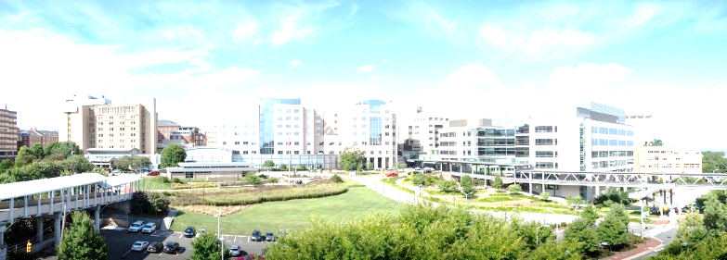


Simplifying The Activation of Trauma Teams
(Trauma STATT)
Alberto Bonifacio RN BSN MHA CEN

Slide 2
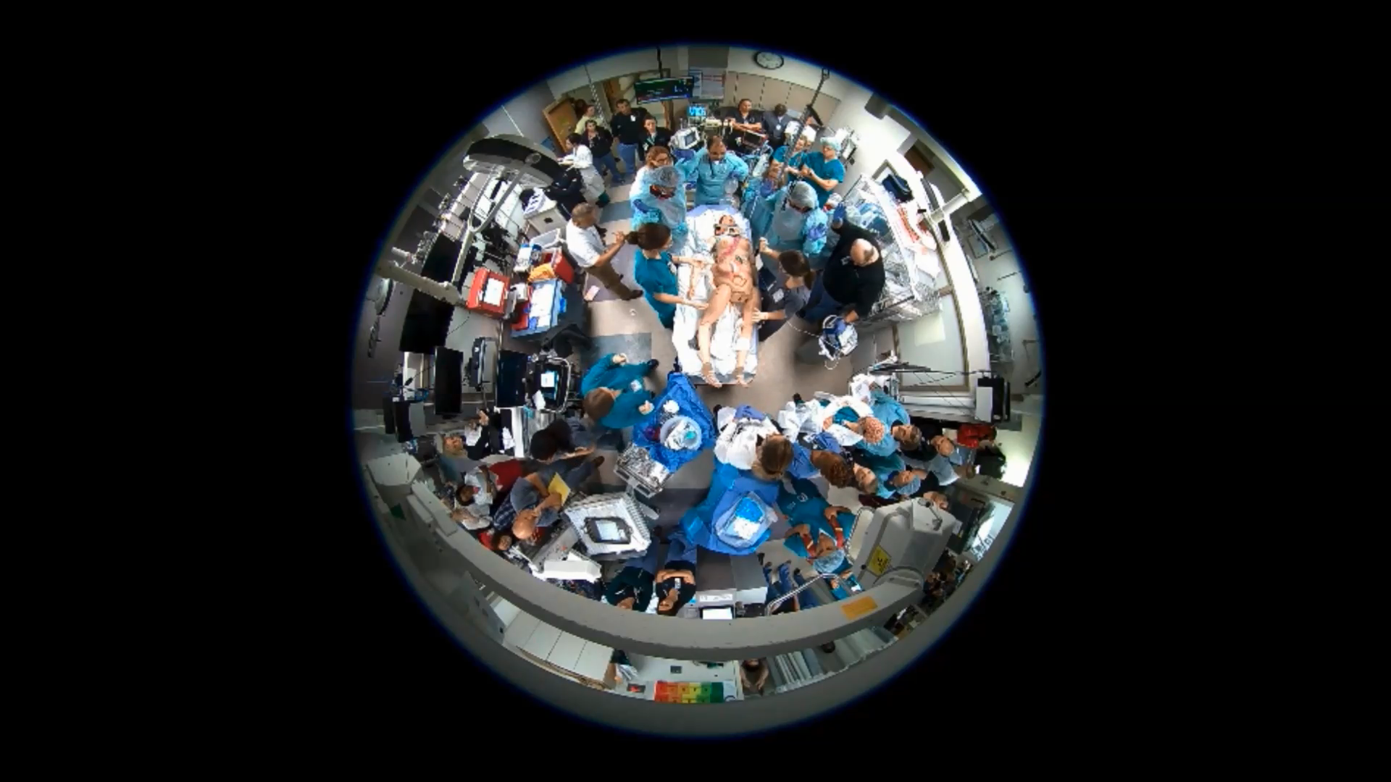

Slide 3










Level 1 Adult and Pediatric Trauma Center
Manage the public health problem of injury (prevention)
Reduce the degree of injury
Optimize the outcome from injury
Reduce mortality and morbidity
Optimal care for the trauma patient across continuum of trauma care.

Slide 4
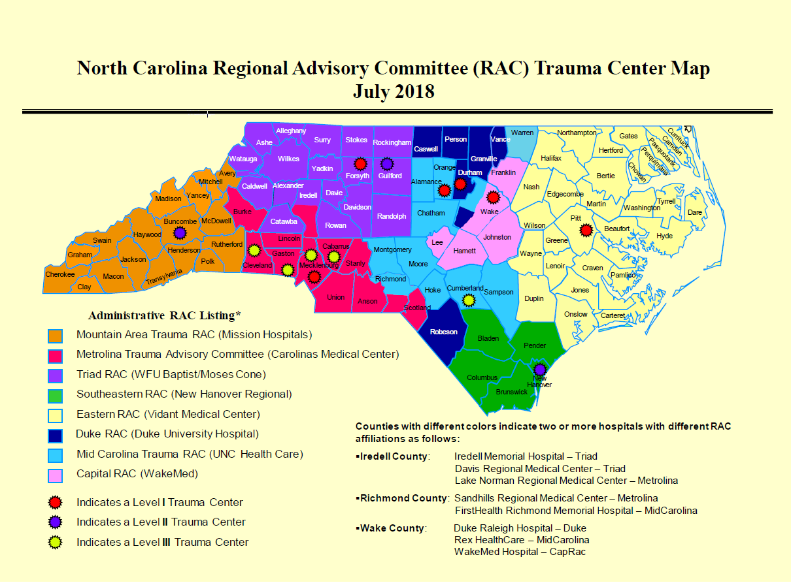
Notes:
Our level 1 accreditation is very important
North Carolina is broken down into regional advisory committees, each is led by a level 1 or level 2 trauma center
UNC is the leading trauma center for the mid carolina RAC, which serves the 11 counties in the light blue

Slide 5

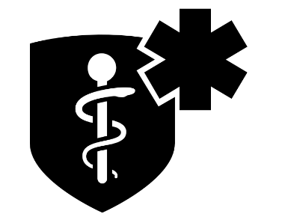

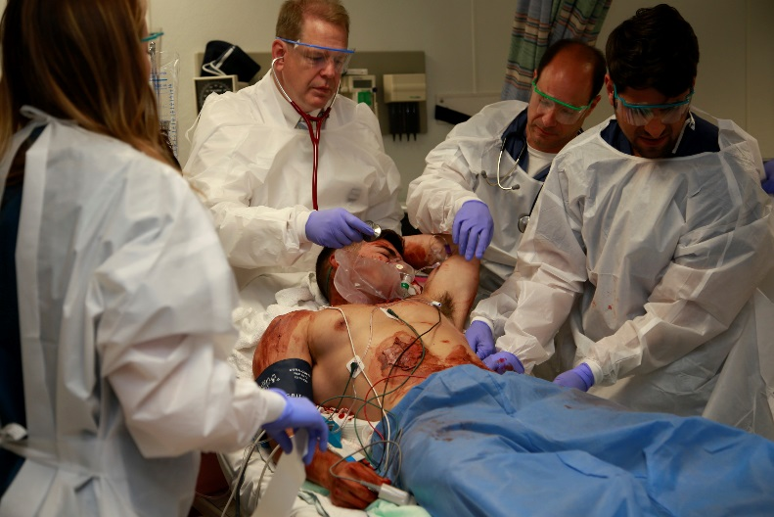
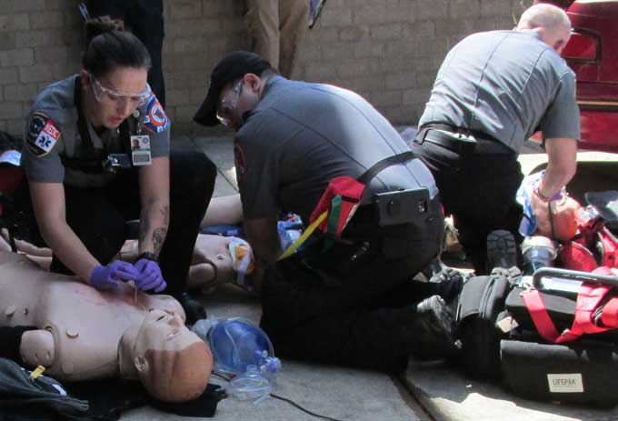
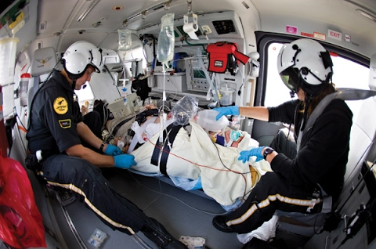
Users Across the Continuum
The app will be used by pre-hospital personnel (e.g. paramedics, EMT’s dispatch), air ambulance crews (e.g. flight nurses and paramedics) and emergency department staff (e.g. nurses, physicians and administrators).
Hospital by monkik from the Noun Project
Medicine by Marc Anderson from the Noun Project
Air Ambulance by Delwar Hossain from the Noun Project

Slide 6
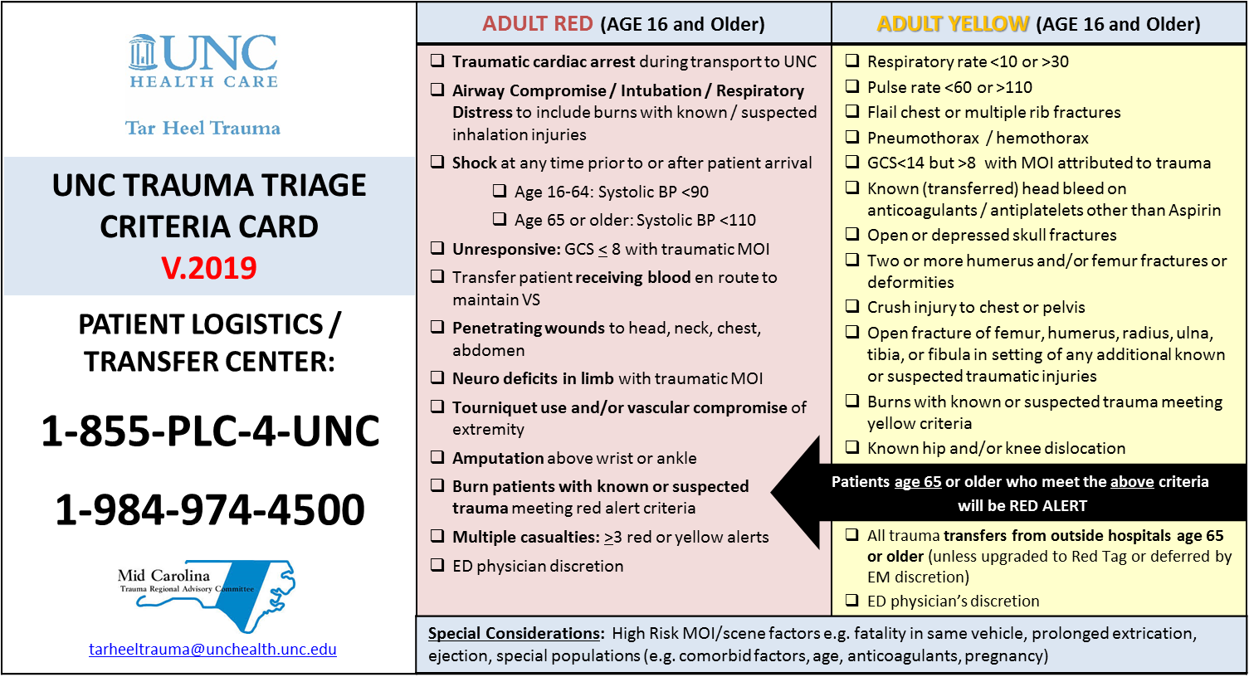
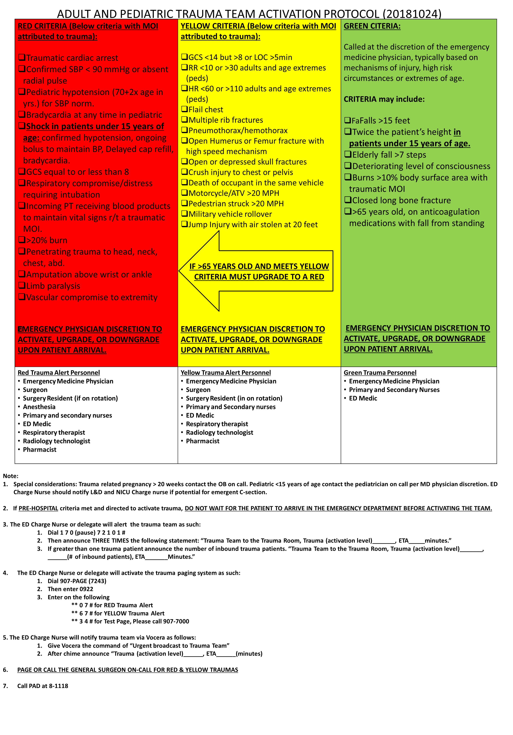
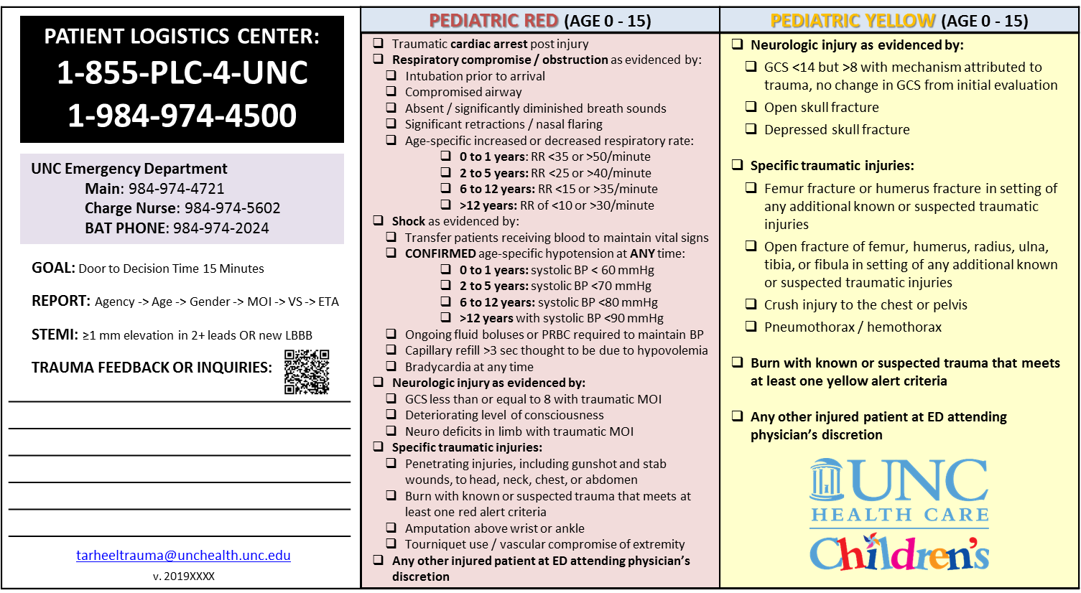
Non-standardized Trauma Triage Criteria

Slide 7

Trauma STATT: Concept
The Mid Carolina Regional Advisory Committee would like help with developing an innovative mobile app that can assist emergency crews with correctly matching patient injury with the proper trauma alert criteria for trauma centers within the region.
medical emergency by Made from the Noun Project

Slide 8
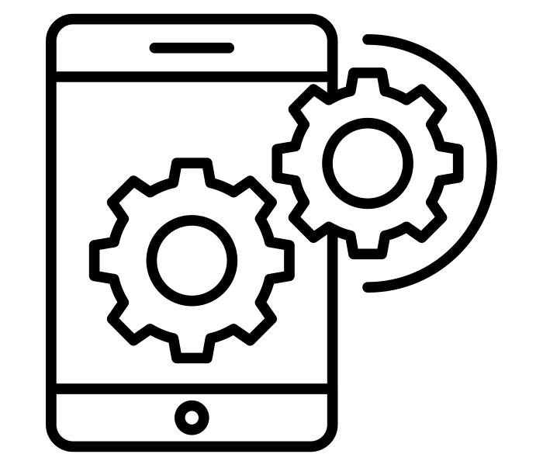
Trauma STATT: Technical Requirements
This app should be portable to all devices, intuitive enough to use in austere and low light environments (ambulances and helicopters) and intuitively designed to reduce cognitive strain.
The app should also be develop in a way that will allow for updates and refinements to the criteria with reasonable amounts of training.
API Integration by Vectors Market from the Noun Project

Slide 9

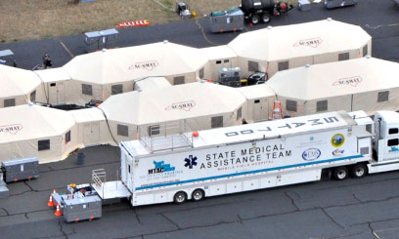
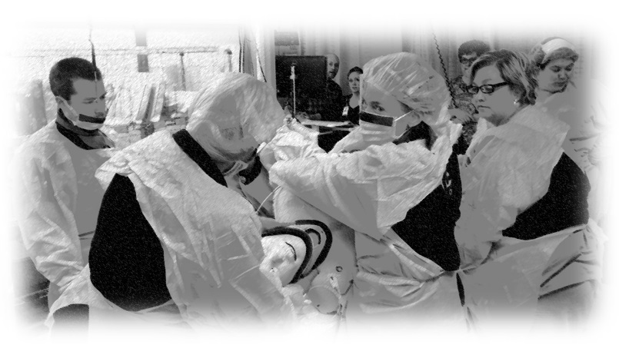

Beyond the App

Slide 10
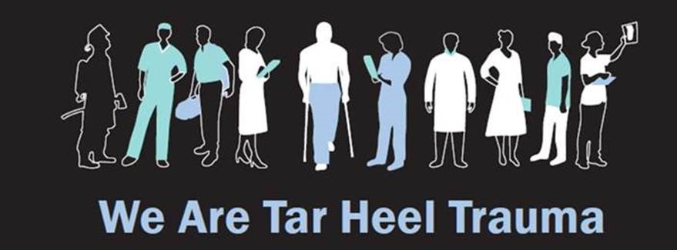
Daryhl Johnson II MD MPH FACS Daryhl_Johnson@med.unc.edu Don Nakayama MD FACS nakayamd@email.unc.edu Alberto Bonifacio RN BSN MHA CEN Alberto.bonifacio@unchealth.unc.edu Paul Zarick RN BSN CCRN Paul.zarick@unchealth.unc.edu
tarheeltrauma@unchealth.unc.edu
Notes:
Daryhl

Slide 11
Project Abstract
Project Idea: Emergency crews work every day to save the lives trauma victims. In addition to the already difficult task of treating the patient, paramedics are also faced with navigating a complex regional trauma system with hospitals providing different and often conflicting guidance on alerting respective trauma teams. The inaccurate or delayed mobilization of trauma resources could mean the difference between life and death for many.
The Mid Carolina Regional Advisory Committee would like help with developing an innovative mobile app that can assist emergency crews with correctly matching patient injury with the proper trauma alert criteria for trauma centers within the region. The app will be used by pre-hospital personnel (e.g. paramedics, EMT’s dispatch), air ambulance crews (e.g. flight nurses and paramedics) and emergency department staff (e.g. nurses, physicians and administrators).
This app should be portable to all devices, intuitive enough to use in austere and low light environments (ambulances and helicopters) and intuitively designed to reduce cognitive strain. The app should also be develop in a way that will allow for updates and refinements to the criteria with reasonable amounts of training.
We will provide the triage trauma criteria and general guidance from end users, but will call on your creativity and expertise with the design of the product. In addition, we will provide team members with opportunities to participate and attend trauma events.
Impact: By helping emergency crews to more quickly and accurately identify trauma alert levels, this app has the potential reduce frustration, save precious minutes, mobilize the correct resources and ultimately save lives. As no such app has yet been developed, this project has the potential for adoption across the state and beyond.

