Slide 1
ᏤᏙᎭᏊ:
An App for Cherokee Language

Slide 2

Reversing Language Shift
Decline since 1950’s
  Federal boarding schools
  Economic, Community structure change
Tribal initiatives to revitalize
  Immersion school
  Adult immersion program
  Signage
Currently ~200 speakers in NC
Not being passed on in the home

Slide 3

How to learn AND use the language?
“Studying”
  Tough
  Time-consuming
  Can be isolating
DuoLingo, Rosetta Stone, etc.
  Rely on translation, memorization
  Still isolating

Slide 4
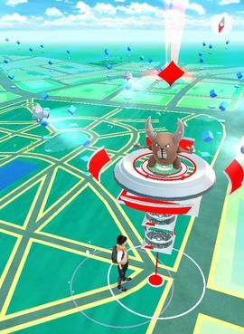
Practicing in day-to-day life
Replacing social domains
Geo-tagging “practice spots” (like Pokémon Go gyms)
Push notification, video “mini-lesson” (~30 seconds)
Vocabulary list w/ sound
Try it in that location with cashier/barista
Ratings and incentives

Slide 5
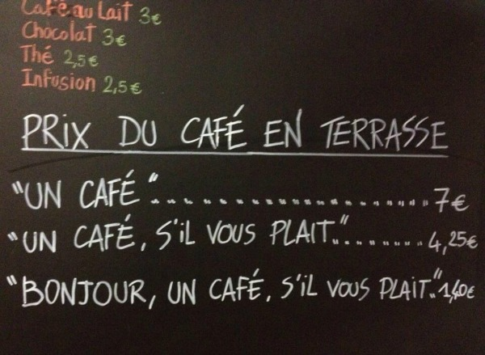
Context
Doing it in ”real life”
Habit formation
Cooperation, community involvement
Situating language within place

