Slide 1
UNC Hospital School
Project Proposal for COMP 523

Slide 2
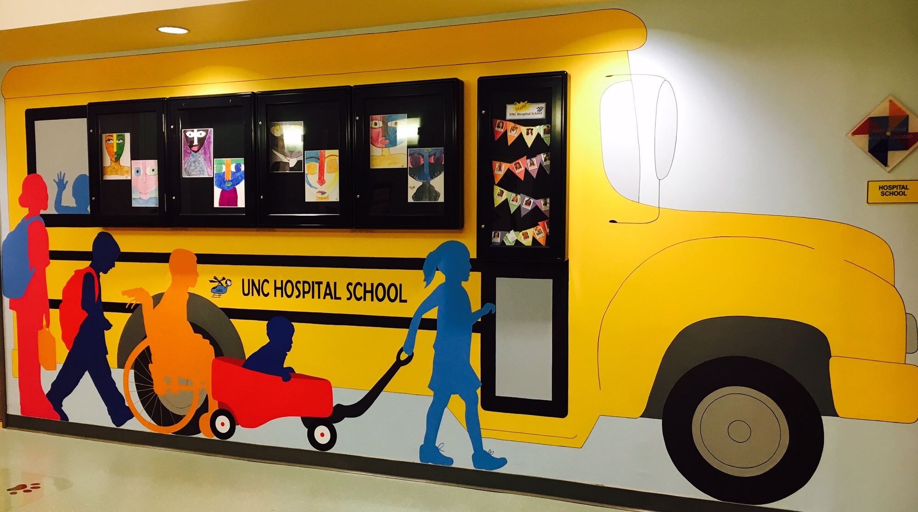
Who We Are

Slide 3
UNC Hospital School
Serves all hospitalized patients between the ages of 3 and 20 if they are in primary/secondary school
Also outpatient Hematology/Oncology patients
Three locations
17 staff members, including 15 teachers
Public school in the Chapel Hill-Carrboro District

Slide 4
What We Do

Slide 5
Our Mission and Work
Transition Back to School
Family Support
School Liaison
Direct
Instruction
School Awareness
Normalcy
College Prep
Social Support
Medical Liaison

Slide 6
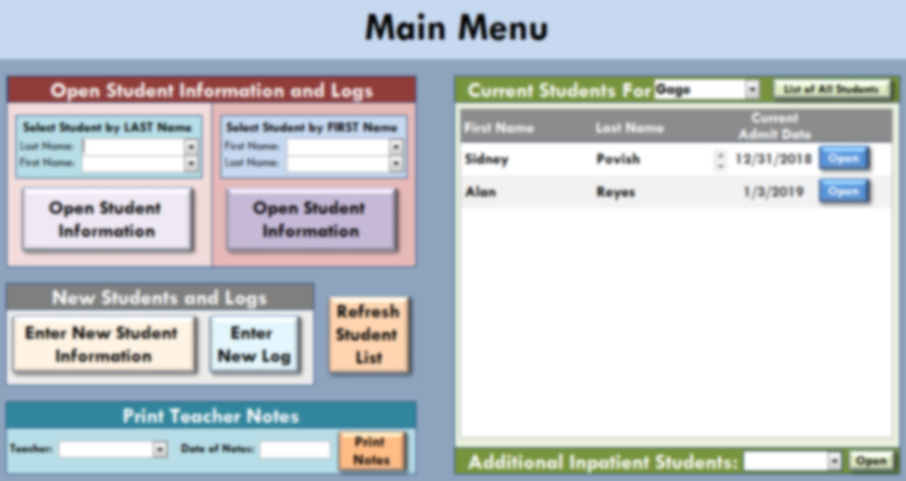
What We Need

Slide 7
Project Background
Currently use a Microsoft Access database
Custom-built with necessary relationships and desired functions
Tracks student information as well as day-to-day work
Data used to report to the state, district, and UNC as well as to inform us regarding our processes, needs, and successes

Slide 8
For our future growth, we need:
More storage space for increasing size of database
Improved speed and functionality
Possibility of future updates (app connectivity, etc.)
Anything else that improves on our system!

Slide 9
Thank you!
Please contact me with any questions:
Gage Matthews
gage.matthews@unchealth.unc.edu
984-974-9332

